Slide 1


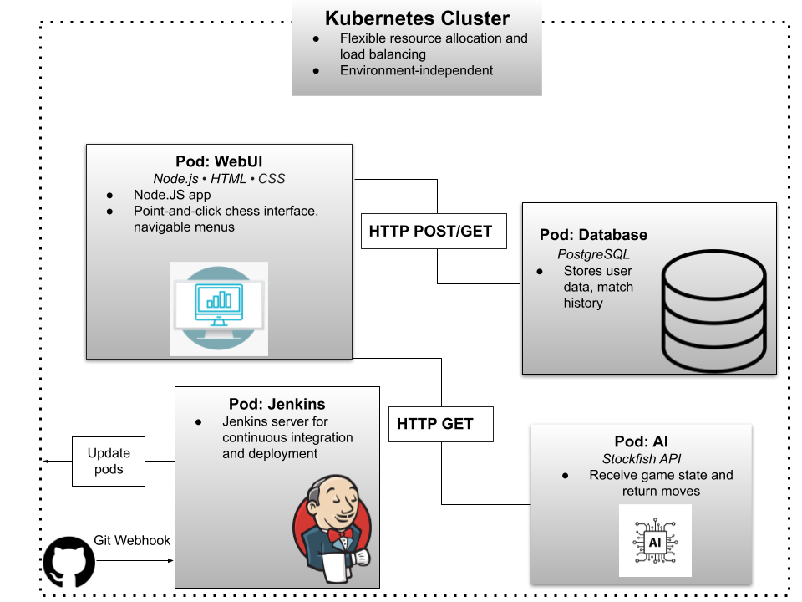

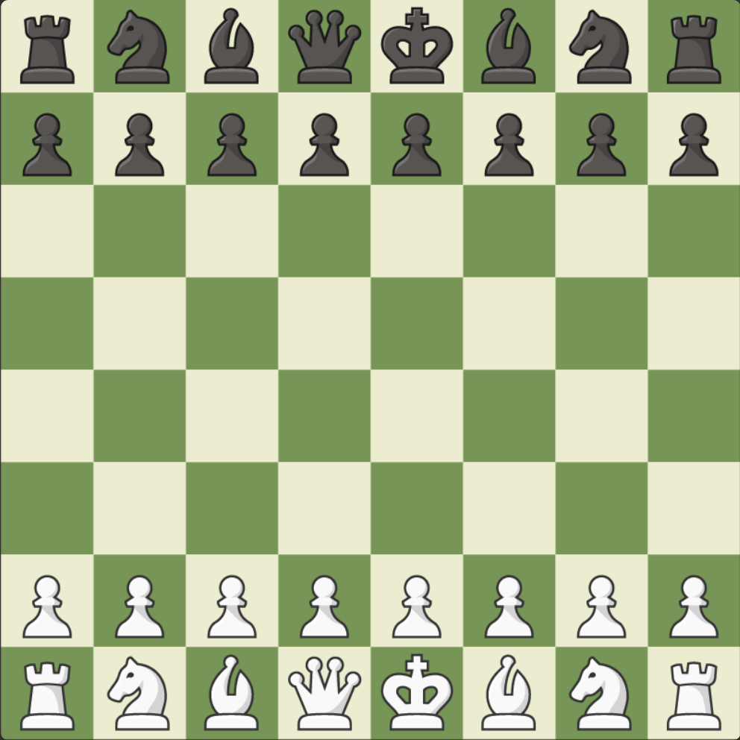

KubeChess
Kevin Codd, Matt DiStefano, Ishmail Koroma, Patrick Lawrence, Trush Patel
https://github.com/trushpatel/CSC468Group5.git
Features
Online chess matches
1v1 against human opponents or Stockfish AI with difficulty tuning
Multiple users and concurrent game sessions
Cloud hosting for high-performance and easy scalability
CI/CD to prevent downtime during source code updates
Generates revenue through advertisements

