Slide 1
Project 1 - Travel Insurance Data
Kevin Lopez, Clarisse Bonang, and Mayank Thacker

Slide 2
Work breakdown:
Kevin Lopez
Create shared Rmd file and combined code from team members. GitHub Repository
Created Report using Rmd ( Not much work, Started Rmd to be well formated for word).
Created Graph 4 and Graph 5,6.
Clarisse Bonang
Created Graph 3.
Worked on PPT, and report.
Mayank Thacker
Created Graph 1, 2.
Created Worked on PPT

Slide 3
Explain the dataset
The travel insurance dataset provides valuable information about travelers, offering insights into their travel insurance purchasing decisions. In addition, the dataset includes details such as age, income, employment status, and more to highlight factors influencing insurance choices. With 10 columns and 1986 rows, the data offers robust information for conducting insightful analyses and patterns within the dataset.
The data was collected at Guru Gobind Singh Indraprastha University (GGSIPU).
To access the dataset please visit kaggle.
The dataset was collected from India.
The columns are:
Age- Age Of The Customer
Employment Type- The Sector In Which Customer Is Employed
GraduateOrNot- Whether The Customer Is College Graduate Or Not
AnnualIncome- The Yearly Income Of The Customer In Indian Rupees[Rounded To Nearest 50 Thousand Rupees]
FamilyMembers- Number Of Members In Customer’s Family
ChronicDisease- Whether The Customer Suffers From Any Major Disease Or Conditions Like Diabetes/High BP or Asthama,etc.
FrequentFlyer- Derived Data Based On Customer’s History Of Booking Air Tickets On Atleast 4 Different Instances In The Last 2 Years[2017-2019].
EverTravelledAbroad- Has The Customer Ever Travelled To A Foreign Country[Not Necessarily Using The Company’s Services]
TravelInsurance- Did The Customer Buy Travel Insurance Package During Introductory Offering Held In The Year 2019.

Slide 4
Load the Dataset
X | Age | Employment.Type | GraduateOrNot | AnnualIncome | FamilyMembers | ChronicDiseases | FrequentFlyer | EverTravelledAbroad | TravelInsurance
0 | 31 | Government Sector | Yes | 400,000 | 6 | 1 | No | No | 0
1 | 31 | Private Sector/Self Employed | Yes | 1,250,000 | 7 | 0 | No | No | 0
2 | 34 | Private Sector/Self Employed | Yes | 500,000 | 4 | 1 | No | No | 1
3 | 28 | Private Sector/Self Employed | Yes | 700,000 | 3 | 1 | No | No | 0
4 | 28 | Private Sector/Self Employed | Yes | 700,000 | 8 | 1 | Yes | No | 0
5 | 25 | Private Sector/Self Employed | No | 1,150,000 | 4 | 0 | No | No | 0
X | Age | Employment.Type | GraduateOrNot | AnnualIncome | FamilyMembers | ChronicDiseases | FrequentFlyer | EverTravelledAbroad | TravelInsurance | AnnualIncomeUSD
0 | 31 | Government Sector | Yes | 400,000 | 6 | 1 | No | No | 0 | 4,800
1 | 31 | Private Sector/Self Employed | Yes | 1,250,000 | 7 | 0 | No | No | 0 | 15,000
2 | 34 | Private Sector/Self Employed | Yes | 500,000 | 4 | 1 | No | No | 1 | 6,000
3 | 28 | Private Sector/Self Employed | Yes | 700,000 | 3 | 1 | No | No | 0 | 8,400
4 | 28 | Private Sector/Self Employed | Yes | 700,000 | 8 | 1 | Yes | No | 0 | 8,400
5 | 25 | Private Sector/Self Employed | No | 1,150,000 | 4 | 0 | No | No | 0 | 13,800

Slide 5
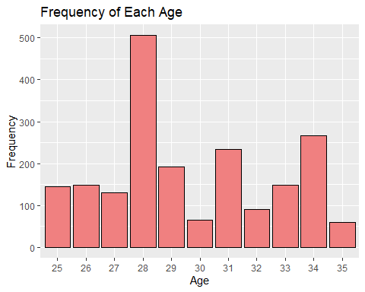
Graph 1 - Frequency of Age Distribution
The histogram shows the frequency of each individual age in the dataset. It provides insights into the prevalence of different age groups within the dataset.
28 years old has the highest frequency
ggplot(data, aes(x = factor(Age))) + geom_bar(fill = "lightcoral", color = "black") + # create histogram based on Age. labs(title = "Frequency of Each Age", x = "Age", y = "Frequency") # add title and labels for x,y axis

Slide 6
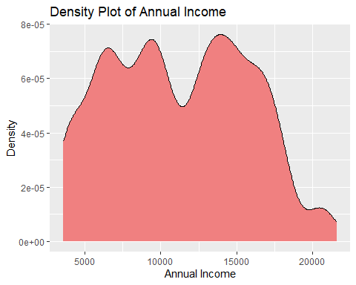
Graph 2 - Annual Income Density
The graph shows the probability density of Annual Income.
X-axis: “Annual Income”, Y-axis: “Density”.
ggplot(data, aes(x = AnnualIncomeUSD)) + # Set the x-axis to AnnualIncome geom_density(fill = "lightcoral", color = "black") + # Add a density layer with lightcoral fill and black border labs(title = "Density Plot of Annual Income", x = "Annual Income", y = "Density") # Add title and axis labels

Slide 7
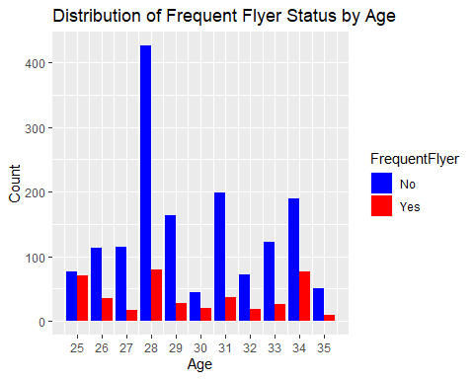
Graph 3 - Bar Plot of Frequent Flyer by age
The graph highlights the distribution of flyer status across different age groups.
It’s evident that there is a higher number of non-frequent flyers than that of frequent flyers between the ages of 25 to 35.
In particular, there is a decline in the number of frequent flyers between ages 25 to 27 and 28 to 30 and a steady increase in non-frequent flyers. In comparison, between ages 32 to 24, there is an increase in the number of frequent flyers and non-frequent flyers.
Notably, 28 year-olds appear to be less likely to be frequent flyers based on the lower count from the graph.
In conclusion, the data suggests that the proportion of frequent and non-frequent flyers varies across different age groups.
# grouped bar chart frequentFlyerStatus <- c("Yes" = "red", "No" = "blue") ggplot(data, aes(x = Age, fill = FrequentFlyer)) + geom_bar(position = "dodge") + #Ensures bars for frequent and non-frequent flyers are side by side scale_fill_manual(values = frequentFlyerStatus) + #Fills colors for both flyer status values labs(title = "Distribution of Frequent Flyer Status by Age", x = "Age", y = "Count") + scale_x_continuous(breaks = seq(25, 35, 1)) # Adding ticks for ages 25 to 35

Slide 8
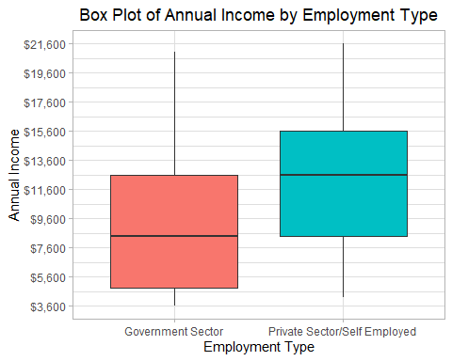
Graph 4 - Sector/Income
The following graph shows how the income is distributed by Employment type ( Government vs Private).
The Graph shows that interquartille range income is slightly higher in the private sector.
Income data does not contain any outliers.
ggplot(data, aes(x = Employment.Type, y = AnnualIncomeUSD, fill = Employment.Type)) + geom_boxplot() + labs(title = "Box Plot of Annual Income by Employment Type", x = "Employment Type", y = "Annual Income") + # Sets the title and label for x,y axis scale_y_continuous(labels = scales::dollar_format(), breaks = seq(from = min(data$AnnualIncomeUSD), to = max(data$AnnualIncomeUSD), by = 2000)) + # Formats the y-axis labels as dollars and sets breaks theme_light() + theme( legend.position = "none", # Hides the legend plot.title = element_text(hjust = 0.5), # Center the plot title )

Slide 9
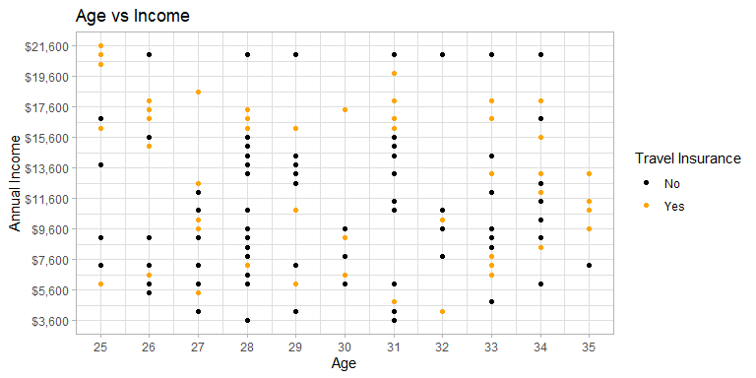
Graph 5 - Age/Income
The graph shows income related to age. And see the income distribution by age.
Generally, it is believed that income increases with age.
Income peak around 40-50 years old, since that is when an individual will be at the peak of their careers.What does the data tell us?
This data does not fit the idea that income increases as age increases.
There is a slight increase in people who buy insurance as they make more money.
It is easier to tell in boxplot compared to scatter plot.
p = ggplot(data, aes(x = Age, y = AnnualIncomeUSD)) + geom_point(aes(color = as.factor(TravelInsurance))) + # Convert TravelInsurance to a factor for color mapping scale_x_continuous(breaks = seq(min(data$Age), max(data$Age), by = 1)) + # Sets the x-axis breaks to increment by 1 (Age) scale_y_continuous(labels = scales::dollar_format(), breaks = seq(from = min(data$AnnualIncomeUSD), to = max(data$AnnualIncomeUSD), by = 2000)) + # Formats the y-axis labels as dollars and increment by 2k scale_color_manual(values = c("0" = "black", "1" = "orange"), name = "Travel Insurance", labels=c("No ", "Yes")) + # Sets custom colors for TravelInsurance and customizes legend title labs(title = "Age vs Income", x = "Age", y = "Annual Income") + # Sets the title and label for x,y axis theme_light() p

Slide 10
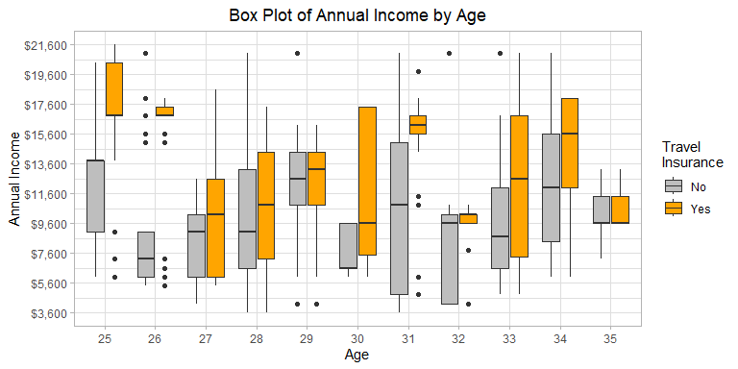
Age/Income as box-plot
ggplot(data, aes(x = as.factor(Age), y = AnnualIncomeUSD, fill=as.factor(TravelInsurance) )) + # Plot Age ( min-max) vs AnnualIncomeUSD with fill color as TravelInsurance geom_boxplot() + labs(title = "Box Plot of Annual Income by Age", x = "Age", y = "Annual Income", fill = "Travel\nInsurance" ) + # Sets the title and label for x,y axis and legend title scale_y_continuous(labels = scales::dollar_format(), breaks = seq(from = min(data$AnnualIncomeUSD), to = max(data$AnnualIncomeUSD), by = 2000)) + # Formats the y-axis labels as dollars and increase by 2k # change the text of legend title scale_fill_manual(values = c("0" = "gray", "1" = "orange"), labels = c("No", "Yes")) + # Sets custom colors and labels for the legend theme_light() + theme( plot.title = element_text(hjust = 0.5) ) # Centers the plot title

Slide 11
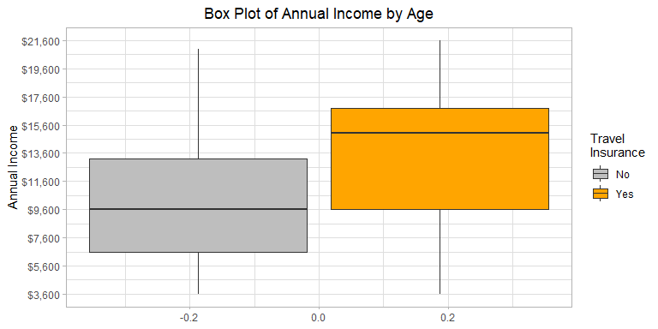
Income vs chances of buying ticket
ggplot(data, aes( y = AnnualIncomeUSD, fill=as.factor(TravelInsurance) )) + # AnnualIncomeUSD with fill color as TravelInsurance geom_boxplot() + labs(title = "Box Plot of Annual Income by Age", y = "Annual Income", fill = "Travel\nInsurance" ) + # Sets the title and label for x,y axis and legend title scale_y_continuous(labels = scales::dollar_format(), breaks = seq(from = min(data$AnnualIncomeUSD), to = max(data$AnnualIncomeUSD), by = 2000)) + # Formats the y-axis labels as dollars and increase by 2k # change the text of legend title scale_fill_manual(values = c("0" = "gray", "1" = "orange"), labels = c("No", "Yes")) + # Sets custom colors and labels for the legend theme_light() + theme( plot.title = element_text(hjust = 0.5) ) # Centers the plot title

