Slide 1
Semi-Autonomous Mobile Robot Navigation in Populated Environments
Mid-term Master Thesis Presentation
Kevin Denis
Supervisor : Prof. dr. ir. E. Demeester
Supervisor : Prof. dr. ir. H. Bruyninckx
Mentor : Dr. J. Philips
Notes:
Informeren Masterproef engels schrijven
Oefening volledige te maken Tussentijdse Presentatie
My Name is ….
Today, I will talk about
My masters’s thesis on

Slide 2
Agenda
Introduction
Goals and Objectives
Approach
Work for 2nd semester
Notes:
Overview of what I’m going to address during this presentation.

Slide 3
Agenda
Introduction
Goals and Objectives
Approach
Work for 2nd semester
Notes:
Let’s kick off with a short introduction to get a global context of this subject

Slide 4
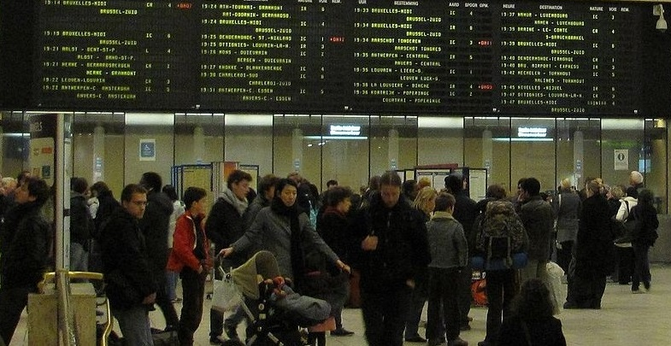
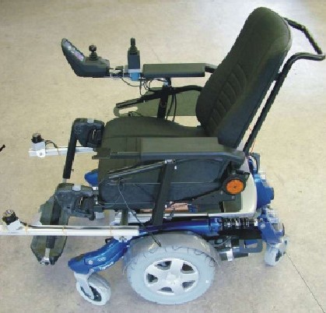
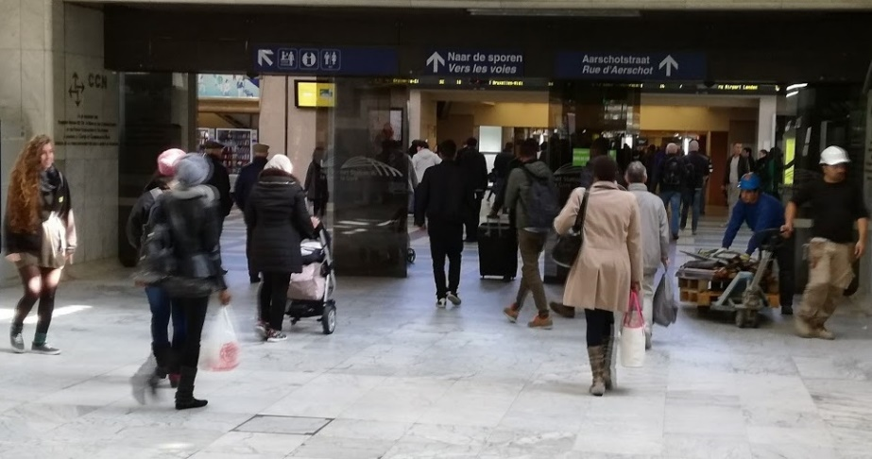
Introduction: Wheelchair Navigation Assistance
Semi-Autonomous
Populated Environments
Notes:
2 important parts in my masters' thesis title:
Semi-autonomous, which reflects on the fact that my case study will be the Navigation Assistance for an electric wheelchair for the eldery or disabled
Populated environments, which raises the challenge to be able to plan a path in a environment, as shown on the pictures, not only dense but also dynamic
The Department of Mechanical Engineering has already made large contributions to the domain Wheelchair Navigation Assistance
through various projects
To photo the left is one of the wheelchairs used for project RADHAR (Robots Adapting to Humans adapting to robots),
The domain of Wheelchair Navigation Assistance can be divided 3 main research areas
Asses of the navigation intention of the driver, who as shown on this picture, a joystick to control the wheelchair
Generation of a local set of paths, (SAFE AND CAN PERFORMED BY WHEELCHAIRE) which will be compared to the drivers navigation intention
Haptic feedback for shared control, needed for a better interaction between the driver and the wheelchair

Slide 5
Agenda
Introduction
Goals and Objectives
Approach
Work for 2nd semester
Notes:
Let’s move on to the goals and objectives I’ve set for my master’s thesis

Slide 6
Goal
Tackle the path planning problem in dynamic environments, using a socially compliant motion planner for semi-autonomous navigation.
Notes:
Socially compliant motion is a very interesting aspect, because :
In general, people will make the navigation of a person in a wheelchair easier, get out of the way) as long as the wheelchair has an clear course path
Also, in crowded spaces, like an airport, it is tolerated to slightly touch someone, so one could imagine that just a slight touch could be accepted (of course, if no other path’s are found)

Slide 7
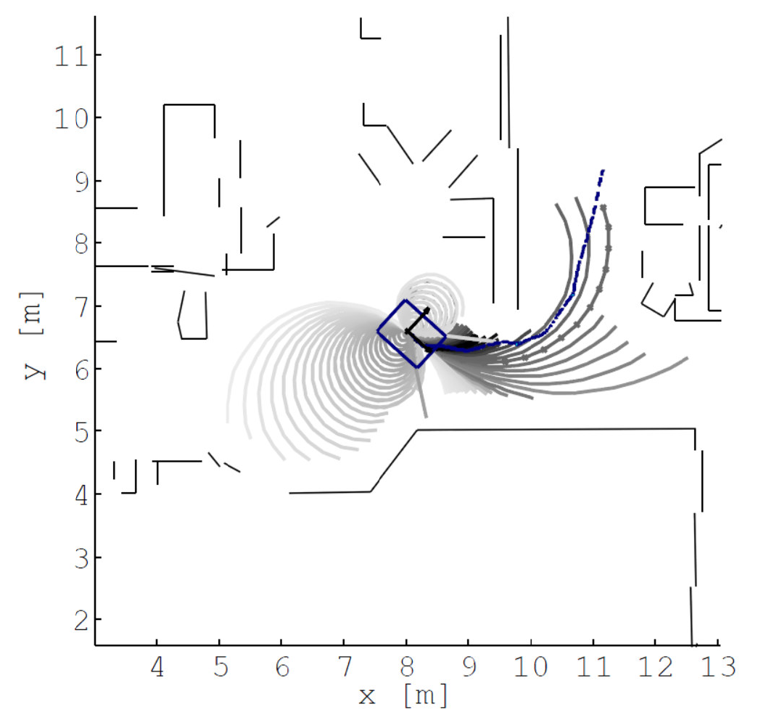
Starting point
Notes:
The starting point of my thesis takes place in the work of Prof. Demeester
We can see here :
In blue the navigation calculated navigation intention of the driver
In grey, the set of local path, consisting of circular arc
Comparted to the navigation intention of the driver
Best one selected

Slide 8
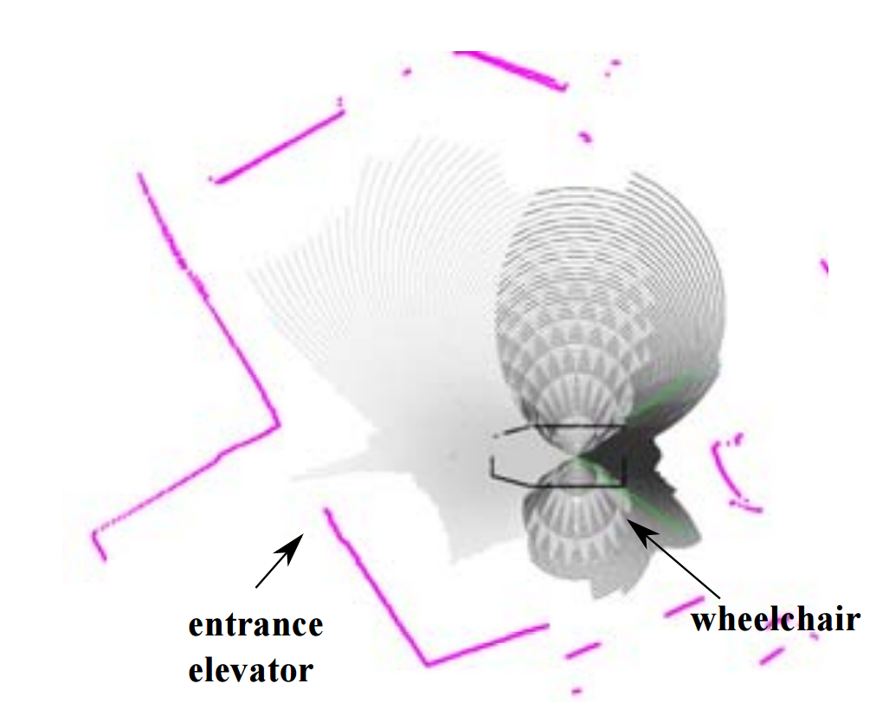
Starting point
Notes:
Here is a more difficult situation, where the wheelchair has to go in a space with close tolerances (entrance of the elevator door),
The path planner, relying only on circular arcs, is unable to find a suitable path

Slide 9
Objectives
Find a more complex geometric form, that will form the basis for local paths.
The socially compliant path planner should be able to :
Asses the moving obstacles around the wheelchair
Take into account the dynamics of the wheelchair
Fast enough so that the user doesn't feel the latency
Notes:
The objectives to achieve the goal of my master’s thesis are

Slide 10
Agenda
Introduction
Goals and Objectives
Approach
Work for 2nd semester
Notes:
We arrive at the main part of my presentation, elaborating the approach that I took to try achieve my goal by completing my objectives
Tackle the path planning problem in dynamic environments, using a socially compliant motion planner for semi-autonomous navigation.

Slide 11
Approach
Use a more complex geometric form as motion primitive.
Work by Pivtoraiko and Kelly (2005) describe a novel approach, “State Lattice” Path Planning.
Notes:
To solve the problem of not finding local paths in certain situations,
a more complex set has to be used
Those paths should still be compliant with the constraints of the vehicle.
… And being able to be used, on the fly (online),
Work by Pivtoraiko and Kelly (2005) describe a novel approach, “State Lattice” Path Planning.
This work provides a part of the solution to the problem.

Slide 12

State Lattice Path Planner
Notes:
The main part of this research consists of calculating offline, a set of precomputed paths (called motion primitives) and use them as a set for path planning
Since it is computed offline, the vehicle constraints to calculated those paths, so that the path planner doesn’t have to take that into account and focus on the objective function.

Slide 13
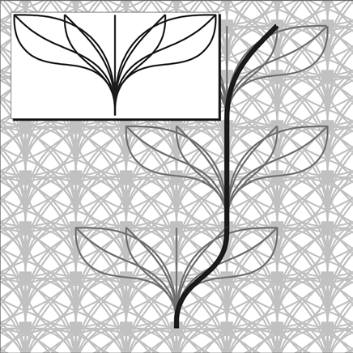
State Lattice Path Planner
Notes:
To generate the state lattice,
The set of motion options (top left corner) is
centered at every node. This set is repeated at the nodes in
the lattice.
Each path is attributed a certain cost and a start and end point is defined.
Then a path planner calculates the optimal path, based on the cost of each path
Since the vehicle constraints are already implemented in the motion primitives, the path planner don’t have to take them into account

Slide 14
State Lattice Motion Primitive
Motion primitives should be more complex than circular arcs.
Based on cubic Bézier Curves :
Start, end pose derived from placement of control points
“DOF” left to influence a desired objective function

Slide 15
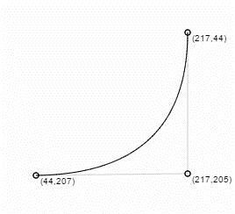
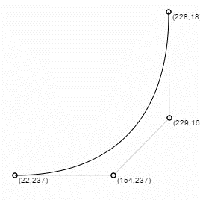
Quadratic vs cubic Bézier Curves
Notes:
Bézier Curve ALWAYS goes threw start and end control point
Orientation is defined by the second and the second last, control point
Here, I present a small animation to see the influence of a control point on the shape of the Bézier curve
Quadratic, defined by 3 control points, has not enough freedom to come with all start and end poses,
By adding an extra control point, I can easily change one control point without interfering with the start, and satisfying a certain objective (minimal path length, curvature)

Slide 16
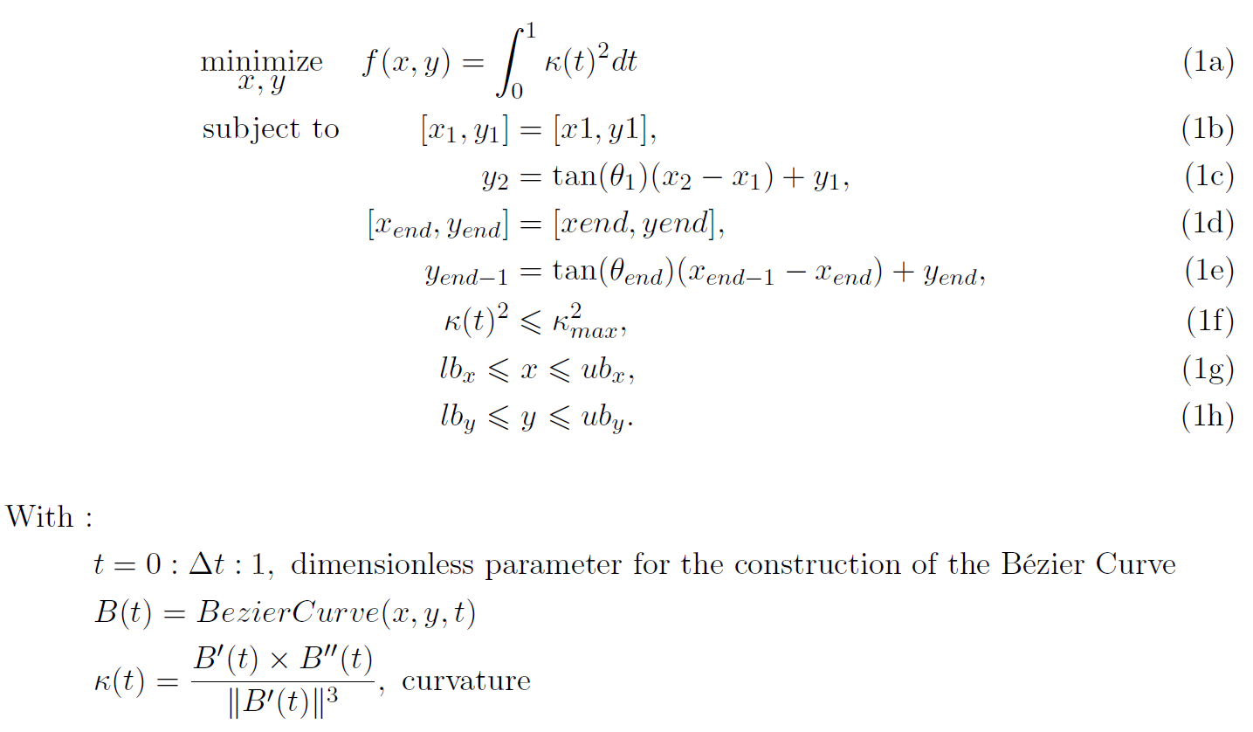
COP : motion primitives
Notes:
The shape of this cubic Bézier Curve that is part of the set of Motion Primitives can be formulated as a Constraint Optimization Problem
So with this 1DOF left, I can try to optimize an objective function.
At this moment, minimising the total bending energy of the curve (that is the integral of the curvature of the curve), this, to have a motion that is as smooth as possible for the driver, minimal normal forces

Slide 17
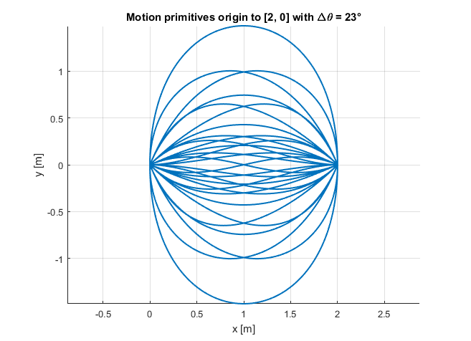
State Lattice : Example fixed position
Notes:
Here, a set of motion primitives are shown going from origin to point 2 0 with a start and end angle varing from +90° to -90° with a step of 22,5°
!!!! No straight lines shown !!!
Implemented separately, this, because straight lines formulated as Bézier Curves are “unreliable”

Slide 18
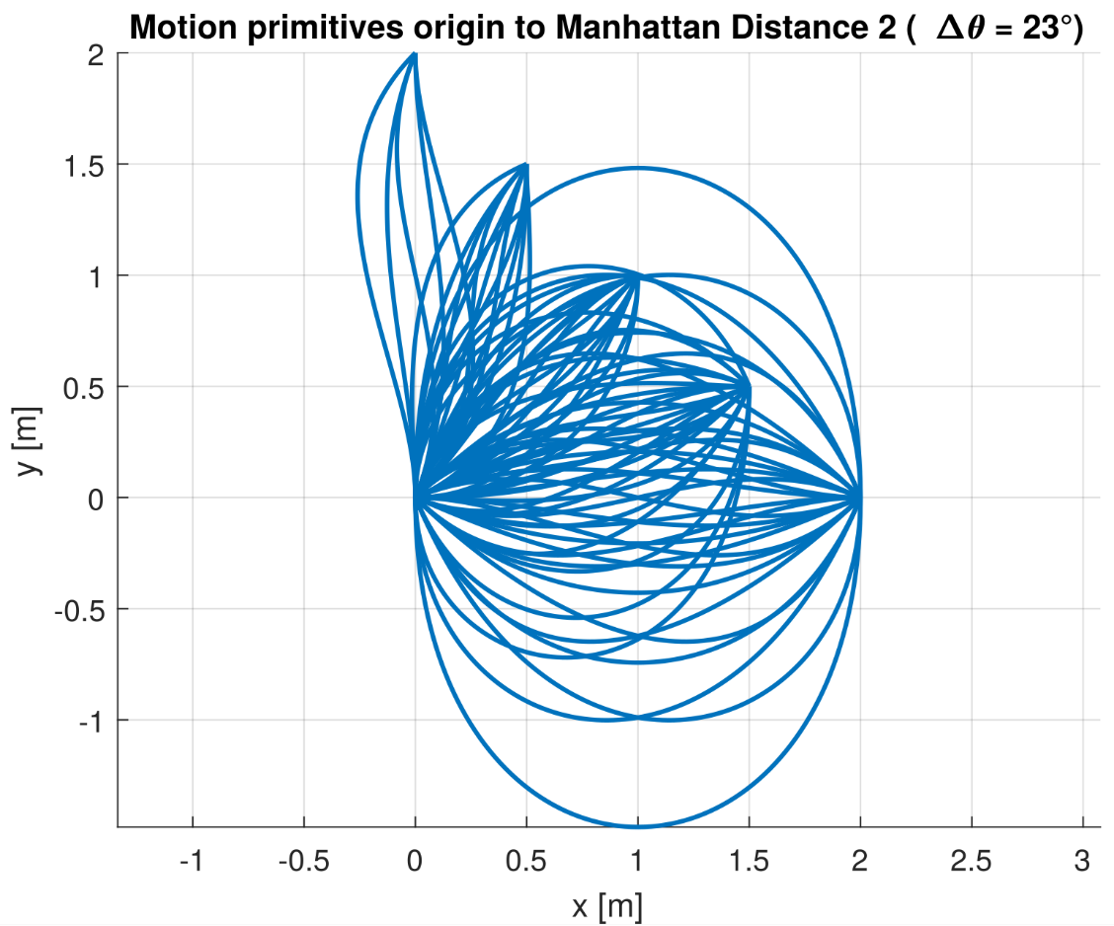
State Lattice : Generation of possible motion primitives
Notes:
For this and the next 2 slides an explanation will be given on how all the possible motion primitives are calculated.

Slide 19
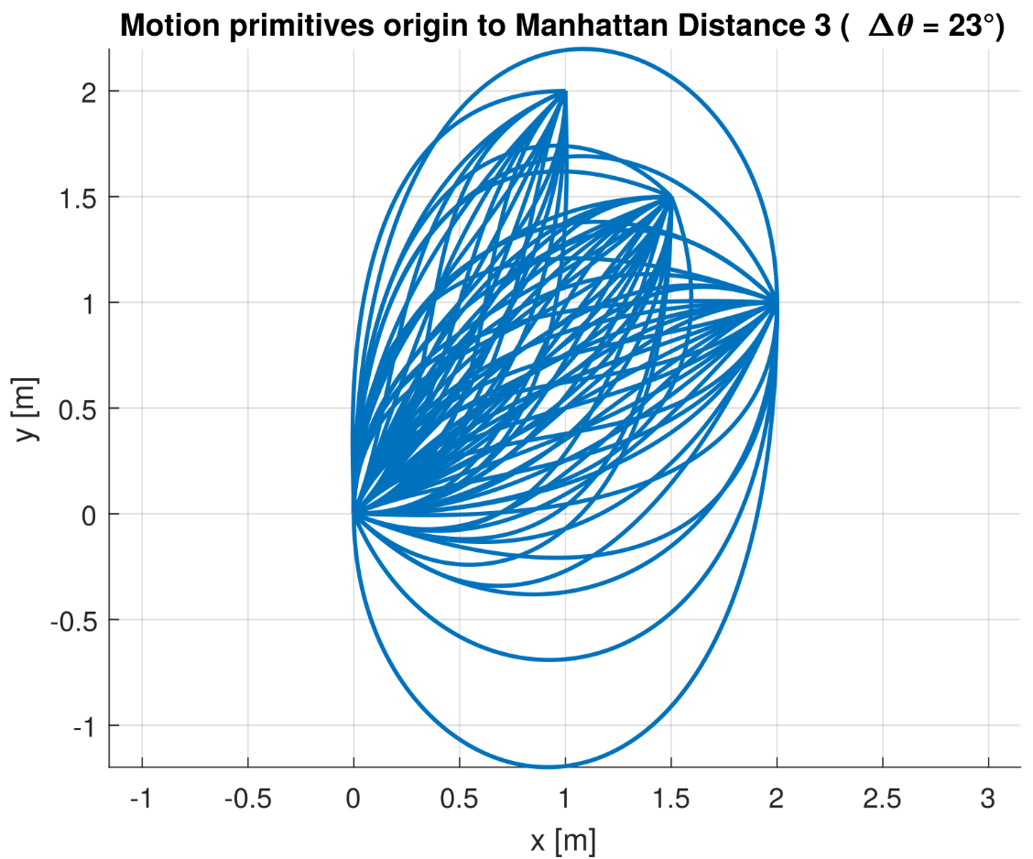
State Lattice : Generation of possible motion primitives

Slide 20
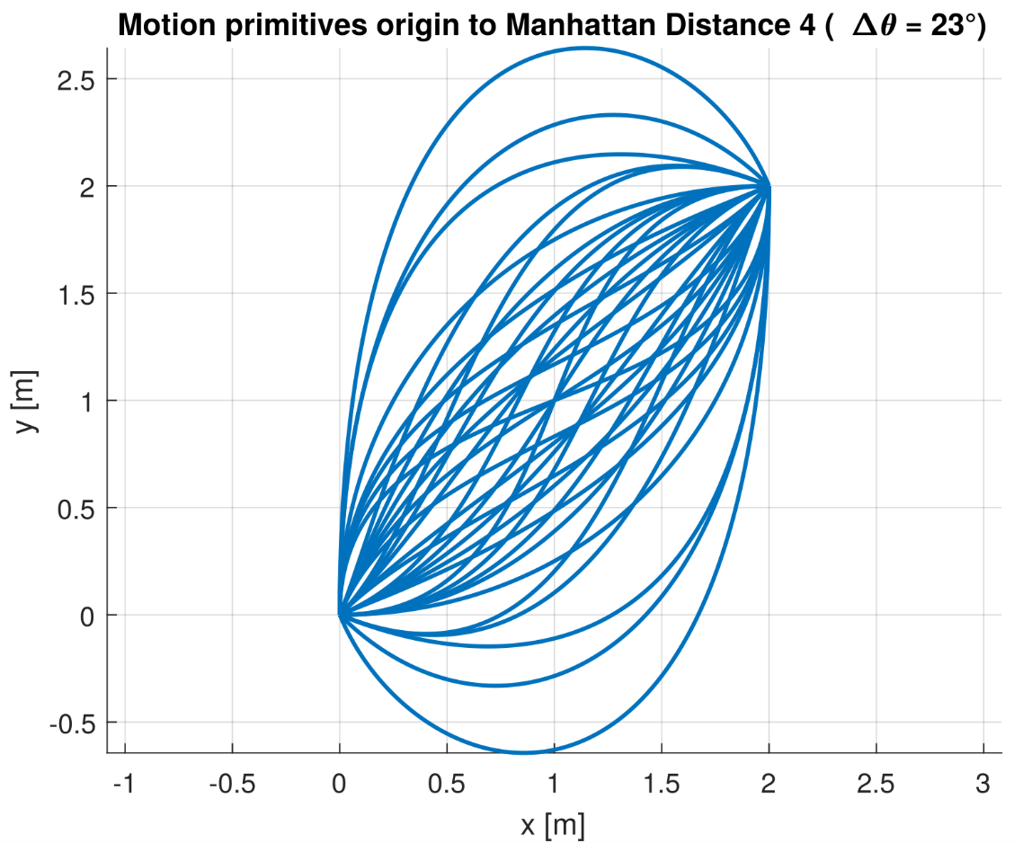
State Lattice : Generation of possible motion primitives
Notes:
Note : the reason we don’t have [3, 1], etc. is that it is out of reach

Slide 21
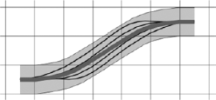
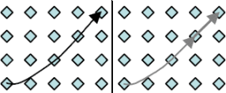
Motion Primitives are unique
Notes:
Motion primitives similar to a combination of previous motion primitives should be eliminated, for a faster path planning,
I have not implemented this at the moment !

Slide 22
State Lattice Path Planner
Notes:
I end this discussion with the same figure as I started,
By combining these motion primitives, and associating a certain cost to each of the primitives (based for example on their length and bending) I can find an optimal path

Slide 23
Agenda
Introduction
Goals and Objectives
Approach
Work for 2nd semester
Notes:
We arrive at the last part of my presentation, the work that I plan to during the second semester

Slide 24
Work for 2nd semester
Path Planning (uncertainty)
Multi-resolution grid
Context based navigation and templates for certain tasks
Notes:
Path Planning (uncertainty)
As you may recall from the introduction, the intention of the driver has to be evaluated,
This means that there lies a certain uncertainty on the intention of the driver.
My motion primitives are over-constrained : in COP the start pose is as important as the end, this is not true in reality,
I have to find a way to model this uncertainty and to add them in the path planner or in the motion primitives itself
Multi-resolution grid
Emphasis on multi-resolution (2 or 3 different grids).
Grid for non-holonomic component of the wheelchair, the castor wheel
“Normal grid”
Coarse grid for >2 m
Context based navigation
Rooms where the wheelchair has to behaves differently,
Small corridor, don’t attempt to find another path, just wait
Templates for fine motion for certain tasks
Driving backwards in an elevator
parallel parking
Docking at table

Slide 25
End of the presentation
Thank you for your kind attention
Notes:
With this presentation, I hope you have grasped the goal and objectives I want to achieve this year for my masters thesis,
Thank you for your kind attention

