Slide 1


DYF Investment Strategy
Yining Gan, Donglin Zhan, Francis Kouomegne Kamdem
DYF Investment Strategy

Slide 2
Factors
Size Factor
Price-Based Factors
Moving Average (Simple and Exponential)
Bollinger Band (BB)
Momentum
Beta
Relative Strength Index (RSI)
Stochastic Oscillator
Money Flow Index (MFI)
MLP
Volume-Based Factor
Liquidity
Volume-ratio

Slide 3
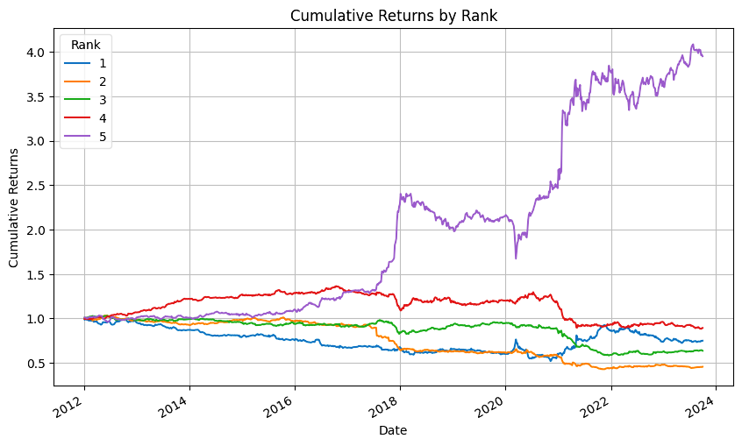
Factors
Feature Engineering
Fa
Divide the universe into 5 groups every week based on the factor values and calculate the cumulative demeaned return for each group

Slide 4
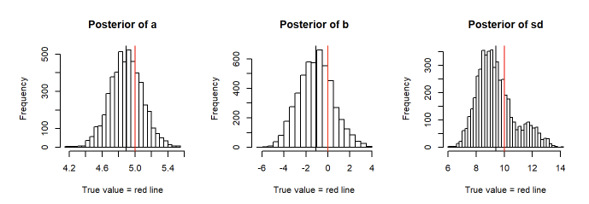
How to get rank?
Confidence interval (Bayesian approach: argmax β P(β|y))
MC methods
Ensemble learning (Random Forest)
Multinomial Logistic Regression (Panel Data)
3 | Investment Strategy of Jay Street

Slide 5
How to get weights?
Long assets that have maximum probability in rank 5 and short assets with maximum probability in rank 1
Max Sharpe Ratio = (Rp − Rf) / σp
st. Rp = ∑(wi⋅Ri )
σp = sqrt(∑∑wi*wj*σij)
wi > 0 if i in long assets, wi<0 if i in short assets, else wi = 0
abs(wi) <= 0.15
4 | Investment Strategy of Jay Street

Slide 6
Time Series Models
Autoregressive models: AR, ARIMA, ARIMAX
LSTM, ATTENTION models (softmax output)
training/validation: 5 months/ 1 month, move forward weekly
return_i = f(x_i_t, x_i_t-1, x_i_t-2, …x_i_t-T) (AR, ARIMA/ LSTM)
vs.
return_i = f(x_0_t, x_0_t-1…, x_i_t-T) (LSTM, ATTENTION, ARIMAX)
5 | Investment Strategy of Jay Street

Slide 7
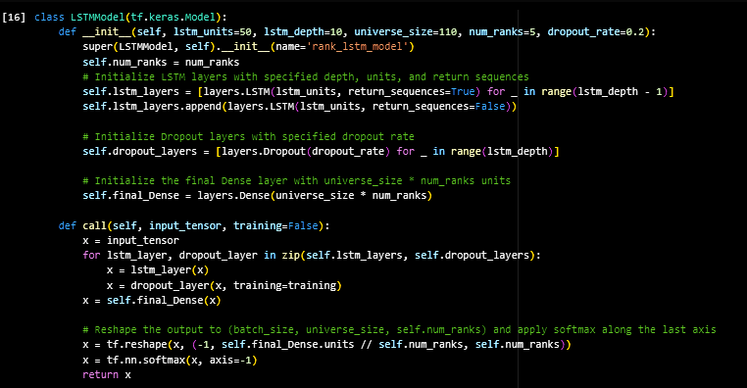
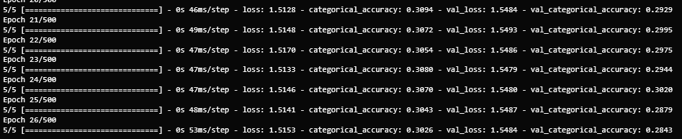
Vanilla LSTM

Slide 8
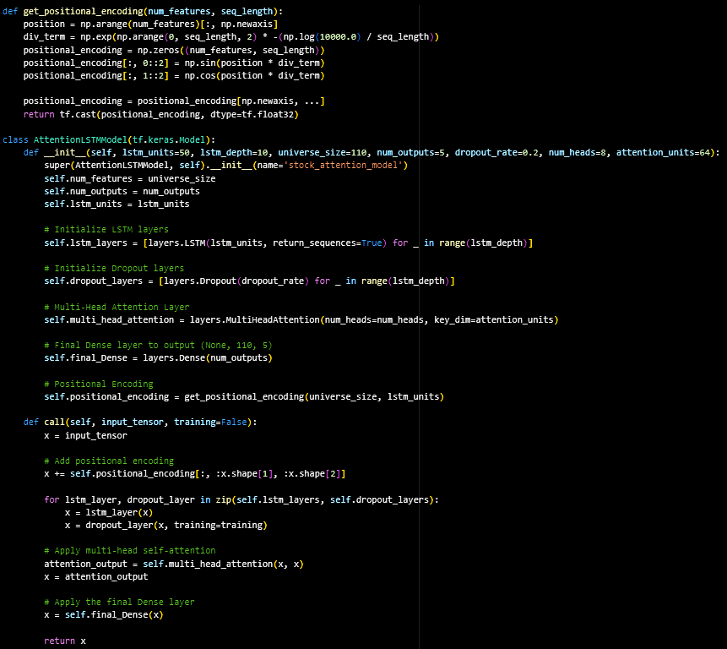
LSTM Modelling
L S T M M O D E L S
Adding attention did not improve accuracy
Adding extra factors into LSTM did not improve and was time consuming;
Having to tune 110 models.

Slide 9
MLP
Data Segmentation: We segmented the data into two groups - equal and non-equal columns based on initial values
Rate of Change Calculation: We calculate the rate of change for each asset to measure stock price momentum.
Sliding Window: We used a sliding window technique for dataset preparation. We created the Input and the corresponding output dataset in a window of 30 days
Data Augmentation: Add Gaussian noise to the raw data to get a more robust representation.
Data Filtering: Using changepoint detection to filter out data under regime shifts.

Slide 10
MLP
Model Architecture: Our MLP model consists of three layers with 28, 64, and 16 nodes respectively, and a final output layer with one neuron.
Training Process: We use the Adam optimizer and Mean Squared Error loss function for training over 100 epochs.
Evaluation: Post-training, the model is evaluated with the test dataset using standard regression metrics
Final Output: The model predicts the rate of change in stock prices

Slide 11
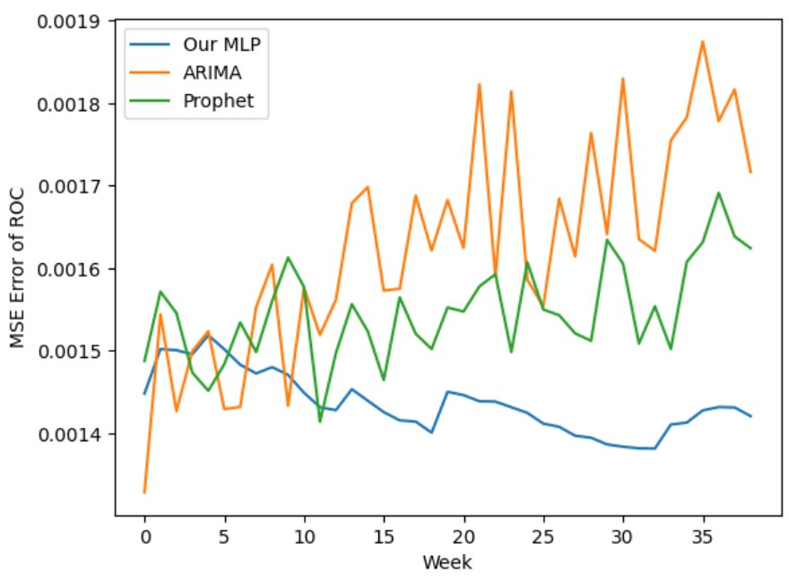
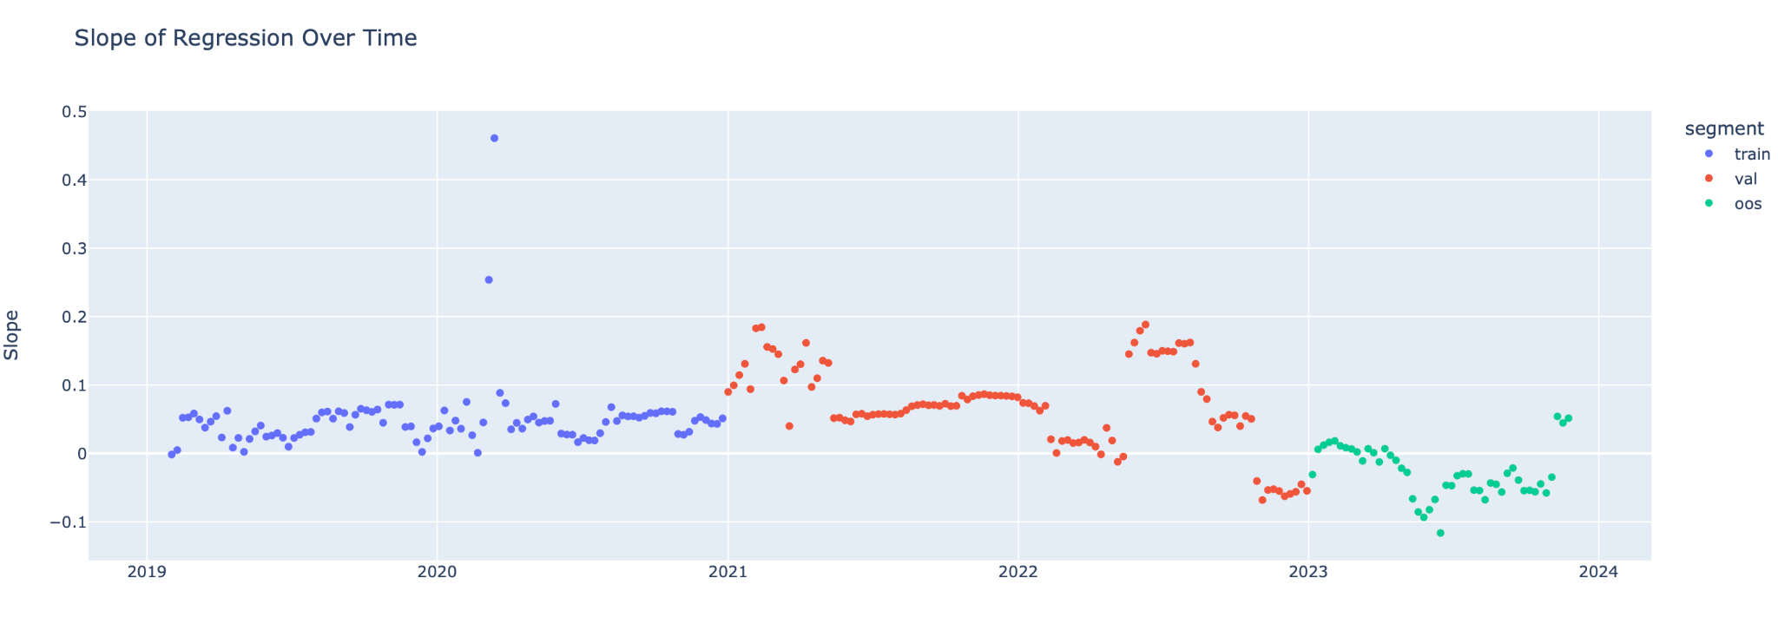
MLP
Data Feeding Strategy
Data Training: 52 weeks data
Testing: previous 4 weeks data to predict next week’s stock returns
Comparison - Time-Series Forecasting
ARIMA
Prophet
Model Accuracy
Consistently low MSE indicates high predictive accuracy
Ability to learn complex non-linear patterns in the data
Strength in short-term forecasting
Model Stability
Relatively stable MSE across weeks suggests that the model has learned a consistent pattern.
No significant spikes in error - model is not overfitting to noise in the data.

Slide 12
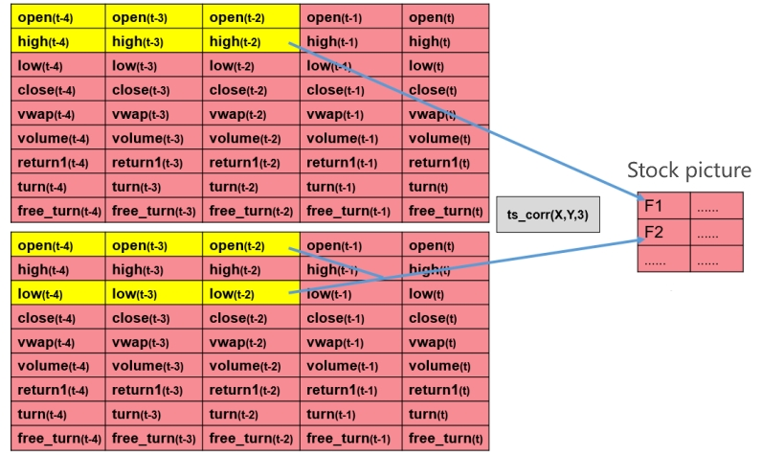
A L P H A N E T
Alphanet
6 months training/6 months validation
A feature extraction neural network from research published by Huatai Securities
Customized layers inspired by convolution, treating stock values as pictures.
It aims to find predictive factors by wrapping statistics of price data in a convolution-like manner.

Slide 13
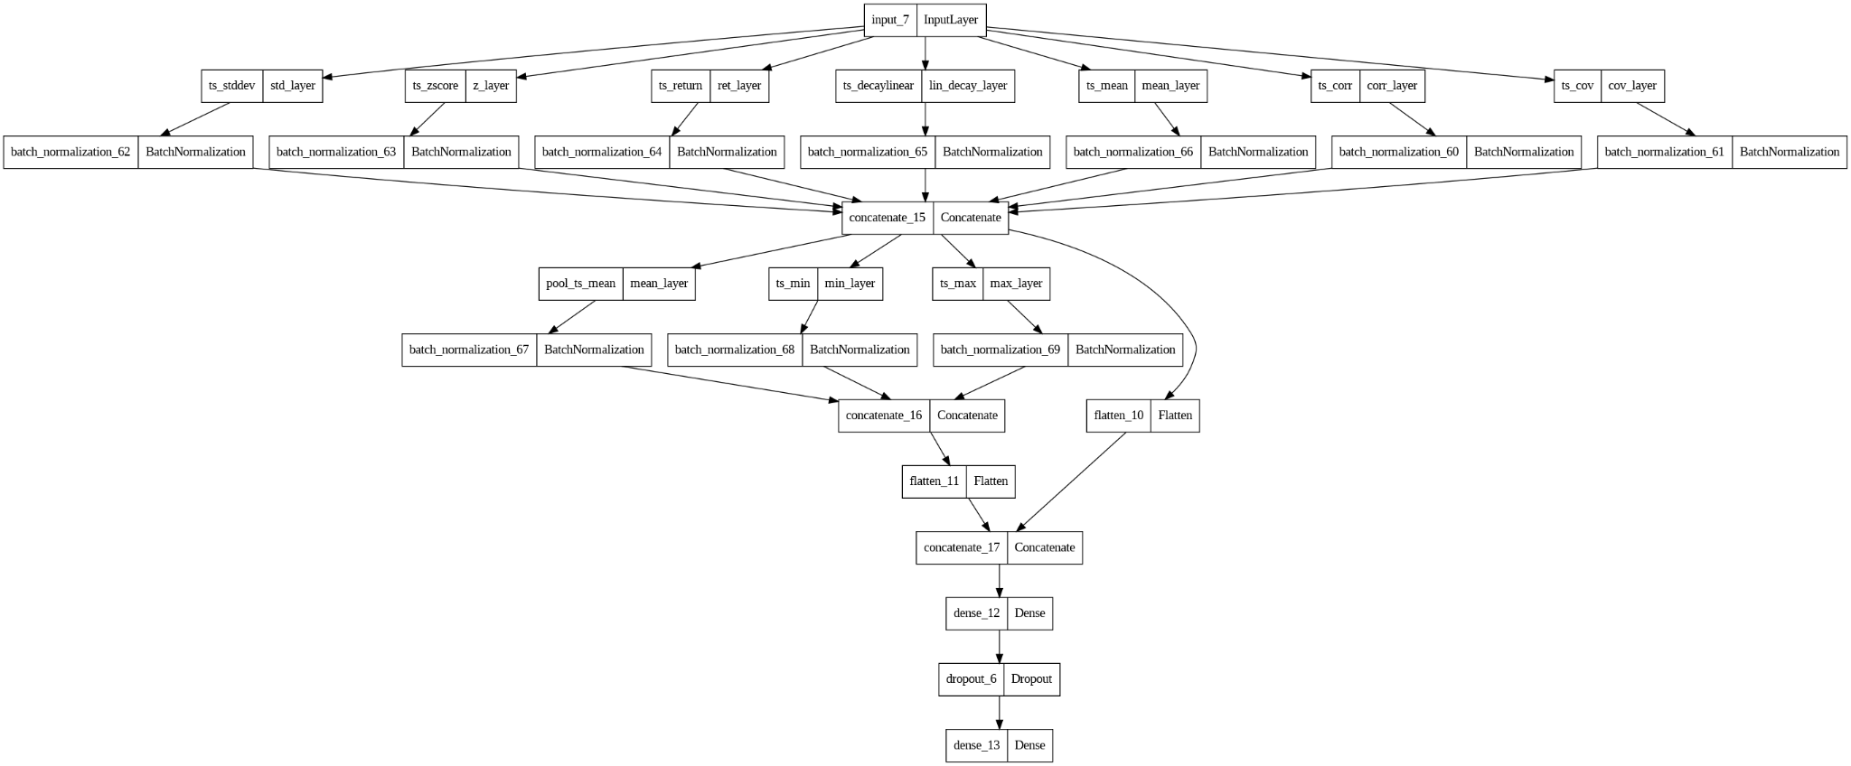
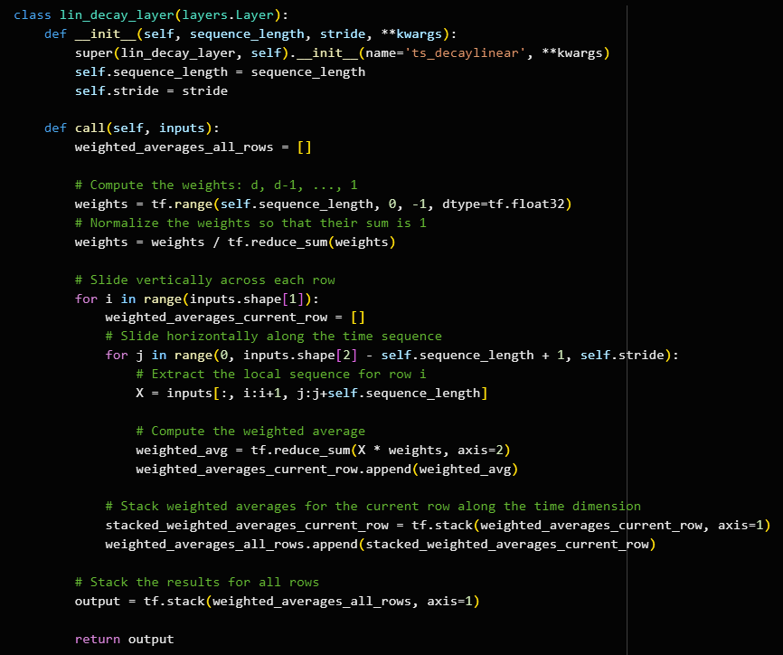
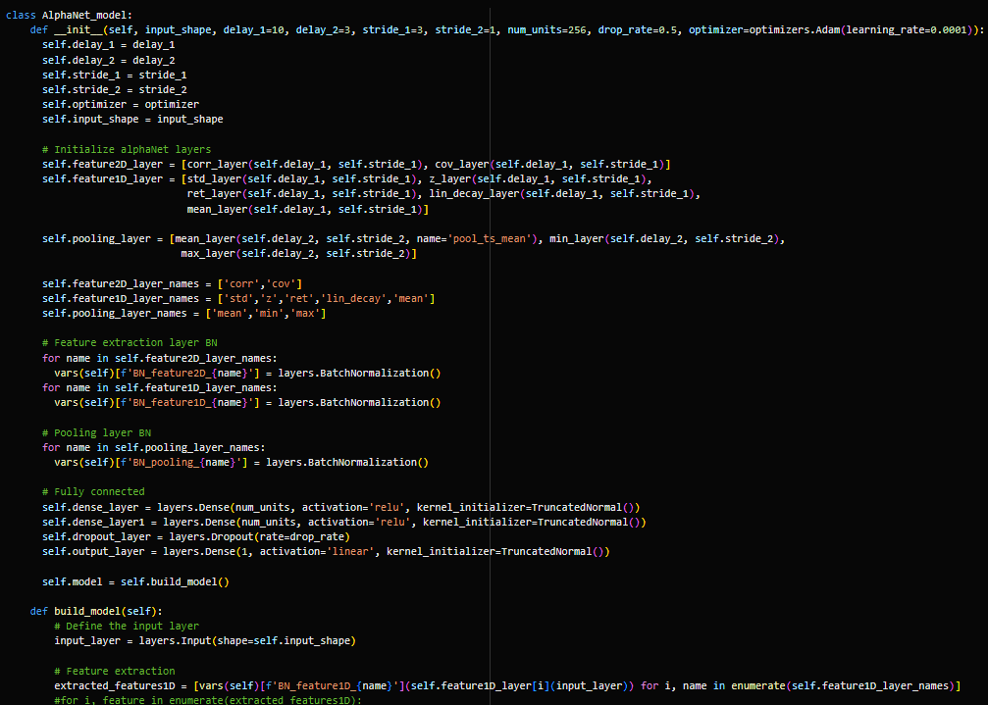

Slide 14
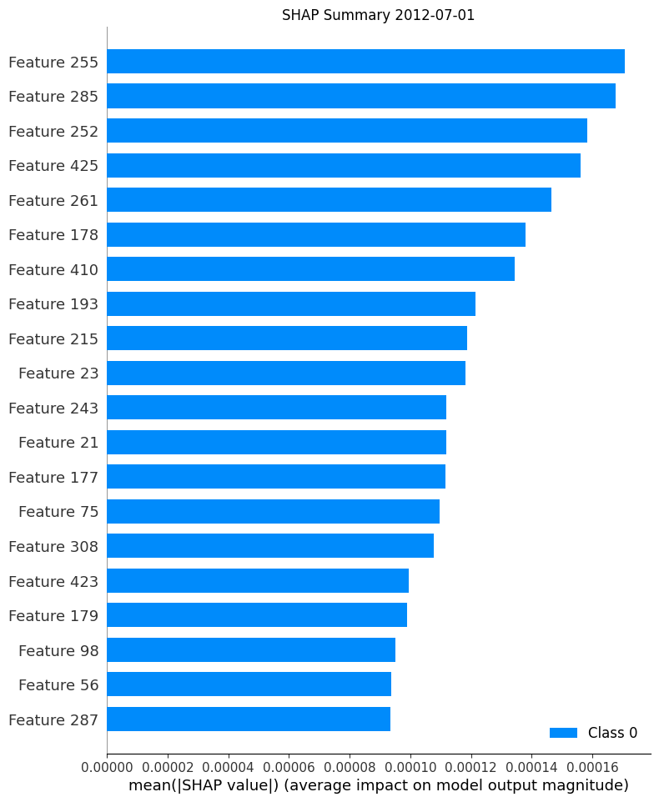
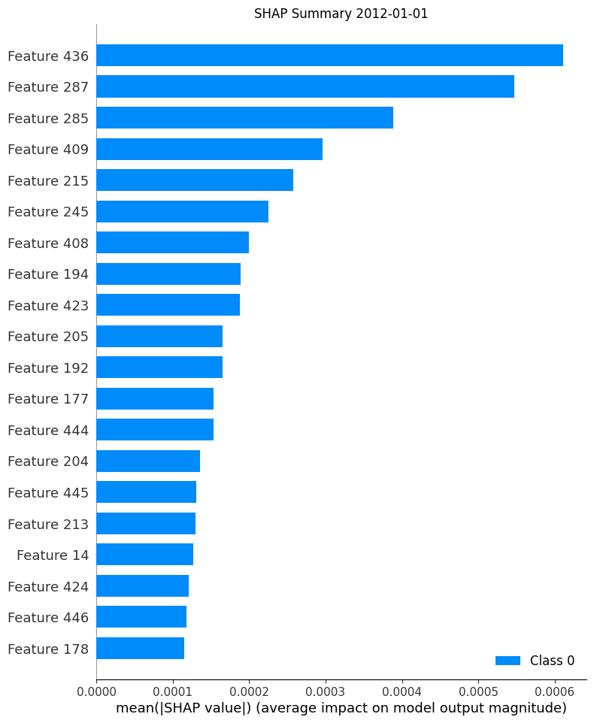
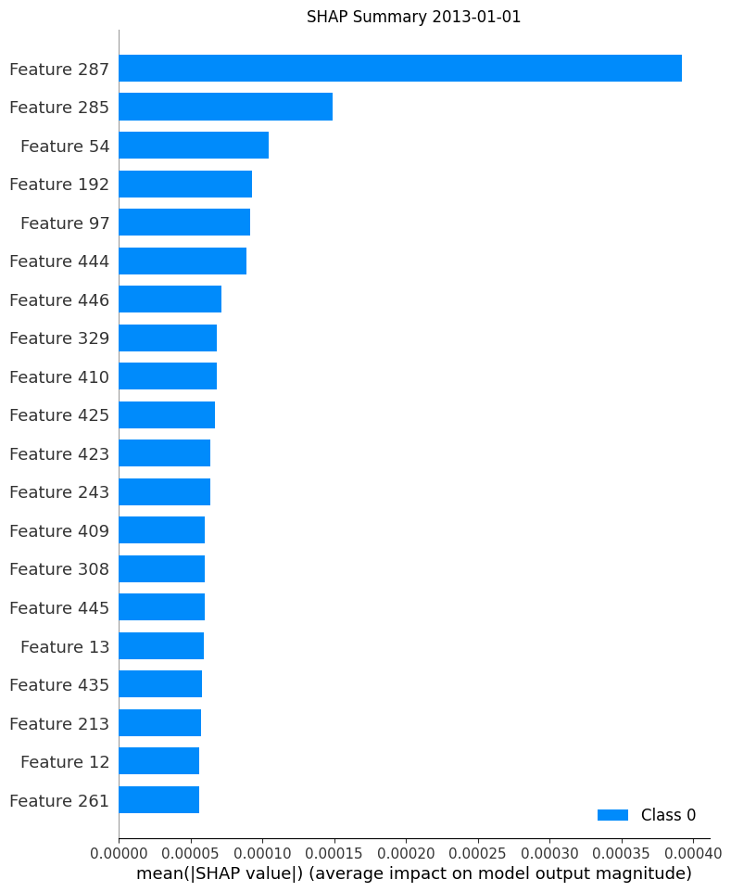
Calculates how much each factor contributes to the outcome of the model.
Factors look like BN(ts_mean(BN(ts_corr(low,return, delay=10)))) etc

Slide 15
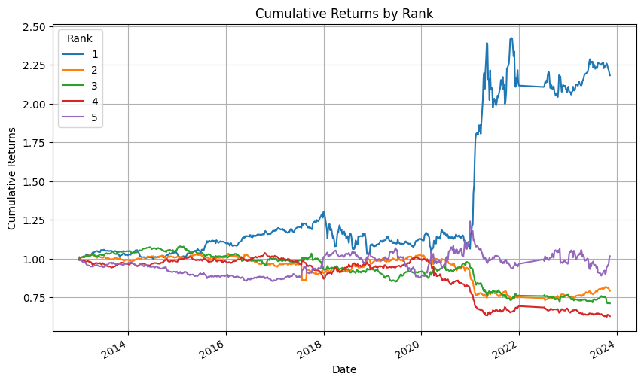
A L P H A N E T F A C T O R
Alphanet
Train the model using a rolling window of one year length, with a training set to validation set ratio of 1:1.
Predict the returns for the latter half of the validation set using the trained model as the Alphanet factor.

Slide 16
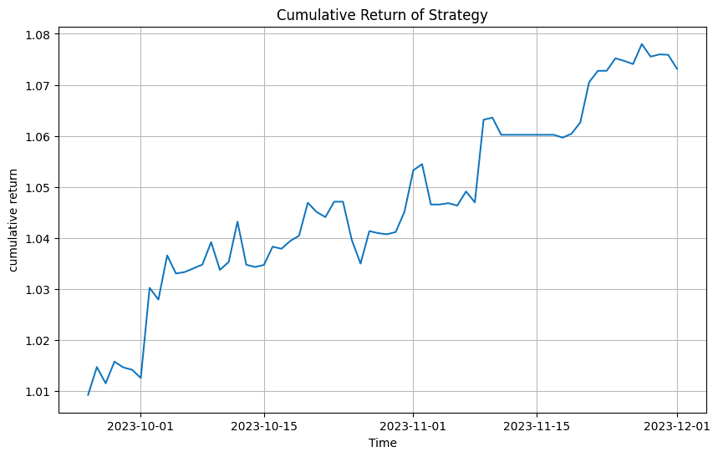
Result
Annual return: 0.2897
Annual std: 0.0731
Sharpe ratio: 3.9622

Slide 17
Thanks for your Attention
DYF Investment Strategy

