Slide 1

Driving customer service through the Service Cloud Console APIs
Kevin Glinski
Lead Technical Integration Specialist
Interactive Intelligence
Kevin.glinski@inin.com
Notes:
Interactive Intelligence provides an open and flexible platform for engaging customers through a variety of channels primarily driven by the telephony channel in the contact center space.

Slide 2
Customer Service Economics
Time == $$
Customer Satisfaction == Time⁻¹
Customer Satisfaction : $$

Slide 3
How to Decrease Time
Keep agents focused on the task at hand
Present them all the information they need to do their job
Prevent them from switching applications

Slide 4
What are the Service Cloud Console APIs?
Javascript API for console use only
Interact with different portions of the Service Cloud Console
Control primary and sub tabs
CTI (Computer Telephony Interface) methods
Custom Console Components
Console Events
Live Agent
Omni Channel

Slide 5

What are the Service Cloud Console APIs?
Works from Visualforce pages or 3rd party remote urls
Pro Tip:
When developing locally on localhost, set your
web server port to 443 to ensure proper
communication with the APIs

Slide 6
What are the Service Cloud Console APIs?
<apex:includeScript value="/support/console/32.0/integration.js"/>
<script src="https://na1.salesforce.com//support/console/32.0/integration.js"/>

Slide 7
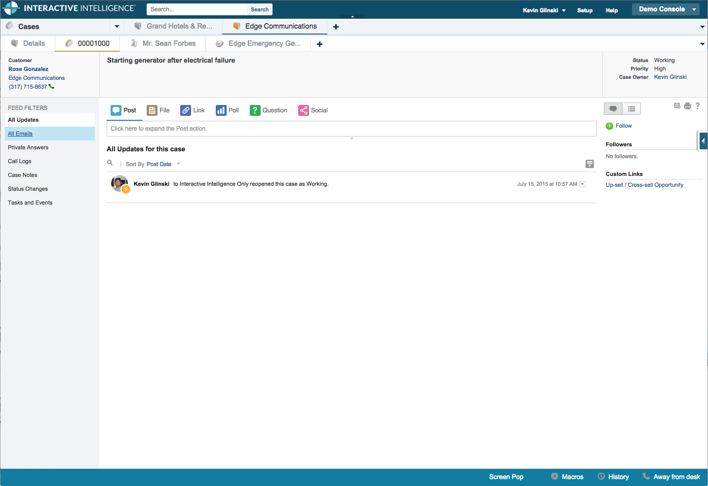
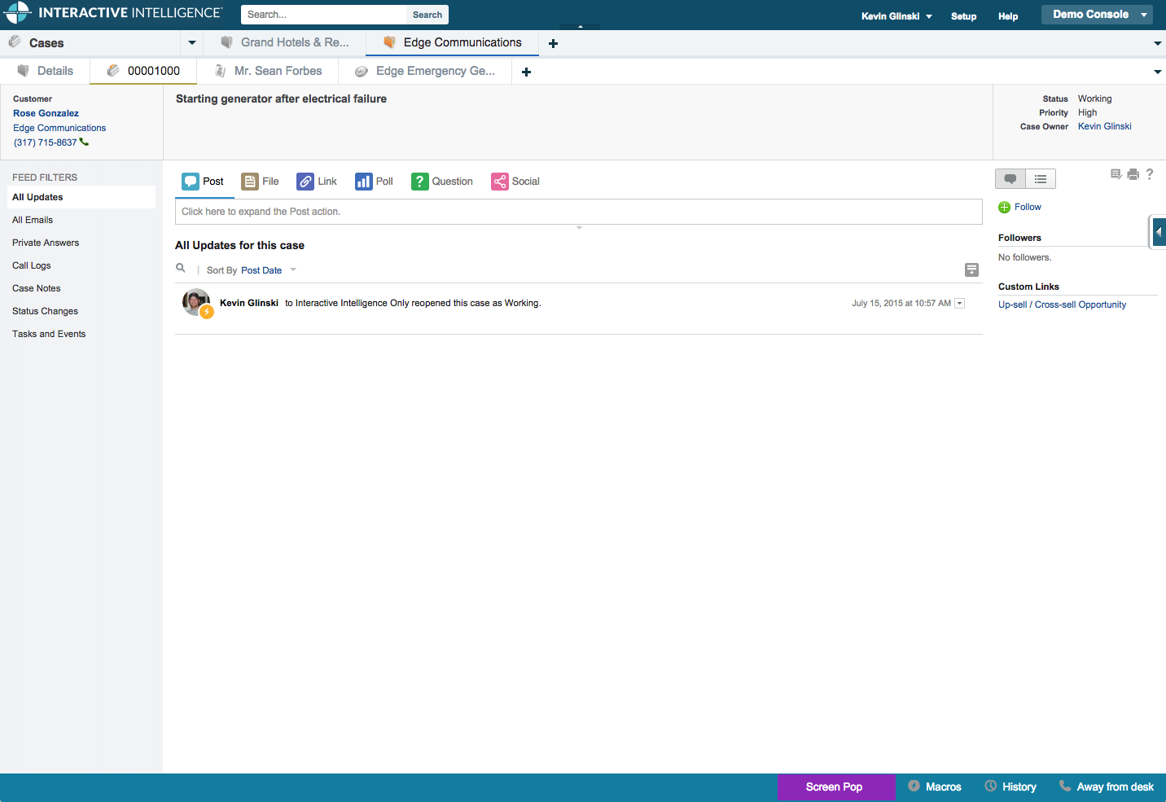
Service Cloud Console
Notes:
The service cloud console has an almost unlimited number of ways it can be customized

Slide 8
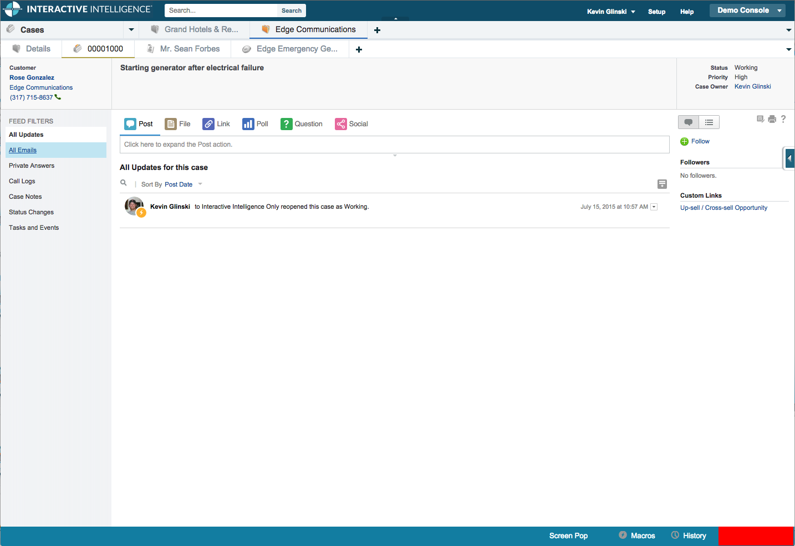
Computer Telephony Integration (CTI)
Notes:
The service cloud console has an almost unlimited number of ways it can be customized

Slide 9
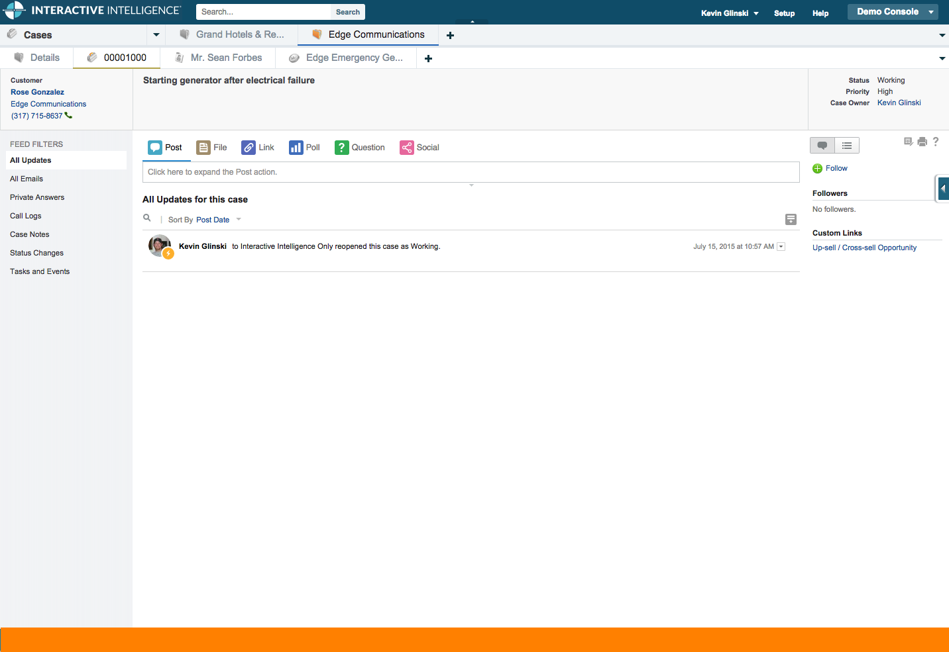
Custom Console Components
Notes:
The service cloud console has an almost unlimited number of ways it can be customized

Slide 10
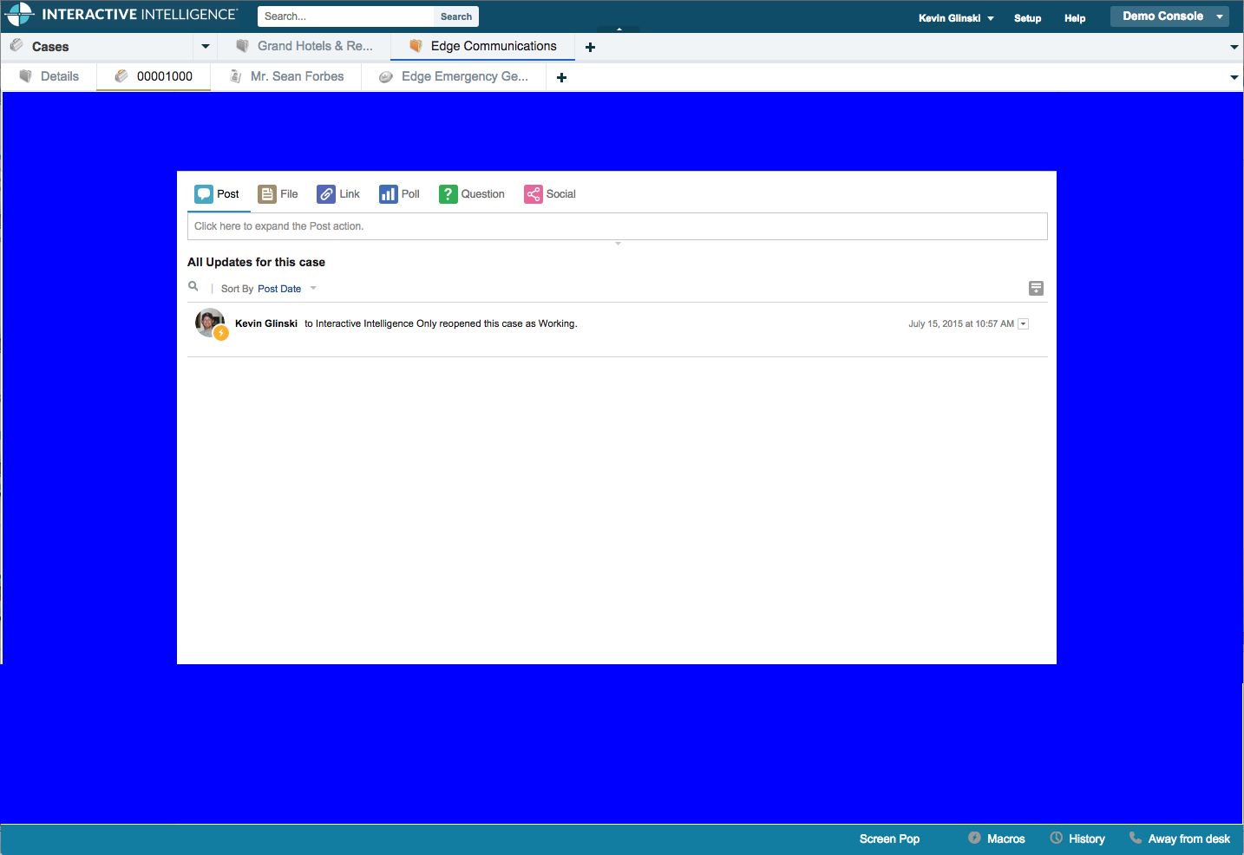
Visualforce Sidebars
Notes:
The service cloud console has an almost unlimited number of ways it can be customized

Slide 11
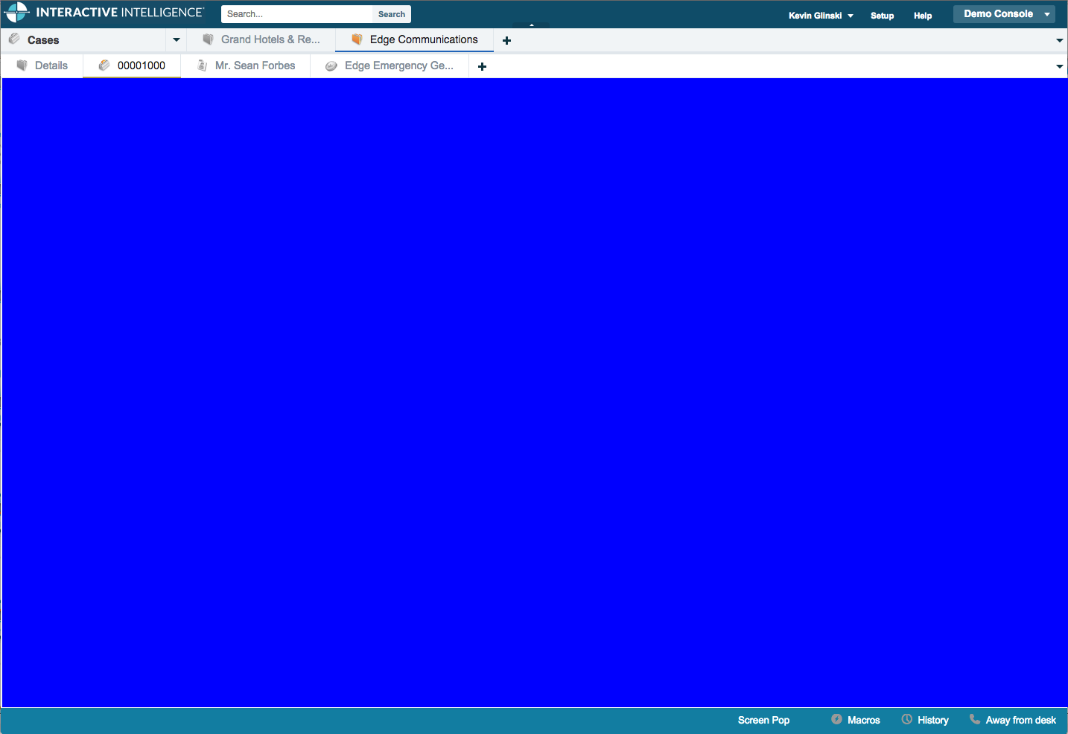
Visualforce Sidebars
Notes:
The service cloud console has an almost unlimited number of ways it can be customized

Slide 12
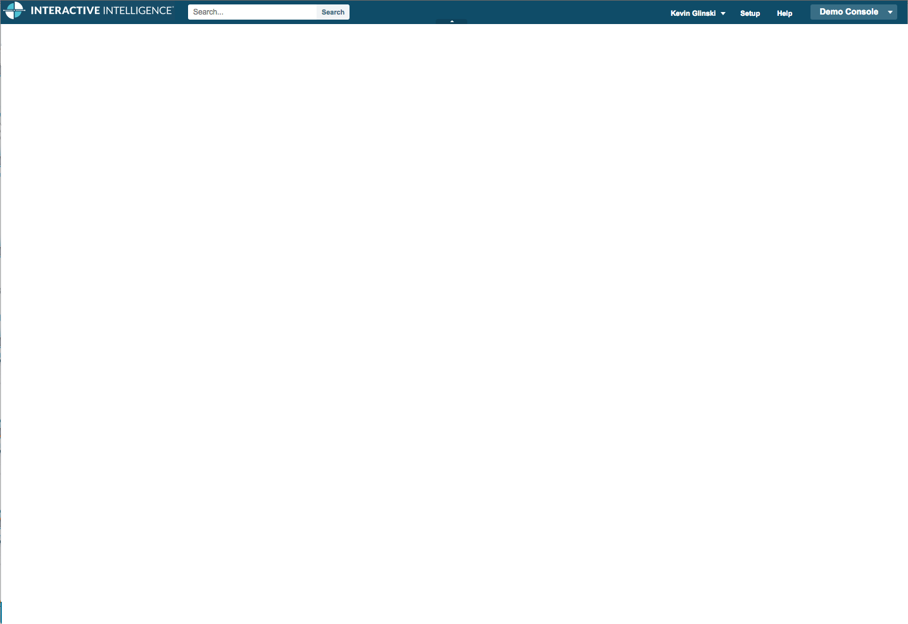
What You Can’t Customize
Notes:
The service cloud console has an almost unlimited number of ways it can be customized

Slide 13
Screen Pop
Present the information that the agent is going to need to do their job
Notes:
Demo Flow:
Open CTI
Set Status to Available
Take call that does screenpop

Slide 14
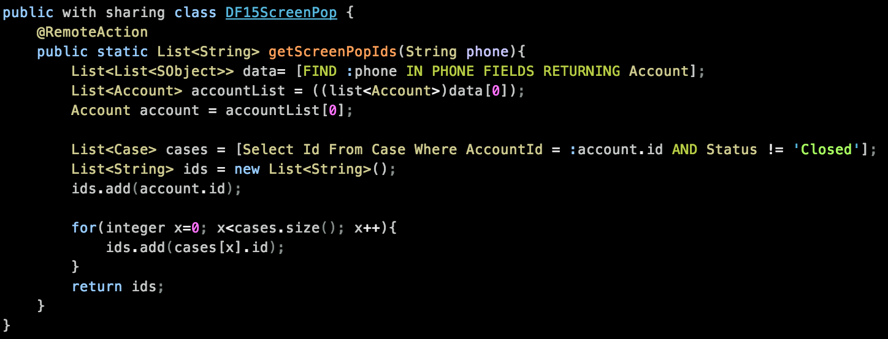

Slide 19
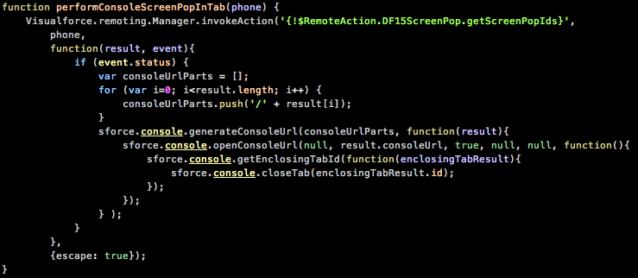

Slide 25
Screen Pop Revision
Make it easier with a Custom Console Component

Slide 26
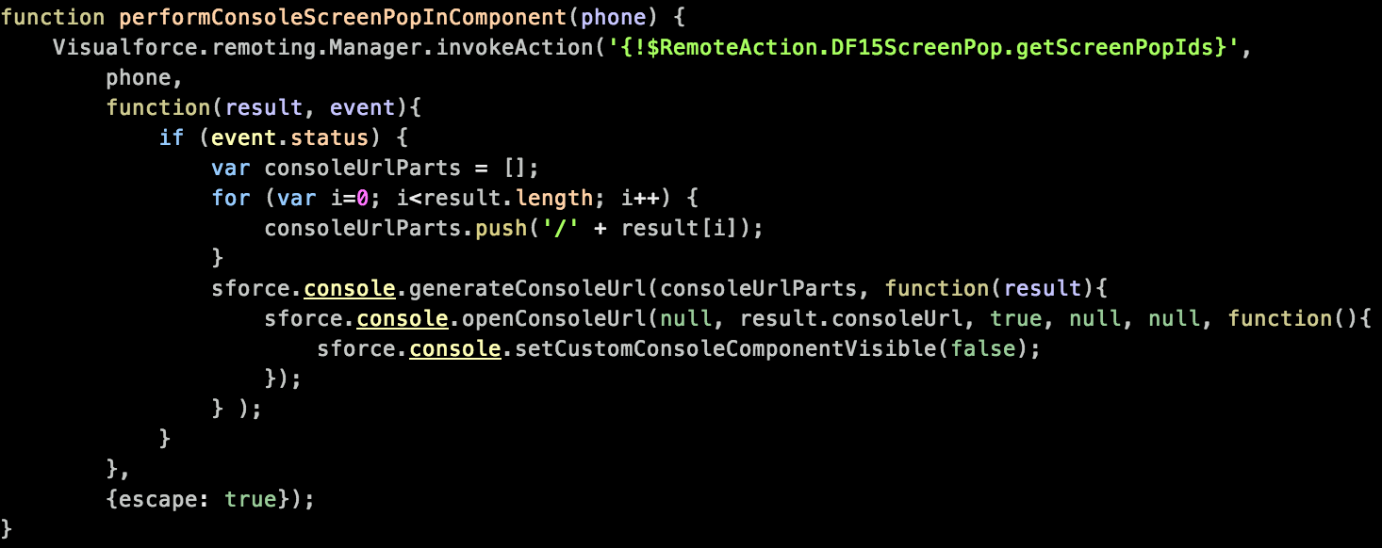

Slide 29
Track Communications With Interaction Logs
Interaction Logs are stored as activities in salesforce
Provide a historical reference for communication (Chat, Email, Voice) regarding an object in Salesforce
Provide context to individual interactions to help someone reviewing the case go get a sense of what has already happened

Slide 30
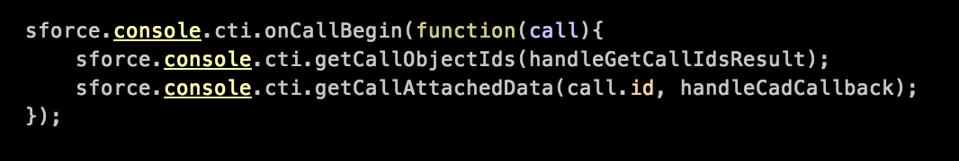
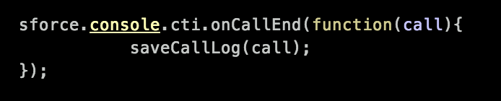

Slide 31
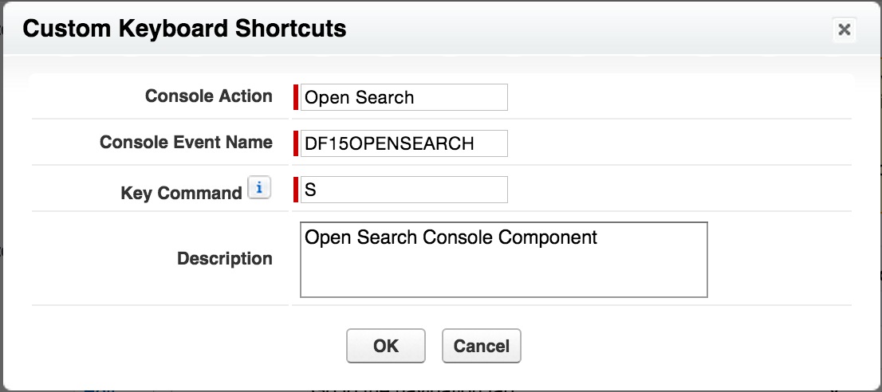
Console Events
Using console events it is possible for different Visualforce pages in the console to communicate with each other
Foundation for keyboard shortcuts

Slide 32
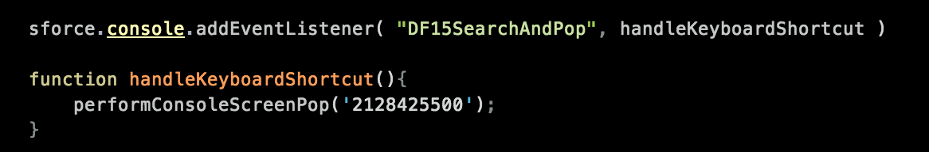

Slide 33
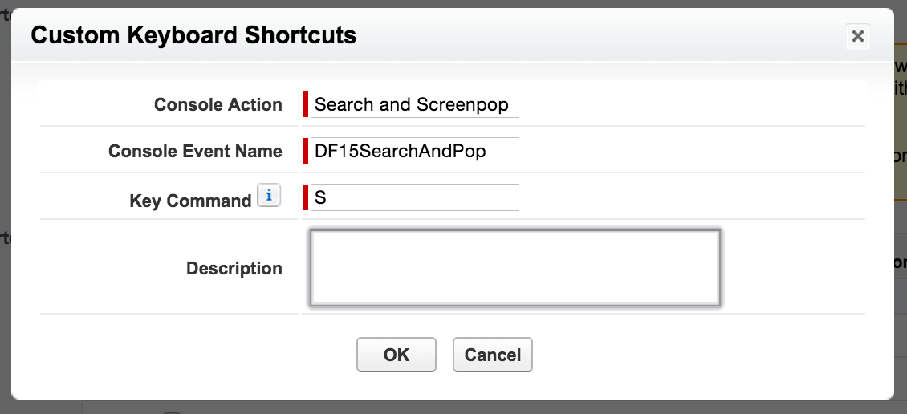

Slide 34
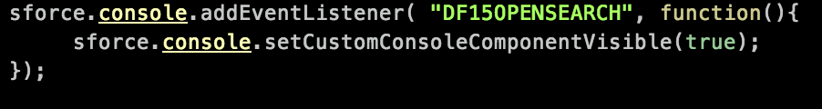

Slide 35
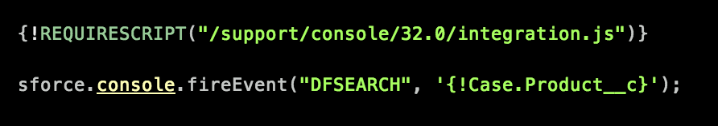

Slide 36
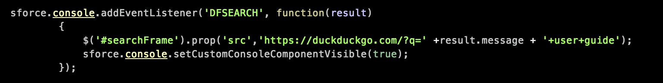

Slide 37
Recap
Keep agents in the service cloud console while doing their work
Leverage console APIs to gather information from different sources
Use the CTI API for telephony operations
Screen pop and Interaction Logs
Use the sidebar panels to display extra information about the records in view
Use Console Components to access information that you want always available

Slide 38
Questions?
All source from this demo is available on GitHub
https://github.com/KevinGlinski/DF15ServiceConsoleAPIs
or
http://bit.ly/DF15ServiceConsoleAPIs

