Slide 1
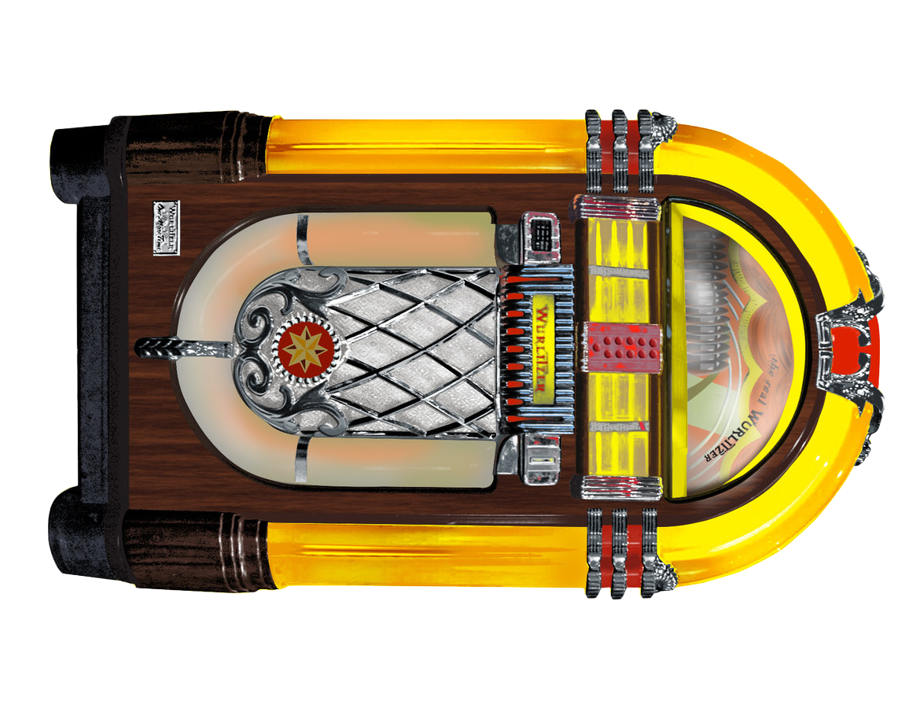

Sam Cooke - Lost and Lookin
Beatles - Lucy in the Sky
Smiths - Rusholme Ruffians
Four Tops - I Cant Help Myself
Bob Marley - Stir It Up
Jam - Down In The Tube Station
Bill Withers - Lovely Day
Otis Redding - (Sittin On) The Dock
Ben E King - Stand By Me
Percy Sledge - When a man loves
Iggy Pop - Lust for life
Chili Peppers - Under the Bridge
Lady Blackbird - Its Not That Easy
Four Tops - Same Old Song
Beach Boys - Good Vibrations
Lou Reed - Walk on the Wild Side
Echo and the Bunnymen - Killing Moon
Joy Division - Atmosphere

Slide 2
Smiths - I Know Its Over
James Brown - I Feel good
Muse - Uno
Nirvana - Come as you Are
Gorillaz - Feel Good
Stevie Wonder - Superstition
Motorhead - Ace of Spades
Damned - Neat Neat Neat
Beatles - Come Together
Sonny n Cher - The Beat Goes On
Motherlode - When I Die
Simon Garfunkel - Scarborough Fair
Nancy Sinatra - Boots Are Made For Walkin
Queen - Another One Bites
KingTubby - Tubbys Dub Song
Madonna - Like a Virgin
Chili Peppers - Higher Ground
Michael Jackson - Billie Jean

Slide 3
EarthWindFire - Boogie Wonderland
Kool n Gang - Celebration
Kool n Gang - Jungle Boogie
MarthaReeves n Vandellas - Nowhere to Run
Stevie Wonder - Uptight
Temptations - Get ready
Temptations - Aint Too Proud to Beg
Jr Walker & The All Stars - Shotgun
Marvin Gaye - Aint That Peculiar
Cure - A Forest
Cure - Love Cats
Smiths - This Charming Man
Smiths - Barbarism Begins
Smiths - Bigmouth Strikes Again
Smiths - Frankly Mr Shankly
Jam - Town Called Malice
PatriceRushen - Forget Me Nots
WildCherry - Play that Funky Music

