Slide 1
XGBOOST: A Scalable Tree Boosting System
By Kevin Gunn
March 9th, 2016

Slide 2
What is XGBoost?
eXtreme Gradient Boosting.
Famously used in Kaggle competitions
Supervised learning algorithm.
A variant of Gradient Boosted Trees.
Builds an ensemble of weak learners in stage-wise manner.
Combines gradient descent with CART.

Slide 3
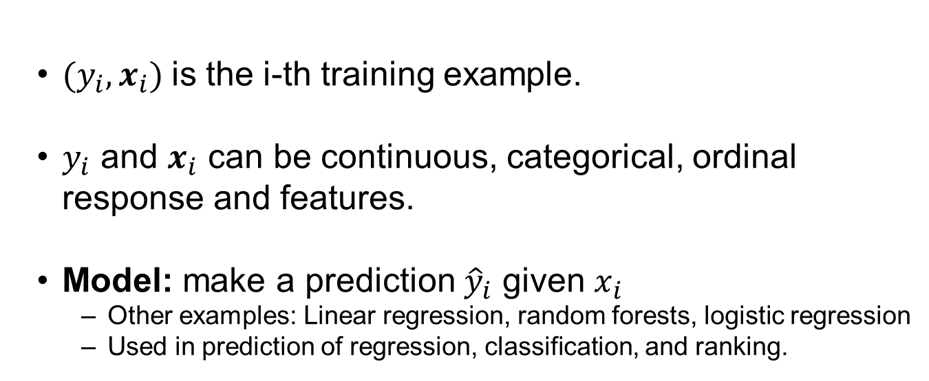
When to use XGBoost?
${(y}_{i},x_{i})$is the i-th training example.
$y_{i}$ and $x_{i}$ can be continuous, categorical, ordinal response and features.
Model: make a prediction ${\hat{y}}_{i}$ given $x_{i}$
Other examples: Linear regression, random forests, logistic regression
Used in prediction of regression, classification, and ranking.

Slide 4
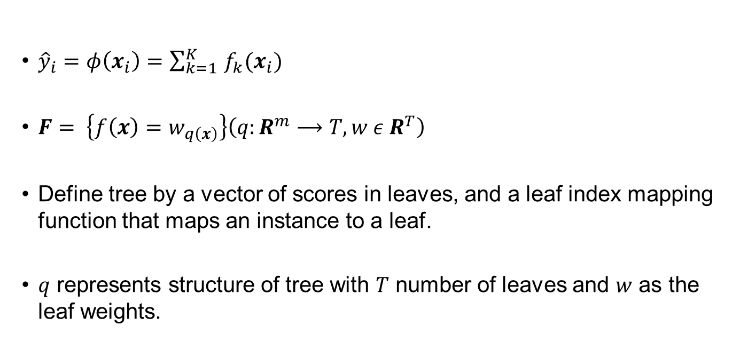
Tree Ensemble Model
${\hat{y}}_{i}=φ\left(x_{i}\right)=\sum_{k=1 }^{K}{f_{k}(x_{i})}$
$F= \left\{f\left(x\right)=w_{q\left(x\right)}\right\}\left(q:R^{m}⟶T,w ε R^{T}\right)$
Define tree by a vector of scores in leaves, and a leaf index mapping function that maps an instance to a leaf.
$q$ represents structure of tree with $T$ number of leaves and $w$ as the leaf weights.

Slide 5
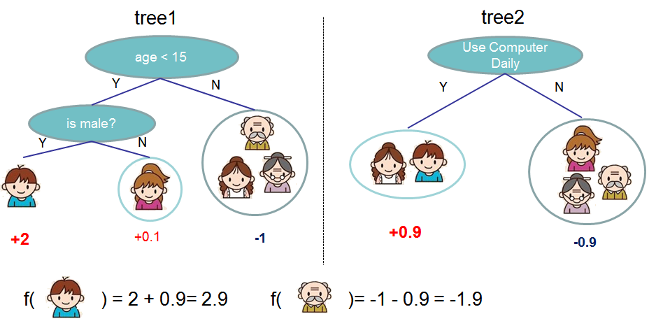

Slide 6
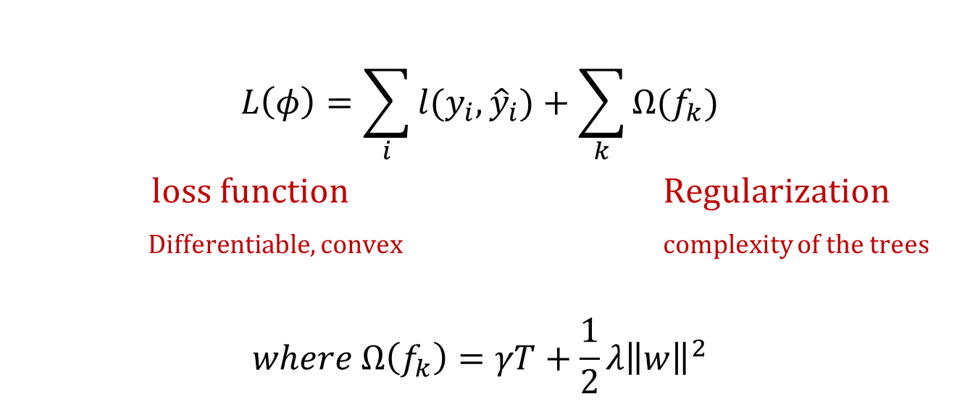
Objective Function
$$L\left(φ\right)=\sum_{i}{l(y_{i},{\hat{y}}_{i})}+\sum_{k}{Ω(f_{k})}$$
loss function Regularization
Differentiable, convex complexity of the trees
$$where Ω\left(f_{k}\right)=γT+\frac{1}{2}λ{\left\|w\right\|}^{2}$$

Slide 7
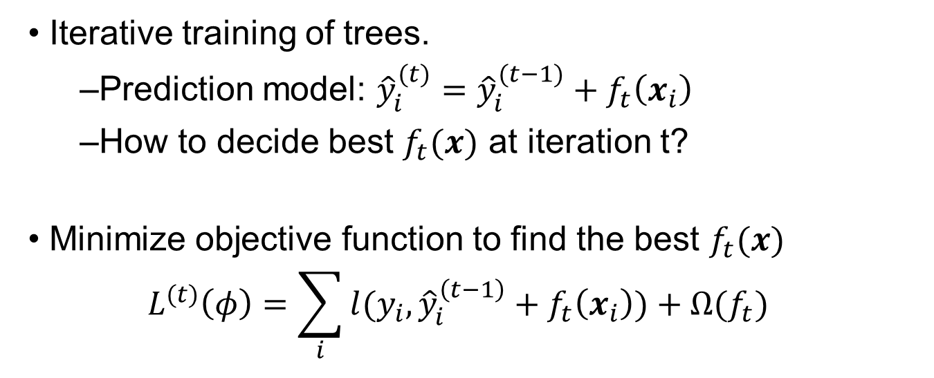
Gradient Tree Boosting
Iterative training of trees.
Prediction model: ${\hat{y}}_{i}^{(t)}={\hat{y}}_{i}^{(t−1)}+f_{t}\left(x_{i}\right)$
How to decide best $f_{t}(x)$ at iteration t?
Minimize objective function to find the best $f_{t}(x)$
$$L^{(t)}\left(φ\right)=\sum_{i}{l(y_{i},{\hat{y}}_{i}^{\left(t−1\right)}+f_{t}\left(x_{i}\right))}+Ω(f_{t})$$

Slide 8
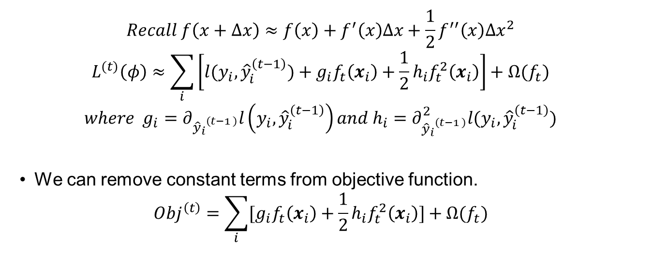
Loss Approximation with Taylor Series
$$Recall f\left(x+Δx\right)≈f\left(x\right)+f^{′}\left(x\right)∆x+\frac{1}{2}f^{′′}\left(x\right)∆x^{2}$$
$$L^{(t)}\left(φ\right)≈\sum_{i}{\left[l(y_{i},{\hat{y}}_{i}^{\left(t−1\right)})+g_{i}f_{t}\left(x_{i}\right)+\frac{1}{2}h_{i}f_{t}^{2}\left(x_{i}\right)\right]}+Ω(f_{t})$$
$$where g_{i}=∂_{{{\hat{y}}_{i}}^{\left(t−1 \right)}}l\left(y_{i},{\hat{y}}_{i}^{\left(t−1\right)}\right)and h_{i}=∂_{{{\hat{y}}_{i}}^{\left(t−1 \right)}}^{2}l(y_{i},{\hat{y}}_{i}^{\left(t−1\right)})$$
We can remove constant terms from objective function.
$$Obj^{\left(t\right)}=\sum_{i}{[g_{i}f_{t}\left(x_{i}\right)+\frac{1}{2}h_{i}f_{t}^{2}\left(x_{i}\right)]}+Ω(f_{t})$$

Slide 9
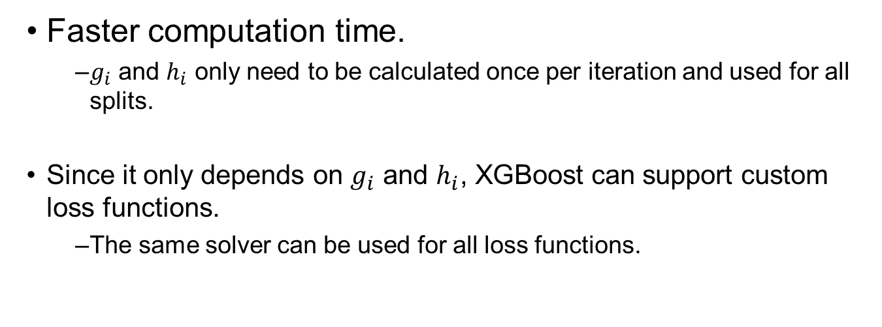
Why use this objective function?
Faster computation time.
$g_{i}$ and $h_{i}$ only need to be calculated once per iteration and used for all splits.
Since it only depends on $g_{i}$ and $h_{i}$, XGBoost can support custom loss functions.
The same solver can be used for all loss functions.

Slide 10
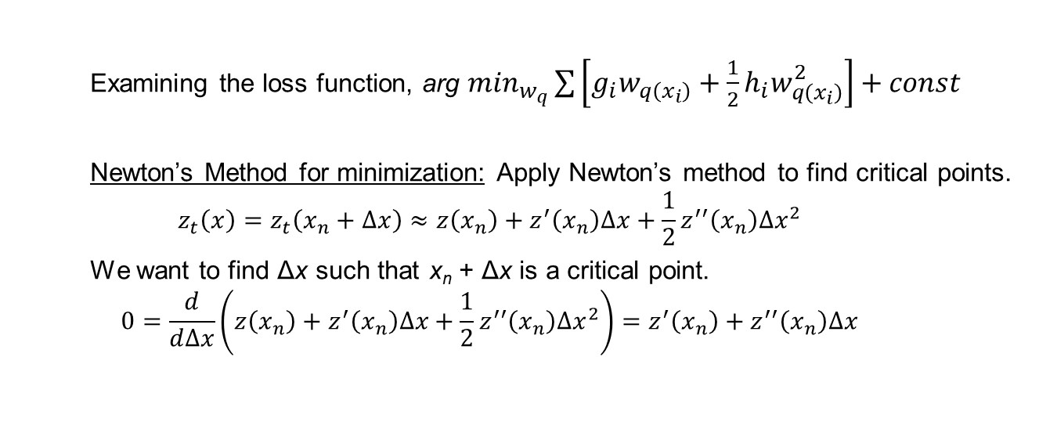
Why use this objective function?
Examining the loss function, arg $min_{w_{q}}\sum{\left[g_{i}w_{q\left(x_{i}\right)}+\frac{1}{2}h_{i}w_{q\left(x_{i}\right)}^{2}\right]}+const$
Newton’s Method for minimization: Apply Newton’s method to find critical points.
$$z_{t}\left(x\right)=z_{t}\left(x_{n}+∆x\right)≈z\left(x_{n}\right)+z^{′}\left(x_{n}\right)∆x+\frac{1}{2}z^{′′}\left(x_{n}\right)∆x^{2}$$
We want to find Δx such that x_{n} + Δx is a critical point.
$$0=\frac{d}{d∆x}\left(z\left(x_{n}\right)+z^{′}\left(x_{n}\right)∆x+\frac{1}{2}z^{′′}\left(x_{n}\right)∆x^{2}\right)=z^{′}\left(x_{n}\right)+z^{′′}\left(x_{n}\right)∆x$$

Slide 11
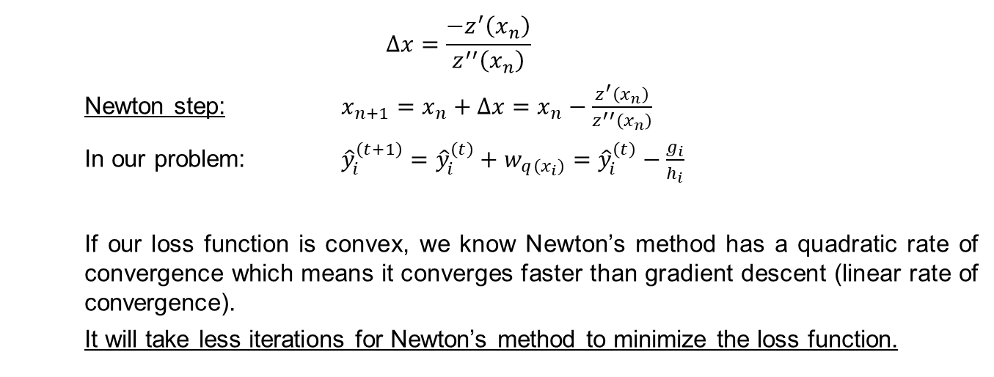
Why use this objective function?
$$∆x=\frac{{−z}^{′}\left(x_{n}\right)}{z^{′′}\left(x_{n}\right)}$$
Newton step: $x_{n+1}=x_{n}+∆x=x_{n}−\frac{z^{′}\left(x_{n}\right)}{z^{′′}\left(x_{n}\right)}$
In our problem: ${\hat{y}}_{i}^{\left(t+1\right)}={\hat{y}}_{i}^{\left(t\right)}+w_{q\left(x_{i}\right)}={\hat{y}}_{i}^{\left(t\right)}−\frac{g_{i}}{h_{i}}$
If our loss function is convex, we know Newton’s method has a quadratic rate of convergence which means it converges faster than gradient descent (linear rate of convergence).
It will take less iterations for Newton’s method to minimize the loss function.

Slide 12
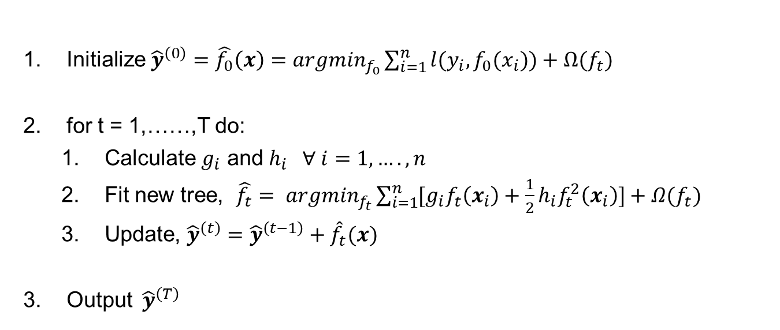
Recap of the XGBoost Algorithm
Initialize ${\hat{y}}^{\left(0\right)}=\hat{f_{0}}\left(x\right)=argmin_{f_{0}}\sum_{i=1}^{n}{l(y_{i},f_{0}(x_{i}))}+Ω(f_{t})$
for t = 1,……,T do:
Calculate $g_{i}$ and $h_{i} ∀ i=1,….,n$
Fit new tree, $\hat{f_{t}}= argmin_{f_{t}}\sum_{i=1}^{n}{[g_{i}f_{t}\left(x_{i}\right)+\frac{1}{2}h_{i}f_{t}^{2}\left(x_{i}\right)]}+Ω(f_{t})$
Update, ${\hat{y}}^{\left(t\right)}={\hat{y}}^{\left(t−1\right)}+{\hat{f}}_{t}(x)$
Output ${ \hat{y}}^{\left(T\right)}$

Slide 13
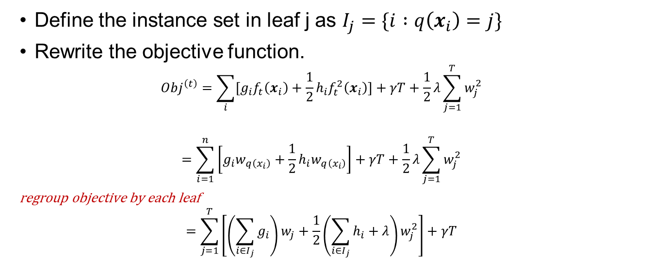
Objective Function for CART
Define the instance set in leaf j as $I_{j}=\{i :q\left(x_{i}\right)=j\}$
Rewrite the objective function.
$$Obj^{\left(t\right)}=\sum_{i}{[g_{i}f_{t}\left(x_{i}\right)+\frac{1}{2}h_{i}f_{t}^{2}\left(x_{i}\right)]}+γT+\frac{1}{2}λ\sum_{j=1}^{T}{w_{j}^{2}}$$
$$=\sum_{i=1}^{n}{\left[g_{i}w_{q\left(x_{i}\right)}+\frac{1}{2}h_{i}w_{q\left(x_{i}\right)}\right]}+γT+\frac{1}{2}λ\sum_{j=1}^{T}{w_{j}^{2}}$$
regroup objective by each leaf
$$=\sum_{j=1}^{T}{\left[\left(\sum_{i∈I_{j}}{g_{i}}\right)w_{j}+\frac{1}{2}\left(\sum_{i∈I_{j}}{h_{i}+λ}\right)w_{j}^{2}\right]+γT}$$

Slide 14
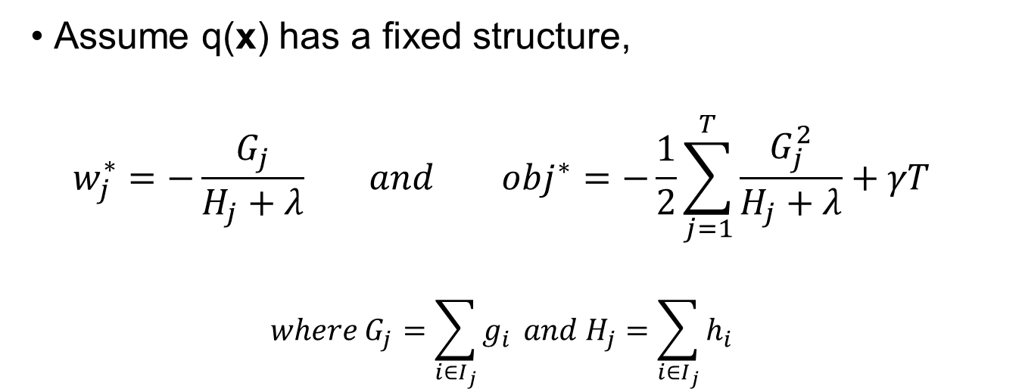
Score the Tree Structure
Assume q(x) has a fixed structure,
$$w_{j}^{∗}=−\frac{G_{j}}{H_{j}+λ} and obj^{∗}=−\frac{1}{2}\sum_{j=1}^{T}{\frac{G_{j}^{2}}{H_{j}+λ}}+γT$$
$$where G_{j}=\sum_{i∈I_{j}}{g_{i}} and H_{j}=\sum_{i∈I_{j}}{h_{i}}$$

Slide 15
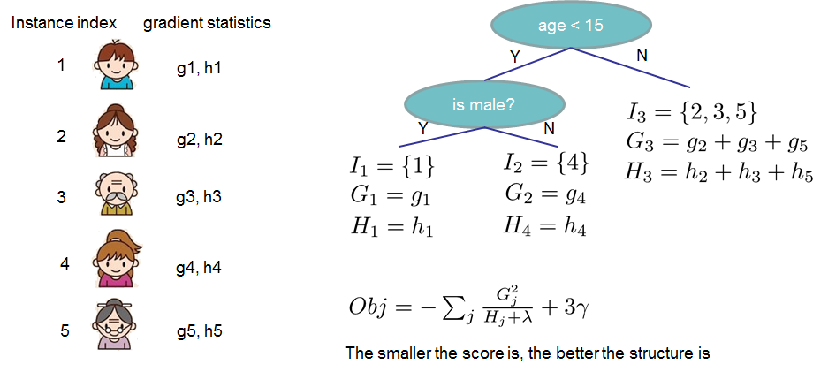

Slide 16
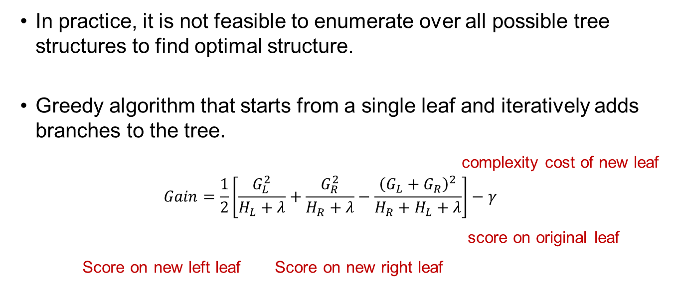
Finding Optimal Tree Structure
In practice, it is not feasible to enumerate over all possible tree structures to find optimal structure.
Greedy algorithm that starts from a single leaf and iteratively adds branches to the tree.
complexity cost of new leaf
$$Gain=\frac{1}{2}\left[\frac{G_{L}^{2}}{H_{L}+λ}+\frac{G_{R}^{2}}{H_{R}+λ}−\frac{{\left(G_{L}+G_{R}\right)}^{2}}{H_{R}+H_{L}+λ}\right]−γ$$
score on original leaf
Score on new left leaf Score on new right leaf

Slide 17
Split Finding Algorithms
Exact greedy algorithm – Potentially time-consuming for continuous variables.
Approximate greedy algorithm
Proposes candidate splitting points according to percentiles of feature distribution.
Maps the continuous features into buckets split by these candidate points.
Aggregates the statistics and ﬁnds the best solution among proposals based on the aggregated statistics.

Slide 18
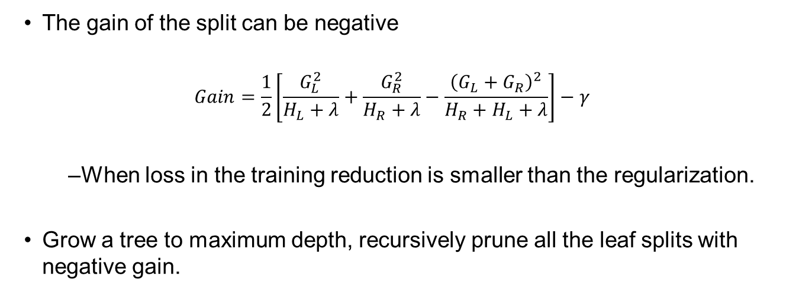
Pruning
The gain of the split can be negative
$$Gain=\frac{1}{2}\left[\frac{G_{L}^{2}}{H_{L}+λ}+\frac{G_{R}^{2}}{H_{R}+λ}−\frac{{\left(G_{L}+G_{R}\right)}^{2}}{H_{R}+H_{L}+λ}\right]−γ$$
When loss in the training reduction is smaller than the regularization.
Grow a tree to maximum depth, recursively prune all the leaf splits with negative gain.

Slide 19
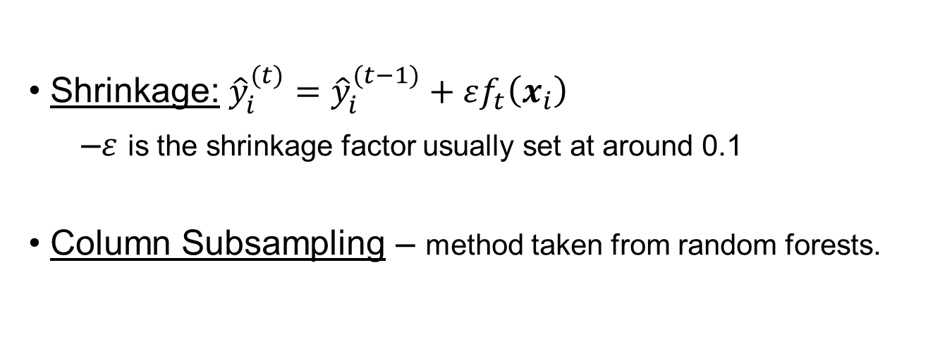
Shrinkage and Column Subsampling
Shrinkage: ${\hat{y}}_{i}^{(t)}={\hat{y}}_{i}^{(t−1)}+εf_{t}\left(x_{i}\right)$
$ε$ is the shrinkage factor usually set at around 0.1
Column Subsampling – method taken from random forests.

Slide 20
Data Analysis
Higgs boson dataset
Monte Carlo Simulations of physics events.
Contains 21 kinematic properties measured by accelerator.
Also contains 7 additional derived physical properties
Task is to classify whether an event corresponds to the Higgs Boson.

Slide 21
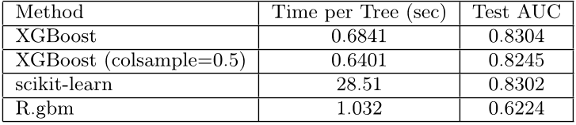
Comparison of Exact Greedy Methods

Slide 22
Conclusion
Tree Boosting System designed for speed and high predictive accuracy.
Designed to handle large data sets.
XGBoost can be implemented in R, Python, and Julia.

