Slide 1
Hopfield Network with Expected Value
(k-Bit Recurrence Model – kBRM)
forecasting binary payment streams, the R way
110
101
010
100
000
001
011
111
Kevin Hon Yin Hau (9 July 2026)
built with dplyr

Slide 2
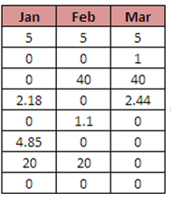
The problem
Forecasting a stream of monthly payments that are either made or missed
How to model decline curve for non-performing customer when they don’t have decline curve?
Amy
Beth
Tradition method:
Use decline curve based on decline rate from last 3 months payment pattern. ‘111’ (three paid in a row) behaves very differently from ‘001' (paid but missed before). Basically, Markov chain with last month only.
What modellers use:
Decline curves fit by hand, one per portfolio. No distribution, no confidence intervals. Good enough but can’t do anything when there is no decline rate for non-performing customer.
Cat
Dan
Eve
Frank
Guy
Hugo
kBRM · Kevin Hau · github.com/KevinHY-Hau/k-Bit_Recurrence_Model
2

Slide 3
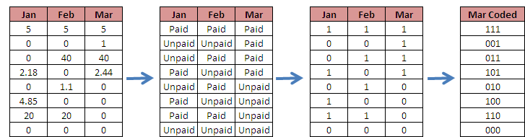
The idea
Treat the last k months as a binary string
Take k = 3 months of history. Encode as 3-bit state. 8 possible states.
raw payments
paid / unpaid
1 / 0
3-bit codes
State ≠ current month — state = last k months. A '000' customer behaves nothing like a ‘110' customer, even if both missed last month.
kBRM · Kevin Hau · github.com/KevinHY-Hau/k-Bit_Recurrence_Model
3

Slide 4
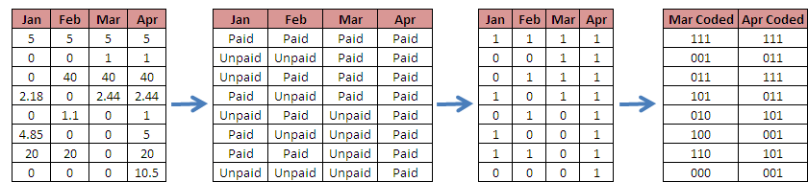
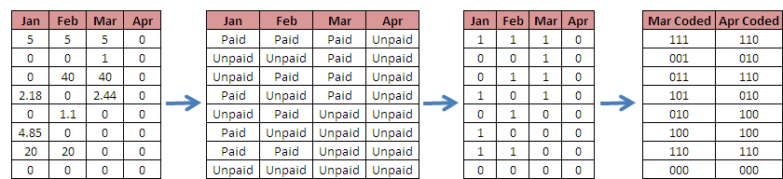
Next Move
Either Pay or Not
8 possible states -> 16 outcomes = 8 possible states
Pay
Not
Pay
kBRM · Kevin Hau · github.com/KevinHY-Hau/k-Bit_Recurrence_Model
3

Slide 5
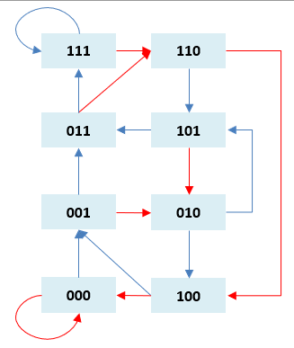
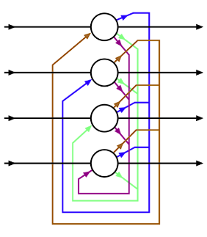
The Hopfield connection
Where the state-space structure comes from — the same eight states, seen in another field
What's a Hopfield network?
A classic recurrent neural network from 1982. A set of neurons, each either on or off — 1 or 0.
So the whole network's state is just a binary string — exactly like our k-bit code.
It updates step by step and settles into stored "memory" states — the attractors.
The link
A network of k neurons has 2^k possible states — the corners of a k-dimensional binary cube.
That is exactly our state space. k = 3 → 8 states → a 3-neuron Hopfield network.
The difference: Hopfield settles to one memory. The kBRM keeps the probabilities and counts payments over time.
Same binary state space, different question. Recognising this was what turned a spreadsheet trick into a proper model.
kBRM · Kevin Hau · github.com/KevinHY-Hau/k-Bit_Recurrence_Model

Slide 6
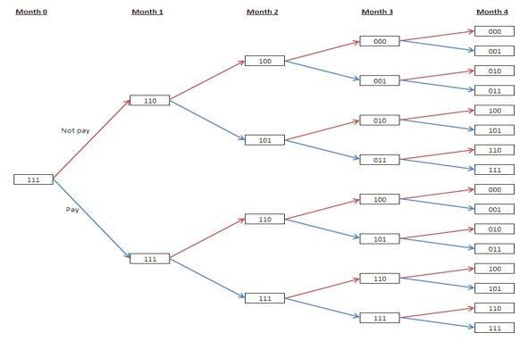
Why not a probability tree?
Branches every month → 2^{t} states in month t
At horizon t, a probability tree has...
t = 6
64 leaves
t = 12
4,096 leaves
t = 24
16,777,216 leaves
t = 36
68,719,476,736 leaves
The kBRM collapses this to just 2^{k} · (t+1) rows — 200 rows at t=24 for k=3.
Standard binary tree: 2^{t} leaves at month t
kBRM · Kevin Hau · github.com/KevinHY-Hau/k-Bit_Recurrence_Model
4

Slide 7
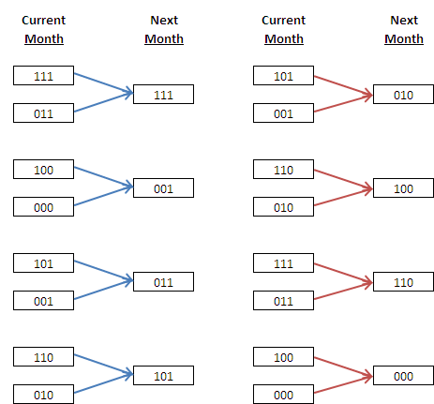
The collapse
Different paths, same state — merge their probabilities based on number of payments and code
In dplyr, one line:
tbl %>%
group_by(numStep, code, payNum) %>%
summarise(prob = sum(prob))
Why it works:
Two different payment paths that arrive at the same (code, payNum) tuple are indistinguishable for future forecasting. Their probabilities just add.
Result: state space bounded by 2^{k} · (t+1). Linear in horizon. Exact, not approximate.
k = 3: pairs of current-month states lead to the same next-month state
kBRM · Kevin Hau · github.com/KevinHY-Hau/k-Bit_Recurrence_Model
5

Slide 8
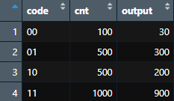
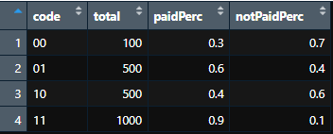
Minimal working example
From parameters to a payment curve in nine lines
library(dplyr)
# parameter table: code, count, paid count
x <- data.frame(
code = c(“00", “01", "10", “11"),
cnt = c(100, 500, 500, 1000),
output = c( 30, 300, 200, 900)
)
y <- getCodeTbl(x)
# full joint distribution over 24 months
dist <- getPymtPercTbl(y, numMth = 24)
# payment curve D(t)
curve <- getModelDeclineCurve(dist)
x
y
No loops to write. No matrix to build. dplyr does the heavy lifting.
kBRM · Kevin Hau · github.com/KevinHY-Hau/k-Bit_Recurrence_Model
7

Slide 9
The whole thing is four functions
Each doing one job
paidOrNotNext()
paidOrNotPaid()
One step forward.
Full horizon from one starting state.
Takes current-step distribution → returns next-step. The shift-register, the group-by, done.
Loops over n months. Handles static or cyclostationary params. Absorbing barrier built in.
getPymtPercTbl()
getModelDeclineCurve()
Runs every starting state, combines.
Post-processing only.
Returns the full joint distribution P(N_t = m, S_t = s). This is the one table everything derives from.
Expected payments + marginal payment curve D(t). No modelling — just sums and a lag.
kBRM · Kevin Hau · github.com/KevinHY-Hau/k-Bit_Recurrence_Model
6

Slide 10
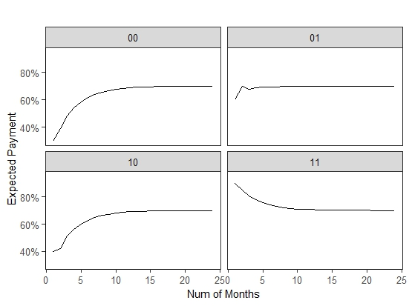
Decline/Growth Curves
Same model, four starting states, different shapes
11
declines from ~90% to ~70%
classic decline
10 / 01
rises then flattens
transitional
00
rises from ~5% to ~70%
growth curve
One model → a decline curve AND a growth curve. Useful for recovery on delinquent accounts.
kBRM · Kevin Hau · github.com/KevinHY-Hau/k-Bit_Recurrence_Model
8

Slide 11
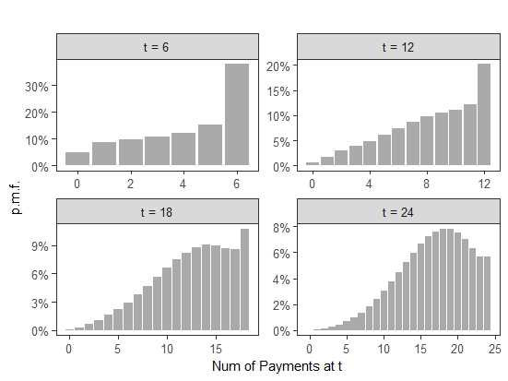
You get the whole distribution, free
Not just E[N_{t}] — the full probability density function at every step
Because the algorithm propagates probabilities (not samples), you get analytically:
E[N_{t}]
expected payments
Var[N_{t}]
variance, any moment
Q_α(t)
any quantile
95% CI
[Q_{0.025}, Q_{0.975}]
P(tail)
stress-test tail probs
No bootstrap. No MCMC. No simulation.
Easy to include maturity
kBRM · Kevin Hau · github.com/KevinHY-Hau/k-Bit_Recurrence_Model
9

Slide 12
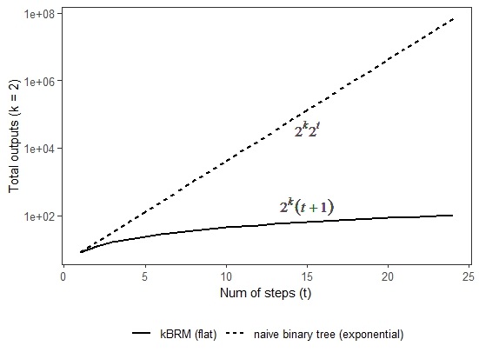
How fast is it?
Linear vs exponential
kBRM
O(2^{k} · t · n)
linear in horizon. For k=3, ~200 rows at 24 months
Naïve tree
O(2^{t})
exponential. 16.8 million nodes at t=24.
Your laptop won't make it.
kBRM · Kevin Hau · github.com/KevinHY-Hau/k-Bit_Recurrence_Model
10

Slide 13
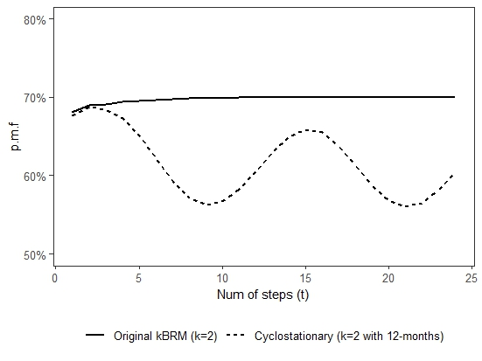
What cyclostationary looks like
Static vs 12-month cycle
Same base parameters.
Same algorithm.
Add a sine wave to paidPerc.
cycle_adj <- 0.95 +
0.05 * sin(
2 * t * pi / 12
)
# join to y, apply
# to paidPerc
kBRM · Kevin Hau · github.com/KevinHY-Hau/k-Bit_Recurrence_Model
12

Slide 14
Live demo
Shiny App
https://kevinhyhau.shinyapps.io/k_Bit_Recurrence_Model/
editable table
2/3/4-bit history
rhandsontable — type your counts, hit Run
slider: k = 2 (4 states), 3 (8), 4 (16)
up to 24 months
interactive plots
horizon slider, any starting portfolio
plotly — hover, zoom, faceted by startCode
kBRM · Kevin Hau · github.com/KevinHY-Hau/k-Bit_Recurrence_Model
13

Slide 15
Shiny app structure
~370 lines
Packages
The reactive flow
shiny
UI + reactivity
1
user moves slider → renderRHandsontable fires
shinythemes
cosmo theme — clean look out of the box
2
user edits table in place
rhandsontable
editable Excel-like input table
3
user clicks Run → observeEvent(input$Run)
dplyr
all the data manipulation
4
validate counts, call getModelDeclineCurve()
ggplot2 / plotly
interactive faceted charts
5
mix in ALL aggregate weighted by proportion
DiagrammeR
the Mermaid diagram on the About tab
6
render plotly charts + datatable tabs
kBRM · Kevin Hau · github.com/KevinHY-Hau/k-Bit_Recurrence_Model
14

Slide 16
Questions?
Kevin Hon Yin Hau
Chartered Statistician (RSS) · UK
GitHub
Paper
Contact
https://github.com/KevinHY-Hau/k-Bit_Recurrence_Model
A k-Bit Recurrence Model for Binary Payment Sequences (in progress)
kevinhyhau@gmail.com

Slide 17
The whole thing is four functions
Each doing one job
paidOrNotNext()
paidOrNotNext <- function(tbl, payCodeTbl) {
## Extract the most recent step and join payment probabilities.
## Shift the state code left by one position (drop oldest bit).
tbl_last <- tbl %>%
filter(numStep == max(tbl$numStep)) %>%
inner_join(payCodeTbl, c("code" = "code")) %>%
mutate(code = substr(code, 2, 1200))
out <- tbl %>% union_all(
## Paid branch: append '1', increment payNum,
## multiply probability by p(s).
tbl_last %>%
mutate(code = paste(code, "1", sep = ""),
payNum = payNum + 1,
prob = prob * paidPerc) %>%
union_all(
## Not-paid branch: append '0', payNum unchanged,
## multiply probability by q(s) = 1 - p(s).
tbl_last %>%
mutate(code = paste(code, "0", sep = ""),
prob = prob * notPaidPerc)
) %>%
mutate(numStep = numStep + 1) %>%
select(-paidPerc, -notPaidPerc)
)
## Collapse: sum probabilities over identical (numStep, code, payNum)
out %>%
group_by(numStep, code, payNum) %>%
summarise(prob = sum(prob)) %>% ungroup()
}
One step forward.
Takes current-step distribution → returns next-step. The shift-register, the group-by, done.
getPymtPercTbl()
Runs every starting state, combines.
Returns the full joint distribution P(N_t = m, S_t = s). This is the one table everything derives from.
kBRM · Kevin Hau · github.com/KevinHY-Hau/k-Bit_Recurrence_Model
6

Slide 18
The whole thing is four functions
Each doing one job
paidOrNotPaid <- function(startCode, payCodeTbl, numMth,
start_mth_num = 1) {
chk_cycle <- any(names(payCodeTbl) == "mth_num")
## Pre-select columns for static case.
if(!chk_cycle) pay_code<-payCodeTbl %>% select(code,paidPerc,notPaidPerc)
## Initialise: step 0, starting state, zero payments, probability = 1.
tbl <- data.frame(numStep = 0, code = startCode, payNum = 0, prob = 1)
for(i in seq_len(numMth)) {
## Cyclostationary: look up the parameter set for the current calendar
## month. The modular index maps any forecast horizon back to the
## correct month in the cycle.
if(chk_cycle) {
mth_idx <- ((start_mth_num + i) %% max(payCodeTbl$mth_num)) + 1
pay_code <- payCodeTbl %>%
filter(mth_num == mth_idx) %>%
select(code, paidPerc, notPaidPerc)
}
tbl <- paidOrNotNext(tbl, pay_code)
}
## Remove the step-0 initialisation row and add the startCode label.
tbl %>%
filter(numStep > 0) %>%
mutate(startCode = startCode) %>%
group_by(startCode, numStep, payNum) %>%
summarise(prob = sum(prob)) %>%
ungroup()
}
paidOrNotPaid()
Full horizon from one starting state.
Loops over n months. Handles static or cyclostationary params. Absorbing barrier built in.
getModelDeclineCurve()
Post-processing only.
Expected payments + marginal payment curve D(t). No modelling — just sums and a lag.
kBRM · Kevin Hau · github.com/KevinHY-Hau/k-Bit_Recurrence_Model
6

Slide 19
The whole thing is four functions
Each doing one job
paidOrNotNext()
paidOrNotPaid()
One step forward.
Full horizon from one starting state.
Takes current-step distribution → returns next-step. The shift-register, the group-by, done.
Loops over n months. Handles static or cyclostationary params. Absorbing barrier built in.
getPymtPercTbl()
getPymtPercTbl <- function(payCodeTbl, numMth,
start_mth_num = 1) {
unique_codes <- unique(payCodeTbl$code)
result <- paidOrNotPaid(unique_codes[1], payCodeTbl,
numMth, start_mth_num)
for(i in seq_along(unique_codes)[-1]) {
result <- union_all(result,
paidOrNotPaid(unique_codes[i], payCodeTbl,
numMth, start_mth_num))
}
result
}
Runs every starting state, combines.
Returns the full joint distribution P(N_{t} = m, S_{t} = s). This is the one table everything derives from.
kBRM · Kevin Hau · github.com/KevinHY-Hau/k-Bit_Recurrence_Model
6

Slide 20
The whole thing is four functions
Each doing one job
paidOrNotNext()
paidOrNotPaid()
One step forward.
Full horizon from one starting state.
Takes current-step distribution → returns next-step. The shift-register, the group-by, done.
Loops over n months. Handles static or cyclostationary params. Absorbing barrier built in.
getModelDeclineCurve <- function(pymtPercTbl) {
result <- pymtPercTbl %>%
group_by(startCode, numStep) %>%
summarise(expectedPayt = sum(payNum * prob)) %>% ungroup()
result %>% left_join(
result %>%
mutate(numStep = numStep + 1, expectedPaytLast = expectedPayt) %>%
select(startCode, numStep, expectedPaytLast),
by = c("startCode", "numStep")
) %>%
mutate(declineCurve = expectedPayt - coalesce(expectedPaytLast, 0)) %>%
select(-expectedPaytLast)
}
getModelDeclineCurve()
Post-processing only.
Expected payments + marginal payment curve D(t). No modelling — just sums and a lag.
kBRM · Kevin Hau · github.com/KevinHY-Hau/k-Bit_Recurrence_Model
6

