Slide 1


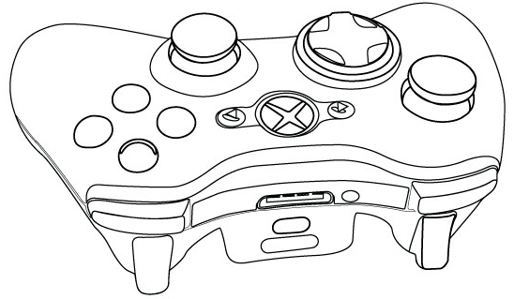
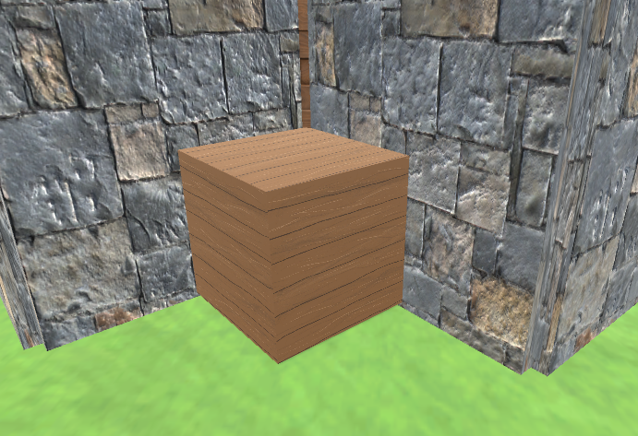


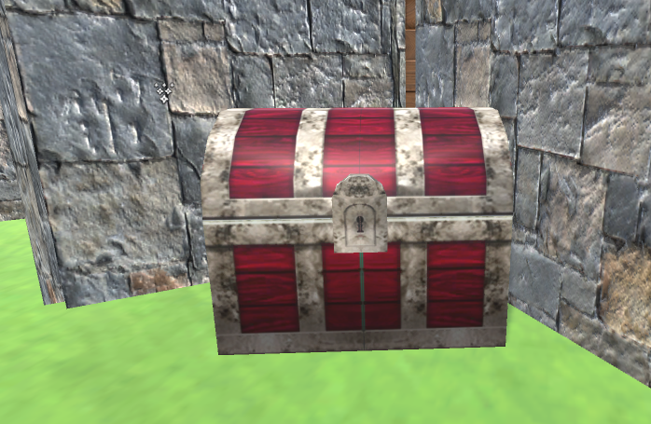



ColorMazing
ColorMazing
Navigate your robot through the maze.
Navigate your robot through the maze.
Choose colours for power-ups.
Choose colours for power-ups.
Destroy the wooden boxes to find power-ups.
Destroy the wooden boxes to find power-ups.
Power-Ups:
Power-Ups:
Switch two door colours.
Switch two door colours.
Switch two player colours.
Switch two player colours.
Find your key and open your treasure chest.
Find your key and open your treasure chest.
Give a player all colours.
You can’t use this for yourself!
Give a player all colours.
You can’t use this for yourself!
Stun a player.
Stun a player.

