Slide 1
A Walk in the Park
Created by Kevin Casas

Slide 2
Research and Observations

Slide 3
Initial Research
1. Benches
Benches are very low to the ground, dirty
No benches on the crossing path
2. User Retention
People mostly walk straight through the park
People usually don’t stick around to explore the park
3. Security
People think about the Back Bay Fens in a negative light

Slide 4
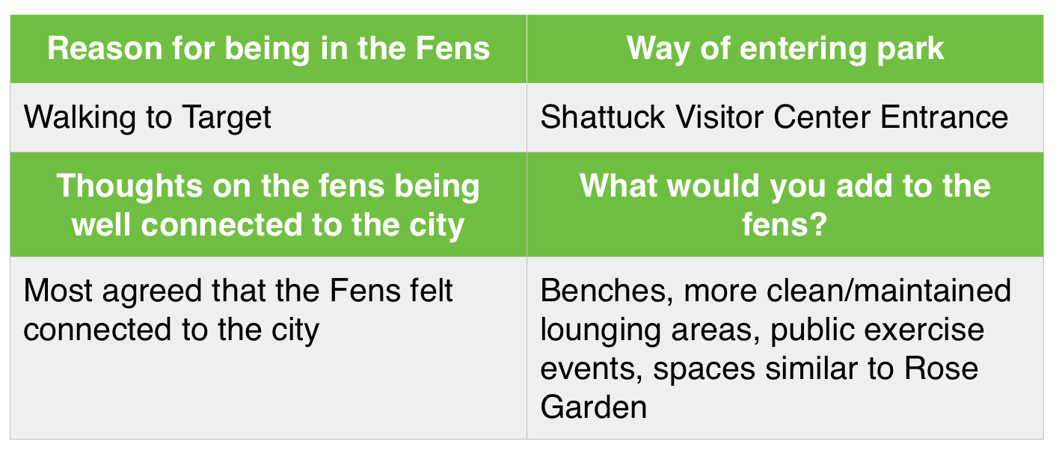
Common Answers in INterviews

Slide 5
Further Observations & Conclusion
Playground & Victory Gardens
No signs pointing to any locations in the park
Playground located in isolated location
Victory Gardens also set apart from everything
Conclusion
People use the park mostly for a passage to locations other than the park (eg. Target, Fenway Park)
People usually don’t stick around to explore the park

Slide 6
Starting Initial Design

Slide 7
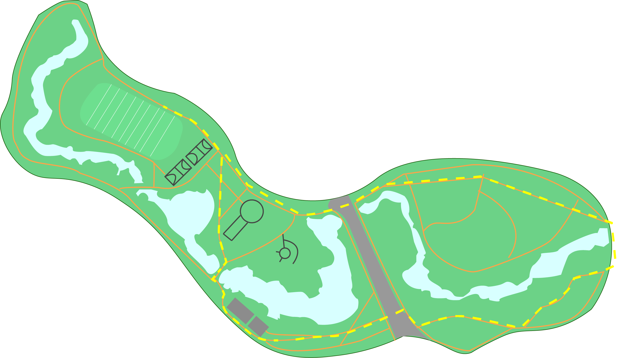
Wayfinding Station
Located at the entrances of every park in the Emerald Necklace
Creating a simplified view of the Emerald Necklace Park System
Showing information that is relevant to the user
Resistive touch-screen allows for use with any press, including gloved hands in the winter
The user can plot a destination and a path, and an RFID Tag will be distributed to the user

Slide 8
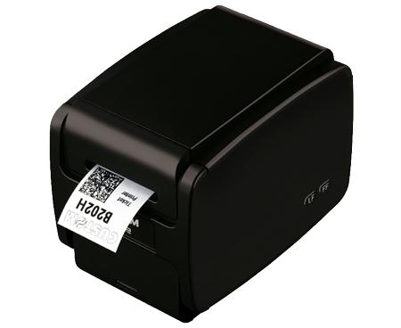
RFID Tags
Disposable tickets are embedded with the path and destination the user chose
The ticket will also be able to send data through the various markers along the path
This data can then be used to show information on the UI at the wayfinding stations, showing popular spots in the park or where an event is taking place

Slide 9
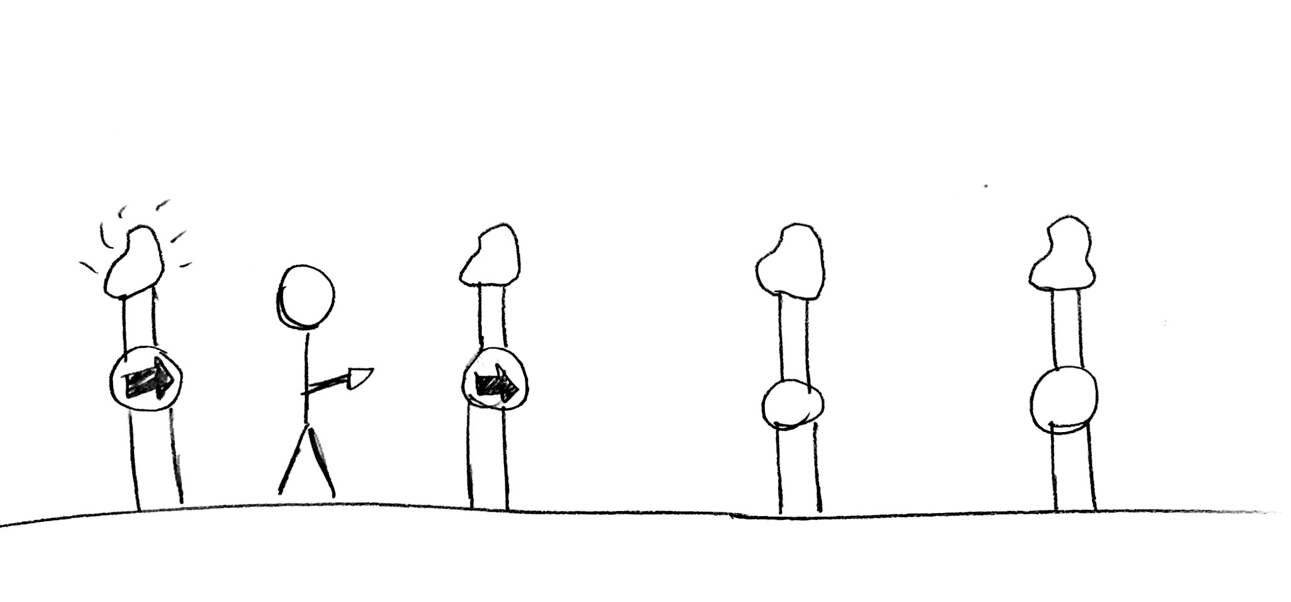
Guidance System
A companion that is guiding you to where you want to go
Takes away the need of having your phone out to navigate
Screens attached to light posts will activate once you get close enough with your RFID ticket
The screen shows an arrow that points in the direction of your destination
You can stop or pause your walk at any time by tapping your ticket against a screen

Slide 10
Final Designs

Slide 11
RFID Ticket

Slide 12
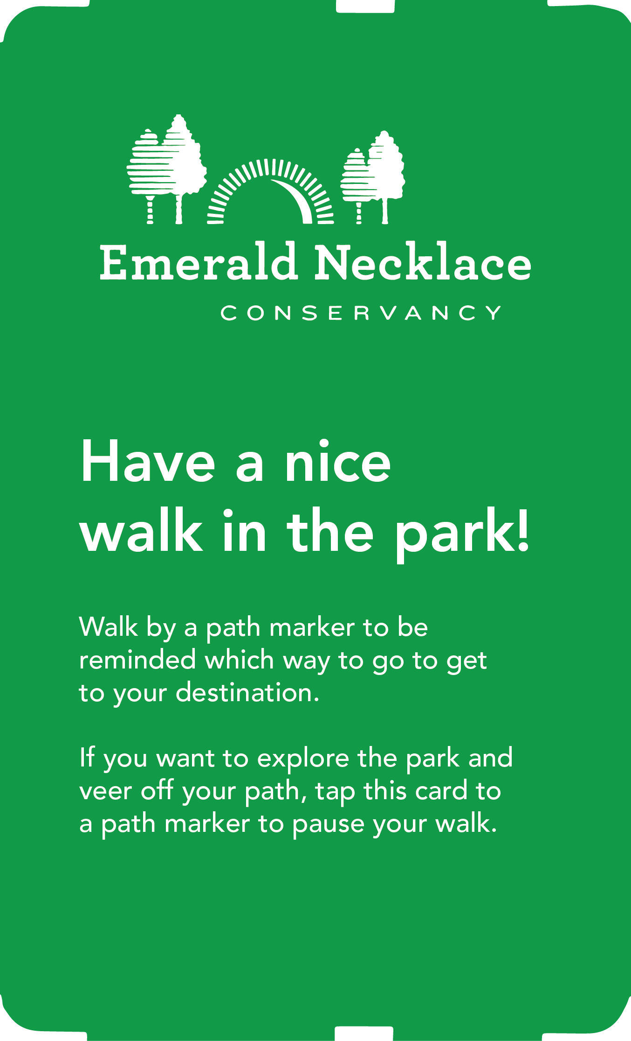

Slide 13
Wayfinding Interface

Slide 14
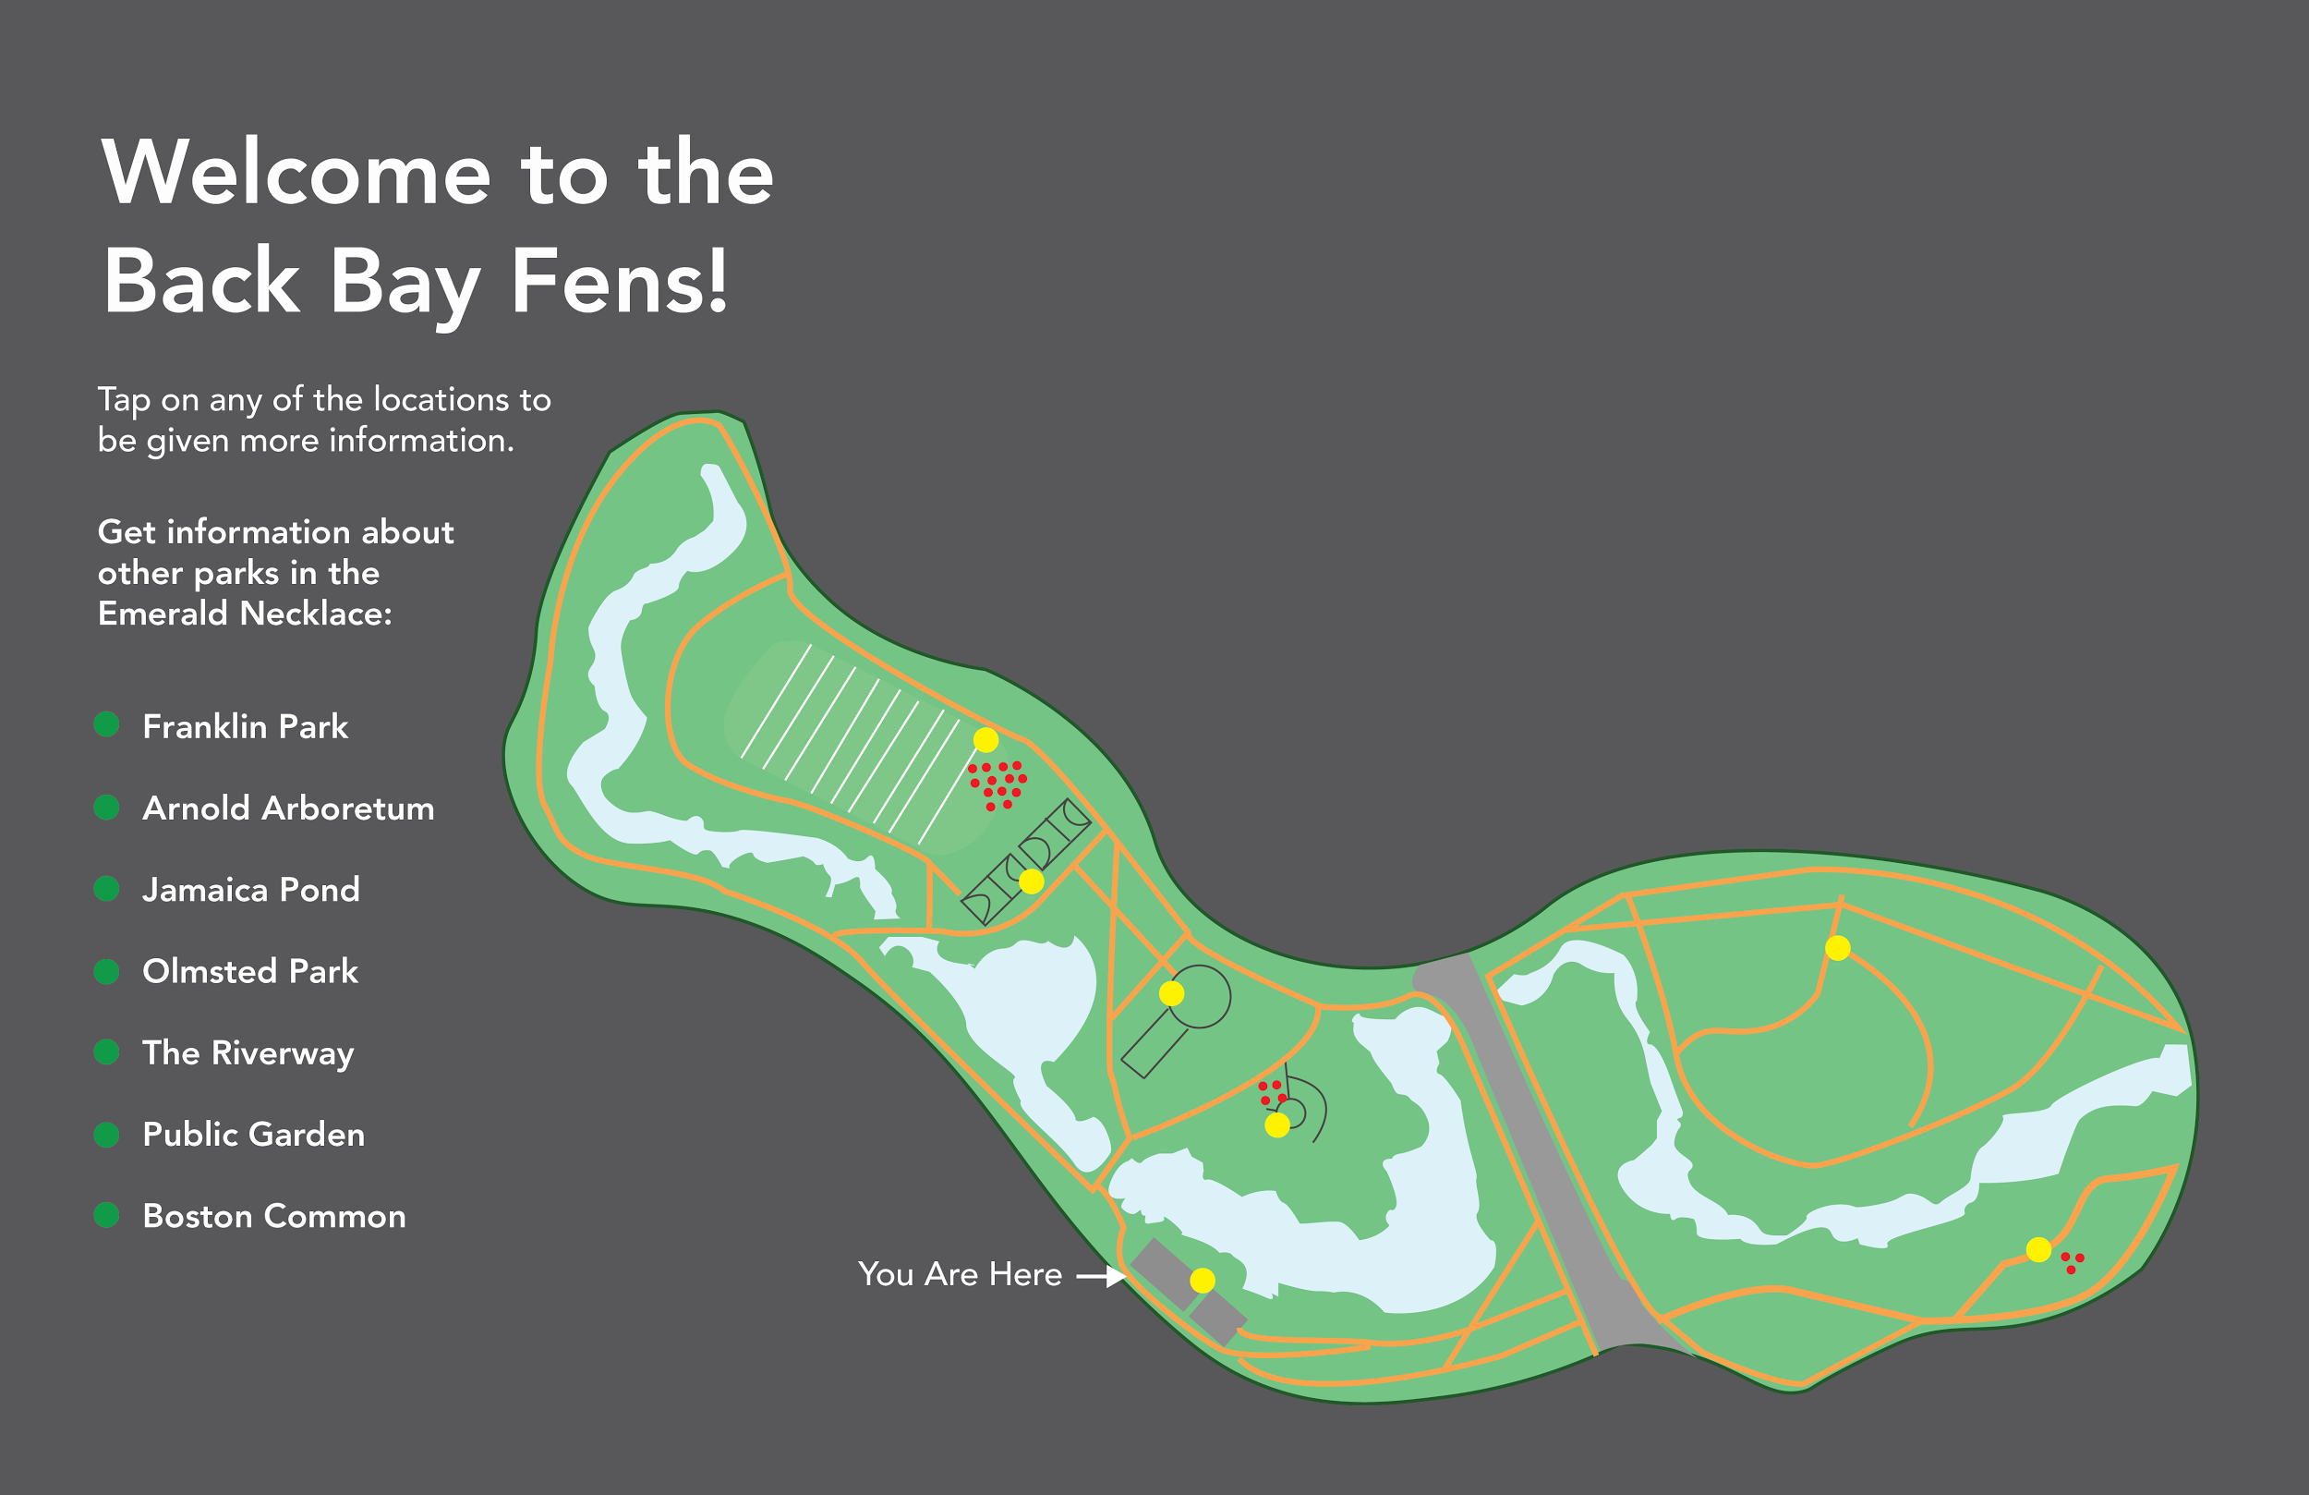

Slide 15
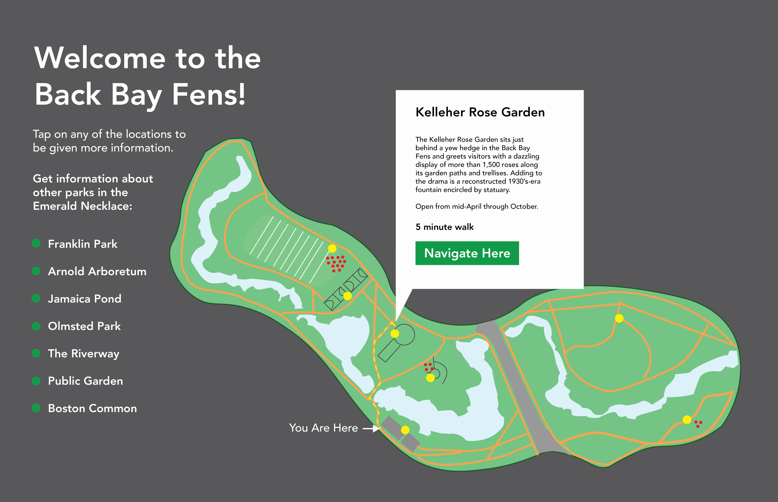

Slide 16
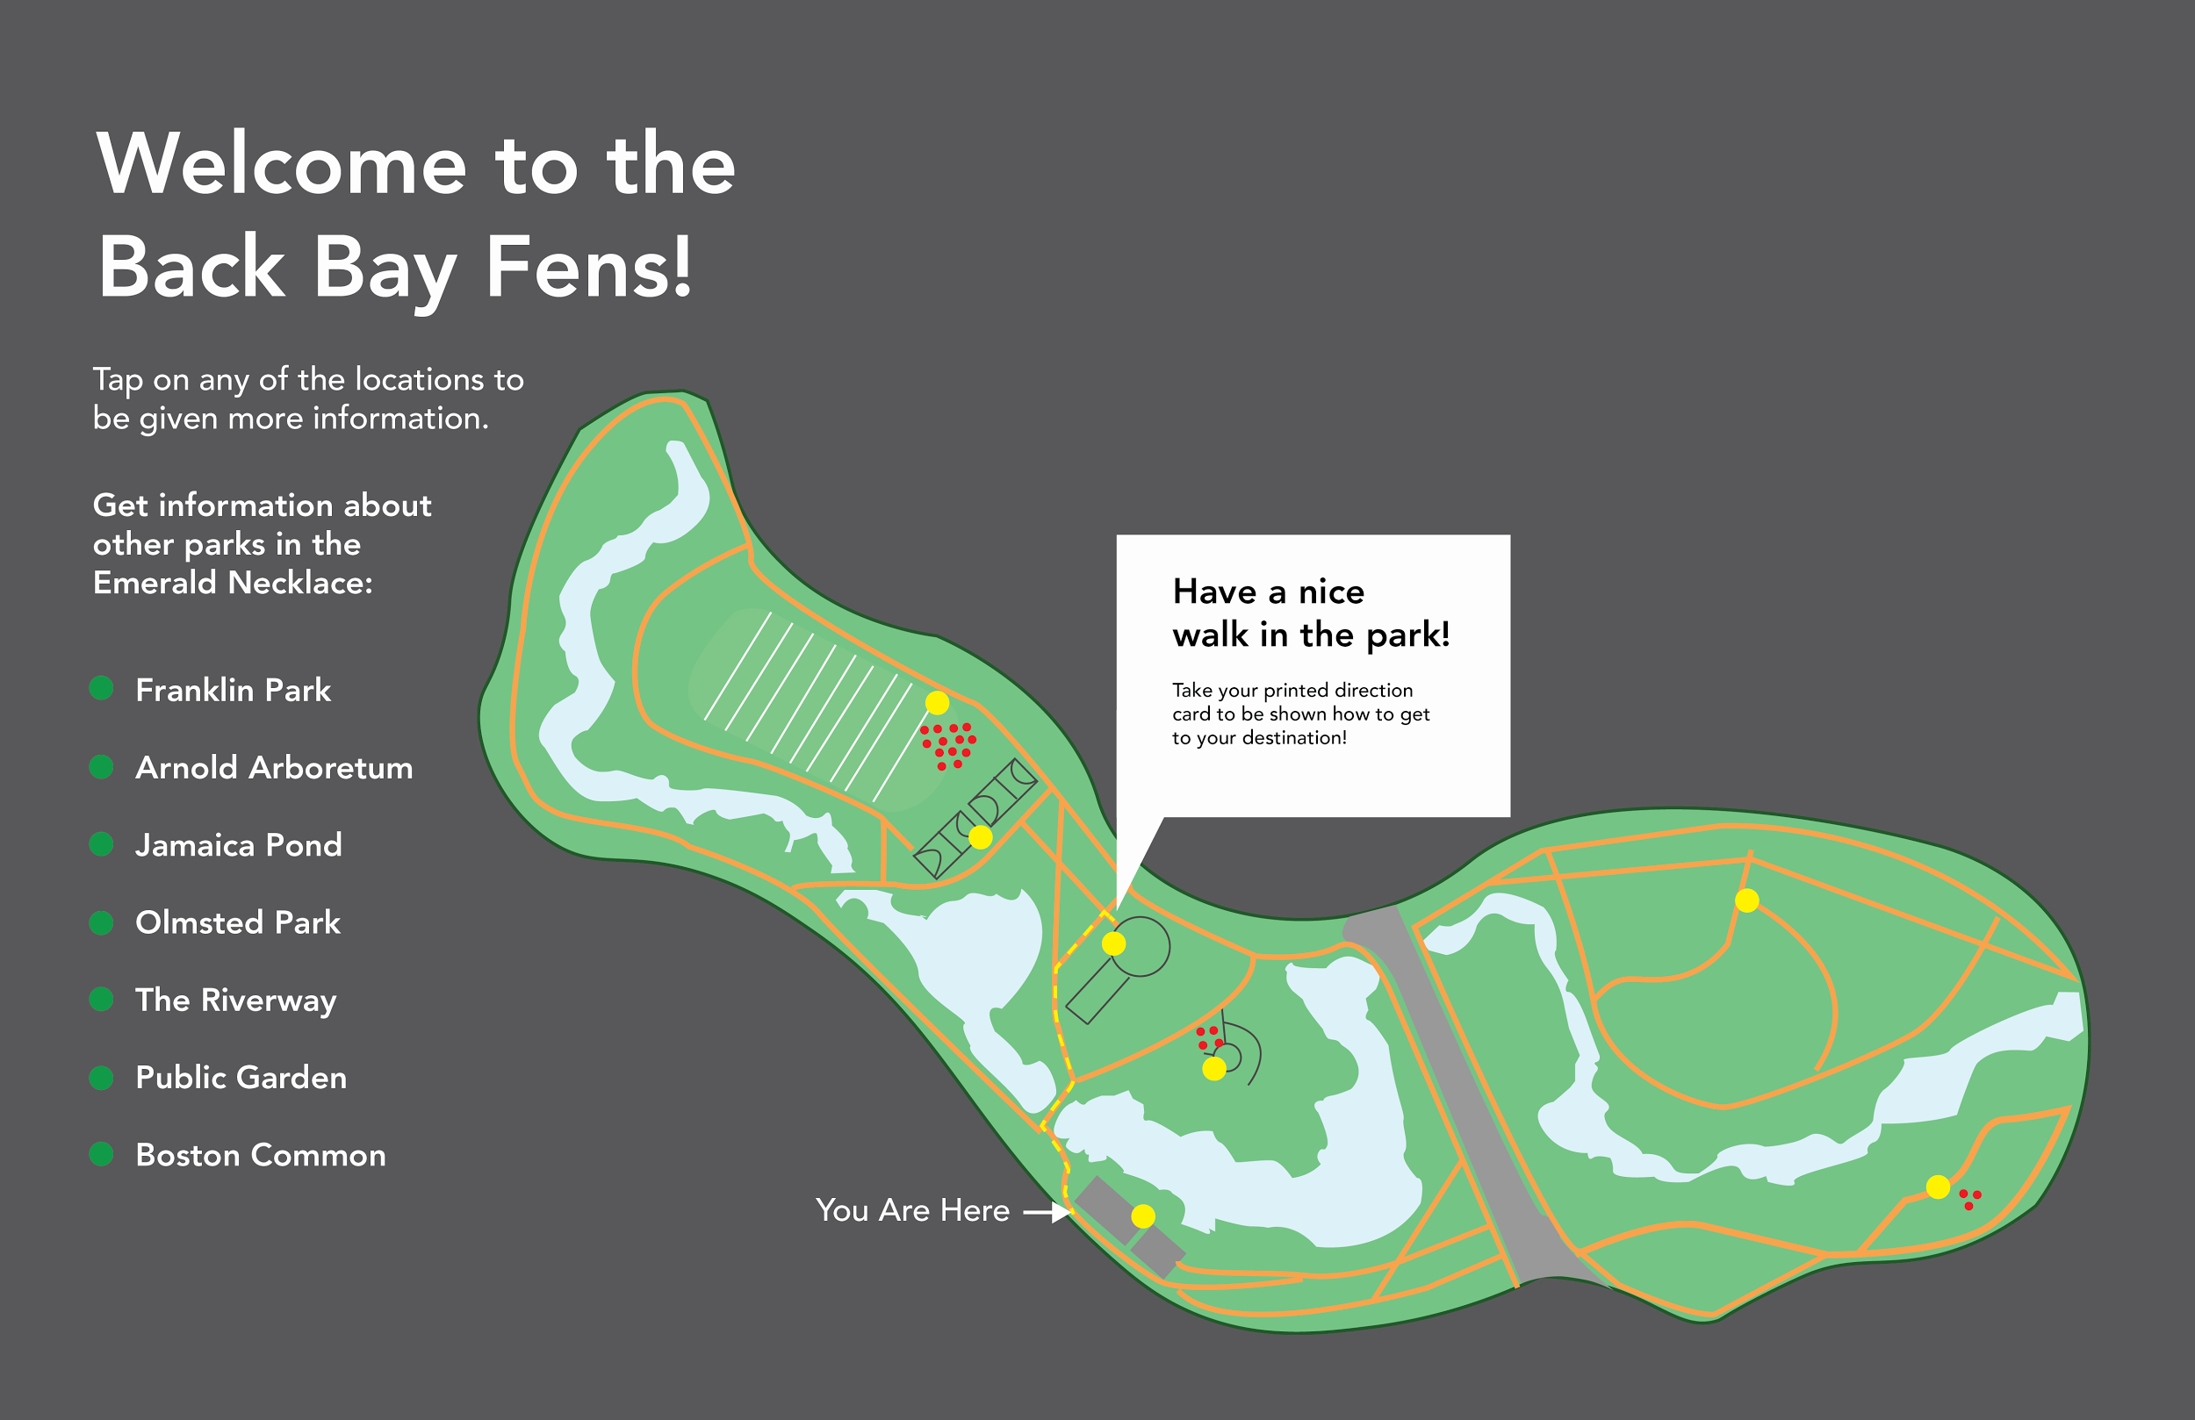

Slide 17
“A Walk in the Park” Experience

Slide 18
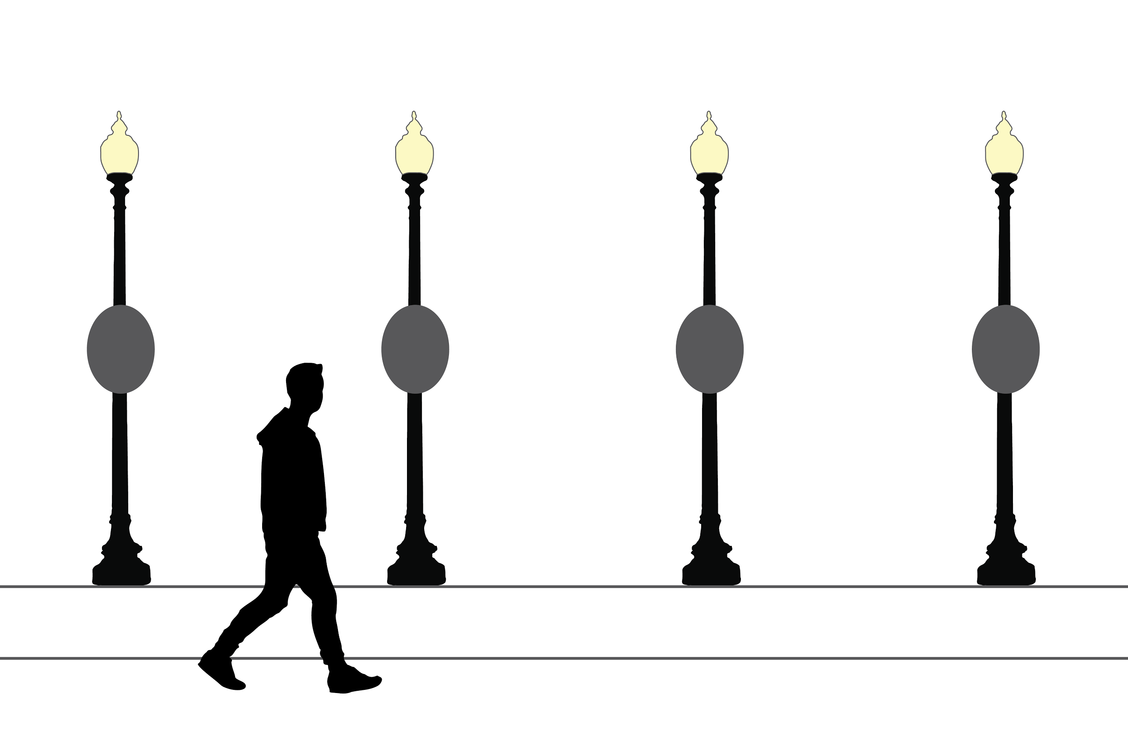

Slide 19
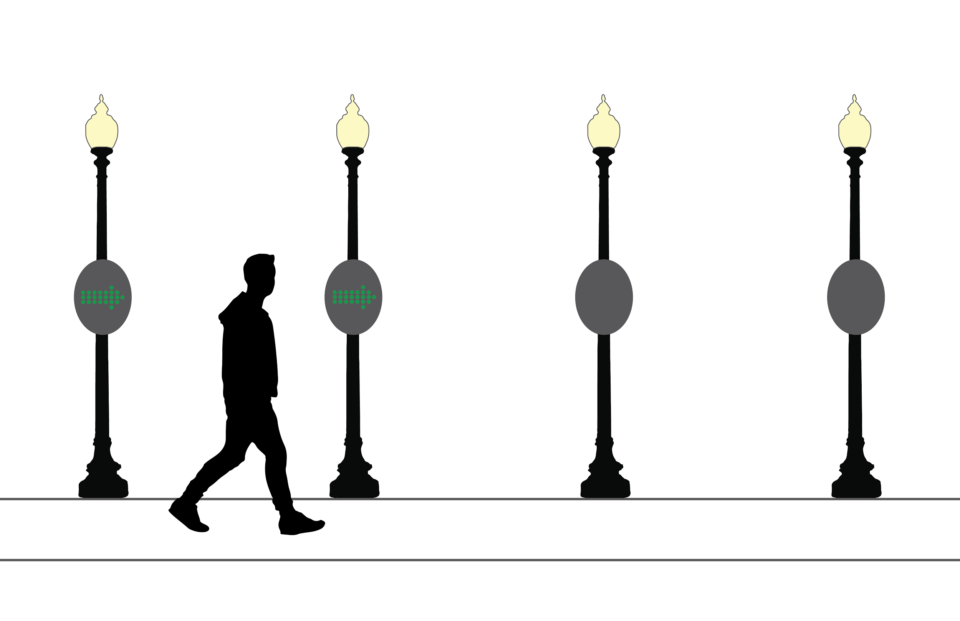

Slide 20
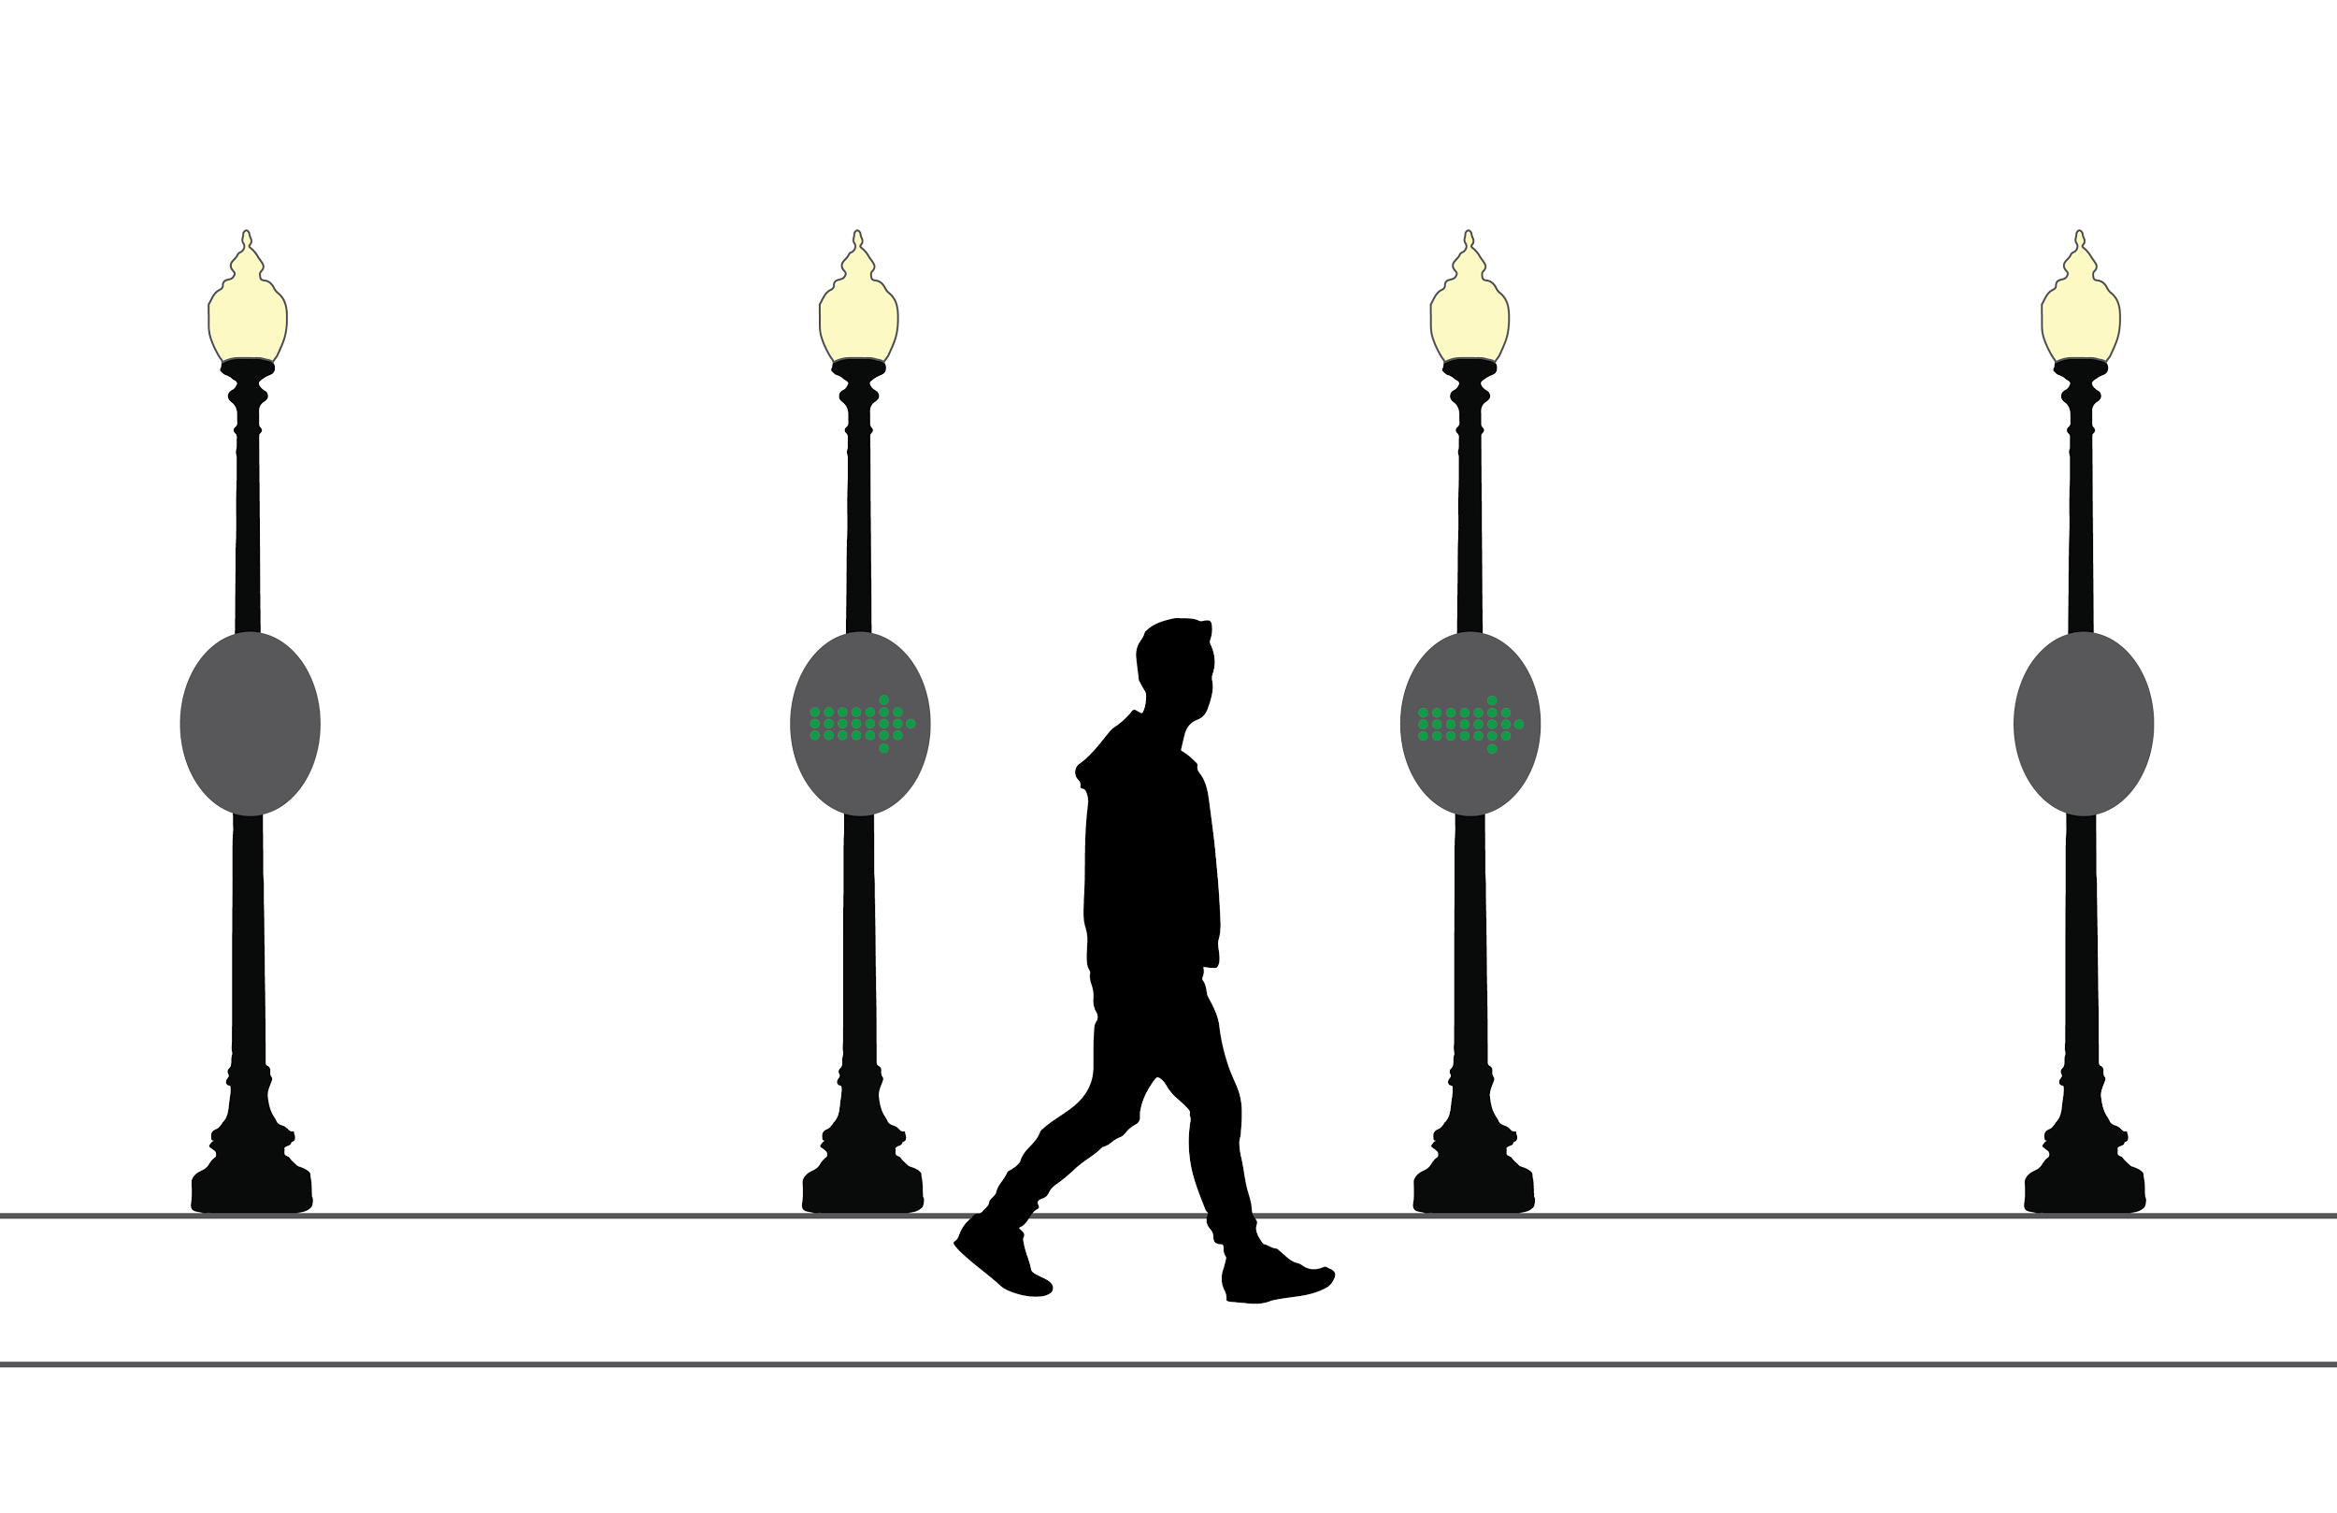

Slide 21
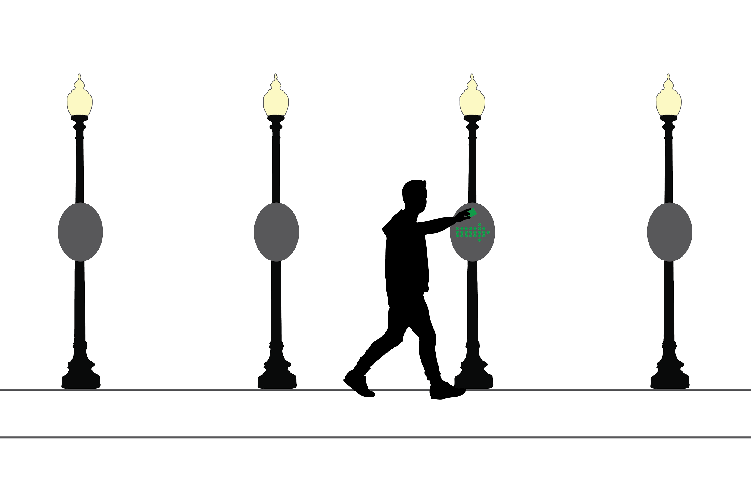

Slide 22
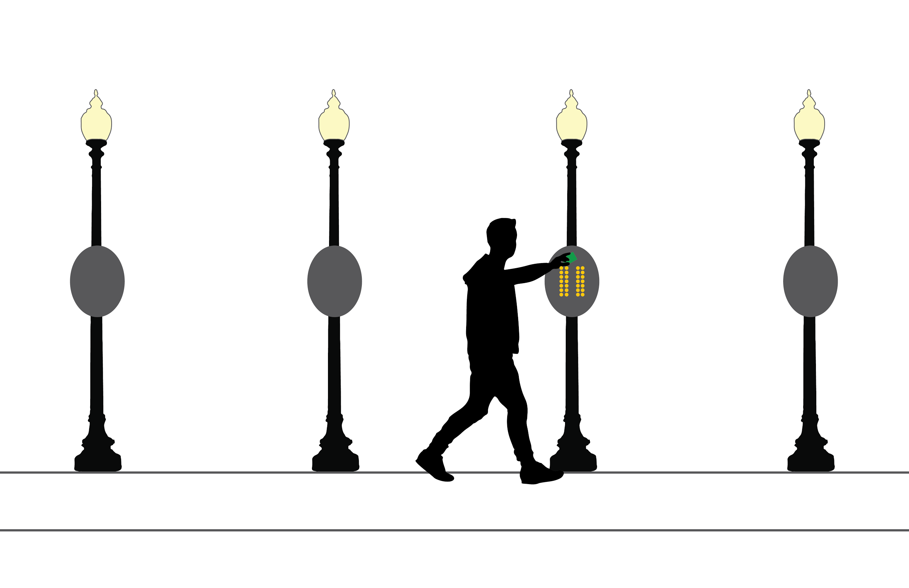

Slide 23
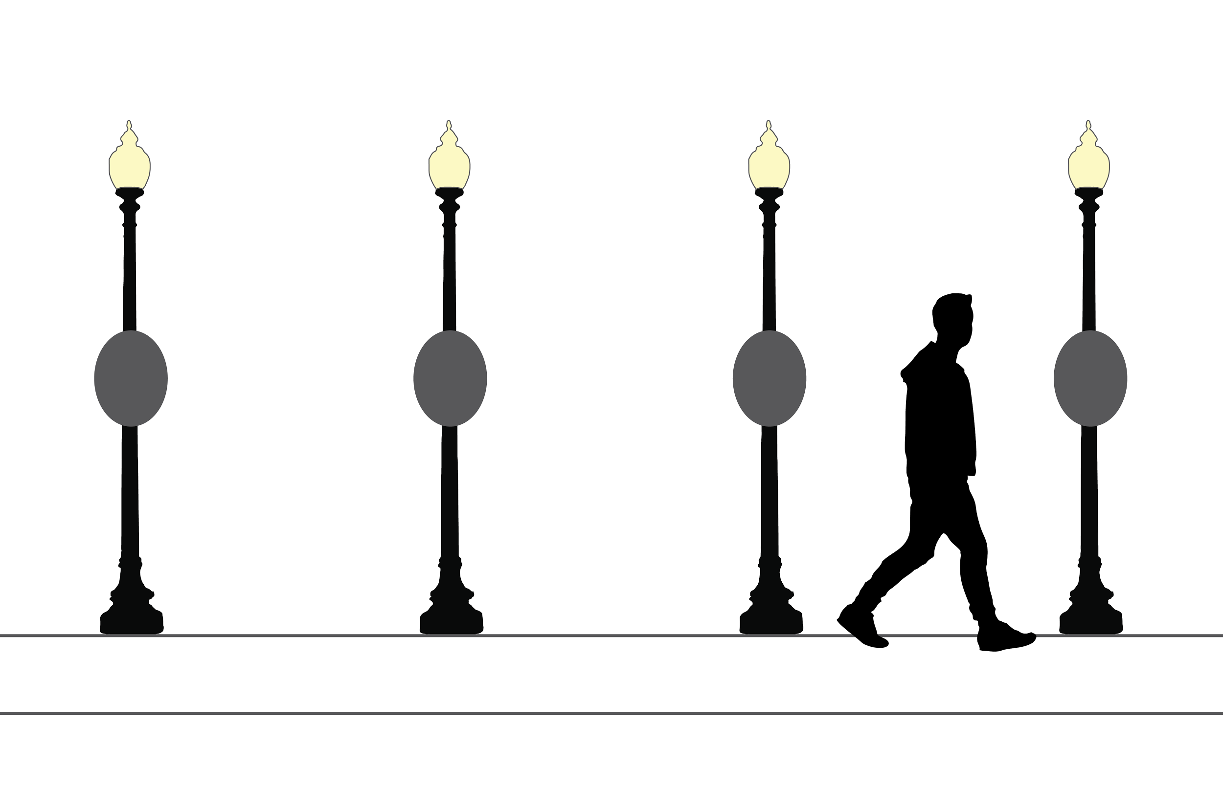

Slide 24
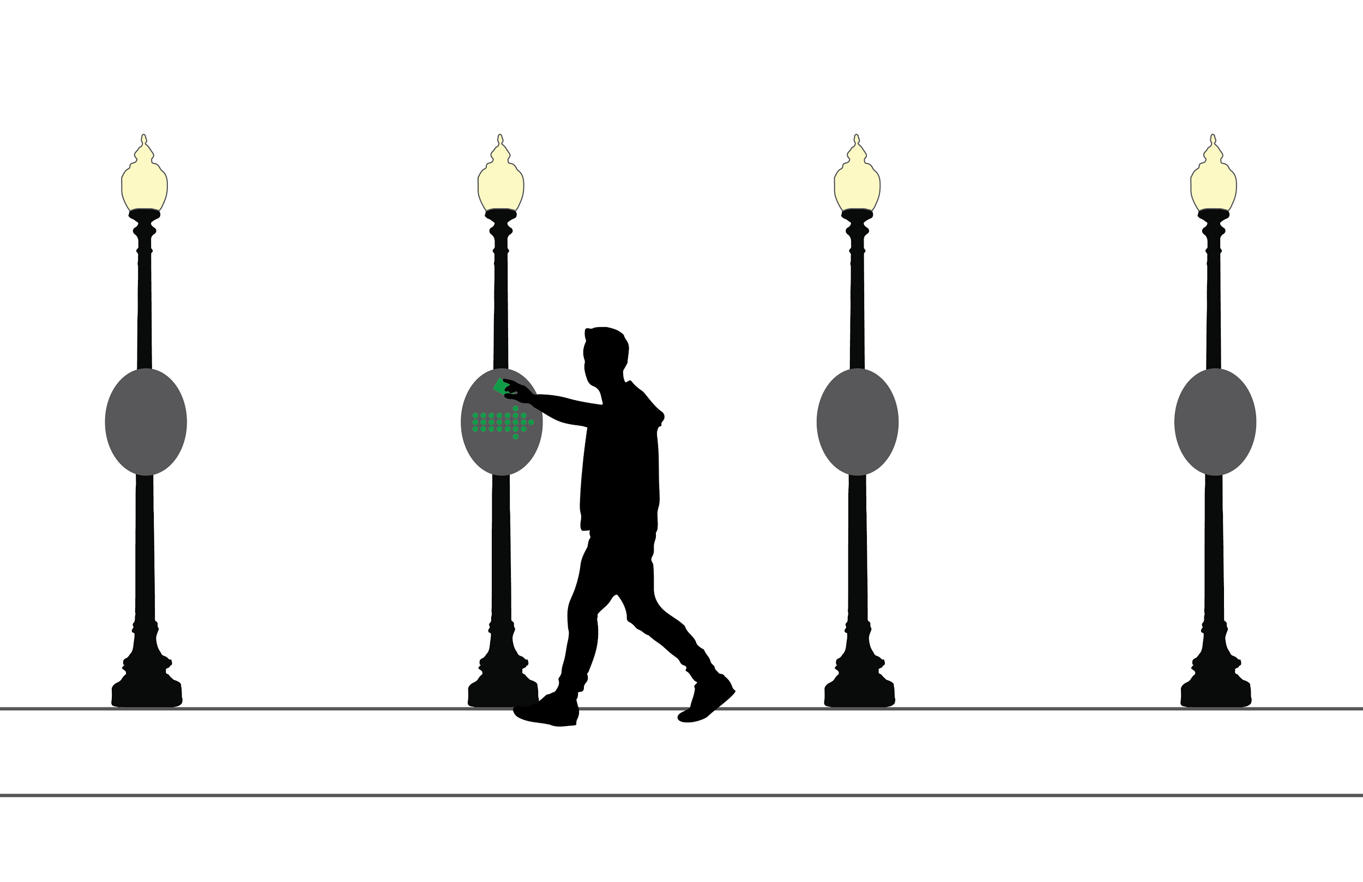

Slide 25
Questions?

