Slide 1




C++ Programming
By Kevin JUBERT

Slide 2


sUMMARY
UML Diagram
Menu
View Class
PaperBack Class
HardBack Class
Magazines
Advertisers/ Advertisement

Slide 3

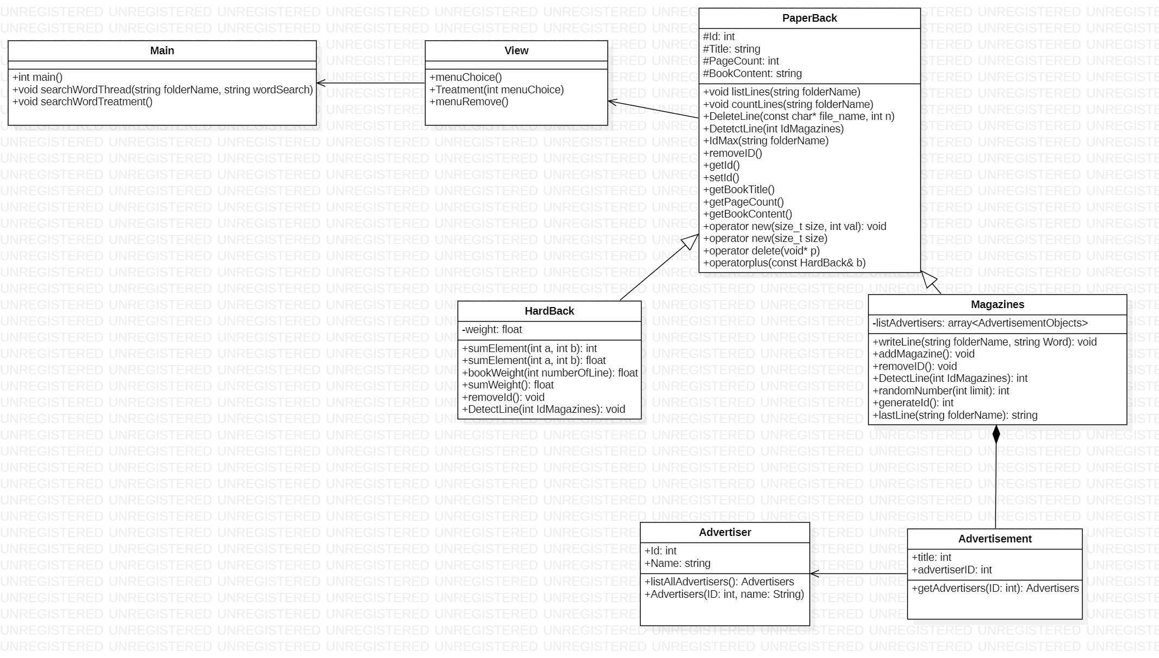
UML Class Diagram

Slide 4
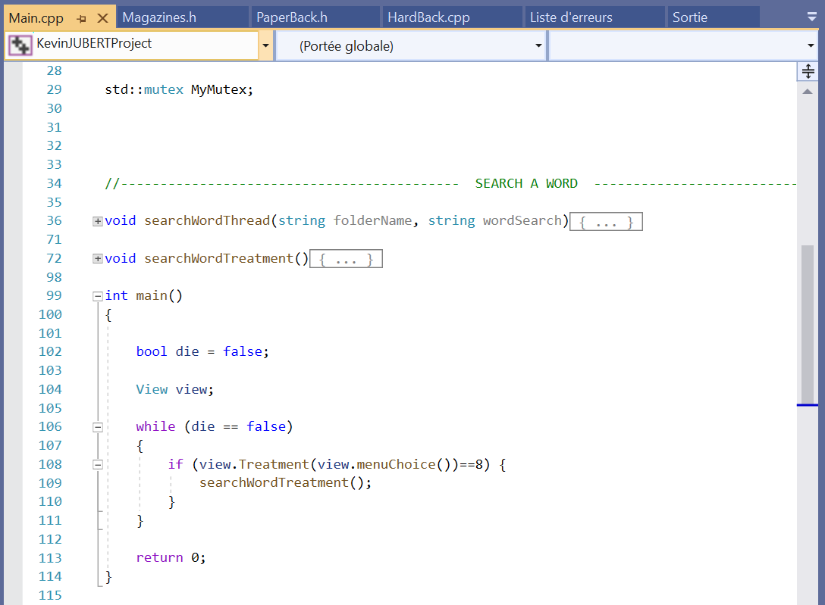
Main class
Mutexes and Threading
Impossible condition to reach
Execution of the Program
If the user want run the
« Search Word » function

Slide 5
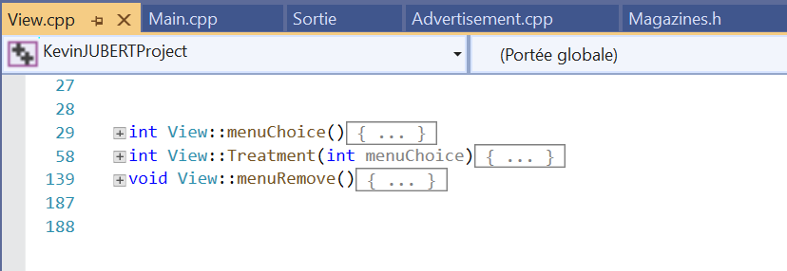
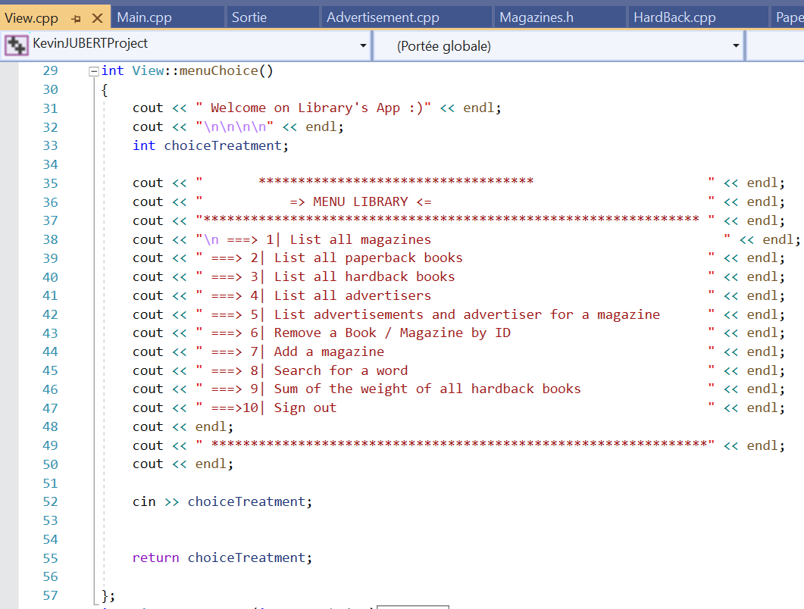
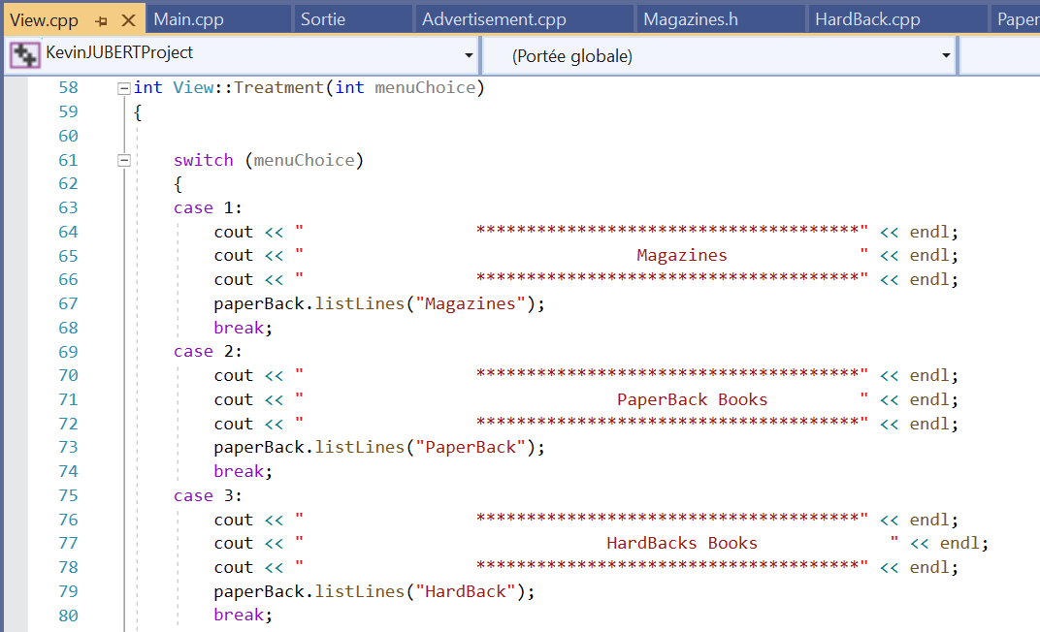
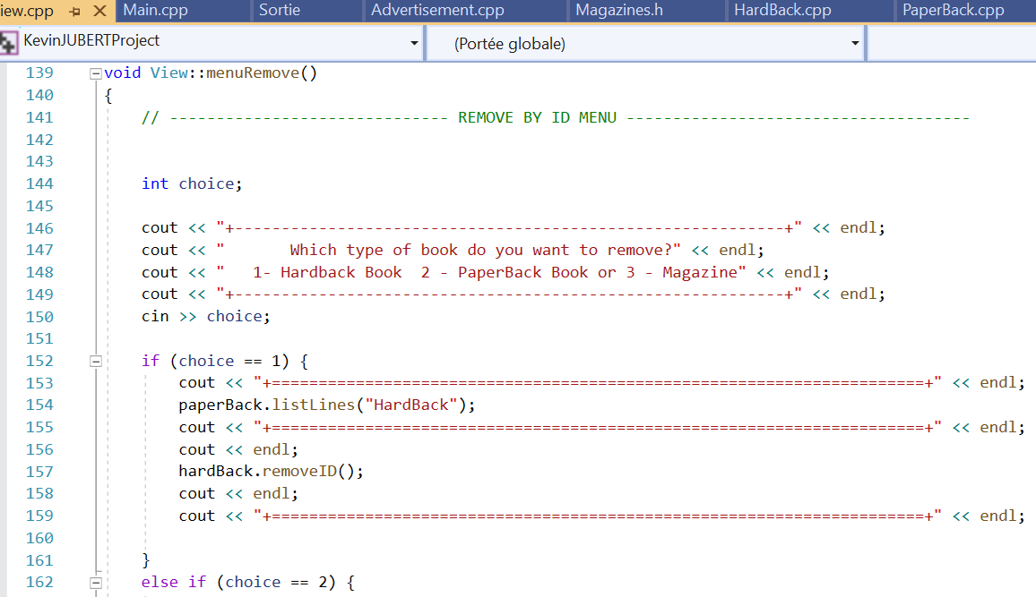
View class
Management of Programs Execution

Slide 6
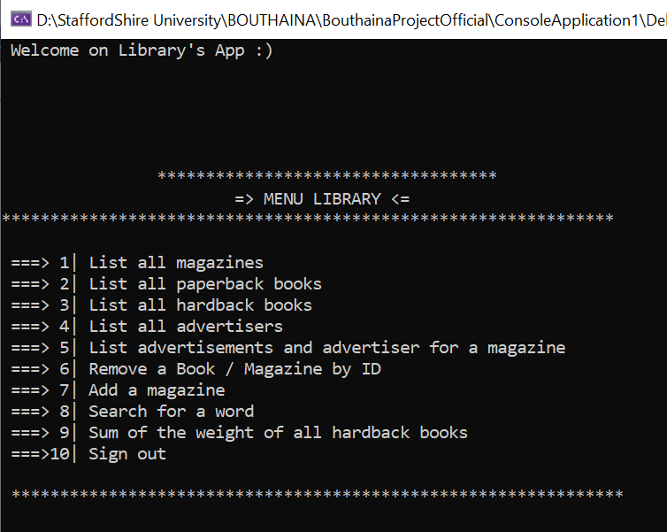
Main menu

Slide 7
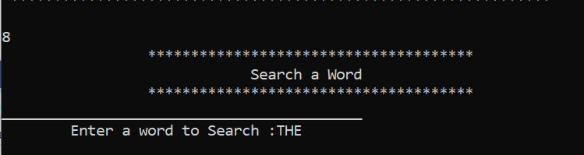
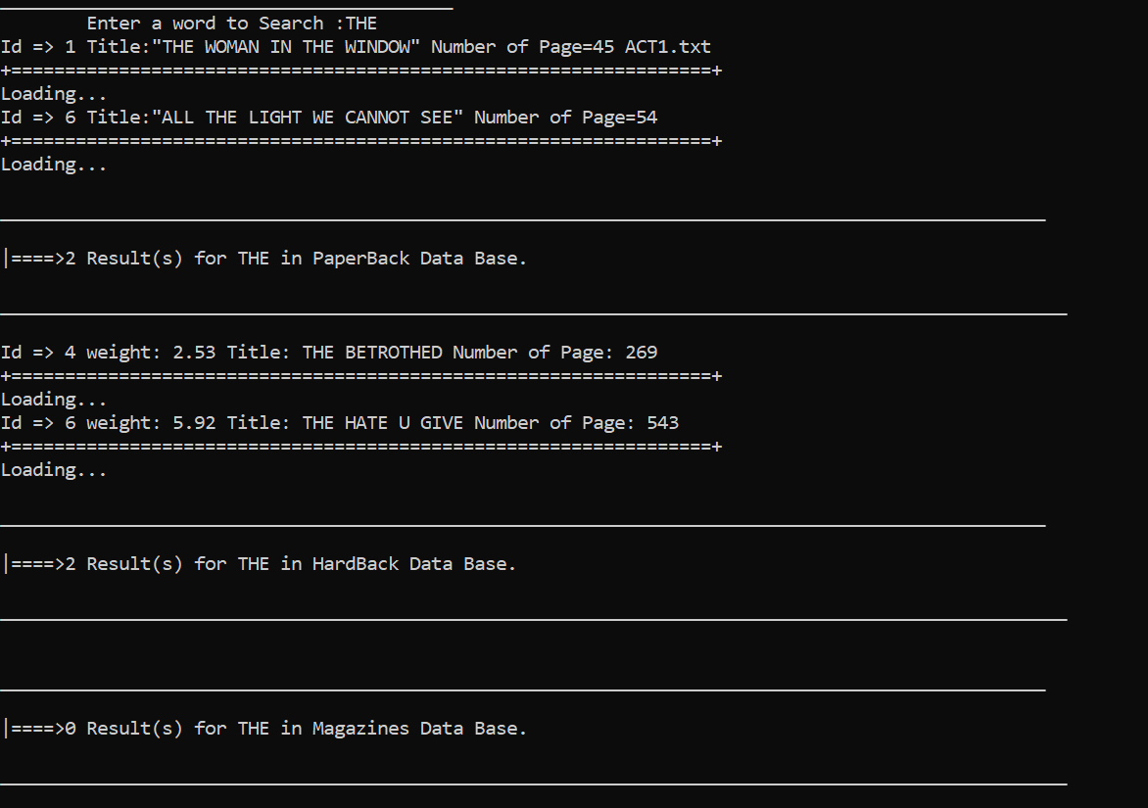
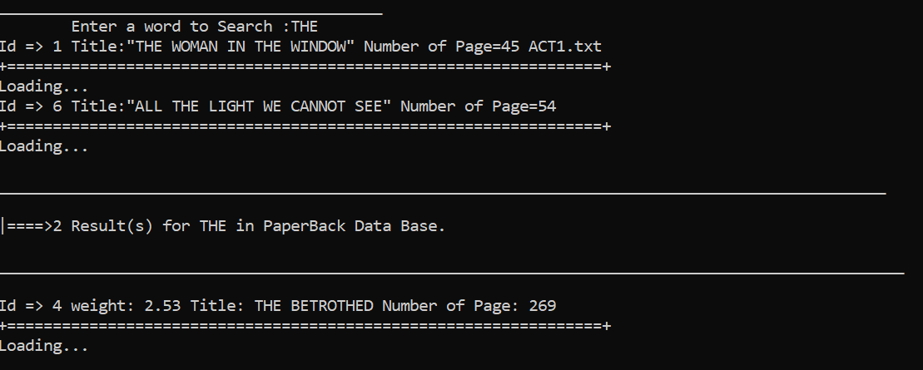
8 . Search a Word

Slide 8

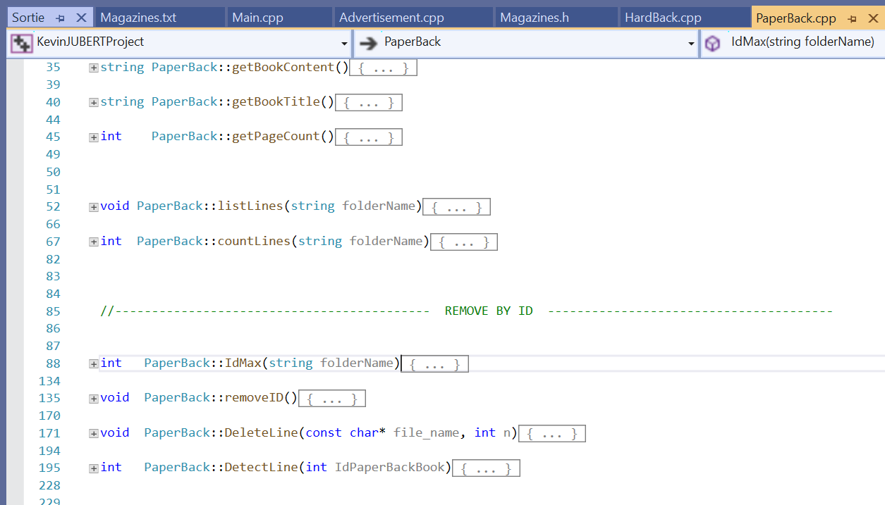
PaperBack CLass

Slide 9
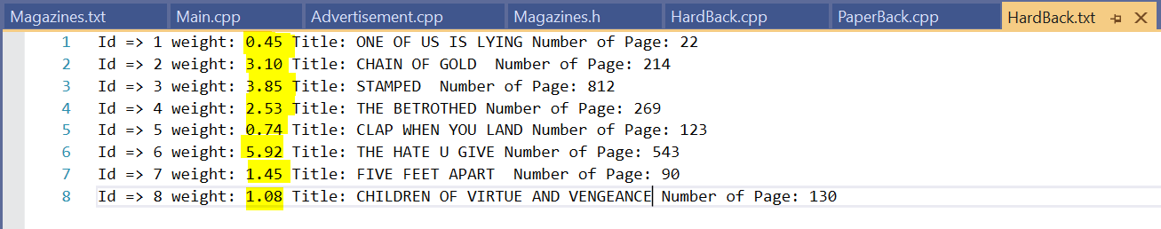
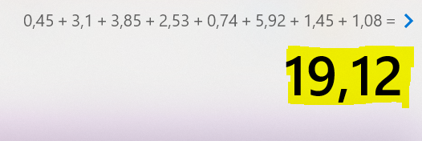
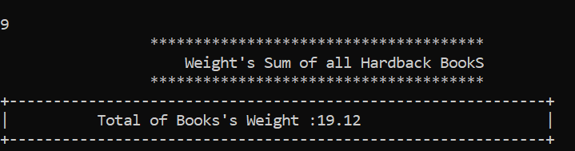
9 . Sum of the weight of all hardback books
Calculator :
Program :
Sounds Perfect !!! ✅

Slide 10
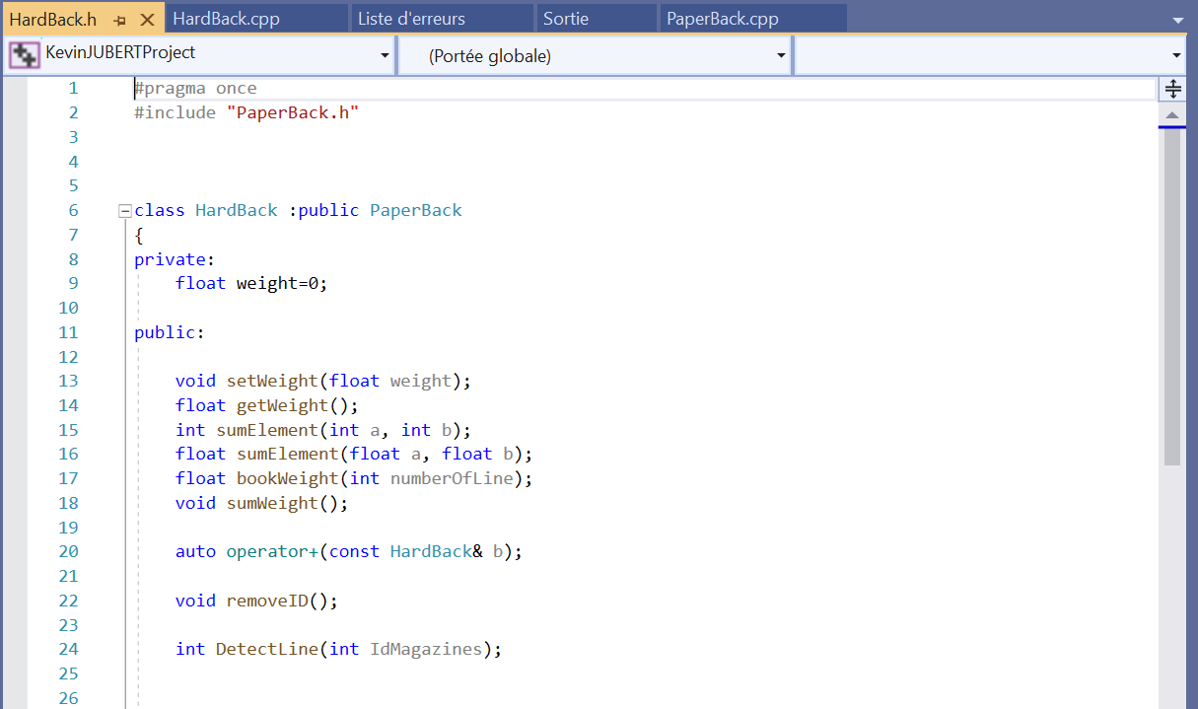
Hardback book « header »
Inheritance of PaperBack Book class
Function Overloading
New & Delete
Operator Overloading

Slide 11

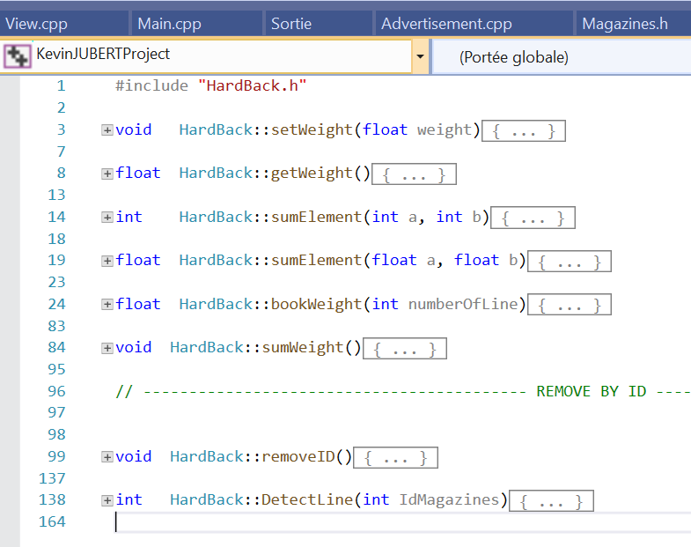
Hardback class
Simple fucntion to sum int and float elements
« bookWeight » has for purpose to collect the HardBack’s weight on a specified line.
« sumWeight » make the sum of all Hardback Book’s weight.
« DetectLine » detect the line of an ID entered.
« removeID » mix the DetectLine and the DeleteLine fucntion of PaperBack class

Slide 12
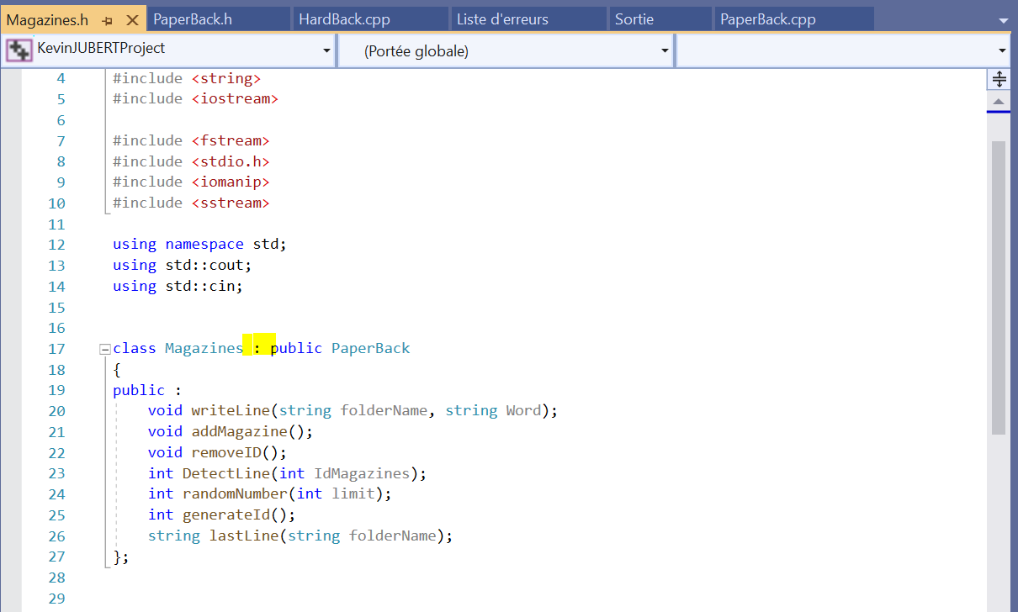
Magazines « Header »
Inheritance of PaperBack Book class
C++ Strings

Slide 13
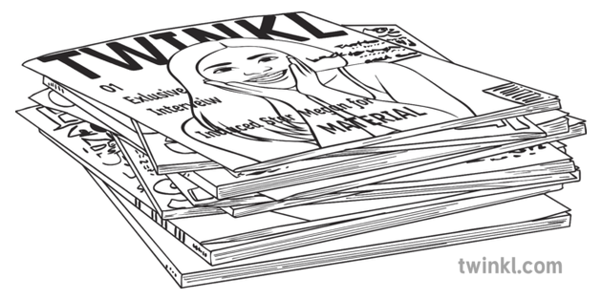
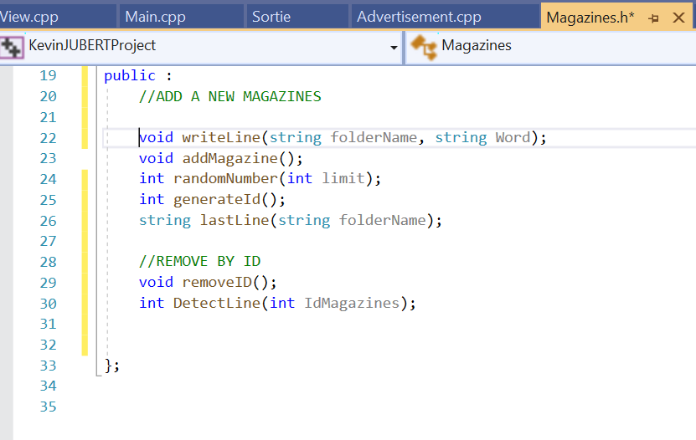
Magazines
« DetectLine » detect the line of an ID entered.
« removeID » mix the DetectLine and the DeleteLine fucntion of PaperBack class

Slide 14
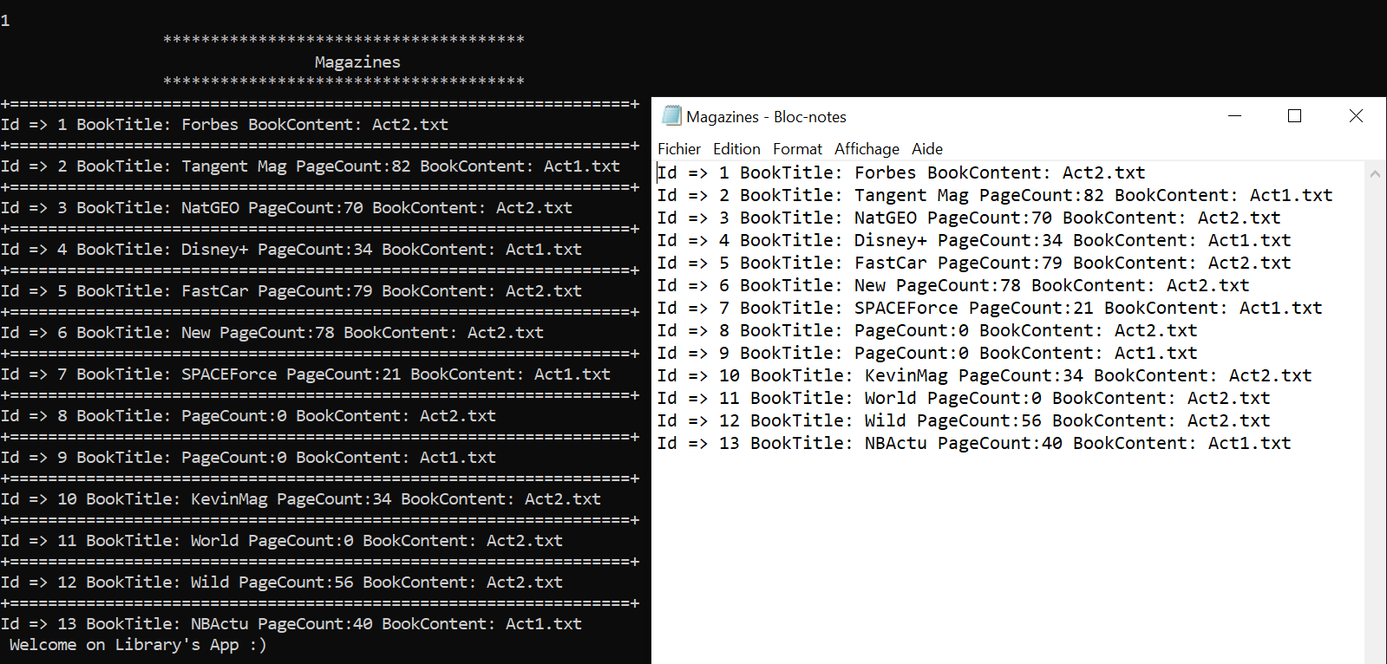
« 1 . List all Magazines »

Slide 15
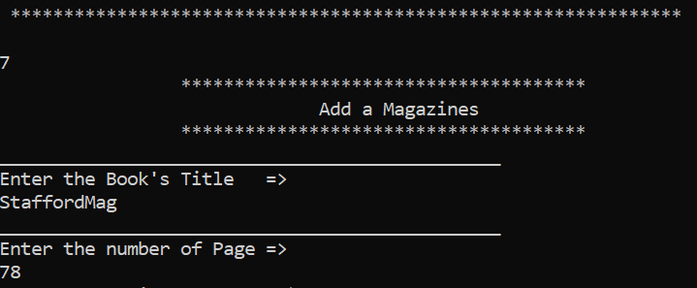
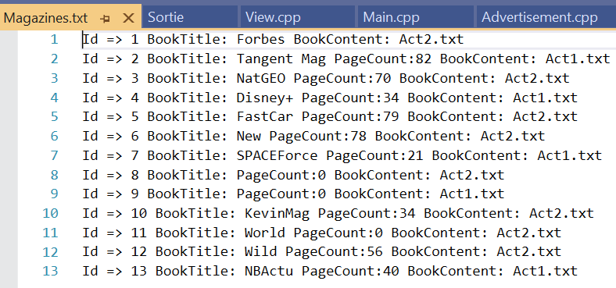
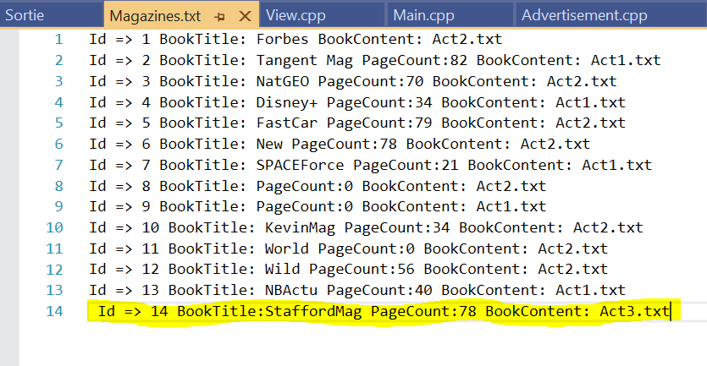
7 . Add a magazine

Slide 16
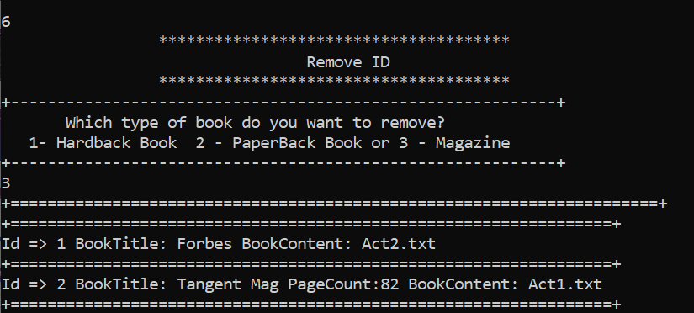
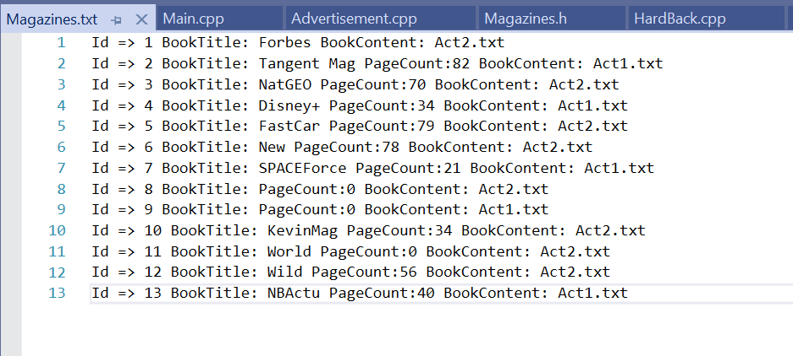
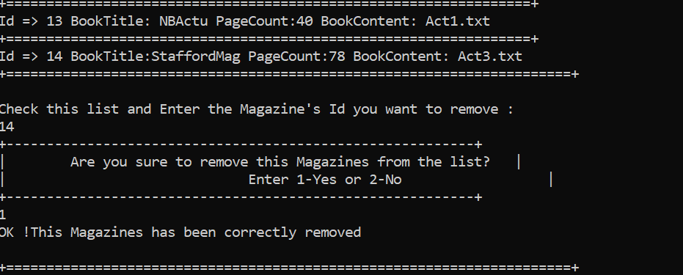
6 . Magazines : Remove by id

Slide 17
END

