Slide 1
Data 622 Final
Adam Gersowitz
Amit Kapoor
Paul Perez
Kevin Potter
Zachary Palmore

Slide 2
Dataset
Source: UCI Machine Learning Repository.
This dataset was donated by Ron Kohavi and Barry Becker. Extraction was done by Barry Becker from the 1994 Census database. A set of reasonably clean records was extracted using the following conditions: ((AAGE>16) && (AGI>100) && (AFNLWGT>1)&& (HRSWK>0)).
Prediction task is to determine whether a person makes over 50K a year.

Slide 3
Approach
Our goal is to understand the relationship between Income and the other variables of interest within the dataset.
We will gain a better understanding of these variables through data exploration followed by data preparation
Finally, we will split the data 75/25 in order to create a training and testing dataset for evaluation of a variety of models
We will first look at the prediction accuracy of these models but will also consider other factors such as other performance statistics and real world application of the results

Slide 4
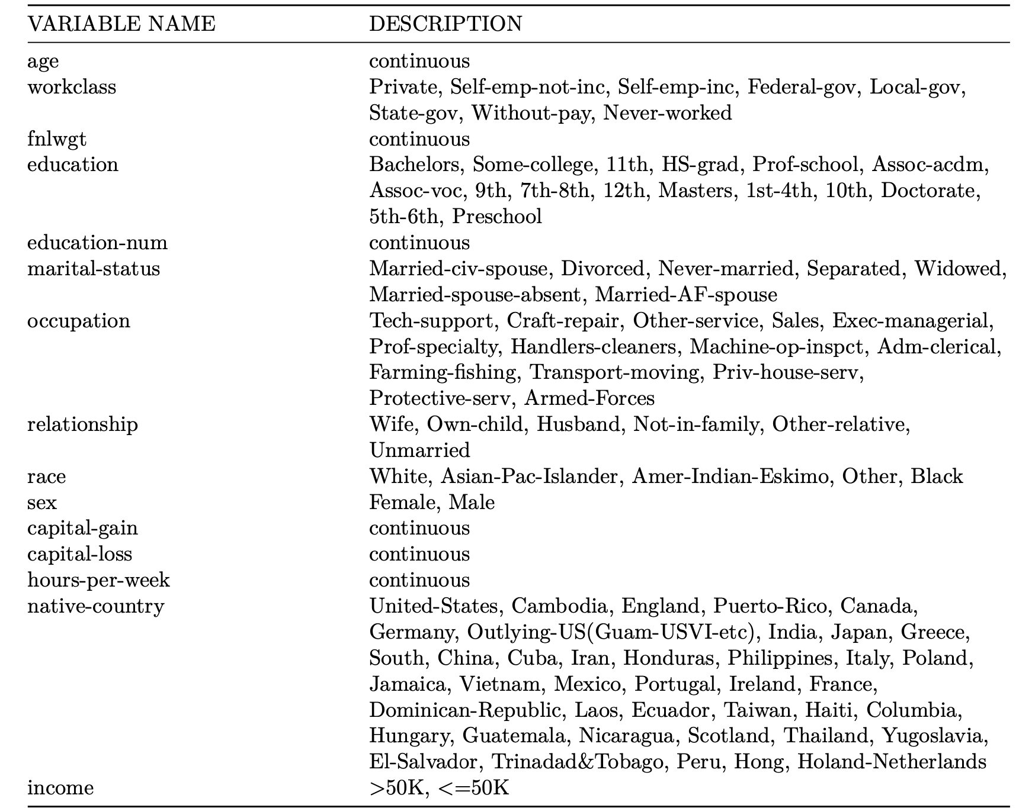
Data Characteristics
There are 48842 observations of 15 variables. Each observation is for individual’s income data with it’s corresponding variables of interest. Here is is the description of the variables of interest in the data set.

Slide 5
Data Summary
We found that a number of variables had “?” as a value
Workclass, occupation, and native_country all had “?” as a value
Additionally, many of the columns have significant difference and skew
67% of the respondents are male
85.5% of the respondents are white
Due to this we can not draw conclusions as widely as we would like for the world population
The variables age, capital_gain, and capital_loss have significant skew

Slide 6
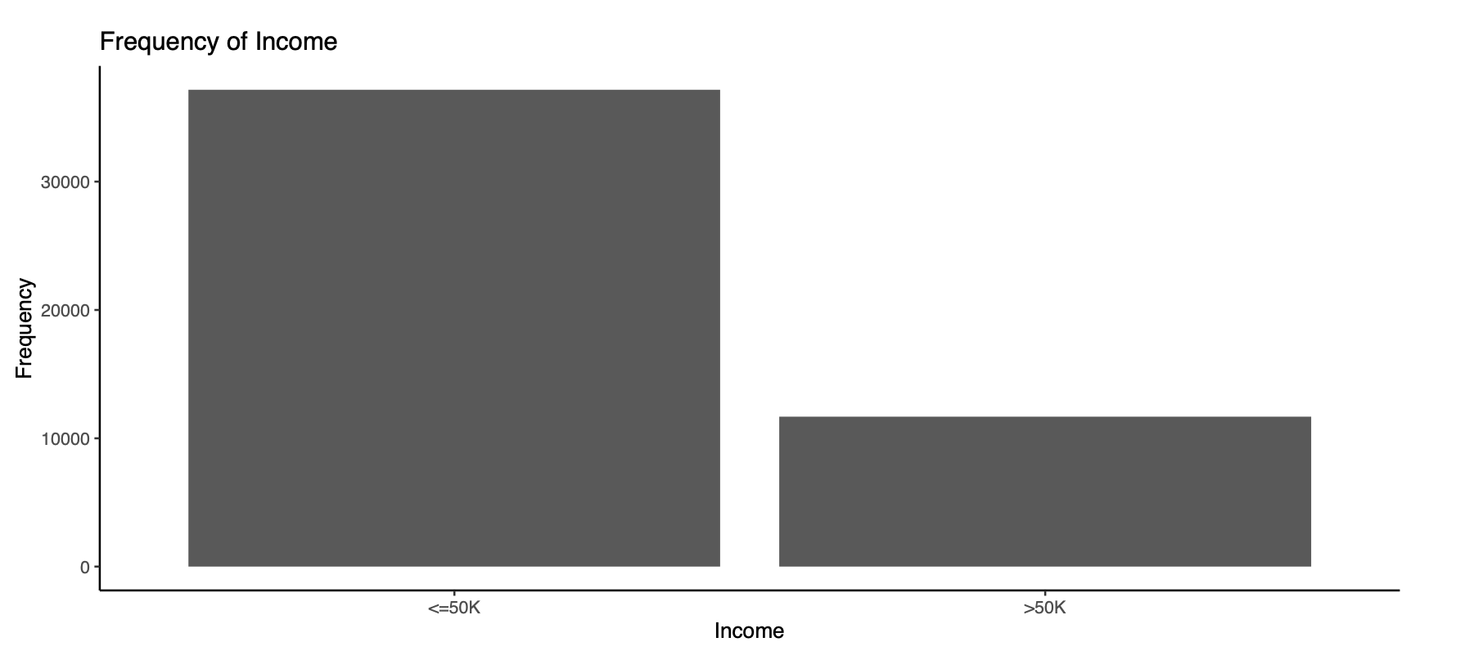
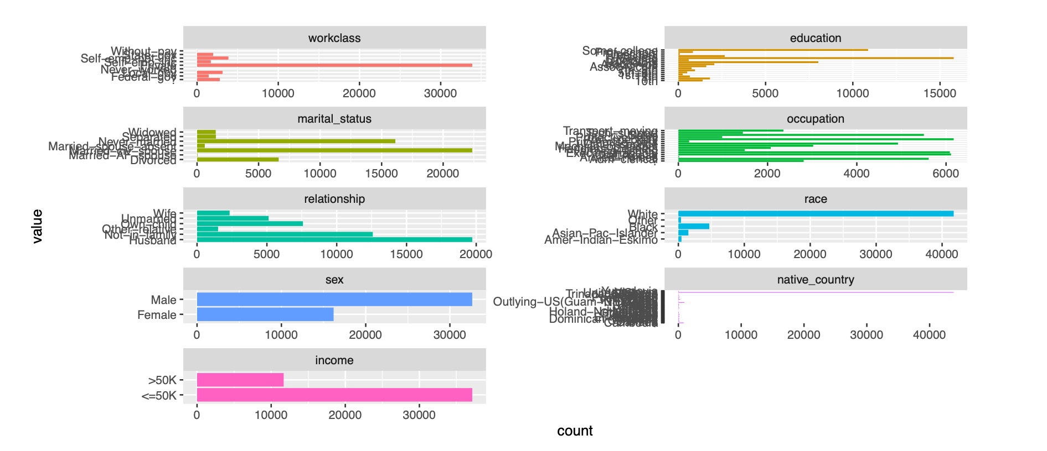
Data Summary
We can see with the accompanying figures that there are many more respondents with <50k income and it verifies our findings from the previous slides

Slide 7
Data Summary
The next set of graphs shows the income distribution against countries, workclass, education, sex and race. We see male has higher income in both the categories than female. White race income distribution is significantly large as compared to other races. Private workclass earns more than any other categories and United States has larget income in both the categories compare to all other countries.

Slide 8
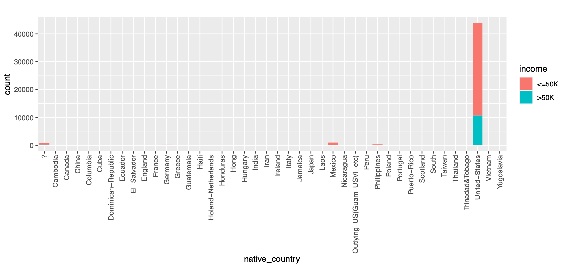
Country

Slide 9
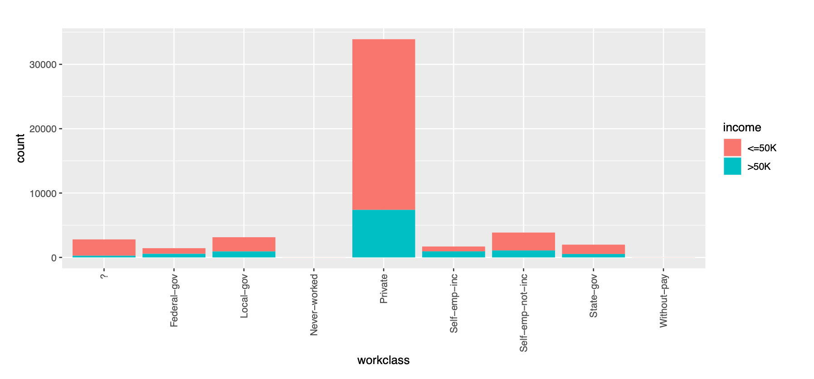
Work Class

Slide 10
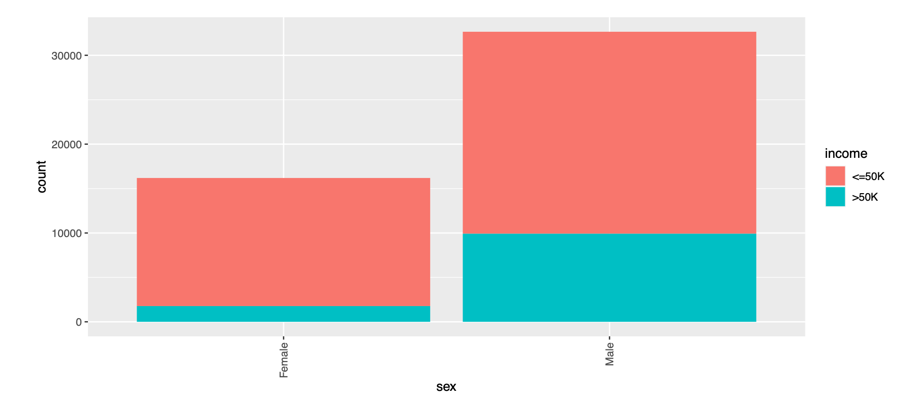
Sex

Slide 11
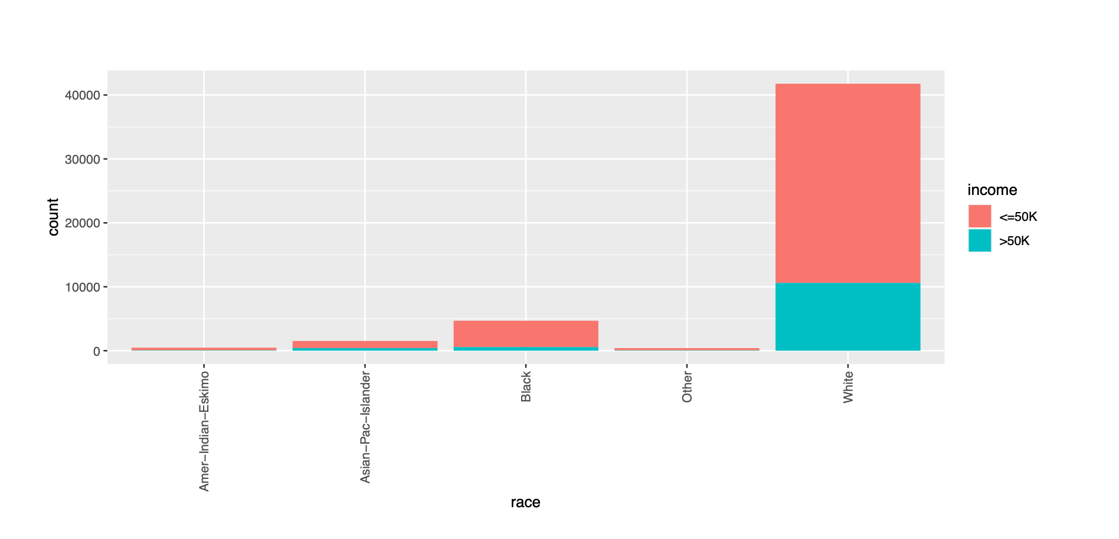
Race

Slide 12
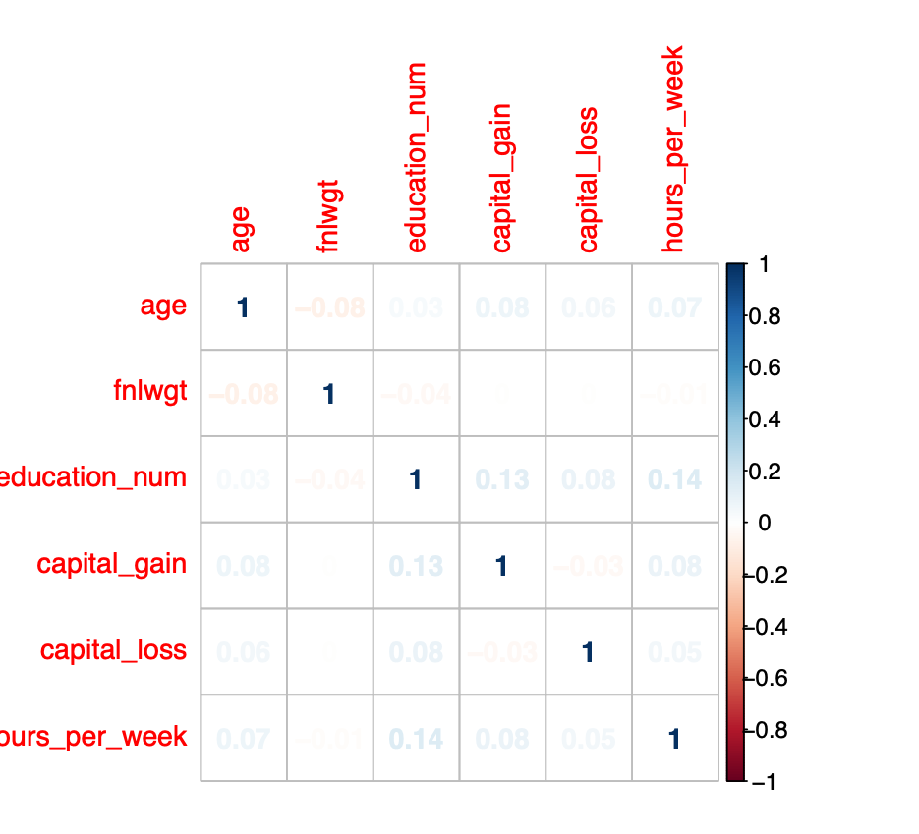
Correlations
To determine how well each variable is correlated with our target variable and with one another, we construct a correlation plot. This plot contains the values of all correlation between variables represented by colors and numbers. The lighter the color, the lower the correlation. Meanwhile, darker blue indicates stronger positive correlations while darker red indicates stronger negative correlations.
Given that our numeric features have correlation values near 0, they do not seem to be strongly correlated with our target. They also do not seem to have any correlation with one another so this is a factor that does not have to be dealt with.

Slide 13
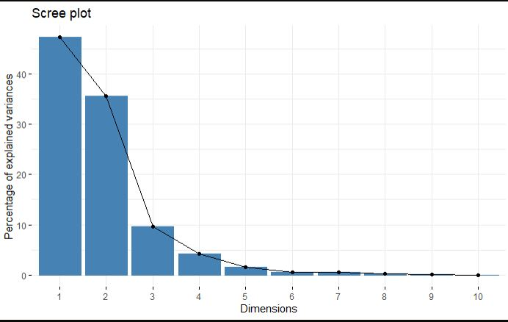
PCA and Factor Analysis
It is important to identify the variables that contribute the most to the dataset. This allows for:
Dimension reduction
Confounding variables’ removal
Greater understanding of underlying relationships
The scree plot shows the eigenvalues of factors and principal components in this analysis alongside their percentage of explained variance per PCA dimension

Slide 14
PCA and Factor Analysis
To get valid results we first grouped the variables by type. (numeric and distinct factors)
We adjust, center, and scale the distributions of factors and run them through a factor analysis. We repeat this for the numeric variables. We then combine the variables, convert them to equivalent numeric values, preserving the distances between variables’ values and repeat the process. These groups can be shown as:
Factors Only
Numerics Only
Numerics and Converted Factors
Numerics and Converted Factors without capital income
We found two confounding variables that confuse would confuse the results of the study. They were unrealistic and unrepresentive of the survey making up less than 3% total. They were the variables capital_gain, and capital_loss.

Slide 15
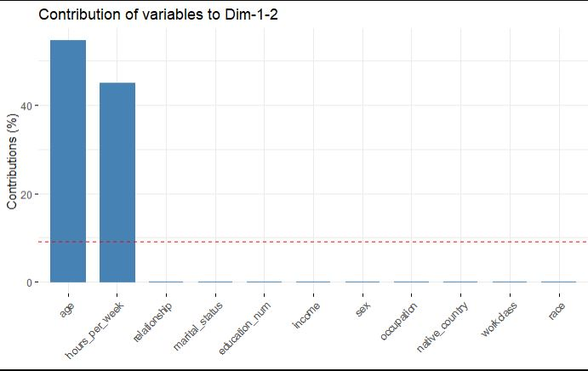
PCA and Factor Analysis
Variables that contribute the most to the dataset are identified by their variance. Those that produce results most similar to the distribution are best.
Together, age and hours_per_week, explain 99% of the data without adjustments.
These are the results of group 4, with capital gains and losses removed. Notice the rest of the variables by comparison.

Slide 16
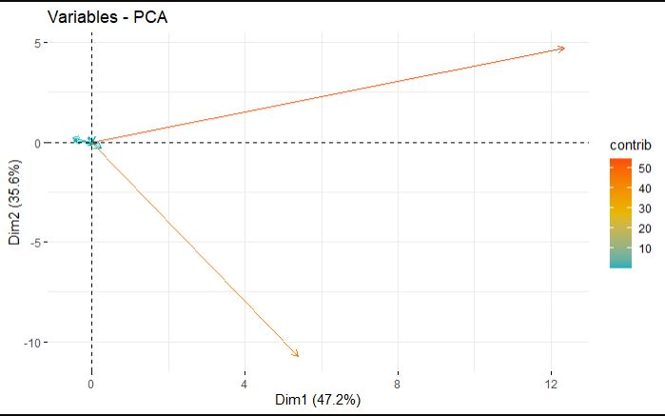
PCA and Factor Analysis
Those same variables are show here. We can see the directional impact of their contributions as well as the strength of their values.
Age
Hours per week
Education
Outside of these factors, education_num is the next biggest factor to consider when predicting income.

Slide 17
Data Preparation
Before this income data can be used as input in our machine learning models, it must be cleaned, formatted, and restructured — this is typically known as preprocessing. In this income dataset there are columns having values as ‘?’. During the data preparation process we will clean these values, transform skewed features and perform train and test split for models. This preprocessing can help us with the outcome and significantly increase model accuracy of almost all learning algorithms.

Slide 18
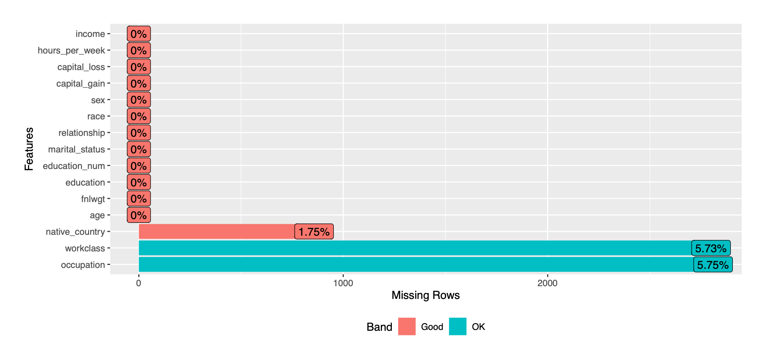
Handling Missing Values
To this stage it is clear that our dataset does have missing values that appear as ‘?’. In the next step we replace the ? with NA and then take all the complete cases only. We do see there are 3620 cases with values missing and needs to be left out. We finally get the dataset with 45222 rows and 15 columns.

Slide 19
Preprocessing
The fnlwgt variable (i.e. final weight) is being removed since it has no predictive power and it is a feature to allocate similar weights to people with similar demographic characteristics. We are also removing variable education since it is just a label of education_num column.
For highly-skewed feature distributions, we will perform boxcox transformation for these column to reduce the skewness and make it more Gaussian. Also combining the center and scale transforms will standardize the data. Now the features will have a mean value of 0 and a standard deviation of 1. This preprocessing uses the caret package’s ‘preprocessing’ function to return a box cox transformation on all numeric variables in our income dataset. These numeric variables include age, education_num, capital_gain, capital_loss and hours_per_week.

Slide 20
Building Models
Logistic Regression
Decision Trees
Random Forest
XGB

Slide 21
Logistic Regression
When first running the logistic regression model, we achieved an accuracy of roughly 85%. Evaluating the variables of the model’s summary, the country variables did not show any significance, so we re-ran the model excluding these country variables. Performance remained consistent for both model’s.
Next we converted all categorical variables to dummy variables before applying the data to a logistic regression in an attempt to improve the model. This was done last since we wanted to leverage the same exact training and testing set for all model’s. Our logistic regression model with dummy variables accuracy comes out as 0.848 or roughly 85%. We can see that this has not changed from the previous two models. There is room for improvement in this model's sensitivity among other variables. We try to improve this with the random forest model.

Slide 22
Decision Trees
In a decision tree model the data is split into distinct options of ‘yes’ or ‘no’ based on parameters that make the options possible. These splits are called nodes and the decisions made at them can be mapped. For example, we provide a small decision tree that shows how decisions can be made based on credit history, coapplicant income, and property area.
We also review which variables are most important for making decisions in our model.These are shown in the plot as a straight line extending from the axis to the length of its importance to the model. Accuracy was also used to select the optimal model using the largest value where our final tree depth used for this model is 1.
Our decision Tree model accuracy comes out as ~84%. As shown in the confusion matrix, there is room for improvement in this model’s sensitivity among other variables. We try to improve this with the random forest model.

Slide 23
Random Forest
A random forest model works by building a number of decision trees and selecting the most accurate decisions from the trees. These decisions are randomized and in our case, tries 3 variables at each node or split in the tree. We set our number of trees to 500 and train the model to predict loan status. We review the variables of most importance in the model and in this case, give the model a boost to improve accuracy.
Our random Forest model accuracy comes out as ~82%. This is an improvement upon our decision model and the sensitivity did increase as we desired.

Slide 24
XGBoost
XGBoost is an implementation of gradient boosted decision trees designed for speed and performance. XGboost is a widely used machine learning algorithm because of it can often provide a high level of accuracy with little hyper parameter optimization. In our implementation of XGboost we combine is with a Bayesian method of feature selection to achieve our desired results.
Our XGBoosted model accuracy comes out as ~84%. This is an improvement upon our decision model and the sensitivity did increase as we desired.

Slide 25
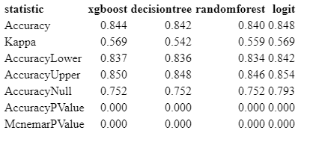
Model Performance
When evaluating how the models performed we focused on accuracy as our main metric. However, we also considered how the results might apply in real-world settings. This does slightly change the results of our model's performances depending on the circumstances in which the prediction is needed. For example, someone with the goal of identifying what factors they need to maximize to boost their income will have a fundamentally different set of variables, and thus results, than someone else with the goal of minimizing income loss for an individual. Nevertheless we compiled the results as follows:

Slide 26
Conclusion
Recall that our target variable, income, was split into two factor levels; those whose income is greater than $50,000 and those who have an income less than or equal to $50,000. As is, our XGBoosted model performed best with an accuracy between 82-87%. Our closest alternative model was the random forest. Excluding capital gain and losses, we found that age, education, and the hours worked per week, capture nearly perfectly the variance in the dataset. If we were to reduce the dimensions of the dataset these would be the best variables to use. This suggests that, aside from capital gains, the best ways to increase income to $50,000 or greater in the United States is to get a higher education, work 40 or more hours per week and be older than your colleagues. These results are applicable across the United States.
Notes:
Our conclusion could be given regardless of model performance and accuracy given the diversity of the dataset and its substantial drawbacks. Perhaps most importantly, we should note that this dataset was not representative of the global population and should not be applied too broadly. This dataset was heavily white, highly educated males who were married at least once in their lives. Many of these respondents also had no kids which evidence suggest can significantly shape an individual’s income over their lifetime. Typically, having kids increases income for males while it decreases for females. This makes our results less realistic and hard to interpret, especially for non-white females and other minority classes not represented in this dataset.
Additionally, responses from individuals located in the U.S. dominated the list, containing nearly 90% of the dataset’s individuals. This nullifies the results for other countries due to large clusters of outliers in their variables that could not be dealt with without compromising the integrity of the data. To reduce the errors inherent to the dataset, an extensive use of oversampling of the minority classes in a strategic manner would be necessary but unfortunately, there is no way to tell if the results would be reliable. For these reasons, we focus on the relationships between the variables which have greater reliability and certainty in this analysis.

Slide 27
References
https://archive.ics.uci.edu/ml/datasets/Census+Income

