Slide 1
Data Science
Skills Analysis
Sounds Good Team
Kevin Potter
Justin Hsi
Vincent Miceli
Bruno de Melo

Slide 2

Reddit
Using Praw
posts
comments
likes
Subreddits Scraped
datascience
datasciencejobs
machinelearning
upvotes
username
awards
machinelearningjobs
learnmachinelearning
learndatascience

Slide 3
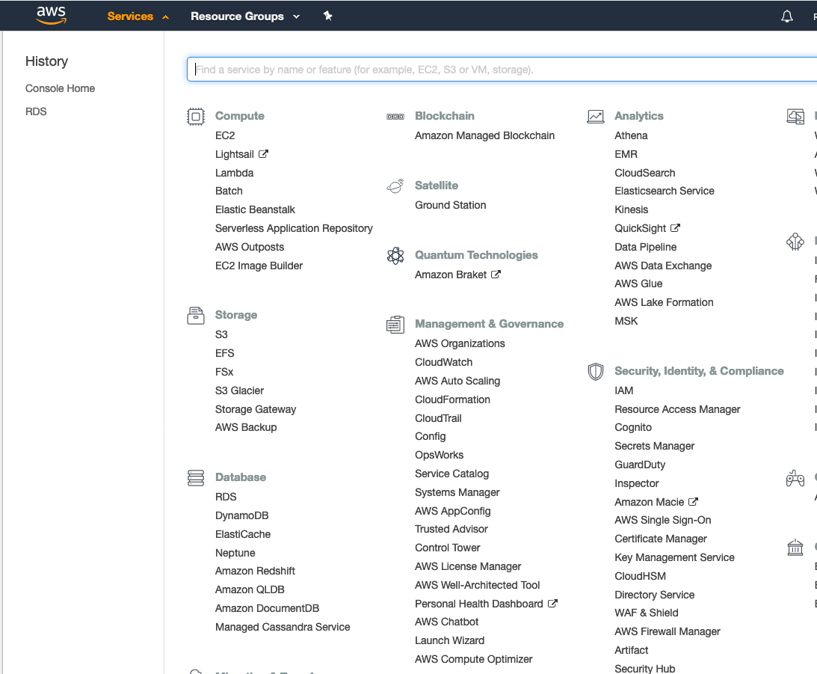
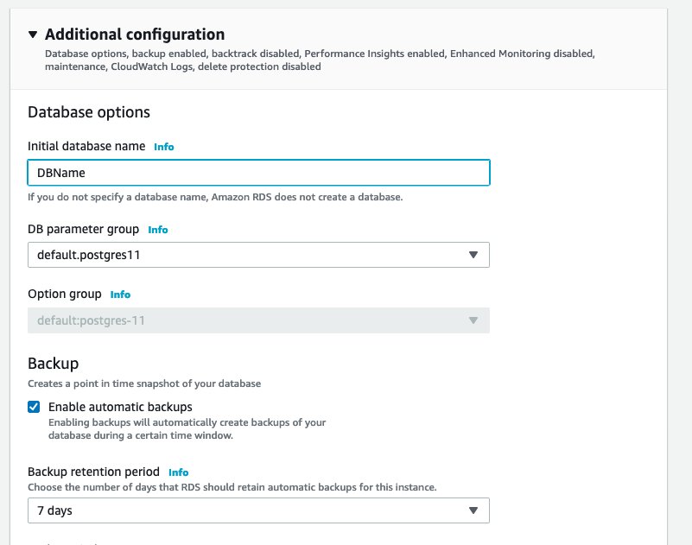
Database in Amazon RDS
Have an AWS account with Free Tier (good for 1 year from account creation)

Slide 4
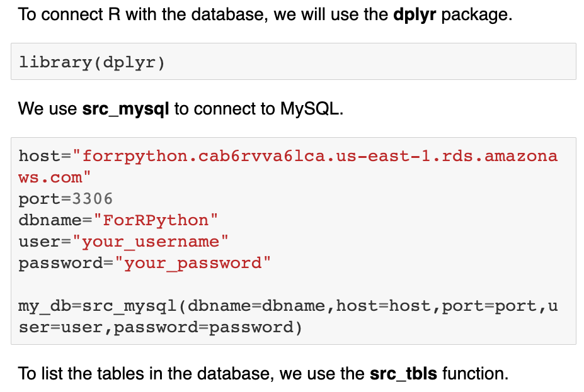
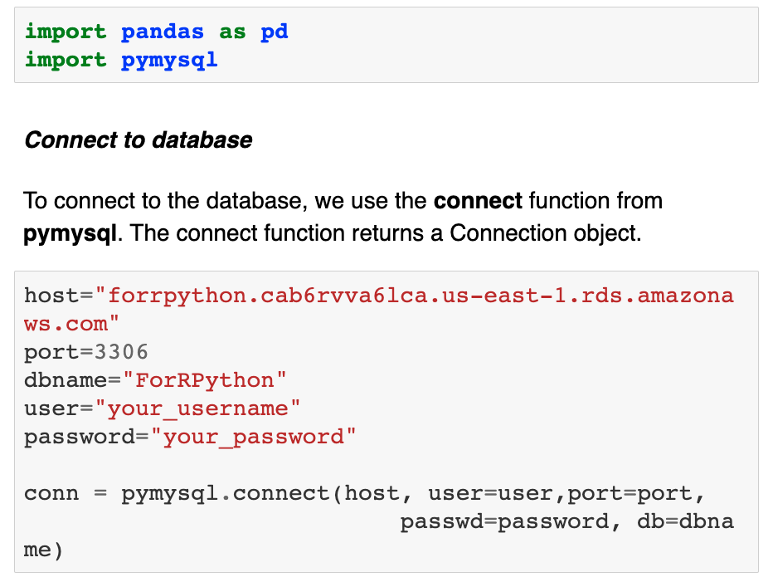
Connecting to Database
Similar methods to connect in R and Python

Slide 5
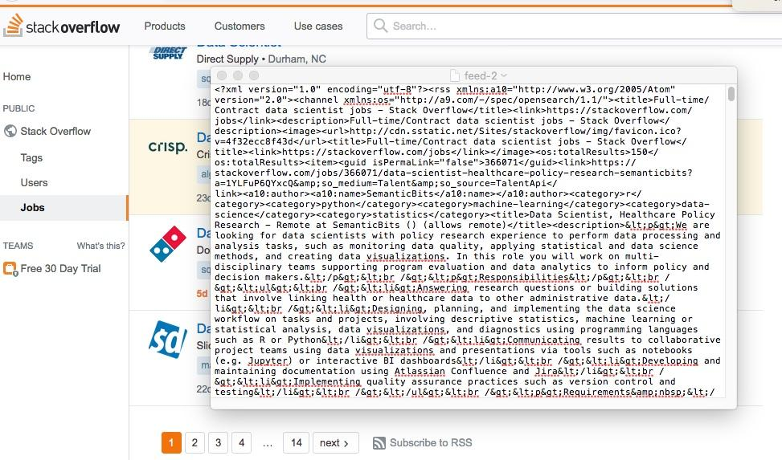
XML Scrapping
Stack overflow website contains job postings downloadable in a RSS feed which are formatted as XML. This is what we scrapped.
We searched for Full-time/Contract data scientist jobs. Result contained >320 posts.

Slide 6
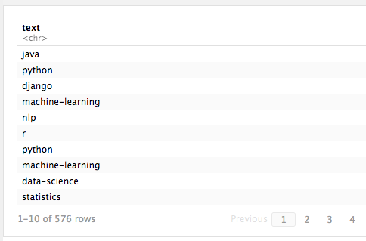
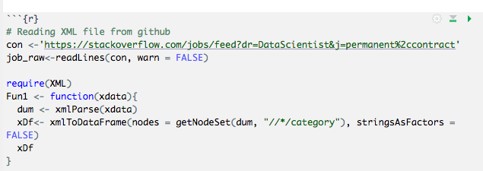
XML Scrapping
We use XML package to retrieve ‘category’ node which contains main job skills required.
Datafafa
Data is then uploaded to AWS database and analysed for the 20 most frequent skills.

Slide 7
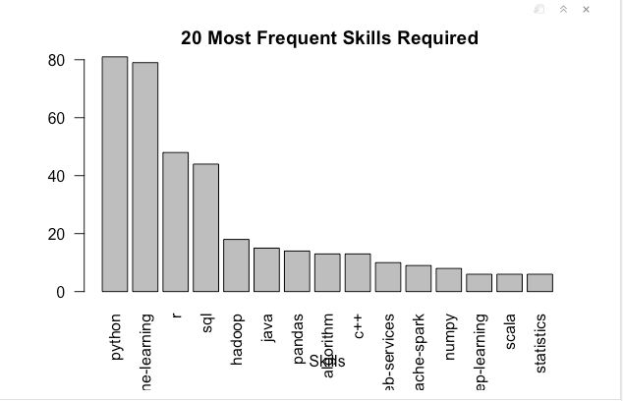
XML Scrapping

Slide 8
Resources
https://github.com/KevinJpotter/data_607_project_3
https://datascience-enthusiast.com/R/AWS_RDS_R_Python.html

