Slide 1
Introduction to Quantitative Finance
By Kevin Potter

Slide 2
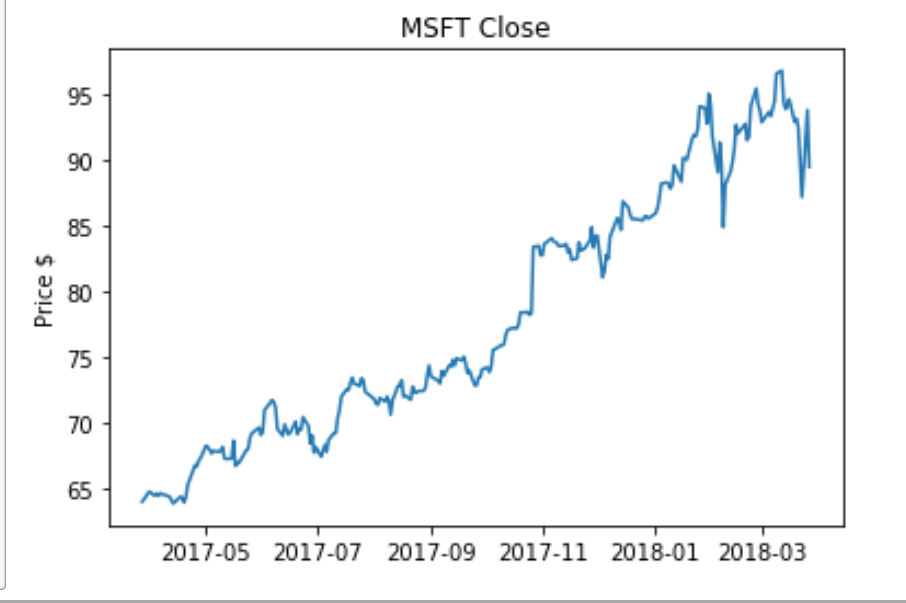
Overview
Research
Tools Used
Testing
Analysis
Conclusion

Slide 3
Quantopian Research Environment
Access to fundamental, sentiment, and pricing data
Survivorship and look-ahead Bias
Using Pipeline
Alphalens

Slide 4
Backtesting the Model
Setting up an executable trading
Momentum & Mean Reversion
Optimizing Portfolio constraints
Difficulties with regression

Slide 5


Slide 6
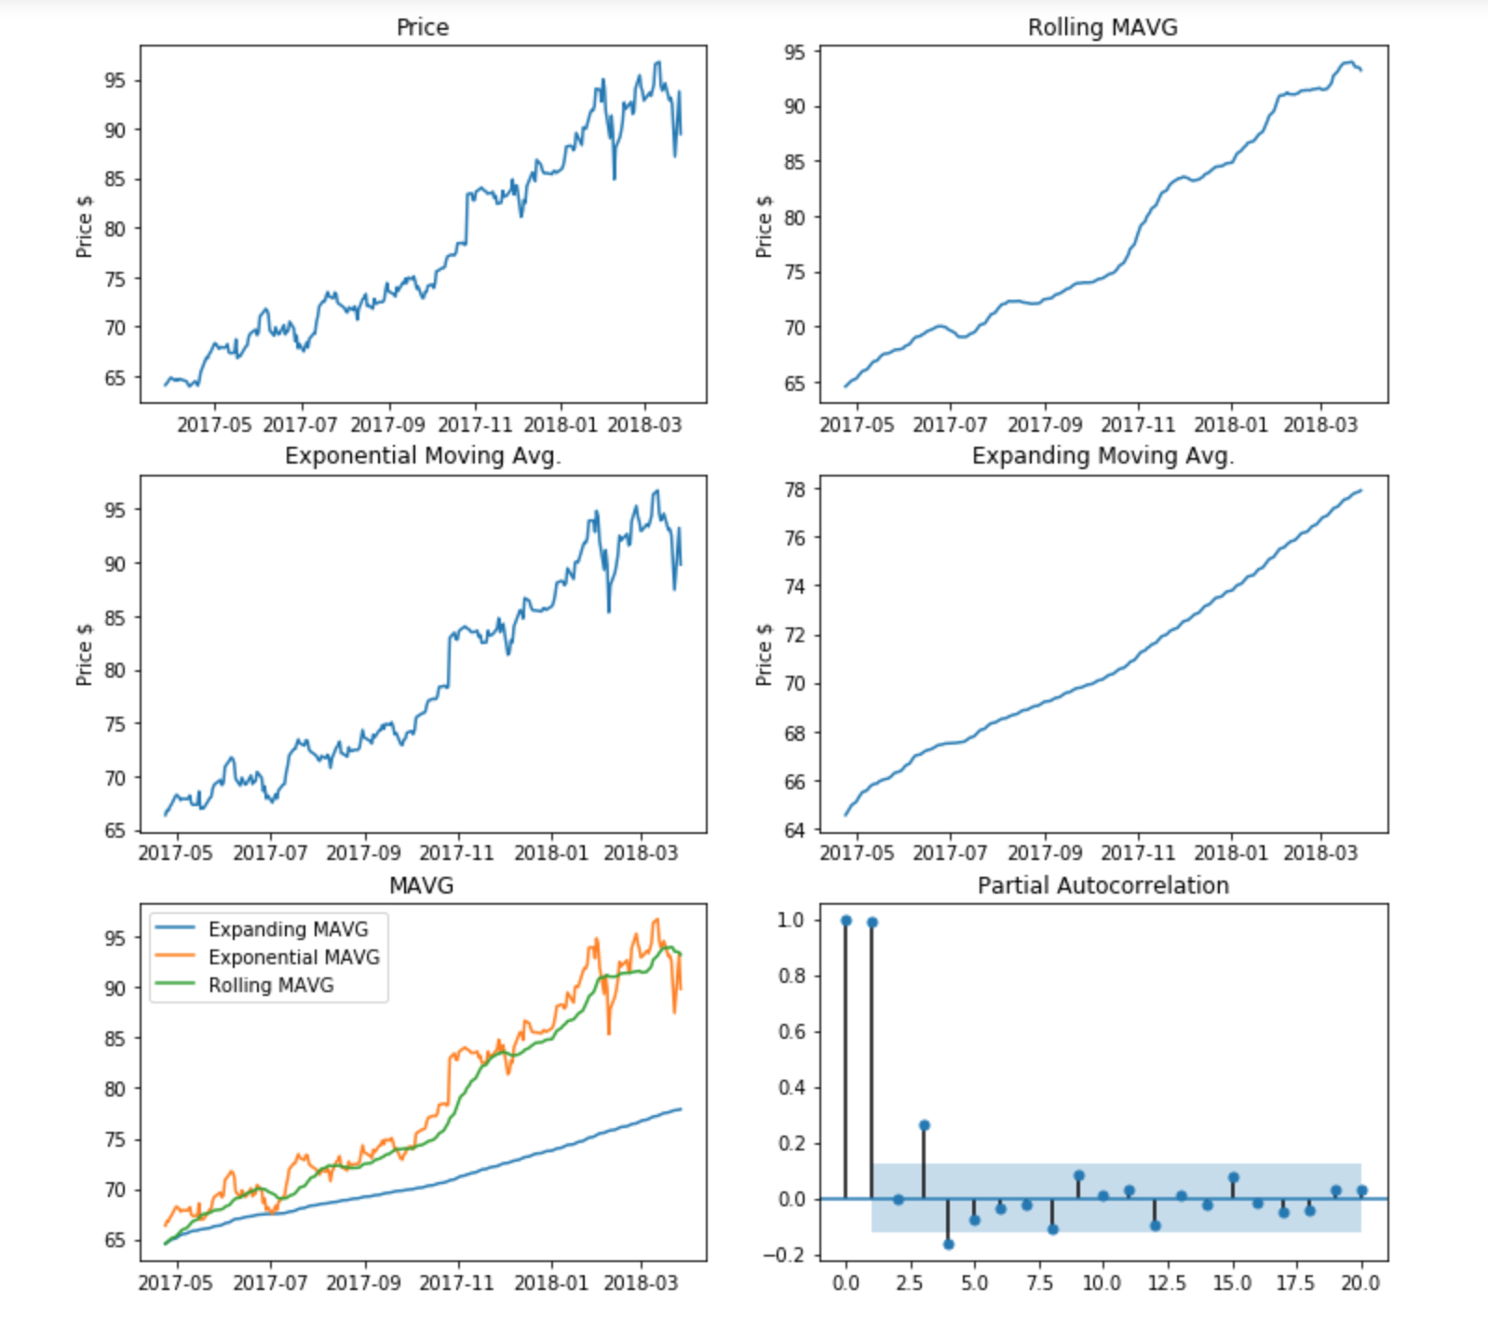
Back to EDA
Building a class
Moving Averages plot
ARIMA & Holt Winters

Slide 7
Conclusion / Next Steps
More research
Seperate Classes / Expand
Build out plots
Time series analysis

