Slide 1
Today
Economic Systems.
PPFs

Slide 2
WARM UP
Using the information in the table below, what is Steve’s opportunity cost of smoking one cigarette?
30 minutes
2 beers
½ of a beer
1.5 beers
 | Beer (time to drink) | Cigarettes (time to smoke)
Dan | 10 mins | 20 mins
Steve | 15 mins | 30 mins

Slide 3
WARM UP
True or false, if your friend can do something better than you, then he must have a comparative advantage in that activity.
True
False

Slide 4
Scarcity and Choice
economics The study of how individuals and societies choose to use the scarce resources to satisfy unlimited wants.
These resources come from nature and previous generations (technology, capital, etc).

Slide 5
The Economic Problem:
Scarcity and Choice
Let’s continue thinking about economics from a societal standpoint:
Three basic questions must be answered by every economic system or society:
What gets produced?
How is it produced?
Who gets what is produced?

Slide 6
The Economic Problem: Scarcity and Choice
Before we try to answer these questions, let’s recall a few terms from last time:
outputs Usable products (goods and services).
production The process that transforms scarce resources into useful goods and services.
factors of production The inputs into the process of production. AKA resources or inputs.
capital Things that are themselves produced and that are then used in the production of other goods and services.

Slide 7
Scarcity, Choice, and Opportunity Cost
THE PRODUCTION POSSIBILITY FRONTIER
To answer our 3 questions, we need to know what our choices are. What can our society make? What are the possibilities for production?
production possibility frontier (PPF) A graph that shows all the combinations of goods and services that can be produced if all of society’s resources are used efficiently.

Slide 8
PPF
The PPF is the next of our VERY simplified “models” (remember the circular flow model).
To be able to draw a PPF, we need to assume that our society makes only two goods (or two “types” of goods).
Often these are referred to as “capital goods” and “consumer goods”
Capital goods are goods that can be used to make other goods.
Consumer goods are consumed by the people in our society (aka outputs).
A PPF then shows the limits of production and the trade-off between these two goods.

Slide 9
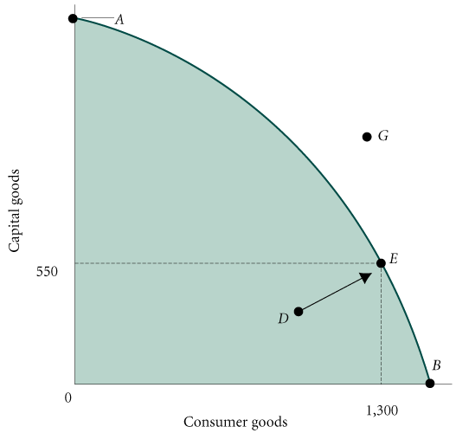
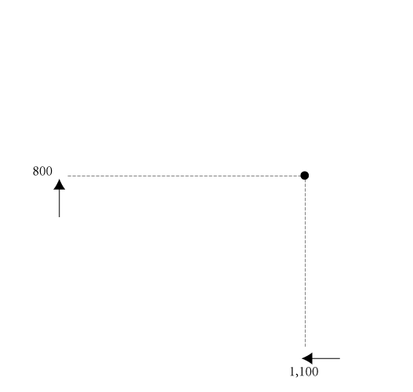
A Production Possibilities Frontier (PPF)
C

Slide 10
Scarcity, Choice, and Opportunity Cost
Efficiency
The goal for any economy is to use all of the resources to their full potential – this puts us on a point ON the PPF (like points A, B, C or E).
NOTE - this does not mean we should use all of our natural resources as quickly as possible - this idea is more focused on labor and capital.
The Optimal Mix of Output
Each society must choose the point on the PPF that is best for it. What each society chooses to produce and consume determines the point on the PPF that is “best” for that society.

Slide 11
Scarcity, Choice, and Opportunity Cost
Unemployment and Inefficiency in the PPF
During economic downturns or recessions, the economy produces less than it can because it does not use all available resources. When there is unemployment of labor and capital, we are at a point INSIDE the PPF (Like point D in our PPF).
Inefficient use of resources (due to mismanagement by the firm or government) can also put us at a point like “D”.

Slide 12








Slide 13


Slide 14
PPF Example
This is a PPF schedule
Option | Butter (million lbs.) | Robots (thousands)
A | 0 | 5
B | 2 | 4
C | 3 | 3
D | 4 | 2
E | 5 | 0

Slide 15
PPF Example
Option | Butter (million lbs.) | Robots (thousands)
A | 0 | 5
B | 2 | 4
C | 3 | 3
D | 4 | 2
E | 5 | 0

Slide 16
Increasing opportunity cost
PPFs are bowed out from the origin.
This is because not all of society’s inputs are equally good at making each product.
In other words, as we make more and more of one good, we are using more and more of society’s resources to make that good.
Some of those resources may not be well suited to producing that product.
If this is the case, you would have to use A LOT of those resources to make even a little more output (thus leaving less for the other product that society makes).

Slide 17
Increasing opportunity cost

Slide 18


















Increasing opportunity cost

Slide 19
Increasing opportunity cost

Slide 20
Increasing opportunity cost

Slide 21
Increasing opportunity cost

Slide 22
Increasing opportunity cost

Slide 23
Increasing opportunity cost

Slide 24
Increasing opportunity cost
5:1

Slide 25
Increasing opportunity cost
5:4

Slide 26
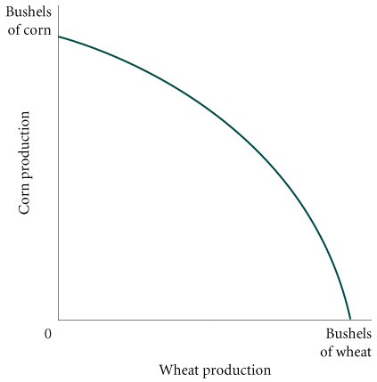
Scarcity, Choice, and Opportunity Cost
Negative Slope and Opportunity Cost
marginal rate of transformation (MRT) The slope of the production possibility frontier (ppf).

Slide 27
Increasing opportunity cost

Slide 28
Increasing opportunity cost
2:3

Slide 29
Increasing opportunity cost
2:3

Slide 30
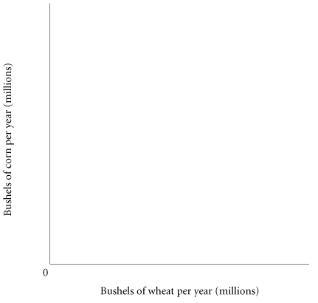

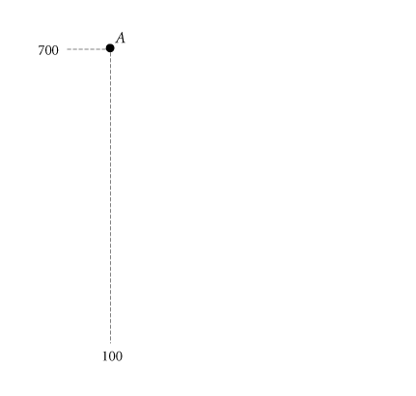
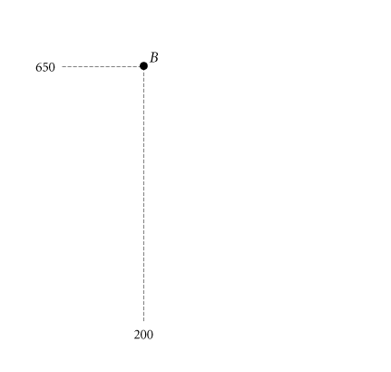
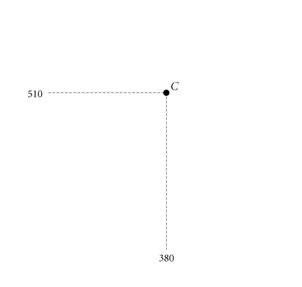
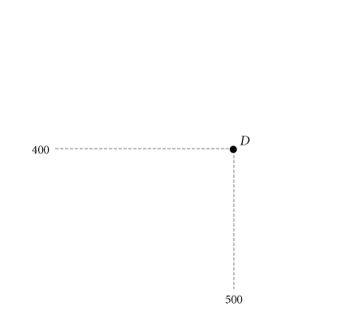
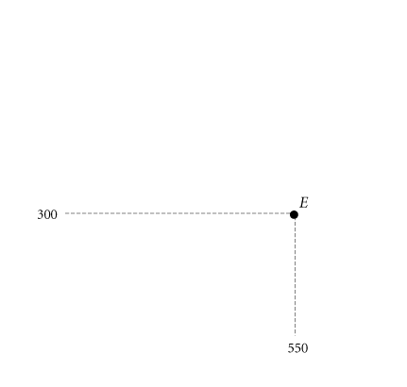
Scarcity, Choice, and Opportunity Cost
The Law of Increasing Opportunity Cost: As society makes more of one output good, it needs to give up more and more of the other output good.
Production Possibility Schedule for Total Corn and Wheat Production in Ohio and Kansas
POINT ON PPF | TOTAL CORN PRODUCTION (MILLIONS OF BUSHELS PER YEAR) | TOTAL WHEAT PRODUCTION (MILLIONS OF BUSHELS PER YEAR)
A | 700 | 100
B | 650 | 200
C | 510 | 380
D | 400 | 500
E | 300 | 550
Corn and Wheat Production in Ohio and Kansas

Slide 31
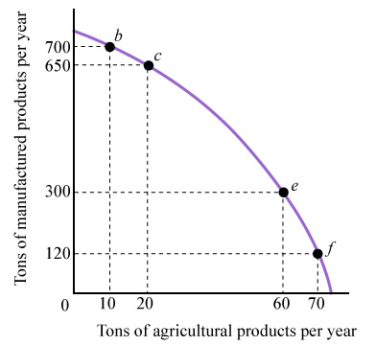
Exercise
Refer to the figure below. A 10-ton increase in the production of farm (ag) goods requires a sacrifice of manufactured goods that is:
greater between points b and c
than between points e and f.
greater between points e and f
than between points b and c.
the same between any two
points.
less and less as you move
downward along the curve.

Slide 32
Scarcity, Choice, And Opportunity Cost
Economic Growth
economic growth An increase in the total output of an economy. It occurs when a society acquires new resources or when it learns to produce more using existing resources.

Slide 33
Scarcity, Choice, And Opportunity Cost
Increasing Productivity in Corn and Wheat Production in the United States, 1935–2006
 | CORN |  | WHEAT
 | Yield Per Acre (Bushels) | Labor Hours Per 100 Bushels | Yield Per Acre (Bushels) | Labor Hours Per 100 Bushels
1935–1939 1945–1949 1955–1959 1965–1969 1975–1979 1981–1985 1985–1990 1990–1995 1998 2001 2006 | 26.1 36.1 48.7 78.5 96.3 107.2 112.8 120.6 134.4 138.2 145.6 | 108 53 20 7 4 3 NAª NAª NAª NAª NAª | 13.2 16.9 22.3 27.5 31.3 36.9 38.0 38.1 43.2 43.5 42.3 | 67 34 17 11 9 7 NAª NAª NAª NAª NAª

Slide 34
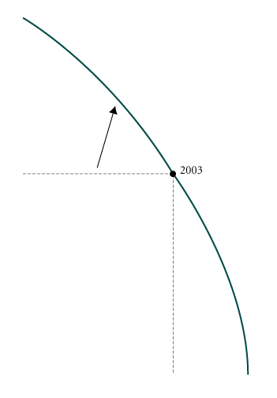
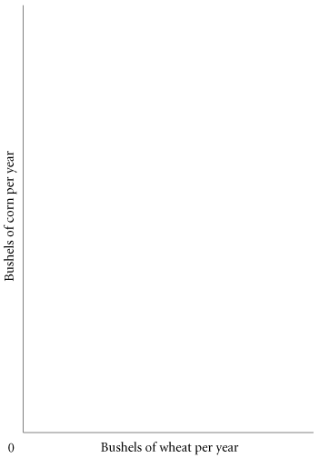
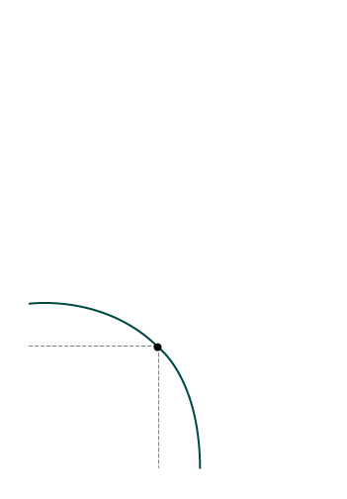
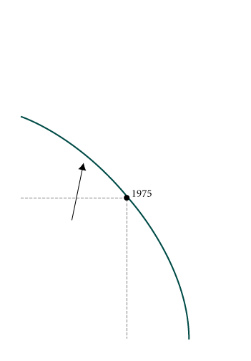
Scarcity, Choice, And Opportunity Cost
1955
Economic Growth Shifts the PPF Up and to the Right

Slide 35
Shifting the PPF
Things that can shift the PPF:
Changes in resource availability
Size, health, skill of labor force
Availability of other resources
Increases in capital stock
More output
Technological change
Employs resources more efficiently
Improvements in the rules of the game
Formal and informal institutions
Economic growth

Slide 36
PPF – consuming today vs. consuming tomorrow
C

Slide 37
Consuming today vs. consuming tomorrow
Capital Goods and Consumer Goods
consumer goods Goods produced for present consumption.
capital goods Goods that are used in the production of other goods and services.
investment The process of using resources to produce new capital.
Because resources are scarce, the opportunity cost of every investment in capital is forgone present consumption.

Slide 38
Consuming today vs. consuming tomorrow
The more we (as a society) invest today, the more we can consume tomorrow.
The more we consume today, the less there is left over for tomorrow.
Every society (as well as every person) faces the decision of how much to consume today vs. how much to consume tomorrow.
This is another example of opportunity cost - the cost of consumption today is consumption tomorrow and vice-versa.

Slide 39
Poor countries and the vicious cycle of poverty
Very poor countries cannot afford to invest much at all as all available resources are used to keep people alive and keep society operating.
Because of this they can never build enough capital to pull themselves out of poverty – and they therefore remain poor.
Rich countries can consume a lot AND invest a lot in new capital – which makes them even richer over time.

Slide 40
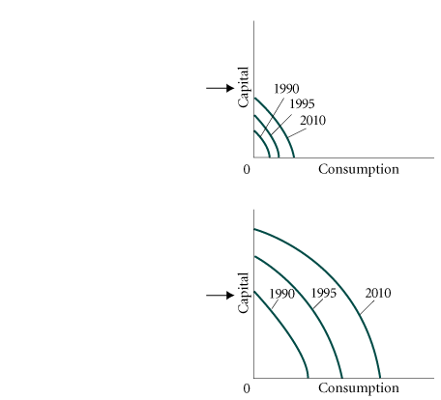
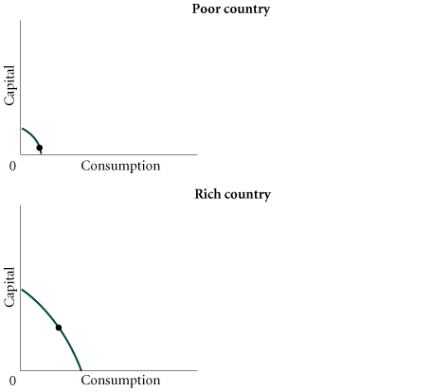
Poor countries and the vicious cycle of poverty
Sources of Growth and the Dilemma of the Poor Countries

Slide 41
Ch 3 Important Points
Households: buy stuff (mostly services) using income gained mostly from wages and salaries.
Firms: make and sell stuff and maximize profits.
Specialization – firms make it possible to make all sorts of stuff for cheaper – “economies of scale”
Different types of firms: sole proprietorship, partnership, corporation
Government:
Establish “rules of the game,” provide public services and monitor/tweak the economy.
save taxes for later
Rest of World: International trade

