Slide 1
Elasticity
We know that a change in price leads to a change in quantity demanded and quantity supplied.
But if price changes, by how much (in percentage terms) will quantity demanded change? By how much will quantity supplied change?
Elasticity tells us this.
But doesn’t the slope of the demand or supply curve tell us this too?
No!

Slide 2
Why Elasticity?
Guess who was good at the test.
Andy : “I got 100 points!”
“…out of 400 points.”
Bob : “I got 10 points.”
“…it is 10/10.”

Slide 3
Price Elasticity Of Demand
Can you tell me how sensitive or responsive the good is?
When price decreased by 1 (ΔP = -1),
…changed from 2 to 1
…changed from 1000 to 999
quantity demanded increases by 1 (ΔQ = 1)
…changed from 999 to 1000
…changed from 1 to 2

Slide 4
Elasticity
elasticity A general concept used to quantify the response in one variable when another variable changes.

Slide 5
Price Elasticity Of Demand
price elasticity of demand The ratio of the percentage of change in quantity demanded to the percentage of change in price; measures the responsiveness of quantity demanded to changes in price.

Slide 6
EXERCISE
Suppose price falls by 20% and as a result, quantity demanded rises by 10%. What is the price elasticity of demand?
20
2
½
10
50%

Slide 7
A simple way to calculate elasticity:

Slide 8
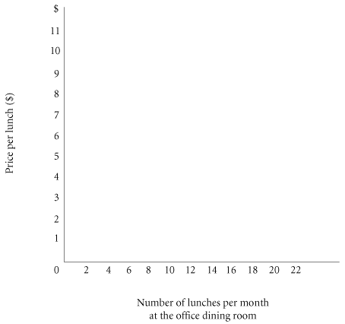
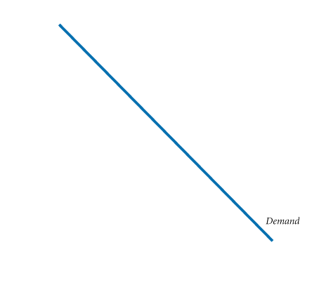
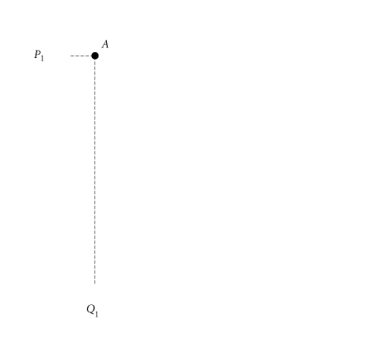
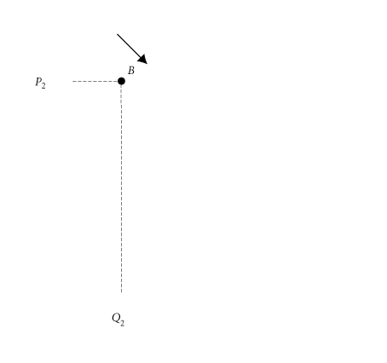
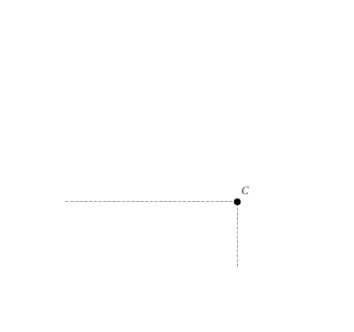
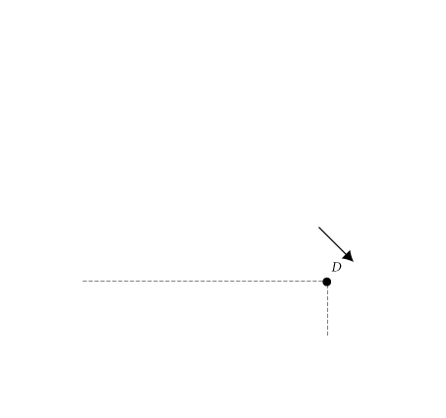
Calculating Elasticities
ELASTICITY CHANGES ALONG A STRAIGHT-LINE DEMAND CURVE
Demand Schedule for Office Dining Room Lunches
PRICE (PER LUNCH) | QUANTITY DEMANDED (LUNCHES PER MONTH)
$11 10 9 8 7 6 5 4 3 2 1 0 | 0 2 4 6 8 10 12 14 16 18 20 22
Demand Curve for Lunch at the Office Dining Room

Slide 9
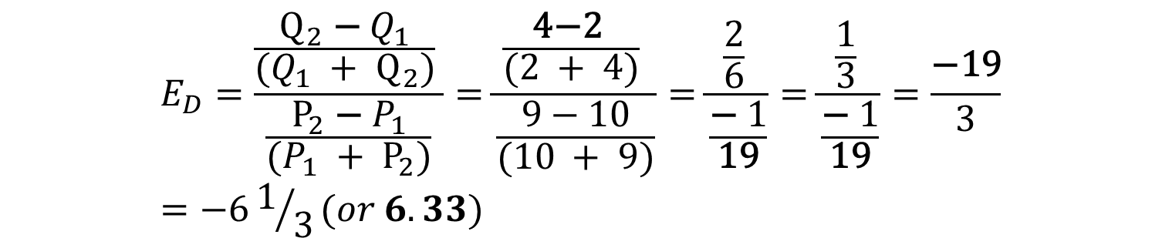
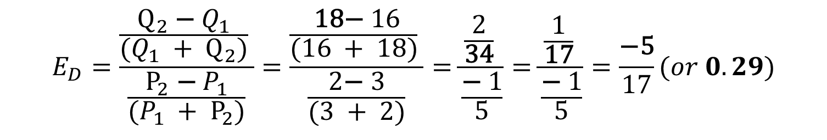
Elasticities are different at different points along a straight line
From A to B
$$E_{D}=\frac{\frac{Q_{2}\text{ − }Q_{1}}{(Q_{1} + Q_{2})} }{\frac{P_{2}\text{ − }P_{1}}{(P_{1} + P_{2})}}=\frac{\frac{\text{4−2 }}{(2 + 4)} }{\frac{9−10}{(10 + 9)}}=\frac{\frac{2}{6} }{\frac{\text{− }1}{\text{19}}}=\frac{\frac{1}{3} }{\frac{\text{− }1}{\text{19}}}=\frac{\text{−19}}{3}=−61/3(or 6.33)$$
From C to D
$$E_{D}=\frac{\frac{Q_{2}\text{ − }Q_{1}}{(Q_{1} + Q_{2})} }{\frac{P_{2}\text{ − }P_{1}}{(P_{1} + P_{2})}}=\frac{\frac{\text{ 18− }16}{(16 + 18)} }{\frac{2\text{− }3}{(3 + 2)}}=\frac{\frac{2}{\text{34}} }{\frac{\text{− }1}{5}}=\frac{\frac{1}{\text{17}} }{\frac{\text{− }1}{5}}=\frac{\text{−5}}{17}(or 0.29)$$

Slide 10
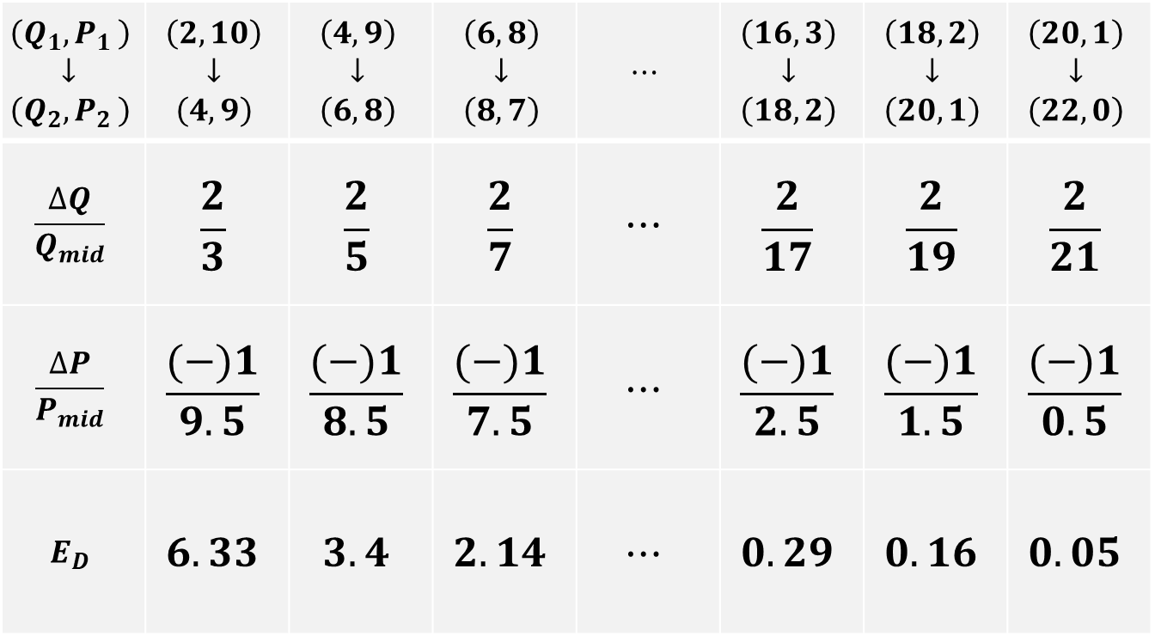
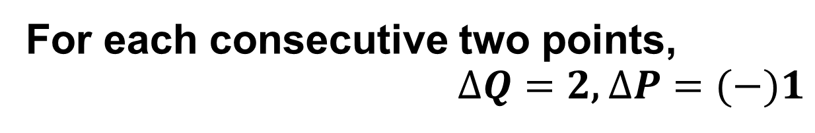
Calculating Elasticities
For each consecutive two points,
$ΔQ=2$, $ΔP=(−)1$
$$\left(Q_{1}{,P}_{1}\right)$$ $$↓$$ $$\left(Q_{2}{,P}_{2}\right)$$ | $$\left(2,10\right)$$ $$↓$$ $$\left(4,9\right)$$ | $$\left(4,9\right)$$ $$↓$$ $$\left(6,8\right)$$ | $$\left(6,8\right)$$ $$↓$$ $$\left(8,7\right)$$ | $$⋯$$ | $$\left(16,3\right)$$ $$↓$$ $$\left(18,2\right)$$ | $$\left(18,2\right)$$ $$↓$$ $$\left(20,1\right)$$ | $$\left(20,1\right)$$ $$↓$$ $$\left(22,0\right)$$
$$\frac{ΔQ}{Q_{mid}}$$ | $$\frac{2}{3}$$ | $$\frac{2}{5}$$ | $$\frac{2}{7}$$ | $$⋯$$ | $$\frac{2}{17}$$ | $$\frac{2}{19}$$ | $$\frac{2}{21}$$
$$\frac{ΔP}{P_{mid}}$$ | $$\frac{(−)1}{9.5}$$ | $$\frac{(−)1}{8.5}$$ | $$\frac{(−)1}{7.5}$$ | $$⋯$$ | $$\frac{(−)1}{2.5}$$ | $$\frac{(−)1}{1.5}$$ | $$\frac{(−)1}{0.5}$$
$$E_{D}$$ | $$6.33$$ | $$3.4$$ | $$2.14$$ | $$⋯$$ | $$0.29$$ | $$0.16$$ | $$0.05$$

Slide 11
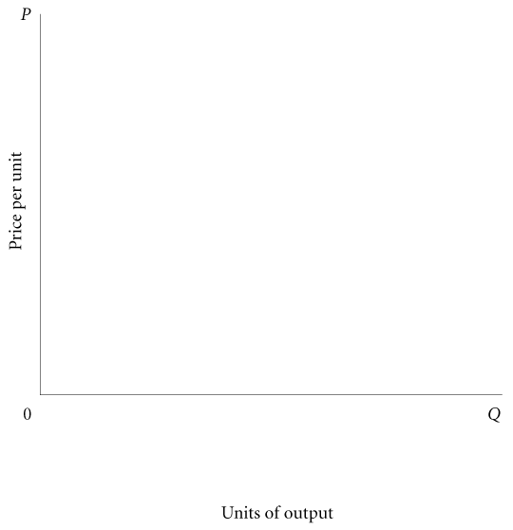
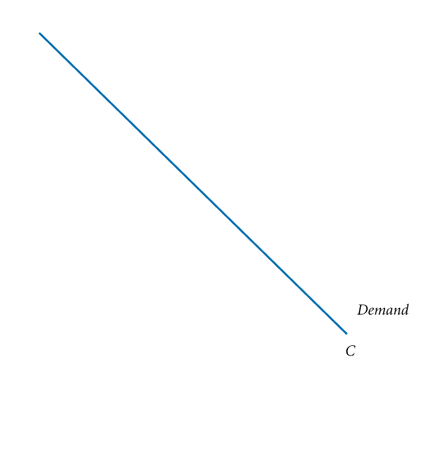
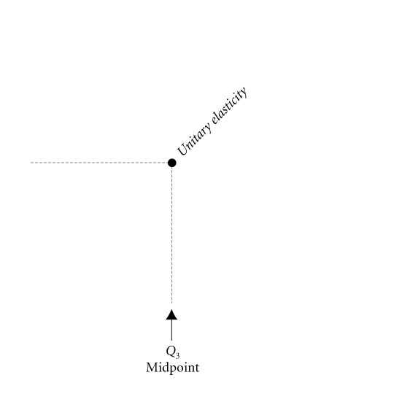
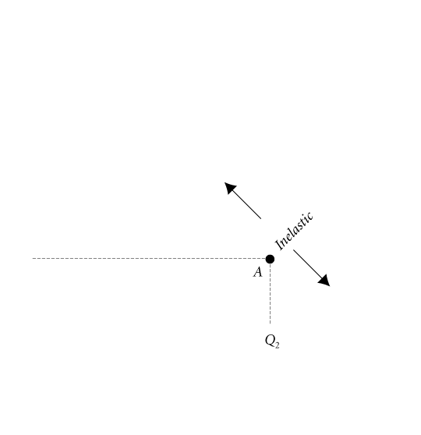
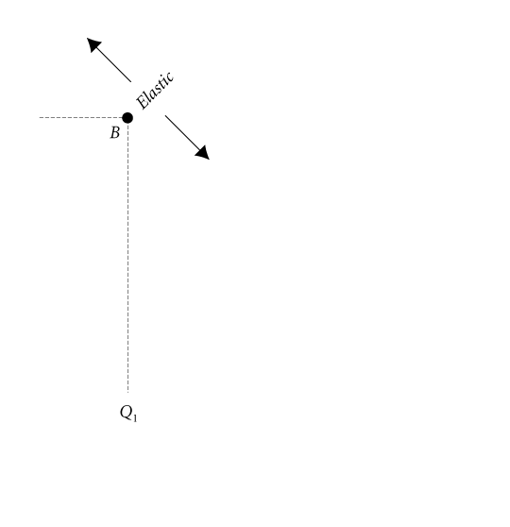
Elasticities along a straight line Demand Curve
Point Elasticity Changes Along a Demand Curve

Slide 12
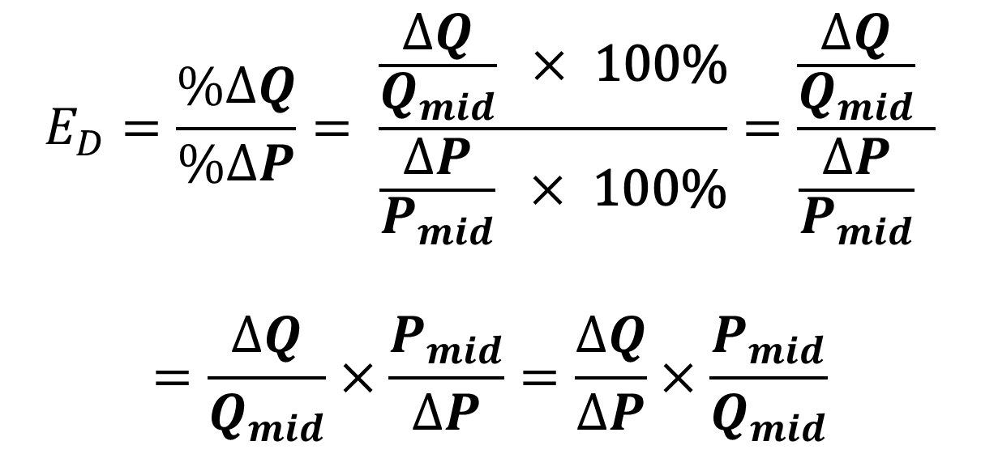
Elasticities on the straight line
$$E_{D}=\frac{\%ΔQ}{\%ΔP}= \frac{\frac{ΔQ}{Q_{mid}} ×\text{ 100\%}}{\frac{ΔP}{P_{mid}} ×\text{ 100\%}}=\frac{\frac{ΔQ}{Q_{mid}} }{\frac{ΔP}{P_{mid}} }$$
$$=\frac{ΔQ}{Q_{mid}}×\frac{P_{mid}}{ΔP}=\frac{ΔQ}{ΔP}×\frac{P_{mid}}{Q_{mid}}$$

Slide 13
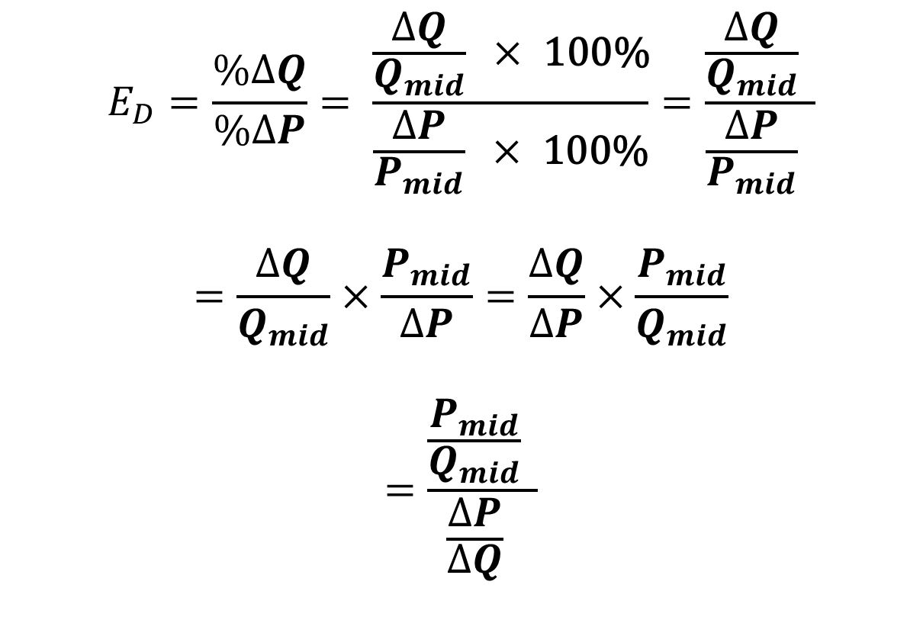
Elasticities on the straight line
$$E_{D}=\frac{\%ΔQ}{\%ΔP}= \frac{\frac{ΔQ}{Q_{mid}} ×\text{ 100\%}}{\frac{ΔP}{P_{mid}} ×\text{ 100\%}}=\frac{\frac{ΔQ}{Q_{mid}} }{\frac{ΔP}{P_{mid}} }$$
$$=\frac{ΔQ}{Q_{mid}}×\frac{P_{mid}}{ΔP}=\frac{ΔQ}{ΔP}×\frac{P_{mid}}{Q_{mid}}$$
$$=\frac{\frac{P_{mid}}{Q_{mid}} }{\frac{ΔP}{ΔQ} }$$

Slide 14
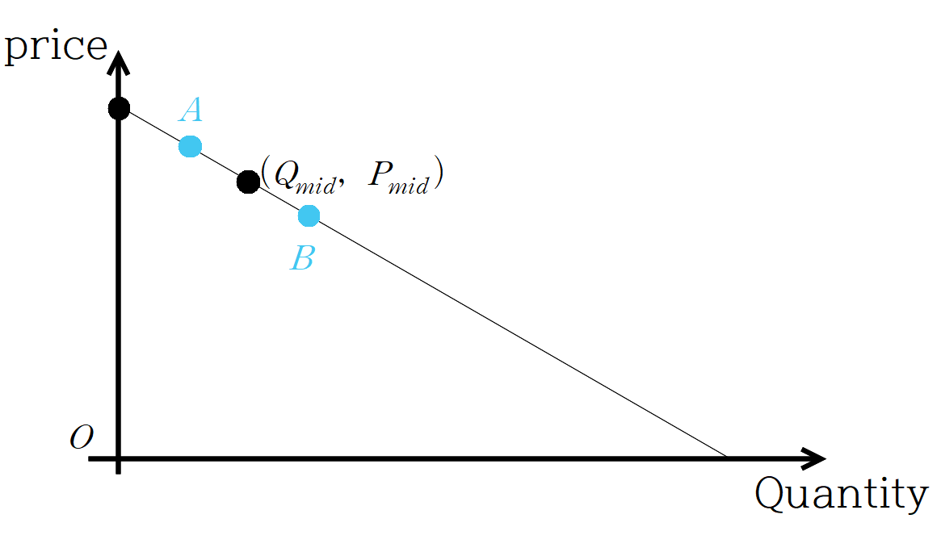
Price Elasticity Of Demand

Slide 15
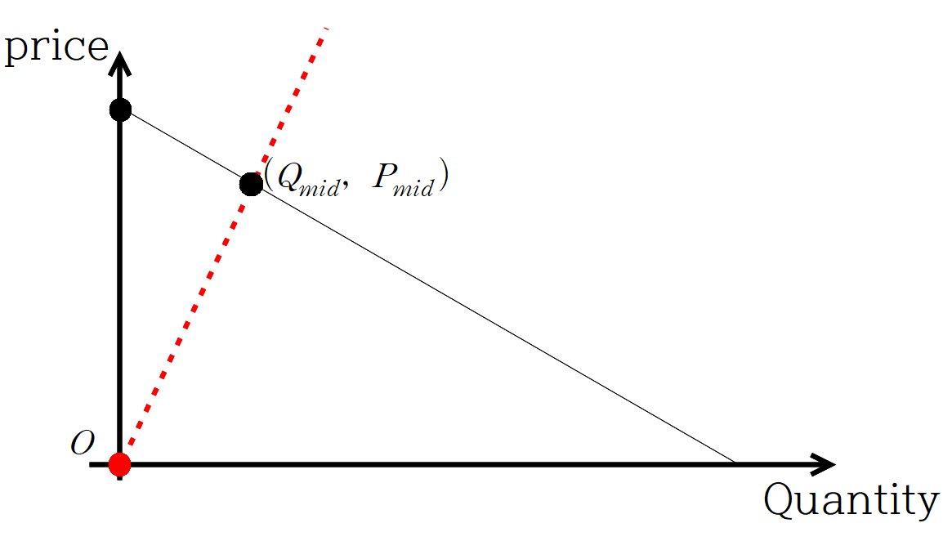

Price Elasticity Of Demand
Compare “slope” and “slope”
“slope” is steeper
$$\frac{\frac{P_{mid}}{Q_{mid}} }{\frac{ΔP}{ΔQ} }>1$$

Slide 16
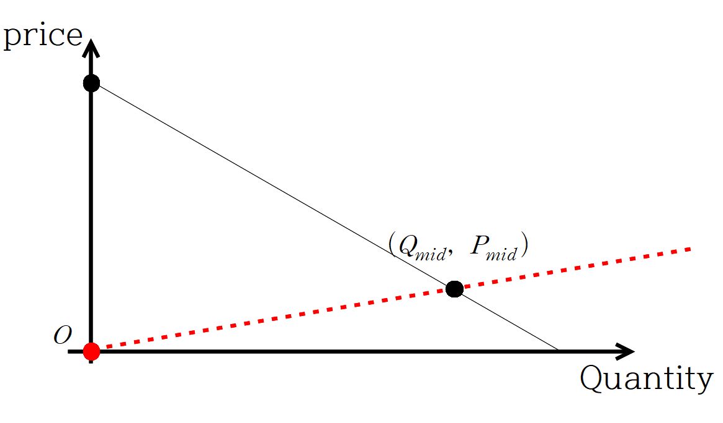

Price Elasticity Of Demand
Compare “slope” and “slope”
“slope” is flatter
$$\frac{\frac{P_{mid}}{Q_{mid}} }{\frac{ΔP}{ΔQ} }<1$$

Slide 17
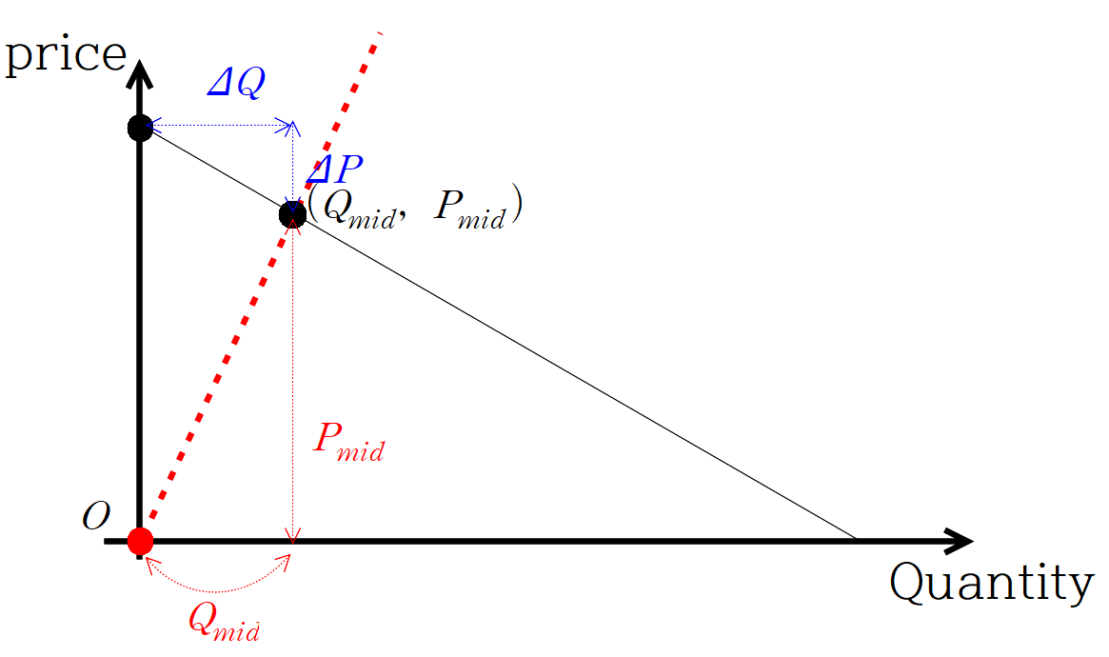
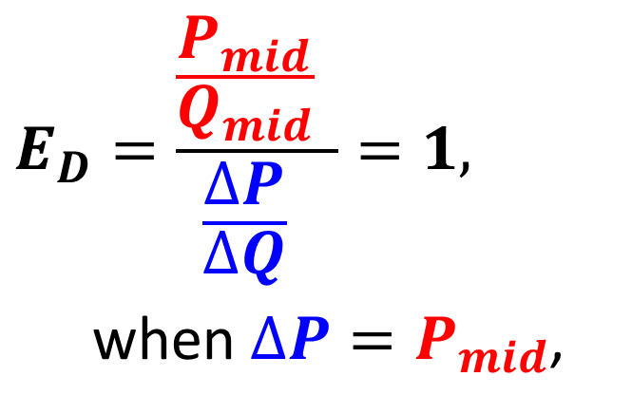
Price Elasticity Of Demand
$$E_{D}=\frac{\frac{P_{mid}}{Q_{mid}} }{\frac{ΔP}{ΔQ} }=1,$$
when $ΔP=P_{mid}$,

Slide 18
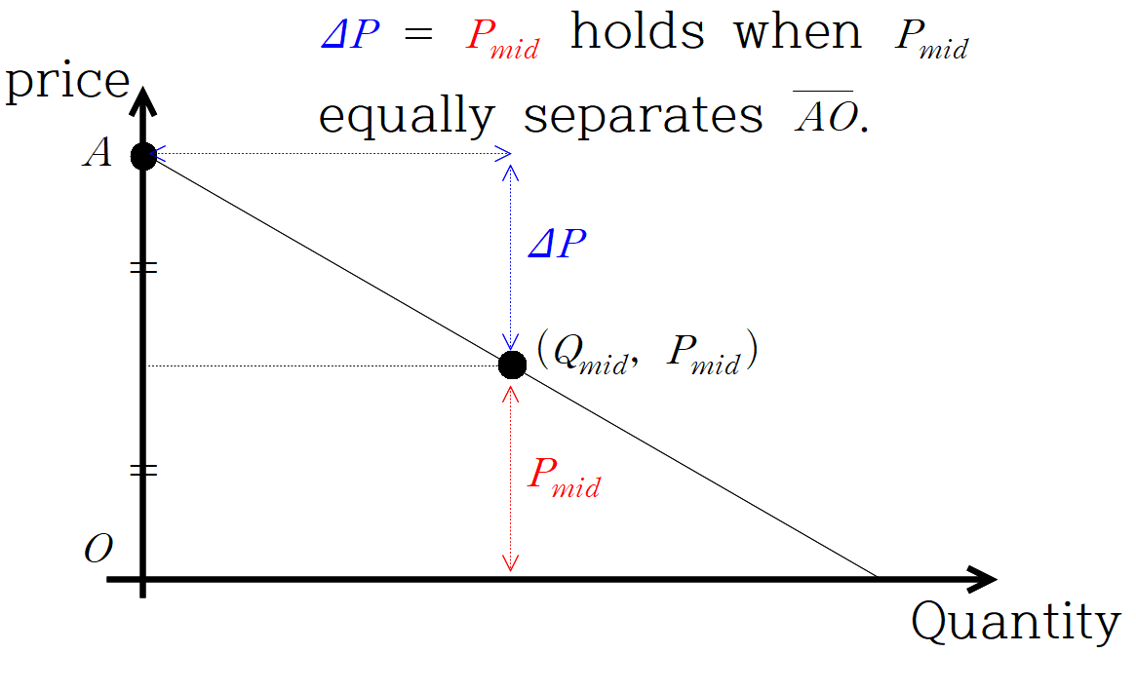
Price Elasticity Of Demand

Slide 19

Elasticities on the straight line
$$E_{S}=\frac{\%ΔQ}{\%ΔP}= … =\frac{ΔQ}{ΔP}×\frac{P_{mid}}{Q_{mid}}$$
$$=\frac{\frac{P_{mid}}{Q_{mid}} }{\frac{ΔP}{ΔQ} }$$

Slide 20
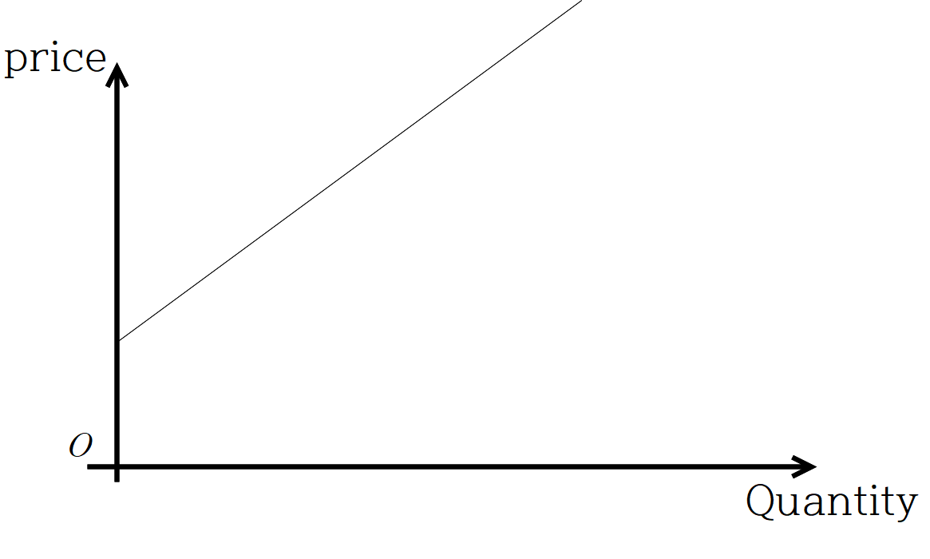
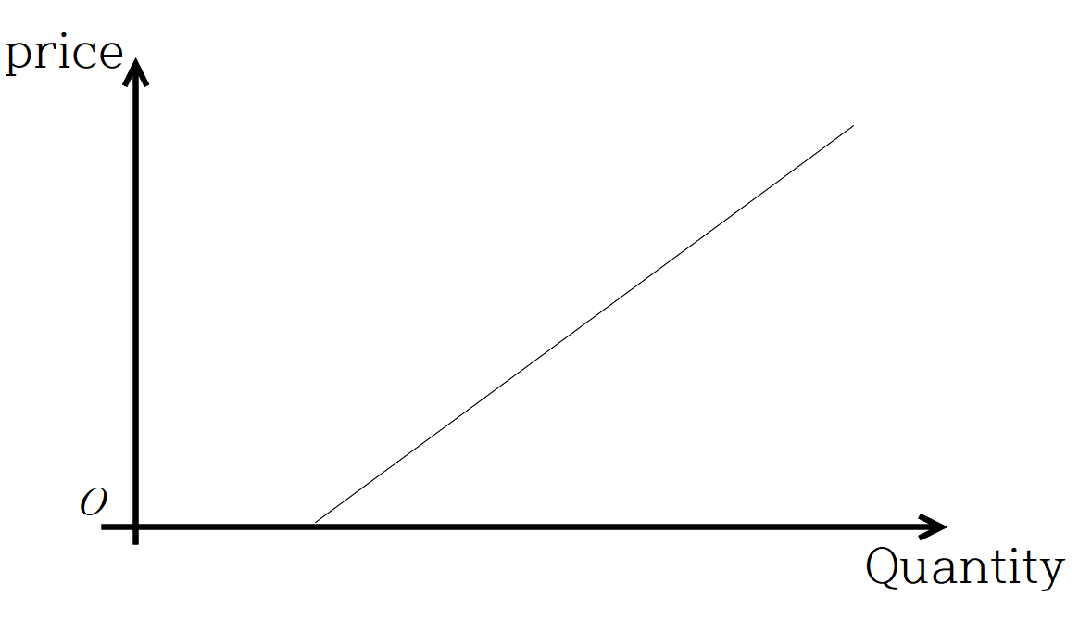
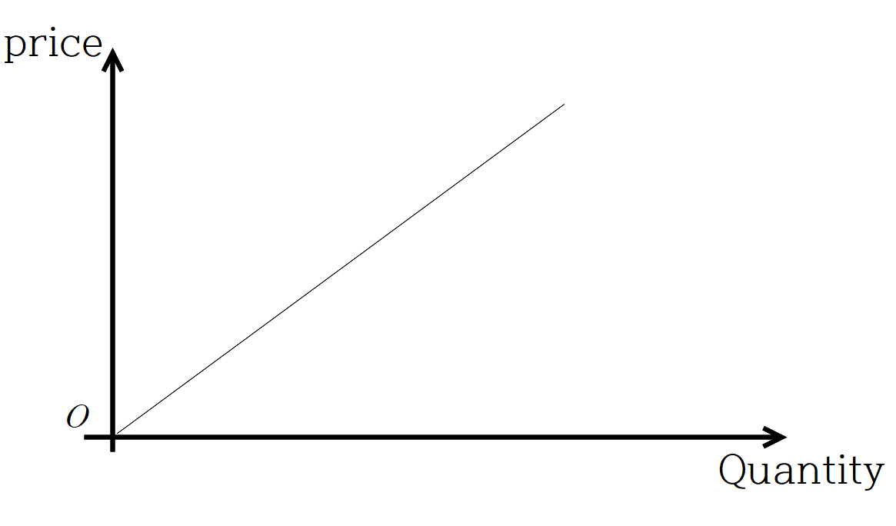



Price Elasticity Of Supply
$$E_{S}>1$$
$$E_{S}<1$$
$$E_{S}=1$$

Slide 21
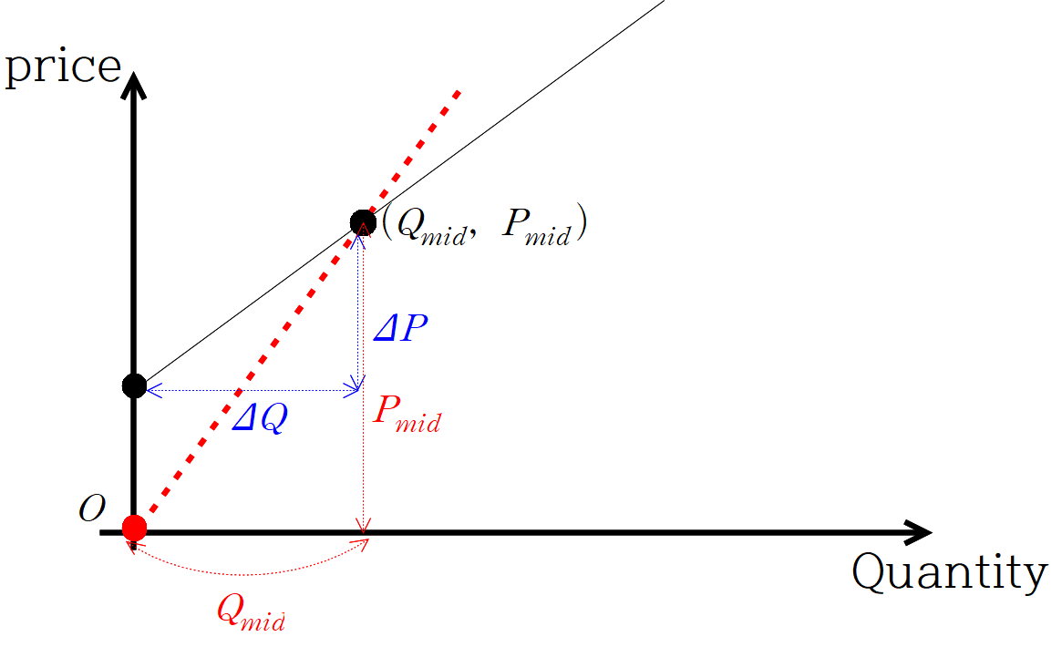

Price Elasticity Of Supply
“slope” is steeper
$$\frac{\frac{P_{mid}}{Q_{mid}} }{\frac{ΔP}{ΔQ} }>1$$

Slide 22
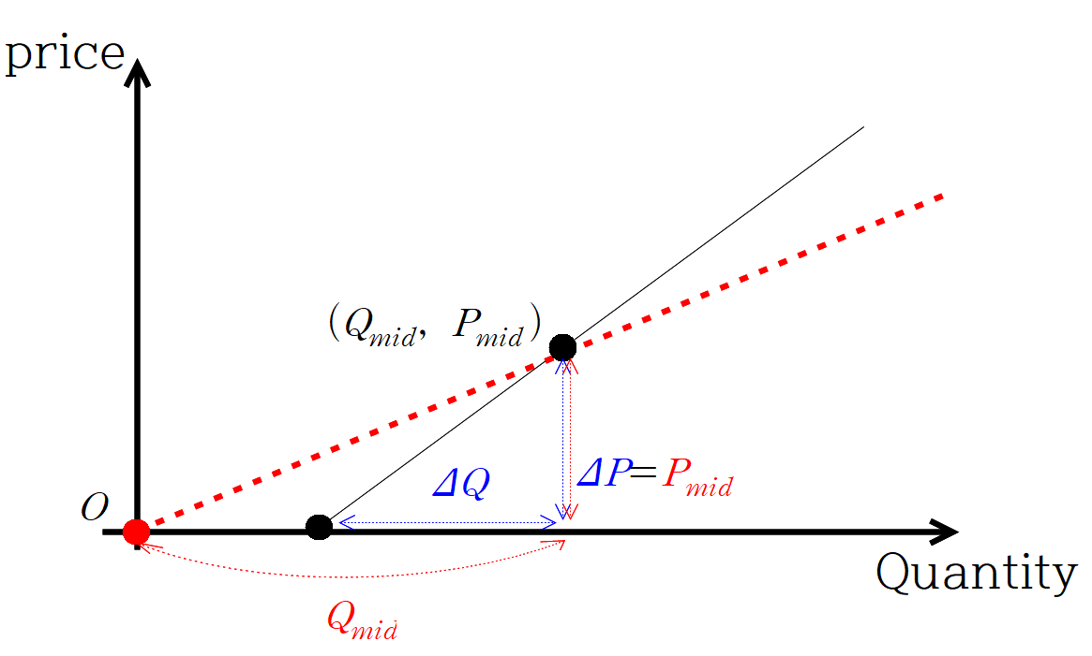

Price Elasticity Of Supply
“slope” is flatter
$$\frac{\frac{P_{mid}}{Q_{mid}} }{\frac{ΔP}{ΔQ} }<1$$

Slide 23
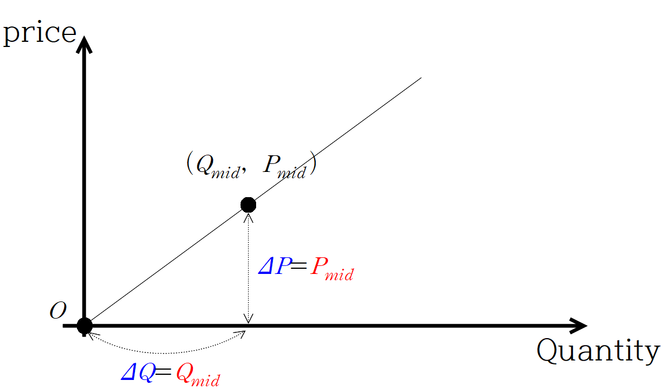

Price Elasticity Of Supply
Identical!
$$\frac{\frac{P_{mid}}{Q_{mid}} }{\frac{ΔP}{ΔQ} }=1$$

Slide 24
Elasticities on the straight line
$$E_{D}=\frac{\%ΔQ}{\%ΔP}= \frac{\frac{ΔQ}{Q_{mid}} ×\text{ 100\%}}{\frac{ΔP}{P_{mid}} ×\text{ 100\%}}=\frac{\frac{ΔQ}{Q_{mid}} }{\frac{ΔP}{P_{mid}} }$$
$$=\frac{ΔQ}{Q_{mid}}×\frac{P_{mid}}{ΔP}=\frac{ΔQ}{ΔP}×\frac{P_{mid}}{Q_{mid}}$$

Slide 25
Elasticity and Slope
While elasticity and slope are not the same thing, they are related.
For any given price, a “flatter” demand/supply curve is more elastic than a “steeper” demand/supply curve.

Slide 26
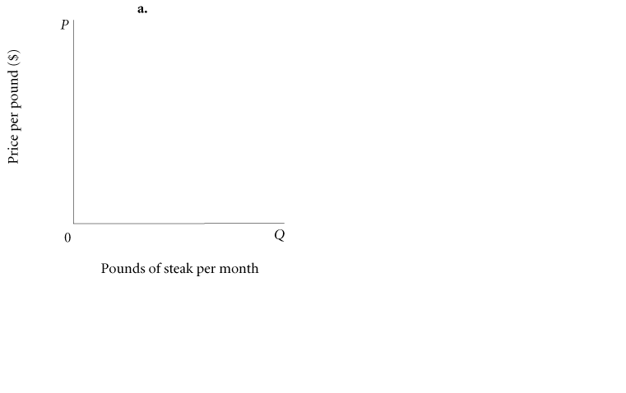
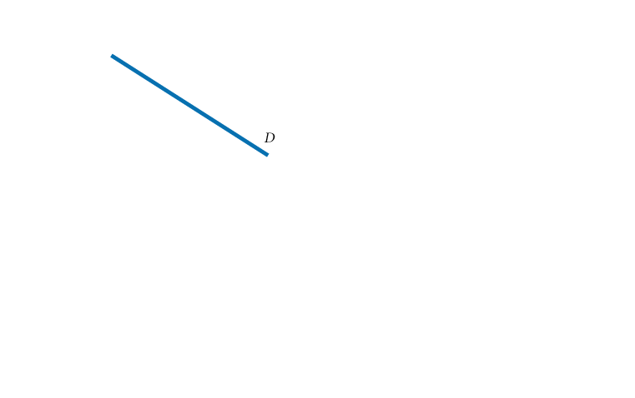
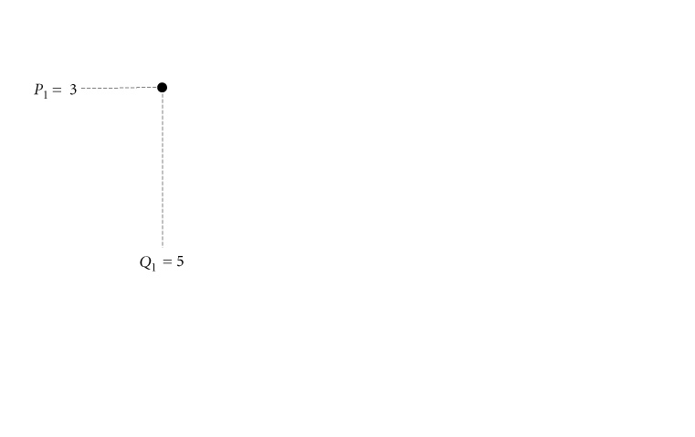
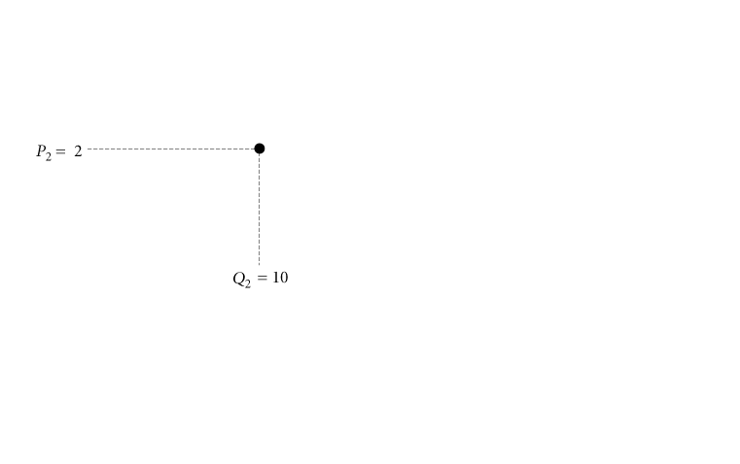
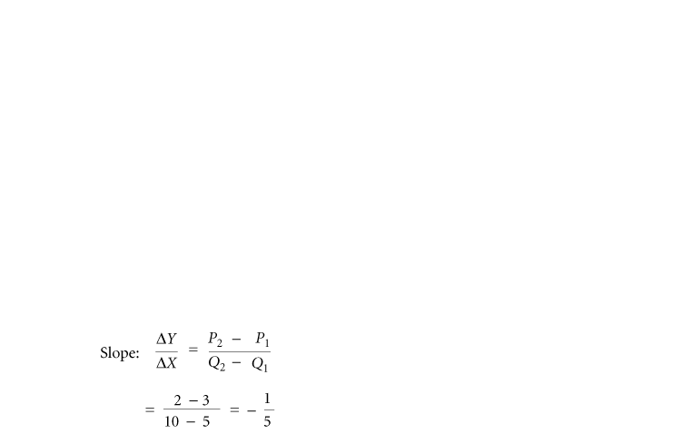
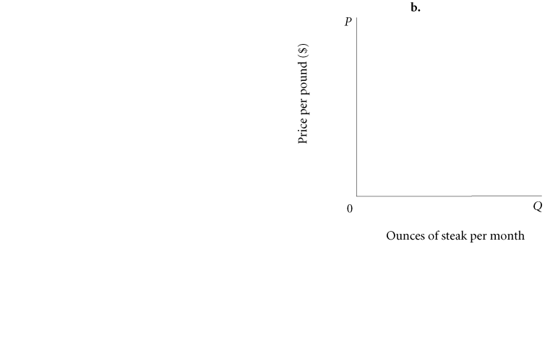
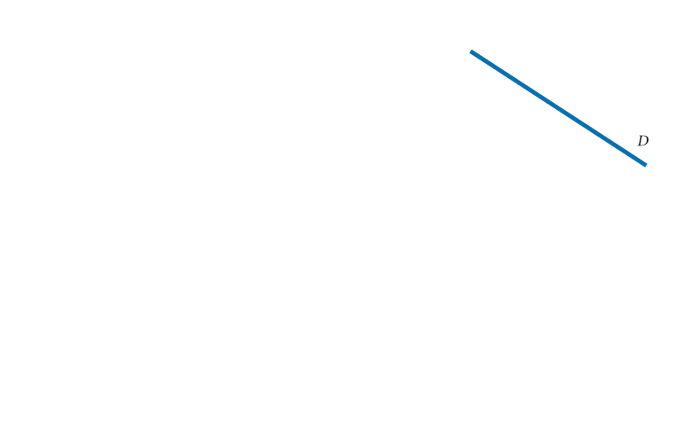
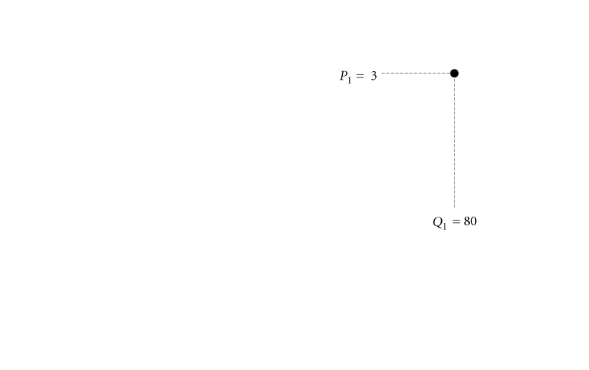
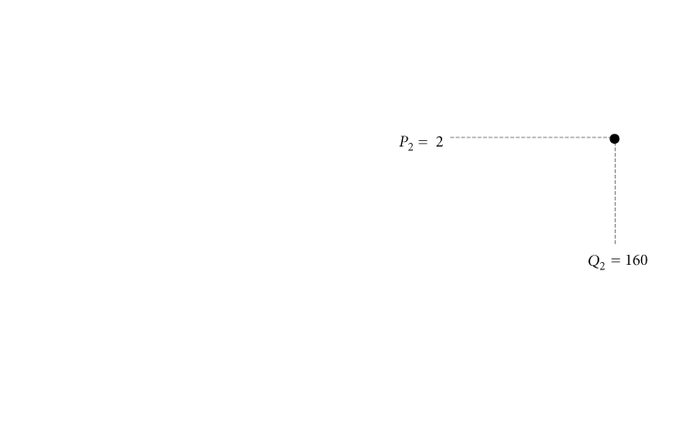
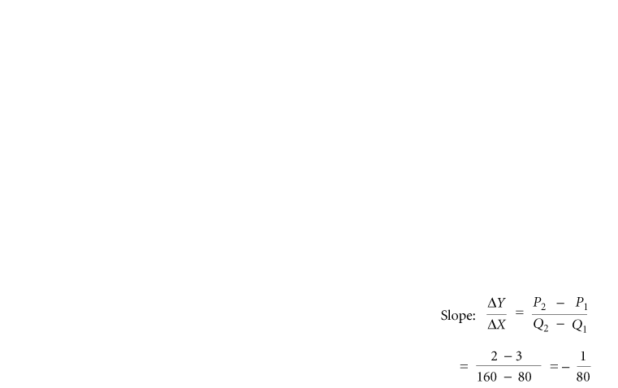
Price Elasticity Of Demand
SLOPE AND ELASTICITY
Slope Is Not a Useful Measure of Responsiveness

Slide 27
Price Elasticity Of Demand
SLOPE AND ELASTICITY

Slide 28
Price Elasticity Of Demand
SLOPE AND ELASTICITY

Slide 29
Elasticity and Slope
While elasticity and slope are not the same thing, they are related.
For any given price, a “flatter” demand/supply curve is more elastic than a “steeper” demand/supply curve, if two demand curves have the same midpoint.

Slide 30
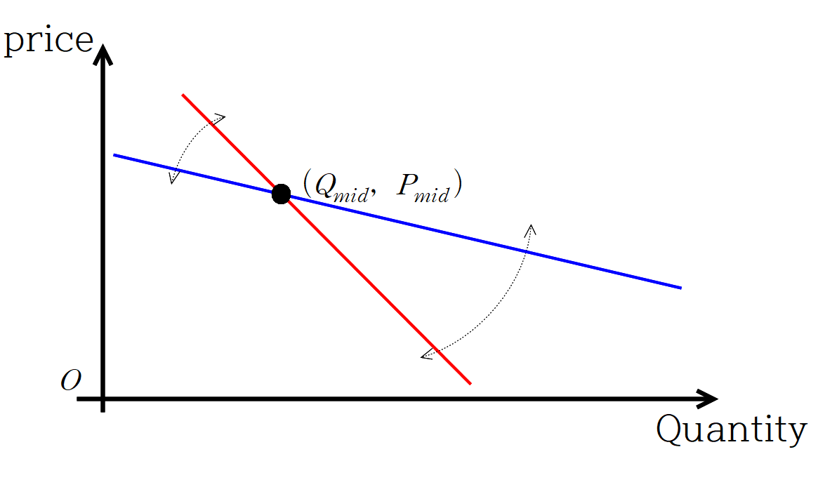
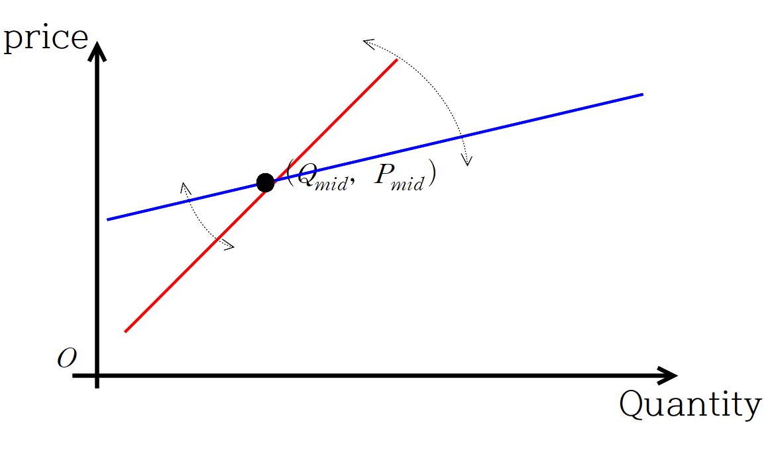
Elasticity and Slope
With two demand/supply curves, when the midpoint of each change in price and quantity demanded/supplied are identical…
“slope” is flatter and it is more elastic than the other

