Slide 1
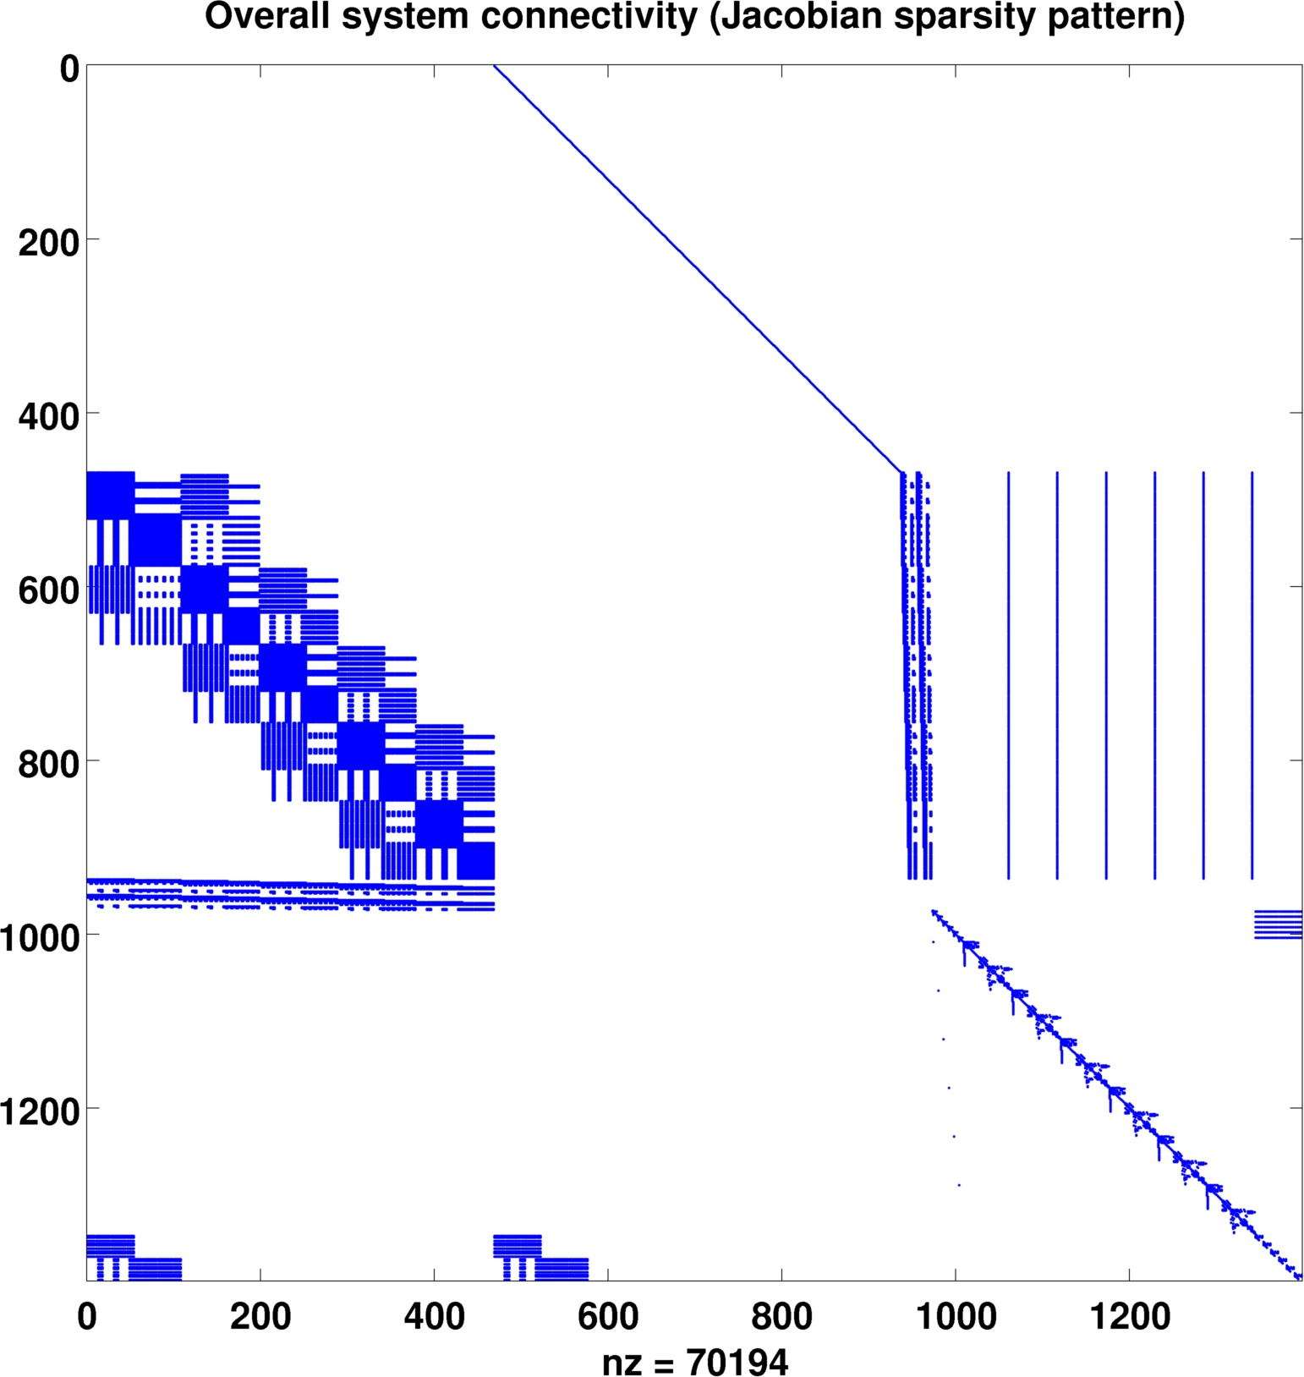
Mechanics (FEM)
Sarcomere to Mechanics
Spindle to Motoneuron
Motoneuron
Motoneuron to Sarcomere
Mechanics to Spindle
Sarcomere
Spindle

