Slide 1
Adaptive Temporal Semantics Learning
Task- and Patient-Conditioned Temporal Representation Learning for Asynchronous EHR
Weekly Group Meeting | EHR Representation Learning

Slide 2
Agenda
1. Core Idea: Why Fixed Temporal Windows Fall Short
2. Paper 1: LLMs as Unified Multimodal Learners
3. Paper 2: Computable Longitudinal Patient Journeys
4. Paper 3: Generative Deep Patient (GDP)
5. Connections & Discussion

Slide 3
Core Hypothesis
Clinical temporal semantics is NOT fixed.
It varies with: patient state + disease stage + downstream task
Stable ICU patient: 12-24h history matters (long-term trend)
Crashing patient: 1-3h history matters (acute dynamics)
Recovering patient: 6-12h history matters (recovery trajectory)
No universally optimal window exists.

Slide 4
From Fixed Window to Adaptive Kernel
Traditional:
if |t_i - t_j| < 5h:
attend(t_i, t_j)
Problem: same window for all
patients and all tasks
Ours:
sigma_t = f(patient_state, task)
K(dt) = exp(-dt^2 / (2*sigma_t^2))
Model learns: how far back
to look for THIS patient
and THIS task

Slide 5
Three Research Questions
RQ1: Does fixed temporal granularity limit EHR representation?
Compare 1h / 3h / 5h / 12h / 24h across all tasks
-> No single window is optimal
RQ2: Is temporal relevance patient-dependent?
Learned sigma_t correlates with SOFA change, vital instability
-> Higher acuity -> smaller sigma_t -> focus on recent
RQ3: Should downstream tasks reshape temporal representation?
Mortality: acute + long-term burden
Decompensation: recent rapid dynamics
Phenotyping: longer-term disease trajectory

Slide 6
Three Core Papers
Paper 1: Large Language Models as Unified Multimodal Learners
-> LLM + EHR serialization (naive baseline we improve upon)
Paper 2: Computable Longitudinal Patient Journeys (Nature Medicine)
-> Change tracking + knowledge graph + time-to-event analysis
Paper 3: GDP - A Multimodal Generative Model for EHR
-> Next-time-step prediction + cross-modal attention

Slide 7
Paper 1: Unified Multimodal Learners
Core idea: Serialize ALL clinical data -> feed to LLM
Time-invariant: Age: 67, Sex: Male, HR: 92 bpm ...
Time-variant: Heart Rate: 76.09, 78.75, 76.88, 69.75 ...
Encoder: ModernBERT (8192 token context)
Decoder: Llama 3.1, Gemma 2B, DeepSeek-R1
Result: Multimodal > unimodal across all models
MIMIC-III mortality: AUROC 0.93 (vs 0.90 fusion baseline)

Slide 8
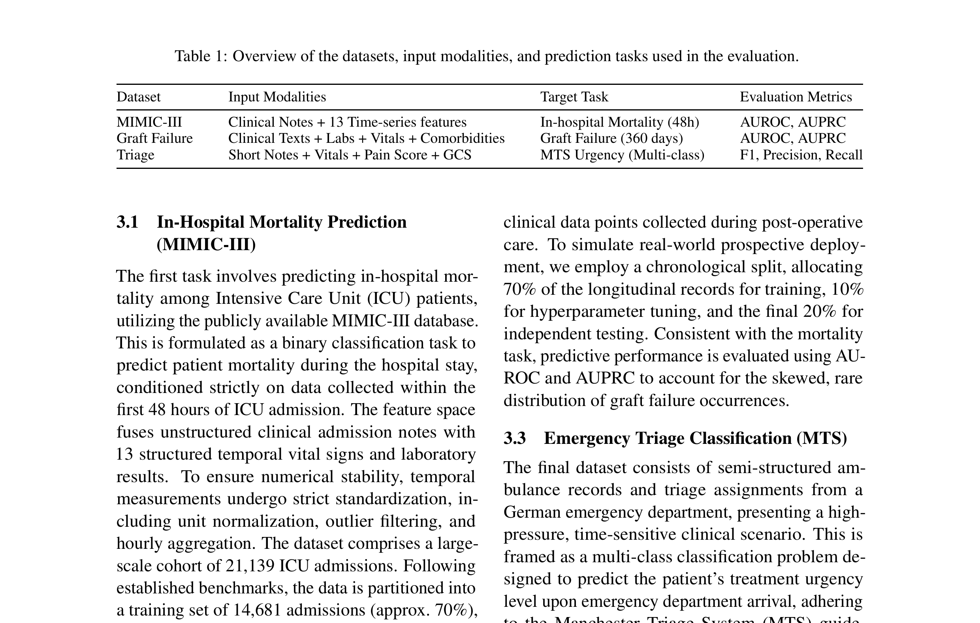
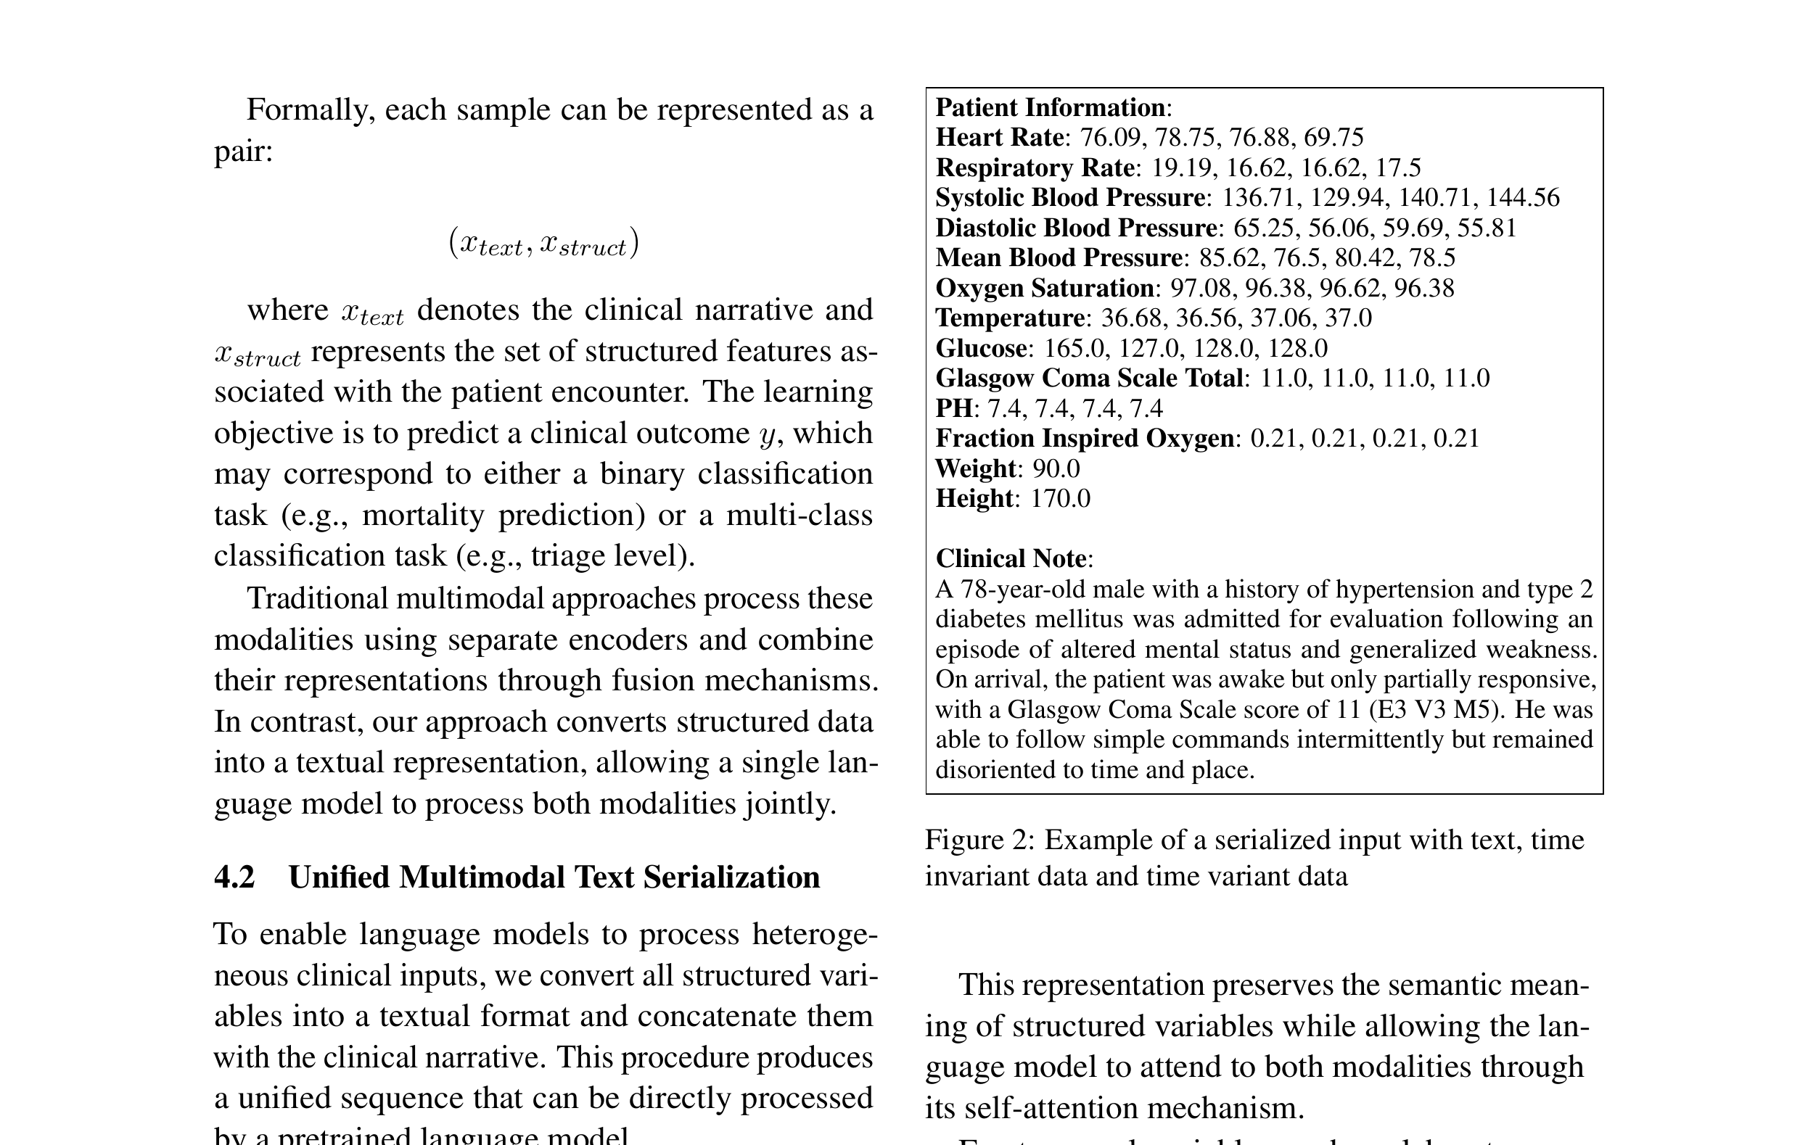
Paper 1: Serialized Input Examples

Slide 9
Paper 1: Results & Limitations
Key limitation: comma-separated values lose temporal ordering
No adaptive mechanism - same attention for all patients
Context window explosion with long histories
-> This is exactly what ATSL aims to fix

Slide 10
Paper 2: Computable Longitudinal Patient Journeys
Nature Medicine 2026 | 35.12M patients -> 25.3M active adults
Step 1: LLM extraction from unstructured notes
Change tracking: added / modified / removed
F1 = 99.4% against physician reference standard
Step 2: Knowledge graph construction
88M nodes, 241M edges, mapped to UMLS/HPO/RxNorm
Step 3: Longitudinal analysis (GLP-1 RA example)
Time-to-event analysis beyond fixed time-point endpoints

Slide 11
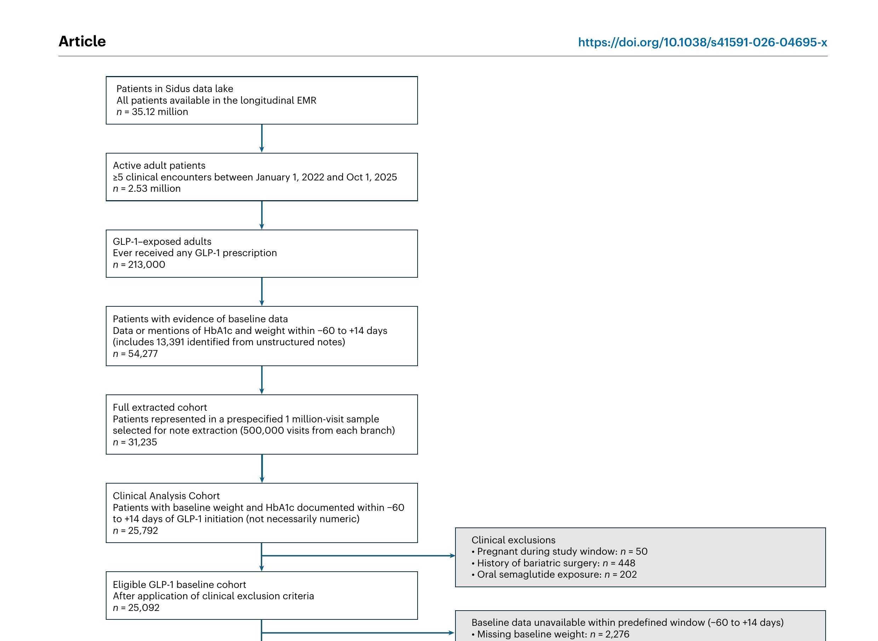
Paper 2: Knowledge Graph & Change Tracking
Change tracking = temporal semantics transition detection
KG as structured knowledge base for ATSL
Time-to-event analysis aligns with adaptive window concept

Slide 12
Paper 3: GDP - Generative Deep Patient
Unified model for BOTH classification AND narrative generation
Structured EHR -> CNN-Transformer encoder
Clinical notes -> BERT encoder
LLaMA decoder + cross-modal attention to both encoders
Pre-training objectives:
1. Masked Feature Prediction (MFP)
2. Next-Time-step Prediction (NTP) <- temporal semantics!
3. Generative pretraining (discharge summaries)
Result: HF AUROC 0.923 (vs 0.779 baseline)

Slide 13
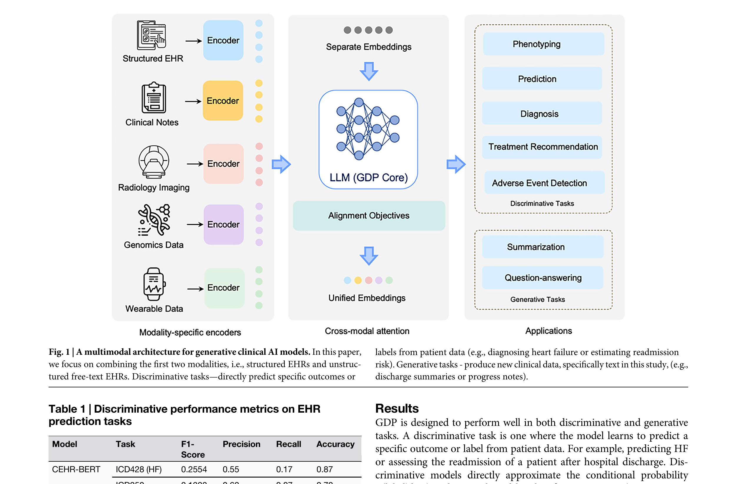
Paper 3: Architecture & Results
NTP = temporal semantics learning (but fixed granularity)
Task-conditioned representation needed
ATSL can upgrade NTP to adaptive temporal semantics prediction

Slide 14
Connections to ATSL
Strengths
Paper 1: LLMs can integrate
multimodal clinical data
Paper 2: Longitudinal change
tracking captures transitions
Paper 3: NTP learns temporal
structure effectively
Gaps
Paper 1: No explicit temporal
modeling, no adaptation
Paper 2: Descriptive only,
no predictive model
Paper 3: Fixed granularity,
no task conditioning
Our Opportunity
sigma_t = f(patient_state, task)
Adaptive temporal kernel
learned bandwidth per patient
and per task
Future Work
Combine change tracking with
adaptive sigma_t switching
Use KG as structured knowledge
base for temporal semantics
Upgrade GDP's NTP to adaptive
temporal semantics prediction

Slide 15
Next Steps
1. Implement adaptive temporal kernel module
2. Run fixed window comparison (RQ1)
3. Train on MIMIC-IV with 4 clinical tasks
4. Analyze learned sigma_t vs clinical indicators (RQ2)
5. Task-conditioned evaluation (RQ3)
6. Ablation study: A1 -> A5
7. Paper writing & submission

Slide 16
Thank You
Questions & Discussion

