Slide 1
PowerShell Core: What is it and how do I use it?
Kevin Laux
Platform Engineering
April 10th 2019

Slide 2

Kevin Laux
Senior Platform Engineer
- PowerShell Advocate
- Leader RTPSUG
- User since v3

Slide 3

What is PowerShell?
Notes:
CLI with the purpose of task automation and configuration management for Windows based Operating Systems
-Built into Windows since Server 2008
-Available for Windows XP SP2 and Server 2003 SP2 (Feb 2008 over a decade)
-CMDlets are unique and give PowerShell its POWER!
-verb-noun easy to understand
Uses PowerShell ISE for scripting environment
.Net Framework
The latest version is 5.x
Like the ISE Microsoft has said that PowerShell will only receive security updates going forward.

Slide 4

What is PowerShell Core?
Notes:
-PowerShell v 6.0
-based on .NetCore instead of .Net Framework
-Open Source and runs on Linux, Mac OS, and Windows. (Windows IoT, Arm support as well)
-Installs sxs with PowerShell 5.0
-pwsh vs powershell.exe
-Microsoft works actively on PowerShell Core. PowerShell, is in a state of extended support. Microsoft has no plans to add features to PowerShell, but it will release critical bug fixes and security updates.
-PowerShell Core has no ISE USE VS CODE!
-missing things like:
web forms, get-credential is all cli based
no out-gridview
limited cmdlets
Supports Remoting over SSH as well as WinRM

Slide 5
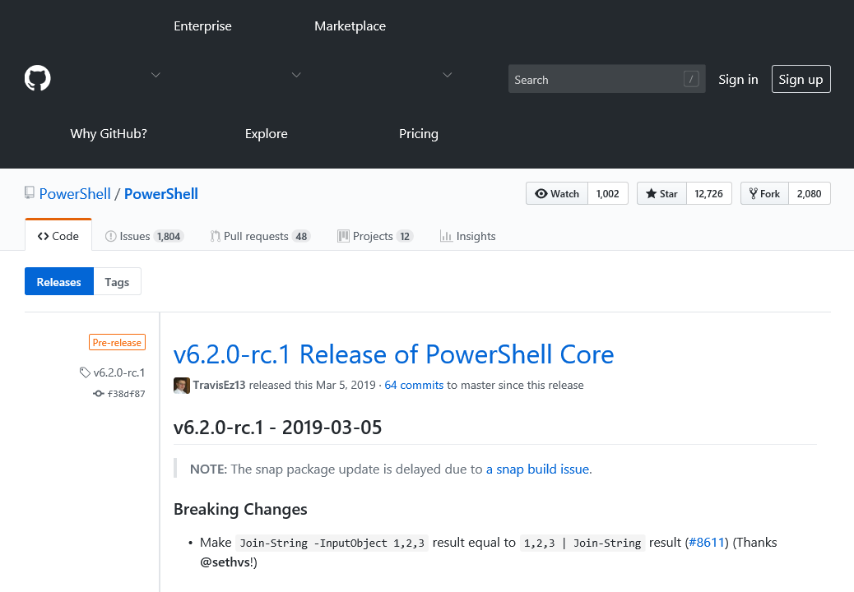
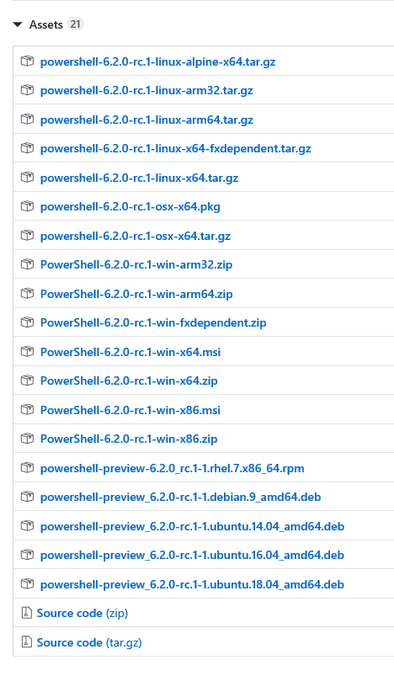
Install
Notes:
-Github for install files
-Version for everything including .rpm, .deb for linux

Slide 6
Demo
Getting Started

Slide 7
Demo
PowerShell vs PowerShell Core

Slide 8
Demo
OpenSSH

Slide 9
Demo
PowerShell Core on Linux

Slide 10
Demo
Remoting between Windows and Linux

Slide 11
Demo
Script Demo

Slide 12
One more thing…
Notes:
-PowerShell v 6.0
-based on .NetCore instead of .Net Framework
-Open Source and runs on Linux, Mac OS, and Windows. (Windows IoT, Arm support as well)
-Installs sxs with PowerShell 5.0
-pwsh vs powershell.exe
-Microsoft works actively on PowerShell Core. PowerShell, is in a state of extended support. Microsoft has no plans to add features to PowerShell, but it will release critical bug fixes and security updates.
-PowerShell Core has no ISE USE VS CODE!
-missing things like:
web forms, get-credential is all cli based
no out-gridview
limited cmdlets
Supports Remoting over SSH as well as WinRM

Slide 13
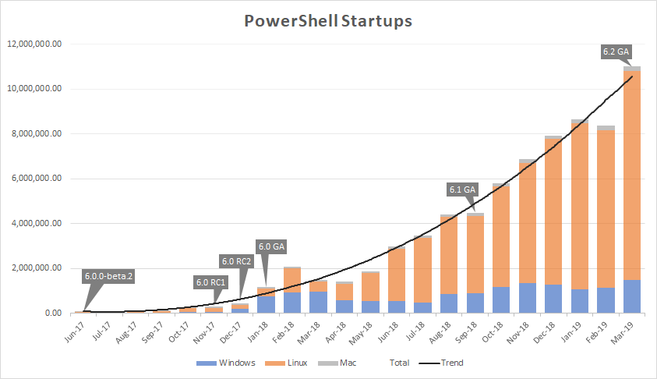
PowerShell 7
Based on .NetCore 3.0
Bulk of users Linux not Windows
90+% Compatibility
“A full replacement of Windows PowerShell 5.1.“
Preview Availability in May (likely)

Slide 14
Information
Personal:
Email: kevin.laux@metlife.com
Join the PowerShell Yammer Group!
PowerShell Training May 21-23
Research Triangle PowerShell Users Group:
Virtual - Meeting 1st Wednesday of month
Onsite - Meeting 3rd Wednesday of month
Website: https://rtpsug.com/
Meetup: https://www.meetup.com/Research-Triangle-PowerShell-Users-Group/
Youtube: https://www.youtube.com/c/RTPSUG
PowerShell Saturday: September 21st, 2019
On NC State Centennial Campus

