Slide 1
HW8&9讲解
唐冰宇
21210240074@m.fudan.edu.cn

Slide 2
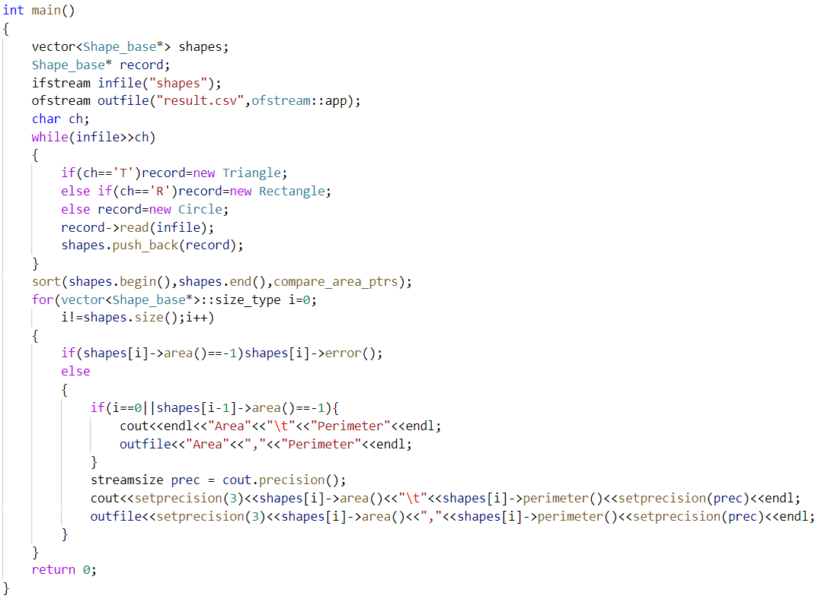
问题1
new 之后没有delete

Slide 3
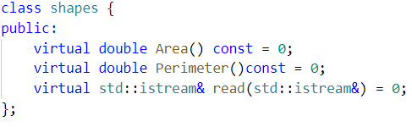
问题2
基类缺少
虚析构函数
Notes:
有了虚析构函数，才能通过动态绑定，让系统根据指针指向的实际对象类型来调用相应的析构函数

Slide 4
HW8-1 部分参考代码
#ifndef GUARD_Student_info
#define GUARD_Student_info
#include<iostream>
#include<vector>
#include<string>
class Core {
public:
Core():midterm(0),final(0) {}
Core(std::istream& is) { read(is); }
virtual ~Core() {}
std::string name() const { return n; }
virtual double grade() const;
virtual std::istream& read(std::istream&);
protected:
std::istream& read_common(std::istream&);
double midterm, final;
std::vector<double> homework;
private:
std::string n;
};
Student_info.h

Slide 5
class Grad: public Core {
public:
Grad():thesis(0){}
Grad(std::istream& is) { read(is); }
double grade() const;
std::istream& read(std::istream&);
private:
double thesis;
};
std::istream& read_hw(std::istream&, std::vector<double>&);
bool compare(const Core&, const Core&);
bool compare_Core_ptrs(const Core*, const Core*);
#endif
Student_info.h

Slide 6
#include "Student_info.h"
#include "grade.h"
std::istream& Core::read_common(std::istream& in) {
in >> n >> midterm >> final;
return in;
}
std::istream& read_hw(std::istream& in, std::vector<double>& hw) {
if (in) {
hw.clear();
double x;
while (in >> x)
hw.push_back(x);
in.clear();
}
return in;
}
std::istream& Core::read(std::istream& in) {
read_common(in);
read_hw(in, homework);
return in;
}
Student_info.cpp

Slide 7
std::istream& Grad::read(std::istream& in){
read_common(in);
in >> thesis;
read_hw(in, homework);
return in;
}
double Core::grade() const {
return ::grade(midterm, final, homework);
}
double Grad::grade() const{
return std::min(Core::grade(), thesis);
}
bool compare(const Core& c1, const Core& c2){
return c1.name() < c2.name();
} bool compare_Core_ptrs(const Core* cp1, const Core* cp2) {
return compare(*cp1, *cp2);
}
Student_info.cpp

Slide 8
#include <algorithm>
#include <iomanip>
#include <ios>
#include <iostream>
#include <stdexcept>
#include <string>
#include <vector>
#include <fstream>
#include "grade.h"
#include "Student_info.h"
using std::cin; using std::setprecision;
using std::cout; using std::sort;
using std::domain_error; using std::streamsize;
using std::endl; using std::string;
using std::max; using std::vector;
using std::ifstream;
int main(){
vector<Core*> students;
Core* record;
char ch;
string::size_type maxlen = 0;
ifstream infile("grades2");
main.cpp

Slide 9
while (infile >> ch) {
if (ch == 'U')
record = new Core;
else
record = new Grad;
record->read(infile);
maxlen = max(maxlen, record->name().size());
students.push_back(record);
}
sort(students.begin(), students.end(), compare_Core_ptrs);
for (vector<Core*>::size_type i = 0; i != students.size(); ++i) {
cout << students[i]->name()
<< string(maxlen + 1 - students[i]->name().size(), ' ');
try {
double final_grade = students[i]->grade();
streamsize prec = cout.precision();
cout << setprecision(3) << final_grade << setprecision(prec) << endl;
}
catch (domain_error e) {
cout << e.what();
}
delete students[i];
}
return 0;
}
main.cpp

Slide 10
HW8-2 部分参考代码
class Shape{
public:
Shape() : area(0), perimeter(0){};
virtual ~Shape(){};
virtual std::istream& read(std::istream&) = 0;
virtual bool valid() { return true; }
virtual void calculate() = 0;
double get_area() const { return area; }
double get_perimeter() const { return perimeter; }
protected:
double area, perimeter;
};
class Triangle : public Shape{
public:
Triangle() : s1(0), s2(0), s3(0){};
Triangle(double a, double b, double c) : s1(a), s2(b), s3(c){};
Triangle(std::istream& is) { read(is); }
std::istream& read(std::istream&);
void calculate();
bool valid();
private:
double s1, s2, s3;
};
shape.h

Slide 11
class Rectangle : public Shape{
public:
Rectangle() : s1(0), s2(0){};
Rectangle(double a, double b) : s1(a), s2(b){};
Rectangle(std::istream& is) { read(is); }
std::istream&read (std::istream&);
void calculate();
private:
double s1, s2;
};
class Circle : public Shape{
public:
Circle() : radius(0){};
Circle(double a) : radius(a){};
Circle(std::istream& is) { read(is); }
std::istream&read (std::istream&);
void calculate();
private:
double radius;
const double PI = 3.14;
};
bool compare(const Shape*, const Shape*);
shape.h

Slide 12
bool compare(const Shape* p, const Shape* q){
return p->get_area() < q->get_area();
}
Triangle::Triangle(double a, double b, double c) : s1(a), s2(b), s3(c){
if (!valid())
std::cout << s1 << ", " << s2 << ", " << s3
<< " can't make a triangle." <<std::endl;
}
std::istream& Triangle::read(std::istream& in){
in >> s1 >> s2 >> s3;
if (!valid())
std::cout << s1 << ", " << s2 << ", " << s3
<< " can't make a triangle." <<std::endl;
return in;
}
void Triangle::calculate(){
perimeter = s1 + s2 + s3;
double s = perimeter / 2;
area = sqrt(s * (s - s1) * (s - s2) * (s - s3));
}
shape.cpp

Slide 13
bool Triangle::valid() const{
if ((s1 + s2 <= s3) || (s1 + s3 <= s2) || (s3 + s2 <= s1))
return false;
return true;
}
std::istream& Rectangle::read(std::istream& in){
in >> s1 >> s2;
return in;
}
void Rectangle::calculate(){
area = s1 * s2;
perimeter = 2 * (s1 + s2);
}
std::istream &Circle::read(std::istream &in){
in >> radius;
return in;
}
void Circle::calculate(){
area = radius * radius * PI;
perimeter = 2 * PI * radius;
}
shape.cpp

Slide 14
int main() {
ifstream in("shapes");
ofstream out("result.csv");
char ch;
vector<Shape*> shapes;
Shape* record;
while (in >> ch) {
if (ch == 'T') record = new Triangle;
else if (ch == 'R') record = new Rectangle;
else if (ch == 'C') record = new Circle;
record->read(in);
if (record->valid()) {
record->calculate();
shapes.push_back(record);
}
else
delete record;
}
sort(shapes.begin(), shapes.end(), compare);
main.cpp

Slide 15
cout<< "\n"<< "Area" << "\t" << "Perimeter" << endl;
out << "Area,Perimeter" << endl;
for (vector<Shape*>::size_type i = 0; i != shapes.size(); i++) {
streamsize prec = cout.precision();
cout << setprecision(3) << shapes[i]->get_area() << "\t"
<< shapes[i]->get_perimeter()
<< setprecision(prec) << endl;
out << setprecision(3) << shapes[i]->get_area() << ","
<< shapes[i]->get_perimeter()
<< setprecision(prec) << endl;
delete shapes[i];
}
return 0;
}
main.cpp

Slide 16
HW9-1 部分参考代码
class Core {
friend class Student_info;
public:
//as before
protected:
virtual Core* clone() const { return new Core(*this); }
//as before
private:
//as before
};
class Grad: public Core {
public:
//as before
protected:
Grad* clone() const { return new Grad(*this); }
private:
//as before
};
Student_info.h

Slide 17
class Student_info{
public:
Student_info() : cp(0) {}
Student_info(std::istream& is) : cp(0) { read(is); }
Student_info(const Student_info&);
Student_info& operator=(const Student_info&);
~Student_info() { delete cp; }
std::istream& read(std::istream&);
std::string name() const;
double grade() const;
static bool compare(const Student_info& s1, const Student_info& s2){
return s1.name() < s2.name();
}
private:
Core* cp;
};
std::istream& read_hw(std::istream&, std::vector<double>&);
bool compare(const Core&, const Core&);
bool compare_Core_ptrs(const Core*, const Core*);
Student_info.h

Slide 18
Student_info& Student_info::operator=(const Student_info& s){
if (&s != this){
delete cp;
if (s.cp) cp = s.cp->clone();
else cp = 0;
}
return *this;
}
std::istream& Student_info::read(std::istream& is)
{
delete cp;
char ch;
is >> ch;
if (ch == 'U')
cp = new Core(is);
else
cp = new Grad(is);
return is;
}
Student_info.cpp新增

Slide 19
Student_info::Student_info(const Student_info& s) : cp(0){
if (s.cp)
cp = s.cp->clone();
}
std::string Student_info::name() const{
if (cp) return cp->name();
else throw std::runtime_error("uninitialized Student");
}
double Student_info::grade() const{
if (cp) return cp->grade();
else throw std::runtime_error("uninitualized Student");
}
Student_info.cpp新增

Slide 20
int main(){
vector<Student_info> students;
Student_info record;
char ch;
string::size_type maxlen = 0; // the length of the longest name
ifstream infile("grades2");
while (record.read(infile)) {
maxlen = max(maxlen, record.name().size());
students.push_back(record);
}
sort(students.begin(), students.end(), Student_info::compare);
for (vector<Core*>::size_type i = 0; i != students.size(); ++i) {
cout << students[i].name() << string(maxlen + 1 - students[i].name().size(), ' ');
try {
double final_grade = students[i].grade();
streamsize prec = cout.precision();
cout << setprecision(3) << final_grade << setprecision(prec) << endl;
}
catch (domain_error e){
cout << e.what();
}
}
return 0;
}
main.cpp

Slide 21
HW9-2 部分参考代码
class Shape{
friend class Handle;
public:
//as before
protected:
//as before
virtual Shape* clone() = 0;
};
class Triangle : public Shape{
public:
//as before
protected:
Triangle* clone() { return new Triangle(*this); }
private:
//as before
};
shape.h

Slide 22
class Rectangle : public Shape{
public:
//as before
protected:
Rectangle* clone() { return new Rectangle(*this); }
private:
//as before
};
class Circle : public Shape{
public:
//as before
protected:
Circle* clone() { return new Circle(*this); }
private:
//as before
static const double PI;
};
shape.h

Slide 23
Triangle::Triangle(double a, double b, double c) : s1(a), s2(b), s3(c){
//as before
}
std::istream& Triangle::read(std::istream& in){
//as before
}
void Triangle::calculate(){
//as before
}
bool Triangle::valid() const{
//as before
}
std::istream& Rectangle::read(std::istream& in){
//as before
}
void Rectangle::calculate(){
//as before
}
std::istream &Circle::read(std::istream &in){
//as before
}
void Circle::calculate(){
//as before
}
const double Circle::PI = 3.14;
shape.cpp

Slide 24
class Handle{
public:
Handle() : p(0) {}
Handle(std::istream& in) : p(0) { read(in); }
Handle(const Handle& h) : p(0) { if (h.p) p = h.p->clone(); }
~Handle() { delete p; }
std::istream& read(std::istream&);
Handle& operator=(const Handle&);
void calculate();
bool valid() const;
double get_area() const;
double get_perimeter() const;
private:
Shape* p;
};
std::istream& readinfo(std::istream&, std::vector<Handle>&);
inline bool compare(const Handle& h1, const Handle& h2){
return h1.get_area() < h2.get_area();
}
void cal_output(const std::vector<Handle>&);
handle.h

Slide 25
istream& Handle::read(istream& in){
delete p;
char c;
in >> c;
if (c == 'T')
p = new Triangle(in);
else if (c == 'R')
p = new Rectangle(in);
else
p = new Circle(in);
return in;
}
Handle& Handle::operator=(const Handle& h){
if (&h != this){
if (h.p)
p = h.p->clone();
else
p = 0;
}
return *this;
}
handle.cpp

Slide 26
void Handle::calculate(){
if (p)
return p->calculate();
else
throw runtime_error("uninitialized shape");
}
bool Handle::valid() const{
if (p)
return p->valid();
else
throw runtime_error("uninitialized shape");
}
double Handle::get_area() const{
if (p)
return p->get_area();
else
throw runtime_error("uninitialized shape");
}
double Handle::get_perimeter() const{
if (p)
return p->get_perimeter();
else
throw runtime_error("uninitialized shape");
}
handle.cpp
Notes:
注意判断P为空的情况

Slide 27
istream& readinfo(istream& is, vector<Handle>& shapes){
Handle record;
while (record.read(is)){
if (record.valid()) {
record.calculate();
shapes.push_back(record);
}
}
return is;
}
void cal_output(const vector<Handle> &h){
ofstream outfile("result.csv");
cout << "\nArea\tPerimeter\n";
cout.precision(3);
outfile << "Area,Perimeter\n";
for (vector<Handle>::size_type i = 0; i != h.size(); i++)
{
cout << h[i].get_area() << "\t" << h[i].get_perimeter() << endl;
outfile << h[i].get_area() << "," << h[i].get_perimeter() << endl;
}
}
handle.cpp

Slide 28
谢谢大家！祝考试顺利!

