Slide 1
第三次作业
冉津豪
21210240095@m.fudan.edu.cn

Slide 2
整体分析
不要重复压缩，三道题目，每道题目提交一个压缩包；
压缩包内容仅需要.cpp .h文件即可，不要提交项目配置文件；
请按照原格式输入输出；

Slide 3
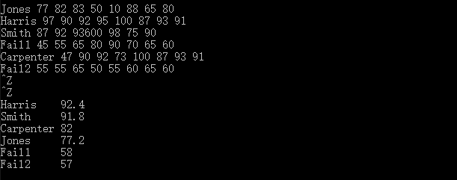
第一题-问题1
未按要求输出

Slide 4
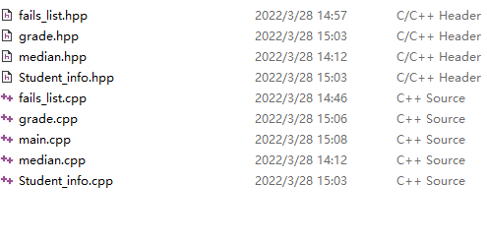
第一题-问题2
错误使用.hpp文件格式

Slide 5
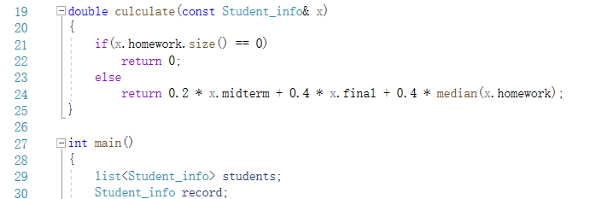
第一题-问题3
main.cpp中与grade函数冗余

Slide 6
第一题-问题4
#include "fails_list.cpp"
多重符号定义问题
改为
list<Student_info> extract_fails(list<Student_info>& stu);

Slide 7
第一题-部分参考代码
//main.cpp
#include"Student_info.h"
#include"grade.h"
...
list<Student_info> extract_fails(list<Student_info>& students); //在此声明即可；
int main(){
list<Student_info> Students,fail;
Student_info record;
string::size_type maxlen=0;
while(read(cin,record)){
maxlen=max(maxlen,record.name.size());
Students.push_back(record);
}
Students.sort(compare);
fail=extract_fails(Students);

Slide 8
//输出名字和成绩
cout<<"passing students records:"<<endl;
list<Student_info>::const_iterator iter=Students.begin();
while(iter!=Students.end()){
cout<<(*iter).name<<string(maxlen+1-(*iter).name.size(),' ');
double final_grade = grade(*iter);
streamsize prec = cout.precision();
cout << setprecision(3) << final_grade << setprecision(prec)<<endl;
++iter;
}
cout<<"failing students records:"<<endl;
iter=fail.begin();
while(iter!=fail.end()){
cout<<(*iter).name<<string(maxlen+1-(*iter).name.size(),' ');
double final_grade = grade(*iter);
streamsize prec = cout.precision();
cout << setprecision(3) << final_grade << setprecision(prec)<<endl;;
++iter;
}
return 0;
}

Slide 9
// fails_list.cpp
#include<list>
#include"Student_info.h"
#include"grade.h"
using std::list;
bool fgrade (const Student_info& s){
return grade(s)<60;
}
list<Student_info> extract_fails(list<Student_info>& students){
list<Student_info> fail;
list<Student_info>::iterator iter=students.begin();
while(iter!=students.end()){
if(fgrade(*iter)){
fail.push_back(*iter);
iter=students.erase(iter);
}
else{
++iter;
}
}
return fail;
}

Slide 10
第二题-问题1
cout << "random integer vector 1:" << endl;
while (cin >> num) {
if (cin.get() == '\n')
break;
else
vec1.push_back(num);
}
部分数据需要随机生成

Slide 11
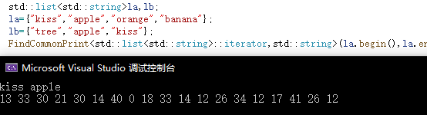
第二题-问题2
未按要求输出

Slide 12
第二题-参考代码
//main.cpp
#include"find.h"
#include<vector>
#include<iostream>
#include<string>
#include<algorithm>
#include<list>
using std::vector; using std::string;
using std::list; using std::cin;
using std::cout; using std::endl;
int main(){
// 整数
vector<int> vec1,vec2,vec3;
cout<<"Random integer vector 1:"<<endl;
for(int i=0;i<10;i++){
vec1.push_back(rand()%20);
}
print_elements(vec1.begin(),vec1.end());

Slide 13
cout<<"Random integer vector 2:"<<endl;
for(int i=0;i<10;i++){
vec2.push_back(rand()%20);
}
print_elements(vec2.begin(),vec2.end());
find_same_elements(vec1.begin(),vec1.end(),vec2.begin(),vec2.end(),vec3);
cout<<"Vector in common:"<<endl;
print_elements(vec3.begin(),vec3.end());
// 字符串
string x;
list<string> list1,list2,list3;
cout<<"Enter some words for string list 1:"<<endl;
while(cin>>x){
list1.push_back(x);
}
cin.clear();
cout<<"Enter some words for string list 2:"<<endl;
while(cin>>x){
list2.push_back(x);
}
cin.clear();
find_same_elements(list1.begin(),list1.end(),list2.begin(),list2.end(),list3);
cout<<"List in common:"<<endl;
print_elements(list3.begin(),list3.end());
return 0;
}

Slide 14
// find.h
#include<iostream>
#include<algorithm>
template <class In>
void print_elements(In begin,In end){
while(begin!=end){
std::cout<<*begin<<" ";
begin++;
}
std::cout<<std::endl;
}
template<class In,class Out>
void find_same_elements(In begin1,In end1,In begin2,In end2,Out& same_list){
while(begin1!=end1){
if(find(begin2,end2,*begin1)!=end2){
same_list.push_back(*begin1);
}
begin1++;
}
}

Slide 15

第三题-问题1
string rand_string(int n)
{
string str;
char c;
int j;
for (j = 0;j != n;j++)
{
c = 'a' + rand() % 26;
str.push_back(c);
}
return str;
}
void create_vecs(vector<string>& v1)
{
int n,i;
for (i = 0;i != 10;i++)
{
n = rand() % 10;
v1.push_back(rand_string(n));
}
}
单个字符串随机长度可为0导致的空字符串

Slide 16
第三题-参考代码
//main.cpp
#include"functions.h"
#include …
int main(){
vector<int> ivec;
int sum1=0;
for(int i=0;i<10;i++){
ivec.push_back(rand()%100);
}
cout<<"the integer list:"<<endl;
output(ivec.begin(),ivec.end());
cout<<endl;
cout<<"the sum of the integer list:"<<accumulate(ivec.begin(),ivec.end(),sum1)<<endl;
cout<<"the max element in the integer list:"<<*max_elements(ivec.begin(),ivec.end())<<endl;
cout<<"the min element in the integer list:"<<*min_elements(ivec.begin(),ivec.end())<<endl;
vector<double> dvec;
double sum2=0;
for(int i=0;i<10;i++){
dvec.push_back(rand()%10000000/1000000.0);
}

Slide 17
cout<<"the double list:"<<endl;
output(dvec.begin(),dvec.end());
cout<<endl;
cout<<"the sum of the double list:"<<accumulate(dvec.begin(),dvec.end(),sum2)<<endl;
cout<<"the max element in the double list:"<<*max_elements(dvec.begin(),dvec.end())<<endl;
cout<<"the min element in the double list:"<<*min_elements(dvec.begin(),dvec.end())<<endl;
list<string> svec;
string sum3,temp;
for(int i=0;i<10;i++){
temp="";
for(int j=0;j<rand()%10+1;j++){
temp.push_back(rand()%26+'a');
}
svec.push_back(temp);
}
cout<<"the string list:"<<endl;
output(svec.begin(),svec.end());
cout<<endl;
cout<<"the sum of the string list:"<<accumulate(svec.begin(),svec.end(),sum3)<<endl;
cout<<"the max element in the string list:"<<*max_elements(svec.begin(),svec.end())<<endl;
cout<<"the min element in the string list:"<<*min_elements(svec.begin(),svec.end())<<endl;
return 0;
}

Slide 18
// founctions.h
// founctions.h
#ifndef GUARD_functions_h
#define GUARD_functions_h
#include<iostream>
template<class In,class X>
X accumulate(In begin,In end,X& x){
while(begin!=end){
x=x+*begin;
begin++;
}
return x;
}
template<class In>
In max_elements(In begin,In end){
In max=begin;
while(begin!=end){
if(*begin>*max)
max=begin;
begin++;
}
return max;
}

Slide 19
template<class In>
In min_elements(In begin,In end){
In min=begin;
while(begin!=end){
if(*begin<*min)
min=begin;
begin++;
}
return min;
}
template<class In>
void output(In begin,In end){
while(begin!=end){
std::cout<<*begin<<" ";
begin++;
}
}
#endif

Slide 20
ICE3-参考代码
#include"selectSort.h"
#include<algorithm>
#include<vector>
#include<list>
#include<iterator>
using std::vector; using std::list;
using std::string; using std::cout;
using std::ostream_iterator; using std::endl;
int main(){
//produce a random number
int j=rand()%10+10;
cout<<j<<" random data:"<<endl;
//test by vector
vector<int> vec1;
for(int i=0;i<j;i++){
vec1.push_back(rand()%100);
}
cout<<"random int vector: ";
print(vec1.begin(),vec1.end(), " ");
cout<<endl;
selectSort(vec1.begin(),vec1.end(),vec1[0]);

Slide 21
list<double> list1;
for(int i=0;i<j;i++){
list1.push_back(rand()%1000000/1000.0);
}
cout<<"random double list: ";
print(list1.begin(),list1.end(), " ");
cout<<endl;
selectSort(list1.begin(),list1.end(),*list1.begin());
string str1;
for(int i=0;i<j;i++){
str1.push_back(rand()%26+'A');
}
cout<<"random string: ";
print(str1.begin(),str1.end(), "");
cout<<endl;
selectSort(str1.begin(),str1.end(),str1[0]);
//output
cout<<"The sorted data: "<<endl<<"sorted int vector: ";
print(vec1.begin(),vec1.end(), " ");
cout<<endl<<"sorted double list: ";
print(list1.begin(),list1.end(), " ");
cout<<endl<<"sorted string: ";
print(str1.begin(),str1.end(), "");
cout<<endl;
return 0;
}

Slide 22
//selectSort.h
#ifndef GUARD_selectSort_h
#define GUARD_selectSort_h
#include<algorithm>
#include<iostream>
#include<string>
using std::cout; using std::string;
template<class In,class T>
void selectSort(In begin,In end,T type){
In flag,min;
T temp;
while(begin!=end){
In flag=begin,min=begin;
while(flag!=end){
if(*min>*flag){
min=flag;
}
flag++;
}
temp=*begin;
*begin=*min;
*min=temp;
begin++;
}
}

Slide 23
//selectSort.h
template<class In>
void print(In begin, In end, string split) {
while (begin != end) {
cout << *begin++ << split;
}
}
#endif

