Slide 1

CSCI 630
Information Assurance

Slide 2
Introduction
What is Information Assurance?
Assurance - a positive declaration intended to give confidence; a promise.
Information - Data that is (1) accurate and timely, (2) specific and organized for a purpose, (3) presented within a context that gives it meaning and relevance, and (4) can lead to an increase in understanding and decrease in uncertainty.
Be careful with: assure, insure, and ensure.

Slide 3
What is Information Assurance?
Information assurance:
The confidence that information systems will perform as needed when needed and be accessible for authorized users only.
Information assurance:
The practice of assuring information and managing risks related to the use, processing, storage, and transmission of information or data and the systems and processes used for those purposes.

Slide 4
Practice of Information Assurance
Information Assurance specialists focus on big business picture
Information Assurance experts seek to know how a company uses information, how valuable that information is to the company
Information Assurance professionals don’t focus on design and deployment of protections
Information Assurance specialists focus on critical organizational management areas

Slide 5
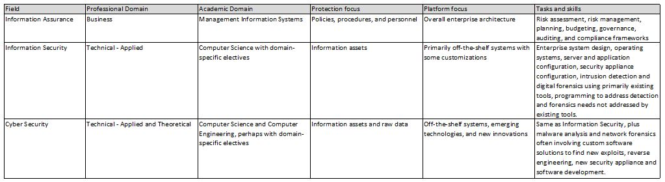
IA vs InfoSec vs Cybersecurity

Slide 6
Five Pillars of Information Assurance
Availability
Integrity
Authentication
Confidentiality
Non-repudiation
NOTE: InfoSec also deals with these 5 pillars. In fact, the entire computer and network security field is focused on these.

Slide 7
Five Pillars of Information Assurance
Availability
Users can access data/serves on their networks
DOD, Ransomware, corrupted data
Integrity
Keep the network intact and uncompromised
Viruses, malware
Policies, penetration testing

Slide 8
Five Pillars of Information Assurance
Authentication
Verify identity before granting access
Username, password, biometric
Multifactor Authentication
Must present 2 or more factors (pieces of evidence). Something you:
Know – PW, PIN, security question
Have – Connected/disconnected token
Are – Biometrics

Slide 9
Five Pillars of Information Assurance
Confidentiality
Protecting private information from disclosure to unauthorized uses
Deals with data, not just access
2018 – FedEx: 119,000 scanned customer documents stolen.
Passports, driver's licenses, etc.
Images stored on unsecured third-party server

Slide 10
Five Pillars of Information Assurance
Non-repudiation
Someone cannot deny the validity
Sender of data given proof of delivery
Recipient given proof of the sender's identity
Digital Signatures & Trusted third parties (TTPs)

Slide 11
How is IA Accomplished in Practice
From Definition: The practice of assuring information and managing risks…
We must manage risk.

Slide 12
Managing Risk in Information Systems
Lesson 1
Risk Management Fundamentals

Slide 13
Key Concepts
Key Concepts
Importance of risk management
Risk, threats, and vulnerabilities
Methods of managing risks
Use of threat/vulnerability pairs in managing risk

Slide 14
What Is Risk?
Risk: Likelihood that a loss will occur
Loss occurs when a threat exposes a vulnerability
Threat: Activity that represents a possible danger
Vulnerability: A weakness
Loss: Results in a compromise to business functions or assets.
Tangible
Intangible

Slide 15
Is Studying Risk A New Concept?
Of course not, but how do we deal with risk?
Don’t focus on risk related to information yet.
Next four slides
What are the risks?
What are the possible consequences?

Slide 16


Slide 17


Slide 18


Slide 19


Slide 20
Risk-Related Concerns for Business
Compromise of business functions
Compromise of business assets
Driver of business costs
Profitability versus survivability

Slide 21
Types of Assets
Tangible – Has actual value
Name some tangible business assets
Intangible – Value cannot be directly determined
Name some intangible business assets

Slide 22
How to Calculate Loss
If a tangible asset –
replacement cost + lost revenue
Example: Web sever outage
Cost to repair - $1,000
Lost revenue - $5,000 times 2 (hours to repair)
$10,000
Total Cost = $11,000
If intangible – Estimate
Lost revenue
Time to restore to previous level

Slide 23
Where are at risk IT assets located?
It is useful to
Create a complete model of the IT function
In order to determine where information/assets are at risk

Slide 24
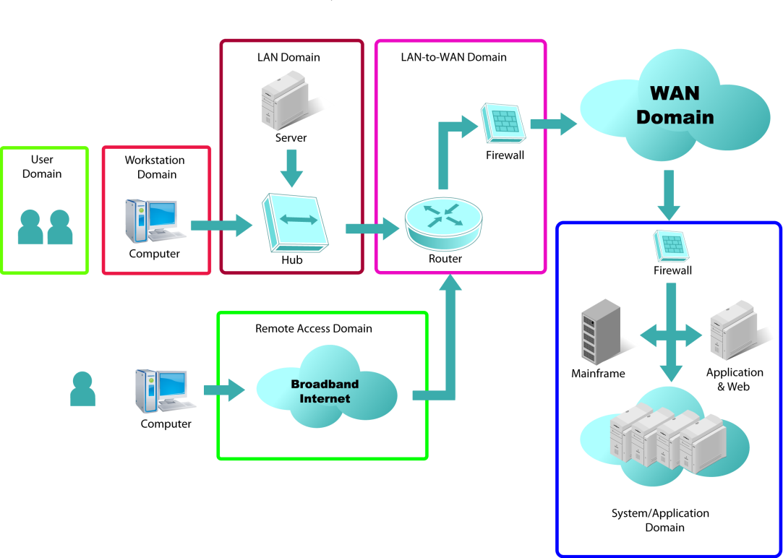
Seven Domains of a Typical IT Infrastructure

Slide 25
Seven Domains of a Typical IT Infrastructure
User Domain
Usernames, passwords, biometric or other authentication, and social engineering

Slide 26
Seven Domains of a Typical IT Infrastructure
Workstation Domain
End user systems, laptops, desktops, cells phones

Slide 27
Seven Domains of a Typical IT Infrastructure
LAN Domain
Includes equipment required to create an internal LAN, such as hubs, switches, and media

Slide 28
Seven Domains of a Typical IT Infrastructure
LAN-WAN Domain
Includes the transition area between the LAN and the WAN, including the router and firewall

Slide 29
Seven Domains of a Typical IT Infrastructure
WAN Domain
Includes routers and circuits connecting the wide area network

Slide 30
Seven Domains of a Typical IT Infrastructure
System/Application Domain
Includes applications you run on your network, such as e-mail, database and Web applications

Slide 31
Seven Domains of a Typical IT Infrastructure
Remote Access Domain
How remote or traveling users use your network, as in a Virtual Private Network (VPN)

Slide 32
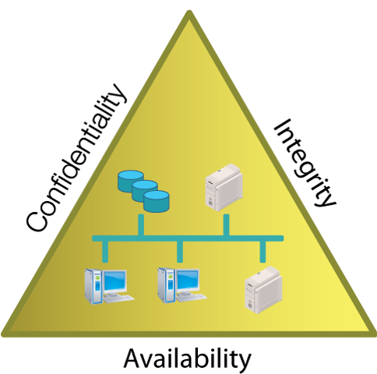
Addressing CIA
Confidentiality
Integrity
Availability
Impact

Slide 33
Addressing CIA
Impossible to make all three completely secure.
They conflict in implementation

Slide 34
Risk Management
Risk
Probability of loss of resource
Threat
Circumstance with the potential to cause harm
Vulnerability
Weakness in the security system
Risk
Probability of Loss
Risk Management
Threat
Potential Harm
Vulnerability
System Weakness
Notes:
Risk
Refers to the probability of loss of a valued resource:
Security, Profitability, Functionality, or Reputation.
Threat
Refers to a source that is defined as any circumstance or event with the potential to cause harm to an IT system.
Vulnerability
Refers to an error or weakness in the security system.

Slide 35
Measuring (Estimating) Impact Level
NIST SP 800-30 gives the following scale
Very High – Catastrophic, Multiple adverse effects
High – Severe, At least one adverse effect
Moderate – Serious adverse effect
Low – limited adverse effect
Very Low – negligible adverse effect

Slide 36
Risk Management Elements/Process
Identify risks to manage
Select controls
Implement and test controls
Evaluate controls
Asses risks

Slide 37
Survivability, and Balancing Risk and Cost
Consider cost to implement control vs. cost of not implementing control
Spending money to manage a risk rarely adds profit
however, it may help ensure a business’s survivability
Cost to manage a risk must be balanced against the impact value

Slide 38
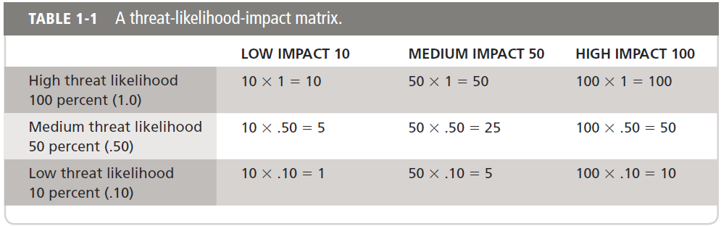
Survivability, and Balancing Risk and Cost (Continued)
Threat-Likelihood-Impact Matrix

Slide 39
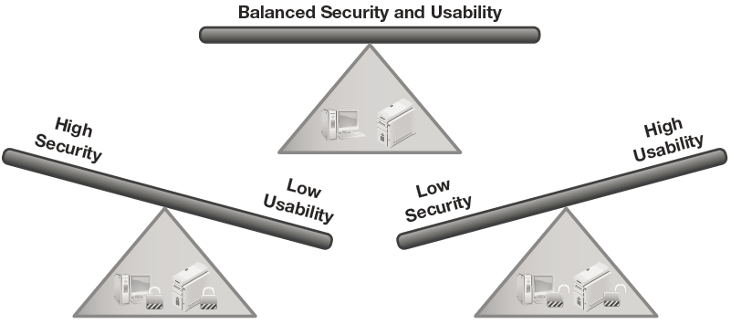
Role-based Perceptions of Risk
Management
System administrator
Tier 1 administrator
Developer
End user
It’s all a case of perspective!
Notes:
Common Vulnerabilities and Exploits
Standard for Information Security Vulnerability Names

Slide 40
Role-based Perceptions of Risk
Management
Concerned with
Profitability
Survivability
View of risk is based on
Cost of risk vs. Cost of control
Need good information to make
Good decisions

Slide 41
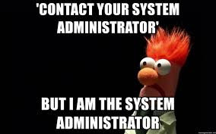
Role-based Perceptions of Risk
System Administrator
Responsible for protecting IT systems
Often want to lock systems down
Sometimes forget to balance
Security costs & profitability

Slide 42

Role-based Perceptions of Risk
Tier 1 Administrator
Often value usability over security
View security controls a “speed bumps”

Slide 43
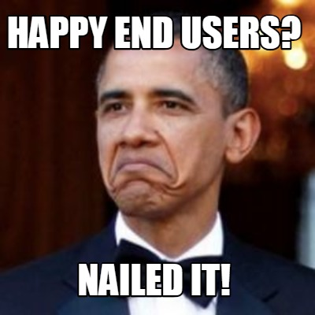
Role-based Perceptions of Risk
End User
Just want it to work
May not understand reason for controls
May circumvent controls (eg. USB drive)

Slide 44

Role-based Perceptions of Risk
Developer
Attitudes are changing
Old – Built & Patch
New – Security designed in from the beginning

