Slide 1

CSCI 630
Information Assurance

Slide 2
Risk Identification Process
Identify threats
Identify vulnerabilities
Estimate likelihood of a threat exploiting a vulnerability

Slide 3
Risk Identification Elements
Component | Type or Source
Threats | External or internal Natural or man-made Intentional or accidental
Vulnerabilities | Audit Certification/accreditation records System logs Prior event Trouble reports Incident response teams
Notes:
Risk Identification
Ways of Identification
Management Techniques
Threats
Employee Records
Client files
Financial reports
Company history
Understand the threats
Control the threats you can
Come up with a plan of execution when threats arise
Vulnerabilities
Develop a list of vulnerabilities
Flaws
Weaknesses
Audits
Prior event history
Certification
Accreditation
System logs
Trouble reports

Slide 4
Risk Identification Elements
Threats - Evaluate
Employee Records
Client files
Financial reports
Company history
Understand the threats
Control the threats you can
Come up with a plan of execution when threats arise
Vulnerabilities

Slide 5
Risk Identification Elements
Vulnerabilities – Develop list of
Flaws
Weaknesses
Look at
Audits
Prior event history
Certification
Accreditation
System logs
Trouble reports

Slide 6
Techniques Used in Risk Management
Avoidance
Transfer
Various Techniques of Risk Management
Mitigation
Acceptance
Cost-Benefit Analysis
Residual Risk
Notes:
Avoidance
To avoid the risk by eliminating the risk cause and/or consequence.
Example: Moving the organization out of a flood zone.
Mitigation
To institute measures to eliminate or reduce the vulnerability.
Example: Prioritizing, evaluating, and implementing the appropriate risk-reducing controls.
Cost-Benefit Analysis (CBA)
To compare the impact of a realized risk to the cost associated with its mitigation. A CBA will include estimation of the likelihood of occurrence and impact of loss.
Example: If your organization is located on a mountain top, is it cost-effective to purchase flood insurance?
Transfer
To move the risk impact from the organization to another entity.
Example: To transfer the risk by using other options , such as purchasing insurance, to compensate for the loss.
Acceptance
To recognize that the risk cannot be economically mitigated and accept is as a “cost of doing business”.
Example: To accept that you cannot control the weather causing a power outage and your organization is temporarily disabled.
Residual Risk
To know the risk that remains after identified risks have been mitigated or accepted.
Example: A department determines that the cost for installing and maintaining add-on security software for the stand-alone personal computer ( PC) that stores its sensitive files is not justifiable, but that administrative and physical controls should be implemented to make physical access to that PC more difficult.

Slide 7
Techniques Used in Risk Management
Avoidance
To avoid the risk by eliminating the risk cause and/or consequence.
Example: Moving the organization out of a flood zone.
Mitigation
To institute measures to eliminate or reduce the vulnerability.
Example: Prioritizing, evaluating, and implementing the appropriate risk-reducing controls.
Cost-Benefit Analysis (CBA)
To compare the impact of a realized risk to the cost associated with its mitigation. A CBA will include estimation of the likelihood of occurrence and impact of loss.
Example: If your organization is located on a mountain top, is it cost-effective to purchase flood insurance?

Slide 8
Techniques Used in Risk Management
Transfer
To move the risk impact from the organization to another entity.
Example: To transfer the risk by using other options , such as purchasing insurance, to compensate for the loss.
Acceptance
To recognize that the risk cannot be economically mitigated and accept is as a “cost of doing business”.
Example: To accept that you cannot control the weather causing a power outage and your organization is temporarily disabled.
Residual Risk
To know the risk that remains after identified risks have been mitigated or accepted.
Example: A department determines that the cost for installing and maintaining add-on security software for the stand-alone personal computer ( PC) that stores its sensitive files is not justifiable, but that administrative and physical controls should be implemented to make physical access to that PC more difficult.

Slide 9
Cost Benefit Analysis
Consider:
Cost of Control
Projected Benefits
Loss Reduction = Loss Before Control – Loss After Control
Loss Before = $100,000; Loss After = $10,000; Reduction = $90,000
Cost of Control = $7,000
Benefit = Reduction – Cost
$83,000 = $90,000 - $7,000

Slide 10
Managing Risk
Threats, Vulnerabilities, and Exploits

Slide 11
Threats to Info Systems
Our Concern is RISK
Risk = Vulnerability * Threat
Control Risk by understanding and controlling vulnerability and threat

Slide 12
The Uncontrollable Nature of Threats
Threats can’t be eliminated.
Threats are always present.
You may be able to reduce the potential for a threat to occur
Reduce the probability that the threat occures
You can take action to reduce the impact of a threat.
You cannot affect the threat itself.

Slide 13
Unintentional Threats
Environmental
Human
Accidents
Failures

Slide 14
Intentional Threats
Greed
Anger
Desire to Damage

Slide 15
Unintentional Threats | Intentional Threats
Environmental: Fire, wind Lighting, flooding Accident Equipment failures | Individuals or Organizations: Hackers Criminals Terrorists Disgruntled employees
Human: Keystroke errors Procedural errors Programming bugs

Slide 16
Common Attackers
Criminals
Advanced persistent threats (APTs)
Vandals
Saboteurs
Disgruntled employees
Activists
Other nations
Hackers

Slide 17
Best Practices for Managing Threats
Create a security policy.
Purchase insurance.
Use access controls.
Use automation.

Slide 18
Best Practices for Managing Threats (Cont.)
Include input validation.
Provide training.
Use antivirus software.
Protect the boundary.

Slide 19
Understanding and Managing Vulnerabilities
Vulnerability is a weakness
Vulnerability does NOT cause loss
Risk = Vulnerability * Threat
Vulnerability allows loss

Slide 20
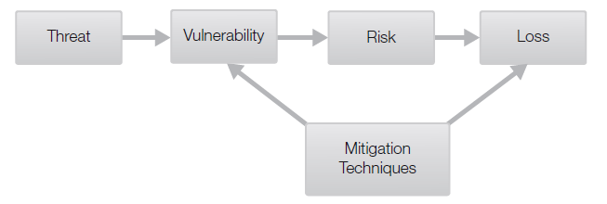
Understanding and Managing Vulnerabilities
Countermeasures reduce risk and loss
Reduce vulnerabilities
Reduce impact of loss

Slide 21
Threat/Vulnerability Pair
Occurs when a threat exploits a vulnerability
A vulnerability provides a path for the threat that results in a harmful event or a loss
Both the threat and the vulnerability must come together to result in a loss
Both threats and vulnerabilities are harmless without the other

Slide 22
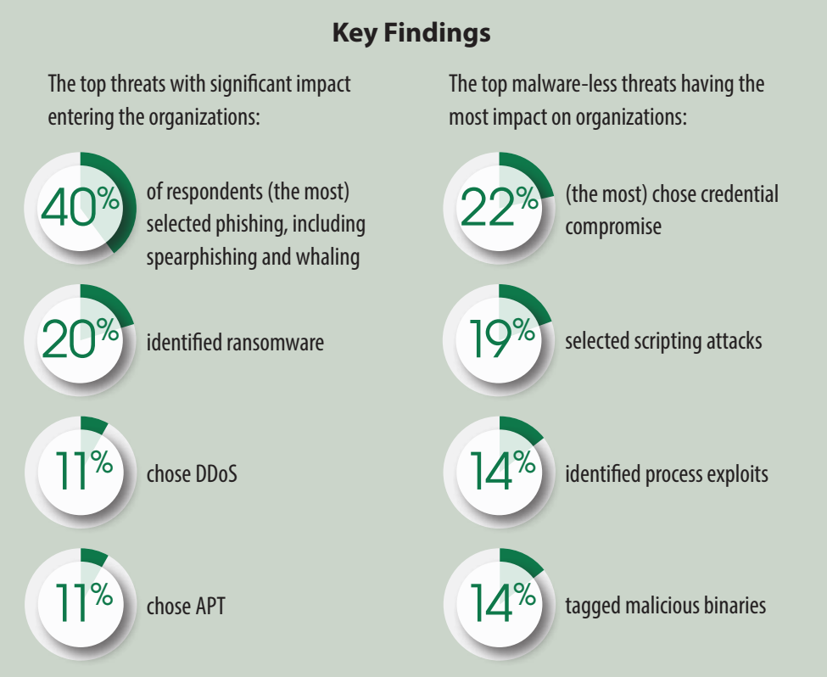
From SANS 2017 Threat Landscape Survey: Users on the Front Line
Notes:
Whaling – Reel in the “BIG FISH”. C-Level executives
Spear Phishing – Targets an individual using information SPECIFIC TO THE USER
APT – Advanced Persistent Threat
> Very Complex
> NOT hit-and-run – Get on network and stay to mine info
> Manual, not automated attacks
> Aim to get into entire network, not just part of it
Talk about Scripting Attach

Slide 23
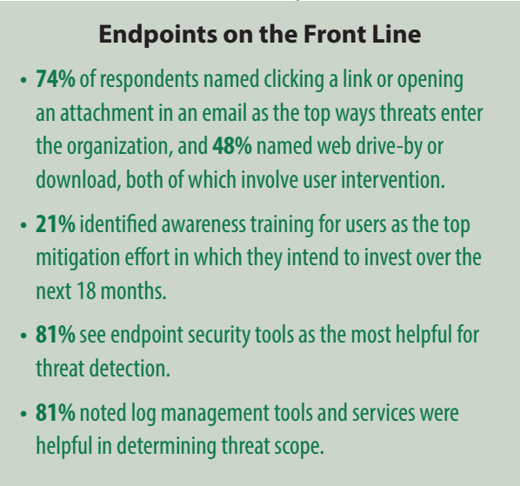
From SANS 2017 Threat Landscape Survey: Users on the Front Line
Notes:
Paradigm shift:
Pre Boom --- BOOM --- Post Boom
Focus on the pre-boom
Don’t give users the bad link in the first place
Analogy of car bumbers

Slide 24
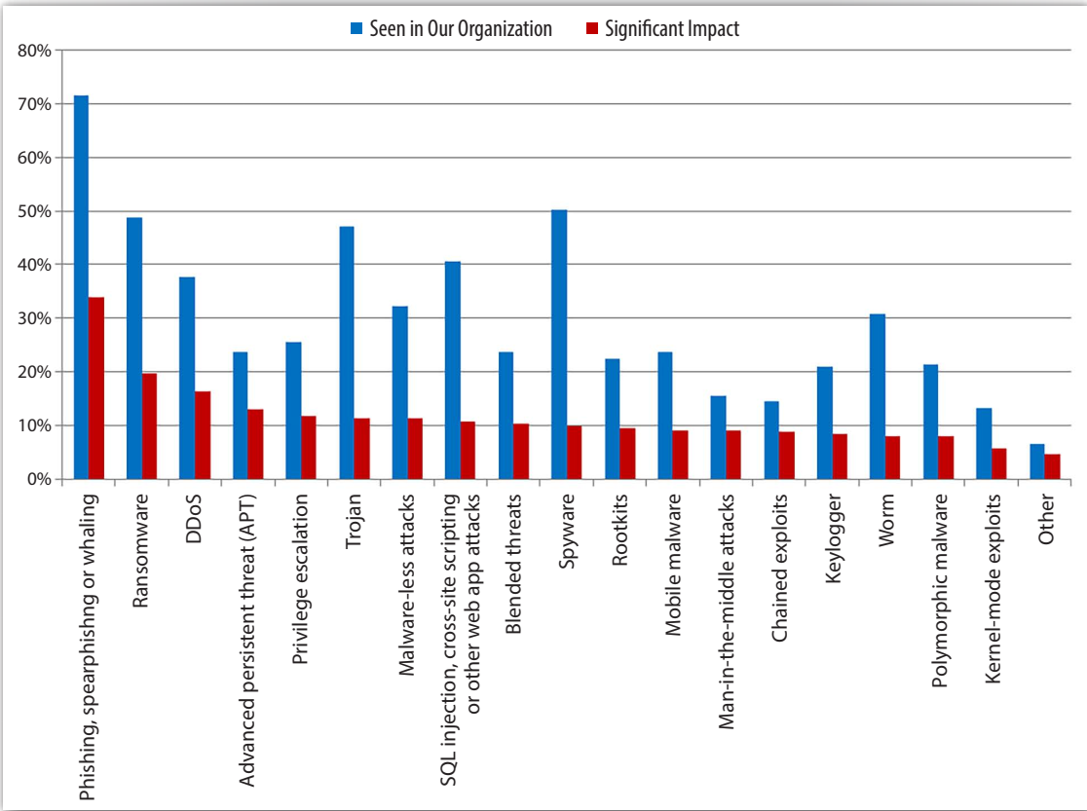
(From Same Document)

Slide 25
Readings Posted on Blackboard
Cyber security breaches survey 2019
Cyber security breaches survey 2018
SANS 2017 Threat Landscape Survey: Users on the Front Line

Slide 26
Threat/Vulnerability Pair and Threat Action
Threat
Ex-employee
Vulnerability
Ex-employee who still has access to the system
Threat Action
Accessing proprietary data

Slide 27
Threat/Vulnerability Pair: Example 1
Threat Source
Fire or negligent person
Vulnerability
Sprinklers used to suppress fire damage
Protective tarpaulins not in place
Threat Action
Sprinkler system turned on

Slide 28
Threat/Vulnerability Pair: Example 2
Threat Source
Unauthorized users (e.g., hackers)
Vulnerability
Identified flaws in system design
New patches not applied
Threat Action
Unauthorized access to files

Slide 29
Vulnerability Mitigation Techniques
Policies and procedures
Documentation
Training
Separation of duties

Slide 30
Vulnerability Mitigation Techniques (Cont).
Configuration management
Version control
Patch management
Intrusion detection

Slide 31
Vulnerability Mitigation Techniques (Cont).
Incident response
Continuous monitoring
Technical controls
Physical controls

Slide 32
Best Practices for Managing Vulnerabilities
Identify vulnerabilities.
Match the threat/vulnerability pairs.
Use as many of the mitigation techniques as feasible.
Perform vulnerability assessments.

Slide 33
Understanding and Managing Exploits
An exploit is the act of taking advantage of a vulnerability
Executes a command or program against an IT system to take advantage of a weakness
Results in a compromise to the system, an application, or data

Slide 34
Understanding and Managing Exploits (Cont.)
Attacks executed by code primarily affect public-facing servers:
Web servers
Simple Mail Transfer Protocol (SMTP) e-mail servers
File Transfer Protocol (FTP) servers

Slide 35
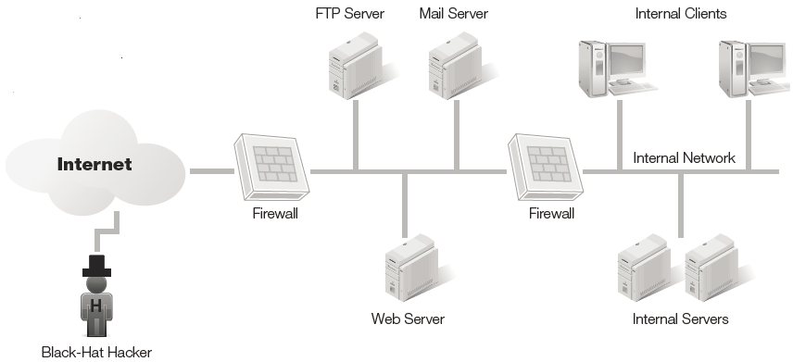
Exploits
Attack public-facing servers
Buffer overflow
SQL injection
DoS attack
DDoS attack

Slide 36
Exploit Example
SQL That might be used to process input from a web page
txtUserId = getRequestString("UserId"); txtSQL = "SELECT * FROM Users WHERE UserId = " + txtUserId;
User Enters
UserId: 105 OR 1=1
Then, the SQL statement will look like this:
SELECT * FROM Users WHERE UserId = 105 OR 1=1;
Notes:
Return ALL rows from the "Users" table
What if the table contained passwords or other PII

Slide 37
Risk Mitigation Techniques for Protecting Public-Facing Servers
Remove or change defaults.
Reduce the attack surface.
Keep systems up to date.
Enable firewalls.

Slide 38
Risk Mitigation Techniques for Protecting Public-Facing Servers
Enable intrusion detection systems (IDSs)
Enable intrusion prevention systems (IPSs)
Install antivirus software

Slide 39
Best Practices for Managing Exploits
Harden servers.
Use configuration management.
Perform risk assessments.
Perform vulnerability assessments.

Slide 40
U.S. Government Risk Management Initiatives
The National Institute of Standards and Technology (NIST)
The Department of Homeland Security (DHS)
The National Cybersecurity and Communications Integration Center (NCCIC)
U.S. Computer Emergency Readiness Team (US-CERT)
The MITRE Corporation – Common Vulnerabilities Exposure (CVE) List

Slide 41
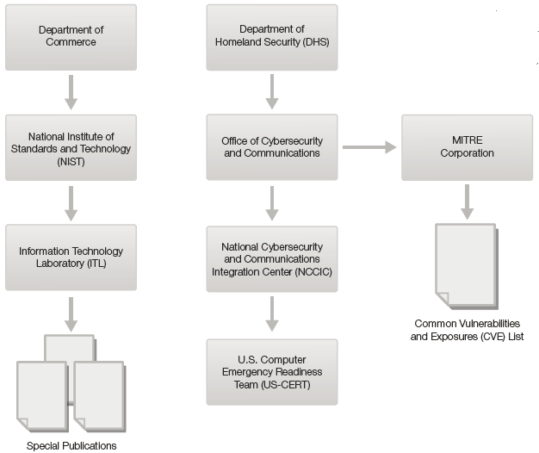
Relationships Among Organizations

Slide 42
Summary
Importance of risk management
Risk, threats, and vulnerabilities
Methods of managing risks
Use of threat/vulnerability pairs in managing risk

