Slide 1
Concepts of Risk Assessment

Slide 2
What Is Risk Assessment?
Key step in a risk management process
Determine quantitative or qualitative value of risk
Conduct for concrete situation and recognized threat
Used to help identify which controls to implement
Required for evaluating risk or control
Often conducted after implementation of a control
This is for follow-up maintenance

Slide 3
Why Is Risk Assessment Important?
Identifies which systems/assets to protect
Gives insight into which controls provide the most value

Slide 4
When Should a Risk Assessment Be Conducted?
When evaluating risk
When evaluating a control
Periodically after a control has been implemented
Note that this is a dynamic and recurring procedure

Slide 5
Critical Components of Risk Assessment
Identify scope of assessment
Identify critical areas
Identify team

Slide 6
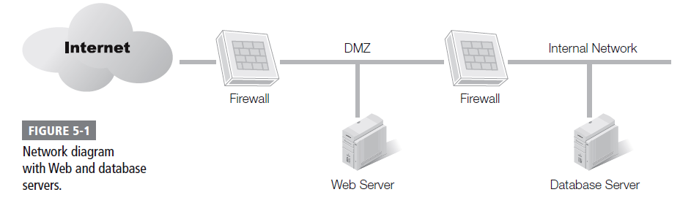
Identify Potential Scope for Web Server RA
Web server
Database server
Firewalls
DMZ

Slide 7
// Sidebar - Firewall operations
Forward facing Firewall
Internal Firewall
What is purpose of FFF?
What is purpose of internal?

Slide 8
// Sidebar - Firewall operations
//
Forward facing Firewall
Internal Firewall

Slide 9
Quantitative and Qualitative RAs
Quantitative Risk Assessments
Calculates absolute financial values, losses, and costs
Qualitative Risk Assessments
Calculates relative values, losses, and costs

Slide 10
Quantitative Risk Assessment (RA)
Uses numbers such as dollar values
Results can help you:
Identify the priority of risks
Determine the effectiveness of controls
Budget appropriately

Slide 11
Quantitative RA Key Terms
Single loss expectancy (SLE)
Annual rate of occurrence (ARO)
Annual loss expectancy (ALE)
Safeguard (Control) value

Slide 12
Quantitative RA Benefits
Becomes a simple math problem
Provides a cost-benefit analysis (CBA)
Accurate values for SLE, ARO, and safeguard value let’s you calculate CBA
Management often familiar with quantitative assessment terminology; easy to grasp details of the assessment and its recommendations
Formulas use verifiable and objective measurements

Slide 13
Quantitative RA Limitations
Accurate data isn’t always available
Especially true when identifying ARO reductions
Ensuring that people use the control as expected
May need additional steps, such as training, to ensure users are aware of the importance of the control

Slide 14
Quantitative RA Limitations (cont.)
Some feel that this doesn’t take into account differences in situations
Tends to omit some characteristics of risk that aren’t quantifiable
Hard to get accurate ARO data
threat occurs once in 10 years: ARO of 1/10 or 0.1;
threat occurs 50 times in a year: ARO of 50.0.

Slide 15
Where to get ARO info?
An example on Ransomware
Simple web search yields:
https://www.comparitech.com/antivirus/ransomware-statistics/

Slide 16
ALE Example (from Wikipedia)
Asset valued at $100,000
Exposure Factor 25% (expected loss)
Single Loss Expectancy is
25% * $100,000 = $25,000.
ALE = ARO * SLE
For ARO of 1:
ALE = 1 * $25,000 = $25,000
For ARO of 3:
ALE = 3 * $25,000 = $75,000

Slide 17
Qualitative Risk Assessment
Subjective (open to interpretation)
Probability
The likelihood that a threat will exploit a vulnerability
Impact
The negative result if a risk occurs

Slide 18
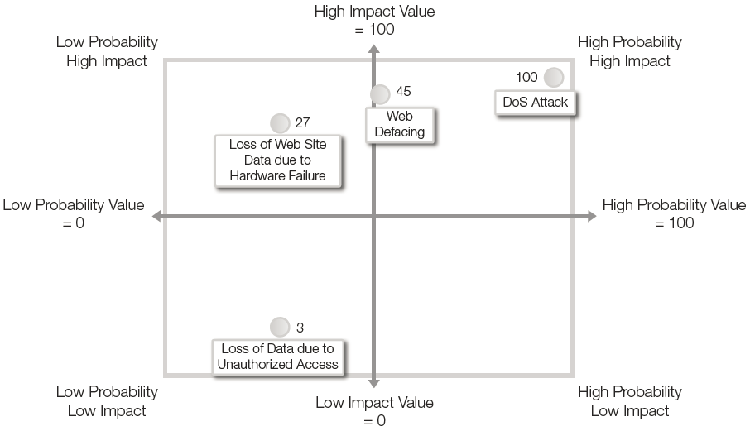
Using a Risk Matrix
Matching probability and impact

Slide 19
Qualitative RA Benefits
Uses the opinions of experts
Is easy to complete
Uses words that are easy to express and understand

Slide 20
Qualitative RA Limitations
Subjective
Based on expertise of the experts
Value of the assessment is only as valuable as the expertise of the experts
No Cost Benefit Analysis
No real standards

Slide 21
Comparing Assessment Methods
Quantitative
Objective
Monetary values
Historical data
More time consuming
Qualitative
Subjective
Word values
Expert opinions

Slide 22
Comparing Assessment Methods
Qualitative
should always be performed
Quantitative
should be performed when more detail is needed AND valid data exists
Compliance
May require quantitative for some assets

Slide 23
Risk Assessment Challenges
Using static process to evaluate a moving target
Availability of data
Data consistency
Estimating impact effects
Providing results that support resource allocation and risk acceptance

Slide 24
Best Practices for Risk Assessment
Start with clear goals and a defined scope.
Enlist senior management support.
Build a strong RA team.
Repeat the RA regularly.
Define a methodology to use.
Provide a report of clear risks and clear recommendations.

