Slide 1
Steps of a risk management plan
Step 1: Identify Risk
Step 2: Assess Risk
Step 3: Control Risk
Steps are similar regardless of context (InfoSec, Physical Security, Financial, etc.)
This presentation will focus on controlling risk within an InfoSec context

Slide 2
Risk Identification
Asset | Asset Type and Subcategory | Asset Function | Priority Level (Low, Medium, High, Critical)
Bob Worker | Personnel: InfoSec | Secure Networks Penetration Testing Make coffee | Low
Cisco UCS B460 M4 Blade Server | Hardware: Networking | Database Server | High
Customer Personally Identifiable Information (PII) | Data: Confidential Information | Provide information for all business transactions | Critical
Windows 7 | Software: Operating System | Employee access to enterprise software | Medium
The steps to risk identification are:
Identify your organization’s information assets
Classify and categorize said assets into useful groups
Rank assets necessity to the organization
Simplified example

Slide 3
Risk Assessment
Threat Agent and Threat | Targeted Asset | Threat Level | Possible Exploits | Risk (Scale of 1-5)
Disgruntled Insider: Steal company information to sell | Company data (i.e. Customer PII) | High | Access control credentials, knowledge of InfoSec policies, etc. | 4.16
Fire: Burn the facility down or cause major damage | Company Facility, Personnel, Equipment | Critical | Mishandled equipment | 2.78
Hacktivists: Quality of service deviation | Company Hardware/Software | Low | Lack of effective filtering | 1.39
Steps to risk assessment:
Identify threats and threat agents
Prioritize threats and threat agents
Assess vulnerabilities in current InfoSec plan
Determine risk of each threat
R = P * V – M + U
R = Risk
P = Probability of threat attack
V = Value of Information Asset
M = Mitigation by current controls
U = Uncertainty of vulnerability
Example combines elements of all of these in a highly simplified format

Slide 4
Risk control
The steps to risk control are:
Cost-Benefit Analysis (CBA)
Single Loss Expectancy (SLE)
Annualized Rate of Occurrence (ARO)
Annual Loss Expectancy (ALE)
Annual Cost of the Safeguard (ASG)
Feasibility Analysis
Organizational Feasibility
Operational Feasibility
Technical Feasibility
Political Feasibility
Risk Control Strategy Implementation

Slide 5
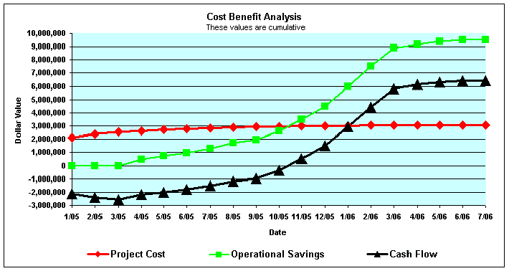
Cost-Benefit analysis
Determine what risk control strategies are cost effective
Below are some common formulas used to calculate cost-benefit analysis
SLE = AV * EF
AV = Asset Value, EF = Exposure factor (% of asset affected)
ALE = SLE * ARO
CBA = ALE (pre-control) – ALE (post-control) – ASG
SLE: Single Loss Expectancy
ALE: Annual Loss Expectancy
ARO: Annualized Rate of Occurrence
CBA: Cost-Benefit Analysis
ASG: Annual Safeguard Cost

Slide 6
Feasibility analysis
Organizational:
Does the plan correspond to the organization’s objectives?
What is in it for the organization?
Does it limit the organization’s capabilities in any way?
Operational:
Will shareholders (users, managers, etc.) be able/willing to accept the plan?
Is the system compatible with the new changes?
Have the possible changes been communicated to the employees?
Technical:
Is the necessary technology owned or obtainable?
Are our employees trained and if not can we afford to train them?
Should we hire new employees?
Political:
Can InfoSec acquire the necessary budget and approval to implement the plan?
Is the budget required justifiable?
Does InfoSec have to compete with other departments to acquire the desired budget?

