Slide 1
CSCI 630
Managing Compliance

Slide 2
Learning Objective and Key Concepts
Learning Objective
Identify compliance laws, standards, best practices, and policies of risk management.
Key Concepts
Purpose, nature, and impact of risk management
Risk management elements of Payment Card Industry Data Security Standard (PCI DSS)
Control Objectives for Information and Related Technology (COBIT) risk management best practices
Risk IT framework

Slide 3
U.S. Compliance Laws
Federal Information Security Management Act (FISMA)
Health Insurance Portability and Accountability Act (HIPAA)
Gramm-Leach-Bliley Act (GLBA)
Sarbanes-Oxley Act (SOX)
Family Educational Rights and Privacy Act (FERPA)
Children’s Internet Protection Act (CIPA)
Notes:
Federal Information Security Management Act (FISMA)
A U.S. federal law enacted in 2002 that requires each federal agency to develop an agency-wide program to provide information security.
Health Insurance Portability and Accountability Act (HIPAA)
Provides patients with access to their medical records and provides more control over how their personal health information is used and disclosed.
Gramm-Leach-Bliley Act (GLBA)
Also known as the Financial Services Modernization Act of 1999, opening up the market among banking companies, securities companies, and insurance companies.
Repealed part of the Glass-Steagall Act of 1933, which prohibited any one institution from acting as any combination of an investment bank, a commercial bank, and an insurance company.
Sarbanes-Oxley Act (SOX)
Sarbanes–Oxley contains 11 titles that describe specific mandates and requirements for financial reporting. Each title consists of several sections.
Family Educational Rights and Privacy Act (FERPA)
Regulations protect the privacy of student records. FERPA applies to all schools that receive any funding from the U.S. Department of Education.
Children’s Internet Protection Act (CIPA)
CIPA is one of many bills that the United States Congress proposed to limit children's exposure to pornography and explicit content online.

Slide 4
International Compliance Laws
General Data Protection Regulation(GDPR)
Customs-Trade Partnership Against Terrorism (C-TPAT)
Voluntary, Not IT specific
Estimated the International organizations must obey 600 different regulations & laws
Just for information security!

Slide 5
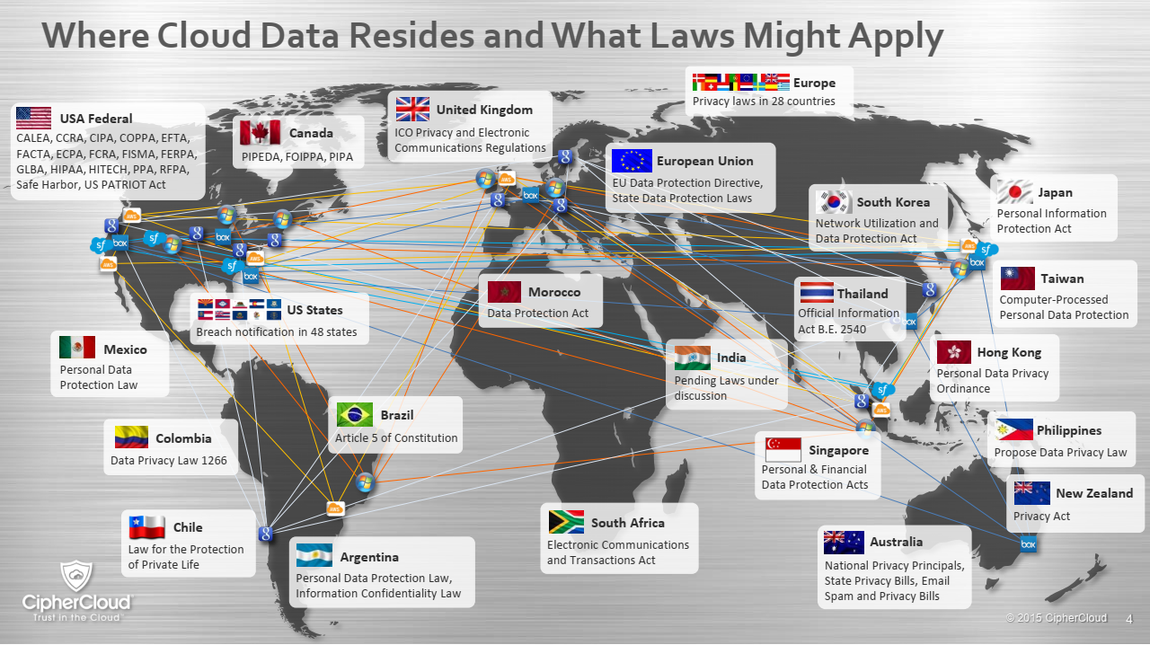

Slide 6
U.S. Compliance Laws and their Applicability
Law | Applicability
FISMA | Federal agencies
HIPAA | Any organization handling medical data
GLBA | Banks, brokerage companies, and insurance companies
FERPA | Educational institutions
CIPA | Schools and libraries using E-Rate discounts
Notes:
FISMA
Federal agencies
The act recognizes the importance of information security to the economic and national security interests of the United States.
HIPAA
Medical organizations
Provides privacy standards to protect patients' medical records and other health information.
GLBA
Banks, brokerage companies, and insurance companies
Companies must securely store personal financial information.
Companies must advise consumers of their policies on sharing of personal financial information.
Companies must give consumers the option to opt-out of some sharing of personal financial information.
FERPA
Educational institutions
The right to access educational records kept by the school.
The right to demand educational records be disclosed only with student consent.
The right to amend educational records.
The right to file complaints against the school for disclosing educational records in violation of FERPA.
CIPA
Schools and libraries using E-Rate discounts
To operate "a technology protection measure with respect to any of its computers with Internet access that protects against access through such computers to visual depictions that are obscene, child pornography, or harmful to minors..." .
This technology protection measure must be employed during any use of computers by minors.
The law also provides that the school or library "may disable the technology protection measure concerned, during use by an adult”.
Schools and libraries that do not receive E-Rate discounts do not have any obligation to filter under CIPA.

Slide 7
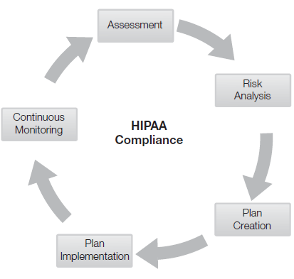
HIPAA Compliance Process
HIPAA covers any organization that handles health data
Medical facilities
Insurance companies
Any company with a health plan if employees handle health data

Slide 8
HIPAA: Implications of Non-Compliance
Hospitals, private practices, health insurance companies, and companies that do not comply with HIPAA face:
Financial penalties for each violation
Criminal charges for failure to protect patients
Example: CVS Caremark – pharmacy chain
Charged: Failure to protect
Med. and Fin. privacy of customers & employees
Paid $2.25 million to settle

Slide 9
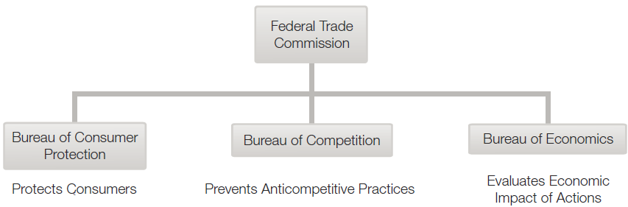
U.S. Compliance Regulatory Agencies
Securities and Exchange Commission (SEC)
Federal Trade Commission (FTC)
Notes:
Securities and Exchange Commission (SEC)
Oversees the exchange of securities to protect investors.
Holds primary responsibility for enforcing the federal securities laws and regulating the securities industry, the nation's stocks and options exchanges, and other electronic securities markets in the United States.
Federal Trade Commission (FTC)
Created in 1914, its purpose was to prevent unfair methods of competition in commerce.
Deals with issues that touch the economic life of every American.

Slide 10
U.S. Compliance Regulatory Agencies
Federal Deposit Insurance Corporation (FDIC)
Department of Homeland Security (DHS)
State Attorney General (AG)
U.S. Attorney General (U.S. AG)
Notes:
State Regulations
Each state has its own regulations and regulatory agencies.
Attorney General - the main legal advisor at the state level in most common law jurisdictions.

Slide 11
Organizational Policies for Compliance: Fiduciary Responsibility
Fiduciary
Refers to a relationship of trust
Could be a person who is trusted to hold someone else’s assets
Trusted person has the responsibility to act in the other person’s best interests and avoid conflicts of interest

Slide 12
Organizational Policies for Compliance: Fiduciary Responsibility (Cont.)
Examples of trust relationships:
An attorney and a client
A CEO and a board of directors
Shareholders and a board of directors
Fiduciary is expected to take extra steps:
Due diligence
Due care

Slide 13
Standards and Guidelines
PCI
DSS
NIST
GAISP
COBIT
ISO
IEC
RMF DoD
ITIL
CMMI
Notes:
PCI DSS
Payment Card Industry Data Security Standard
A worldwide information security standard defined by the Payment Card Industry Security Standards Council.
NIST
National Institute of Standards and Technology
A measurement standards laboratory which is a non-regulatory agency of the United States Department of Commerce.
GAISP
Generally Accepted Information Security Principles
Industry-wide guidelines for information security.
COBIT
Control Objectives for Information and Related Technology
A set of best practices (framework) for information technology (IT) management created by the Information Systems Audit and Control Association (ISACA), and the IT Governance Institute.
ISO
International Organization for Standards
ISO is the world's largest developer and publisher of International Standards, including those in the IT industry.
IEC
International Electrotechnical Commission
The IEC is the world's leading organization that prepares and publishes international standards for all electrical, electronic, and related technologies.
ITIL
Information Technology Infrastructure Library
A set of concepts and practices for IT services management, IT development, and IT operations.
CMMI
Capability Maturity Model Integration
A process improvement approach to management that helps organizations improve their performance.
RMF for DoD IT (as of March 2014)
Risk Management Framework (RF) for Department of Defense Information Technology (IT), formerly Department of Defense (DoD) Information Assurance Certification and Accreditation Process (DIACAP)
Defines DoD-wide formal and standard sets of activities, general tasks, and a management process for lifecycle cybersecurity risk to DoD IT.
13

Slide 14
PCI DSS Compliance
Payment Card Industry Data Security Standard
Created by Payment Card Industry Security Standards Council
American Express, Discover Financial Services, JCB International, MasterCard Worldwide, and Visa Inc.
Modernized by the Security Standards Council
Effort to obstruct and prevent further theft of personal information

Slide 15
PCI DSS Standards
Use of personal identification numbers (PIN)
Installation of software used to store, process, and/or transmit cardholder data
PCI DSS standards serve as PCI DSS goals
Merchants who store, process, and/or transmit cardholder data must comply
Merchants should establish processes that work toward PCI DSS goals

Slide 16
PCI DSS Standards
Merchant Level | Description
1 | Any merchant — regardless of acceptance channel — processing over 6M Visa transactions per year. Any merchant that Visa, at its sole discretion, determines should meet the Level 1 merchant requirements to minimize risk to the Visa system.
2 | Any merchant — regardless of acceptance channel — processing 1M to 6M Visa transactions per year.
3 | Any merchant processing 20,000 to 1M Visa e-commerce transactions per year.
4 | Any merchant processing fewer than 20,000 Visa e-commerce transactions per year All other merchants — regardless of acceptance channel — processing up to 1M Visa transactions per year.

Slide 17
PCI DSS Process (6 Principles)
Build and maintain a secure network that is PCI compliant
Protect cardholder data
Maintain a vulnerability management program
Implement strong access control measures
Regularly monitor and test networks
Maintain an information security policy

Slide 18
Goals and Process Steps to PCI DSS
Goals | Process Steps
Build and maintain a secure network that is PCI compliant | Install a firewall system Perform testing when configurations change Identify all connections to cardholder information Review configuration rules every six months Change all default passwords

Slide 19
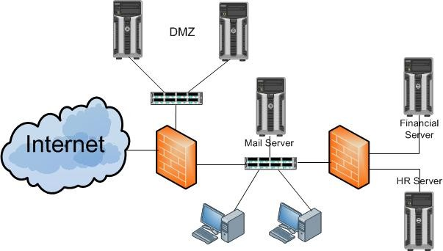
Install a Firewall
Firewall

Slide 20
Goals and Process Steps to PCI DSS
Goals | Process Steps
Protect cardholder data | Display the maximum of the first six and last four digits of the primary account number Encrypt all online information
Maintain a vulnerability management program | Keep anti-virus software updated Install vendor-provided security patches

Slide 21
Goals and Process Steps to PCI DSS
Goals | Process Steps
Implement strong access control measures | Limit the accessibility of cardholder information Assign an unreadable password Monitor the physical access to cardholder data Maintain a visitor log and save the log for at least three months

Slide 22
Goals and Process Steps to PCI DSS
Goals | Process Steps
Regularly monitor and test networks | Use a wireless analyzer to check for wireless access points Scan internal and external networks Install software to recognize any modification by unauthorized personnel

Slide 23
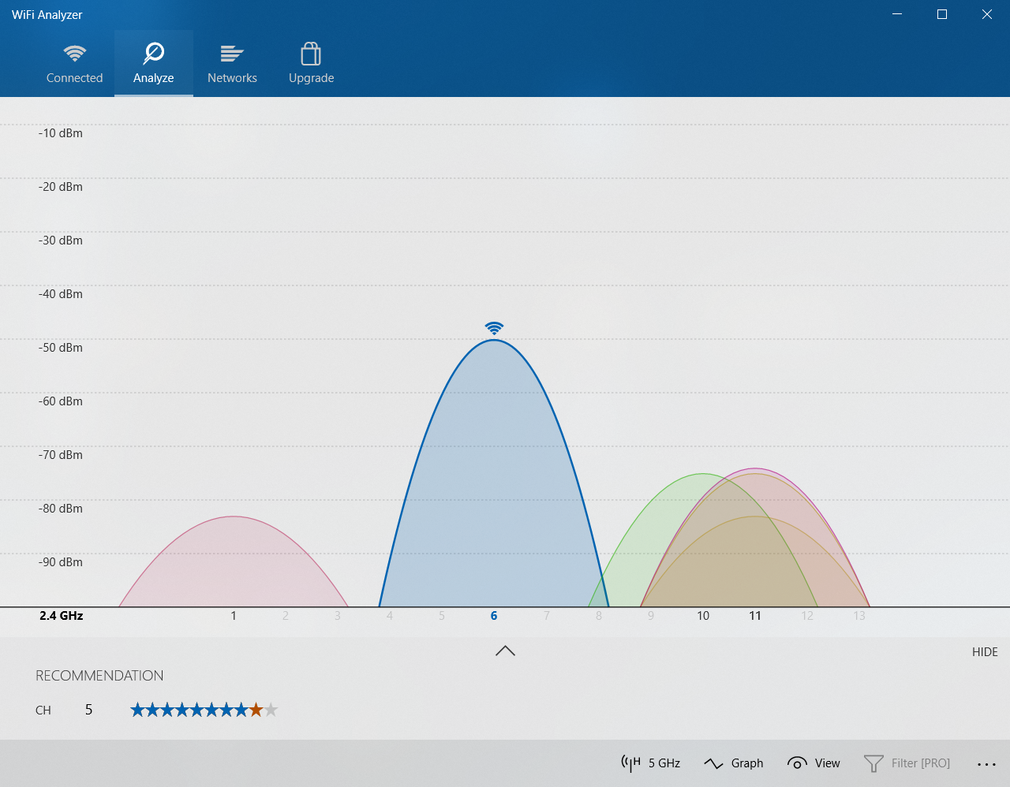

Slide 24
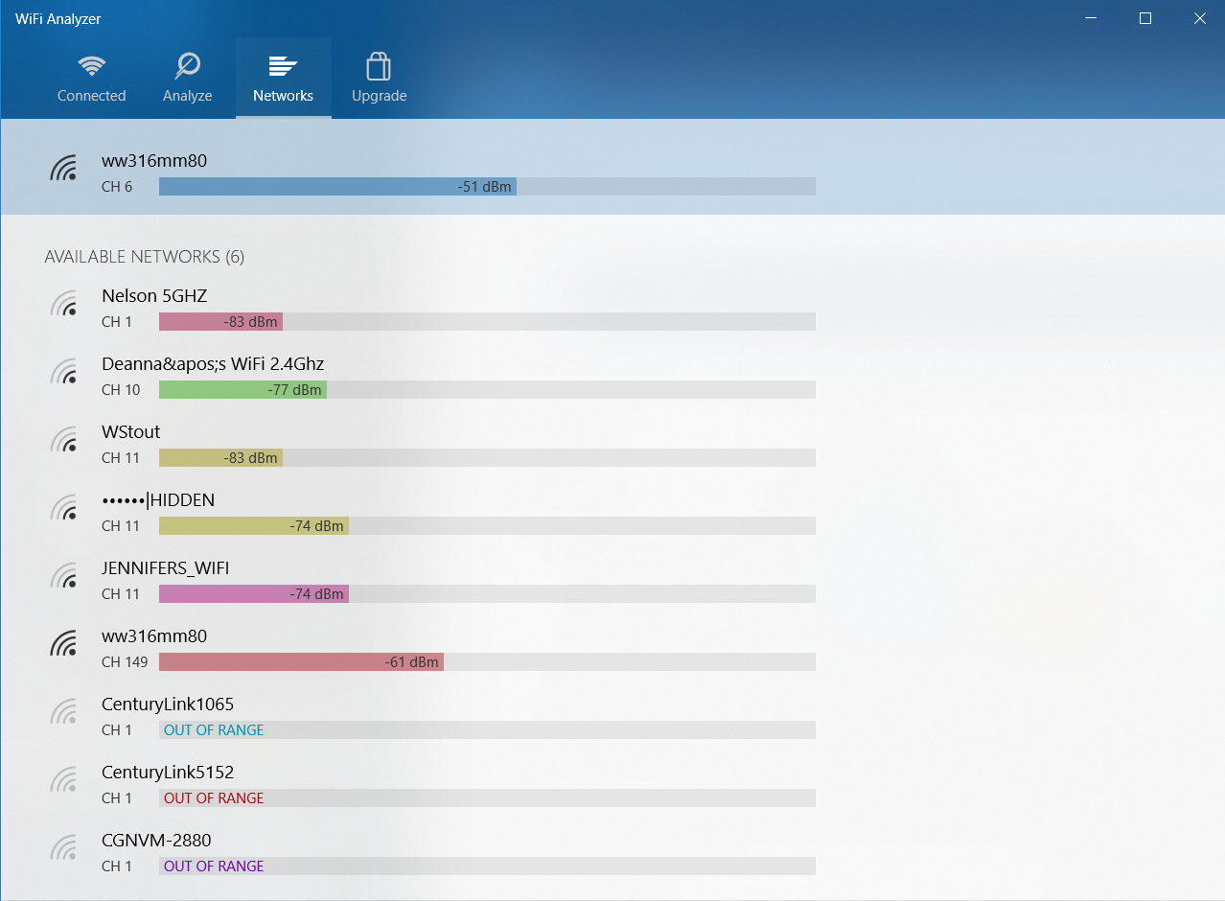

Slide 25
Goals and Process Steps to PCI DSS
Goals | Process Steps
Maintain an information security policy | Include annual and day-to-day security procedures and policies to recognize security breaches Perform background checks on potential employees Educate employees on compliance regulations

Slide 26
Credit Card Side Bar
Swipe vs. Dip
U.S. was late to the CC contact chip processing
Much more secure than swipe
Swipe data includes all information from card
Info can be replayed
Stripe(s) can be easily cloned
Liability shift
As early as 2005 in various countries (Not in U.S.)
U.S. POS in 2015, Gas pumps in 2020

Slide 27
Credit Card Side Bar
Dip Card Authentication
Initialization: selection of the application on the smartcard and reading of some data
Data authentication, by means of SDA (static), DDA(dynamic), or CDA(combined);
Most today are CDA
Use asymmetric encryption
Cardholder verification, by means of PIN or signature
The actual transaction

Slide 28
SDA, DDA, CDA
SDA – Static Data Authentication
Protects against counterfeit
Validates that the card data has not been fraudulently altered
SDA is static it is no longer supported as a valid offline data authentication option
DDA – Dynamic Data Authentication
Protects against counterfeit and skimming
Dynamic and more secure than SDA
Card has key that creates dynamic digital signature
Valid for one authentication, using card data and unique one time terminal data

Slide 29
SDA, DDA, CDA
CDA – Combined Data Authentication
Protects against
counterfeit, skimming, man-in-the-middle attacks
Highest level of security
Generation of the digital signature combined with
Generation of the card’s cryptogram
Ensures authentication
And that data exchanged between the terminal and card is not altered

Slide 30
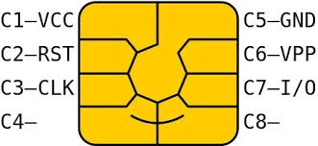
Credit Card Side Bar
Dip processing
Chip uses a new transaction code for each transaction so no replay.
Card info is not sent with transaction
This is verified at the terminal
Chip is a computing device
Each chip has unique ID
Public-key cryptography is
used so each transaction has new key

