Slide 1
Beetle Swarm Antennae Search Algorithm for Optimization Problems
Final Project Preview (2020)
R08546002
劉晏誠
January 4, 2021

Slide 2
Introduction
Beetle Swarm Antennae Search algorithm (BSAS)
Motivated from Beetle Antennae Search algorithm (BAS)
Improve the drawbacks of BAS algorithm

Slide 3

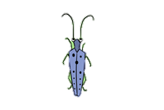
Behaviors of Beetle
Imitate Beetle prey or seek for a mate by its antennae.
the antennae in one side detects a higher concentration of odour, the beetle would turn to the direction towards the same side, otherwise, it would turn to the other side.
Target
right > left
right > left
right > left
right < left

Slide 4
BAS Algorithm
Model BAS algorithm by three rules.
Searching behavior
Describing a random direction of beetle searching.
Imitate the activities of the beetle’s antennae.
Detecting behavior
Generate iterative model to associate with the odour detection by considering the searching behavior.
Update rule
Solution Set
Position of beetle

Slide 5
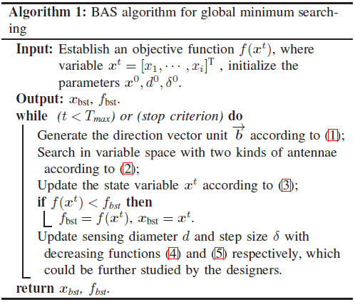

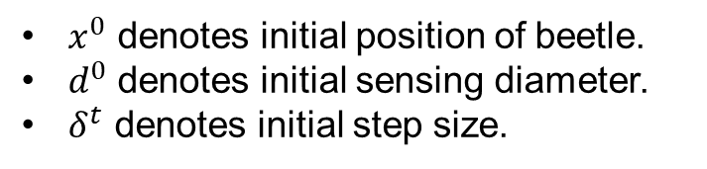
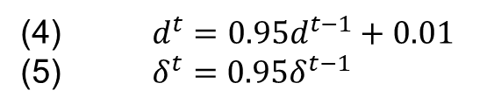
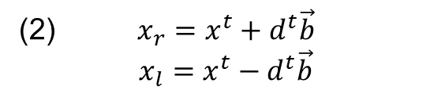
BAS Algorithm —Pseudo Code
(1) $\vec{b}= \frac{rnd(1,k)}{\left\|rnd(1,k)\right\|}$
(2) $x_{r}=x^{t}+d^{t}\vec{b}$
$$x_{l}=x^{t}−d^{t}\vec{b}$$
(3) $x^{t}=x^{t−1}+δ^{t}\vec{b} sign(f\left(x_{r}\right)−f(x_{l}\text{)}\text{)}$
(4) $d^{t}={0.95d}^{t−1}+0.01$
(5) $δ^{t}={0.95δ}^{t−1}$
$x^{0}$ denotes initial position of beetle.
$d^{0}$ denotes initial sensing diameter.
$δ^{t}$ denotes initial step size.

Slide 6
BSAS Algorithm
Drawbacks of BAS
Beetle moves in one random direction for each iteration. It cannot guarantee that the move of beetle will make the objective function value better.
Every movement of the beetle will cause an update of the position and step size.
Above these two cause the beetle falls into local optimum position and cannot jump out of the local area.
Improvement of BSAS
Improve the searching behavior of BAS algorithm by employing k beetles to move in k directions, thus enhancing the possibility for finding better position of beetle.
Design a feedback-based position and step size update strategy.

Slide 7
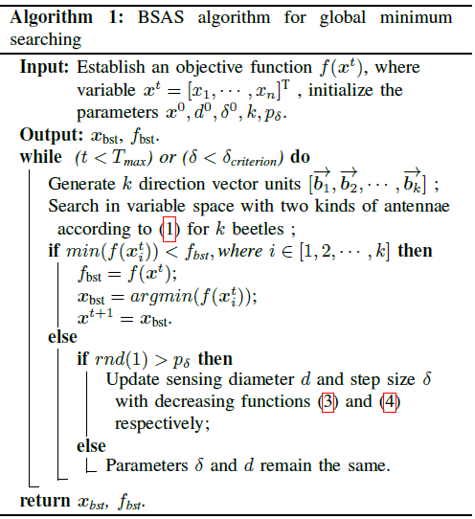
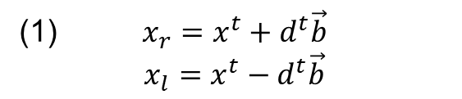
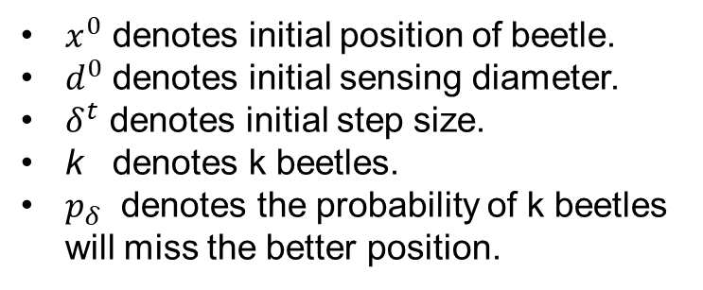
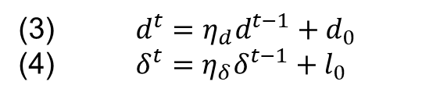
BSAS Algorithm —Pseudo Code
(1) $x_{r}=x^{t}+d^{t}\vec{b}$
$$x_{l}=x^{t}−d^{t}\vec{b}$$
(2) $x^{t}=x^{t−1}+δ^{t}\vec{b} sign(f\left(x_{r}\right)−f(x_{l}\text{)}\text{)}$
(3) $d^{t}={η_{d}d}^{t−1}+d_{0}$
(4) $δ^{t}={η_{δ}δ}^{t−1}+l_{0}$
$x^{0}$ denotes initial position of beetle.
$d^{0}$ denotes initial sensing diameter.
$δ^{t}$ denotes initial step size.
k denotes k beetles.
$p_{δ}$ denotes the probability of k beetles will miss the better position.

Slide 8
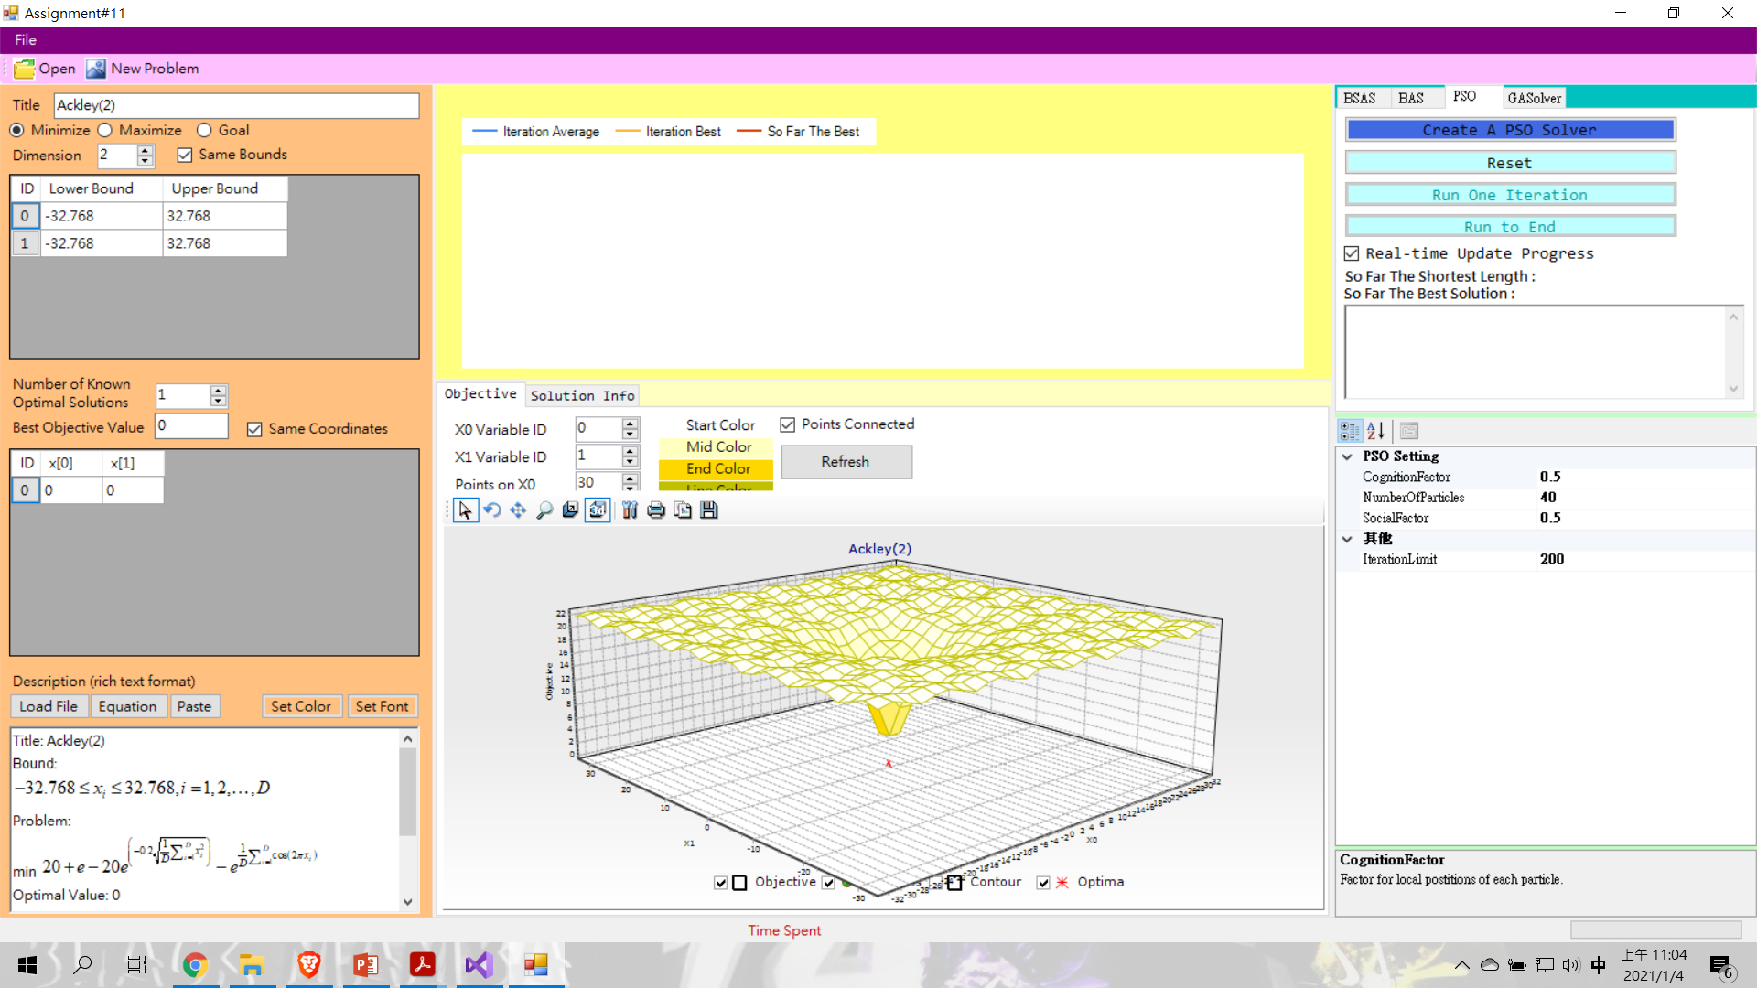
Prototype

Slide 9
Schedule

Slide 10
Reference
Jiang, X., & Li, S. Bas: Beetle antennae search algorithm for optimization problems. arXiv 2017. arXiv preprint arXiv:1710.10724.
Wang, J., & Chen, H. (2018). BSAS: Beetle swarm antennae search algorithm for optimization problems. arXiv preprint arXiv:1087.10470.

