Slide 1
Long short term memory
group member:
Kevin yang, mark gilland, chiran chappagai

Slide 2
Table of contents
Introduction
Recurrent Neural Network
Architecture of LSTM
Example using LSTMs.

Slide 3
introduction
Humans do not start their thinking from scratch every second. As we read the paper, we understand each word based on our understanding of previous words. We do not throw everything away and start thinking from scratch again. Our thoughts have persistence.
Although we do not know how brain functions yet, we have the feeling that it must have a logic unit and a memory unit. We make decisions by reasoning and by experience. So do computers, we have the logic units, CPUs and GPUs and we also have memories.
But when we look at a neural network, it functions like a black box. You feed in some inputs from one side, you receive some outputs from the other side. The decision it makes is mostly based on the current inputs
Notes:
I think it is unfair to say that neural network has no memory at all.
After all, those learnt weights are some kind of memory of the training data.
But this memory is more static.
Sometimes we want to remember an input for later use.
There are many examples of such a situation, such as the stock market.
To make a good investment judgement, we have to at least look at the stock data from a time window.

Slide 4
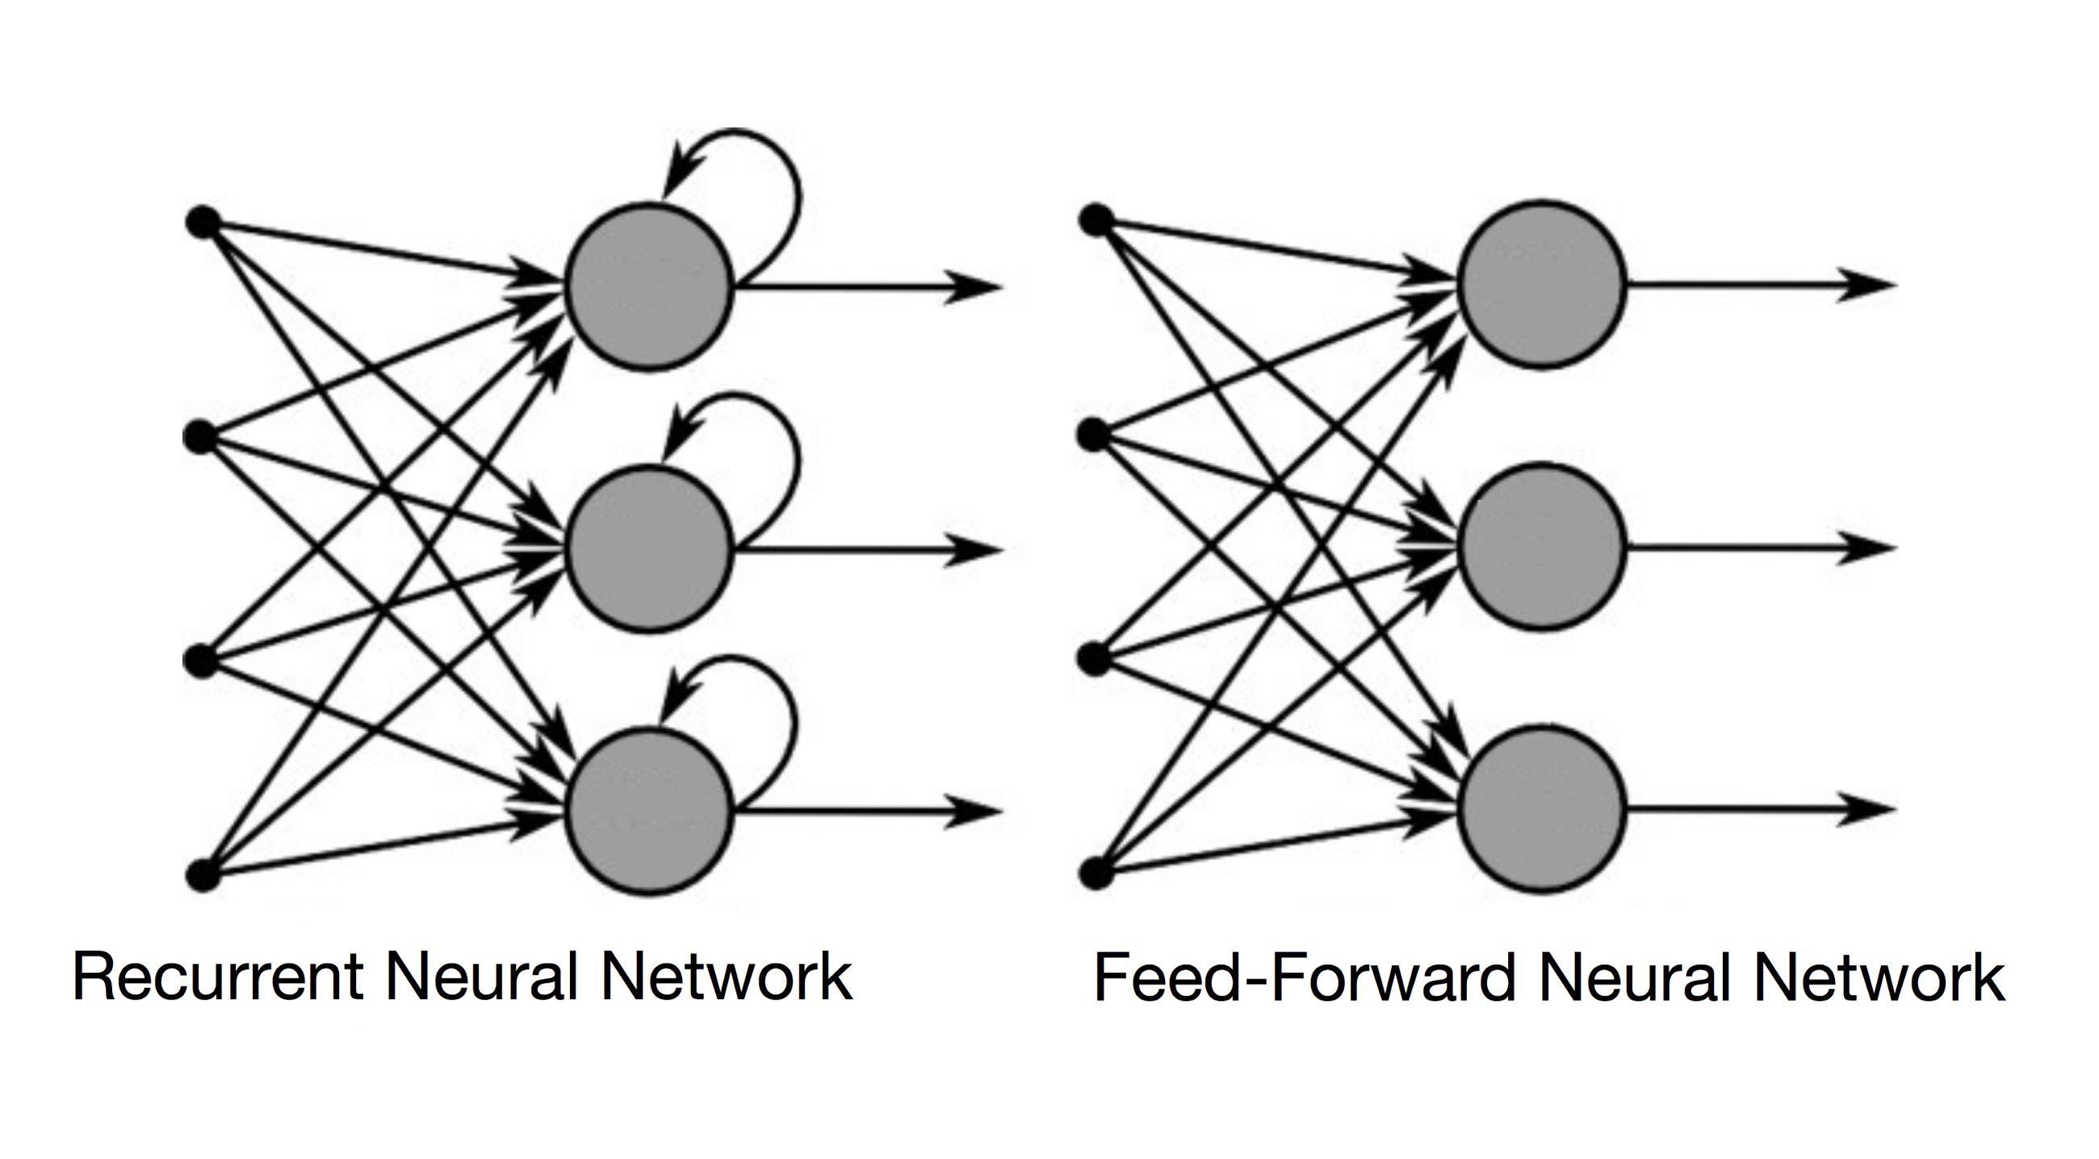
Recurrent neural network
The difference between Recurrent neural networks and traditional feed-forward neural networks:
Recurrent networks have an internal state that can represent context information. They keep information about past inputs for an amount of time that is not fixed a priori, but rather depends on its weights and on the input data
A RNN whose inputs are not fixed but rather constitute an input sequence can be used to transform an input sequence into an output sequence while taking into account contextual information in a flexible way

Slide 5
what makes rNN so special
A glaring limitation of Vanilla Neural Networks is that their API is too constrained:
Accept a fixed-sized vector as input* and produce a fixed-sized vector as output*
Models perform mapping using a fixed amount of computational steps*
The core reason that recurrent networks are more exciting is that they allow us to operate over sequences of vectors: Sequences in the inputs, the output or in the most general case both.
3 basic requirements of a RNN:
Be able to store information for an arbitrary duration
Be resistant to noise
Parameters be trainable (in reasonable time)
Notes:
1.(an image) and (probabilities of different classes)
2. ( the number of layers in the model)

Slide 6
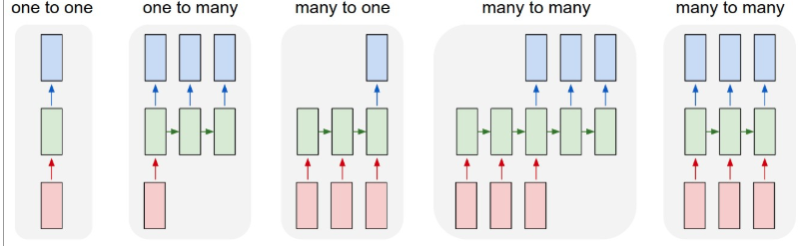
A few examples may makes this more concrete:
Each rectangle is a vector, and arrows represent functions
Input vectors are in red, output vectors are in blue and green vectors ahold the RNN’s state.
Notice that I every case are no pre-specified constraints on the lengths sequences because the recurrent transformation(green) is fixed and can be applied as many times as we like
Notes:
From left to right:
Vanilla mode of processing without RNN, from fixed-sized input to fixed-sized output eg. Image classification
Sequence output eg. Image captioning takes an image and outputs a sentence of words
Sequence input eg. sentiment analysis where a given sentence is classified as expressing positive or negative sentiment
Sequence input and output eg. Machine Translation: an RNN reads a sentence in English and then output a sentence in French
Synced sequence input and out eg. Video classification where we wish to label each frame of the video

Slide 7
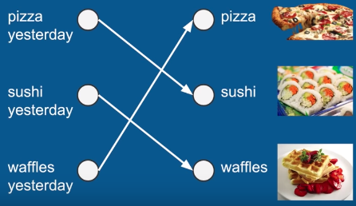
Examples of rnn
Notes:
What is for dinner?

Slide 8
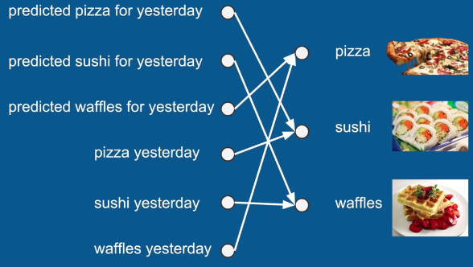
Examples of rnn

Slide 9
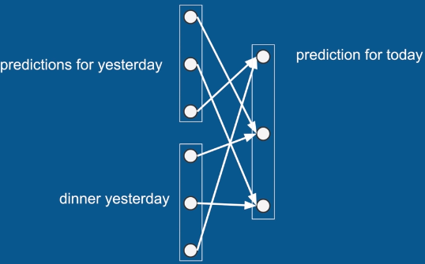
Examples of rnn

Slide 10
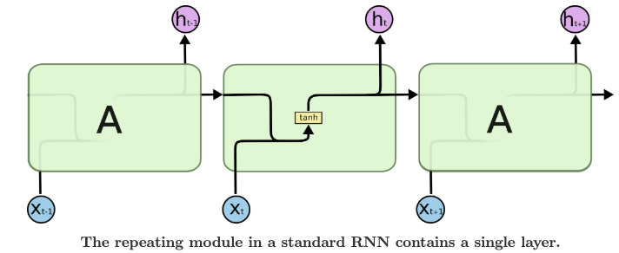
Recurrent neural networks

Slide 11
BPTT(backpropagation through time)
The purpose of recurrent networks is to accurately classify sequential input. We rely on the backpropagation of error and gradient descent to do so.
Back propagation in feedforward networks moves backward from the final error through the outputs, weights and inputs of each hidden layer, assigning those weights responsibility for a portion of the error by calculating their partial derivative or the relationship between their rates of change. Those weights up or down, whichever direction decreases error.
Recurrent networks rely on an extension of backpropagation called backpropagation through time. Time is simply expressed by a well-defined, ordered series of calculations linking one time step to the next, which is all backpropagation needs to work.

Slide 12
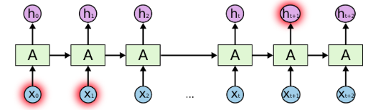
Rnn cannot do
If we trying to predict the last word in the text “I grew up in Taiwan… . I speak fluent French.”
Recent information suggests that the next word is probably the name of a language, but if we want to narrow down which language, we need the context of Taiwan, from further back. It is entirely possible for the gap between the relevant information and the point where it is needed to become very large.
Unfortunately, as that gap grows, RNNs become unable to learn to connect the information
Notes:
1.(an image) and (probabilities of different classes)
2. ( the number of layers in the model)

Slide 13
Vanishing/exploding gradients
Recurrent networks seeking to establish connections between a final output and events many time steps before were hobbled, because it is very difficult to know how much importance to accord to remote inputs. (likes great-great-great-great grandparents, they multiply quickly in number and their legacy is often obscure)
This is partially because the information flowing through neural networks passes through many stages of multiplication
Because the layers and time steps of deep neural networks relate to each other through multiplication, derivatives are susceptible to vanishing or exploding.

Slide 14
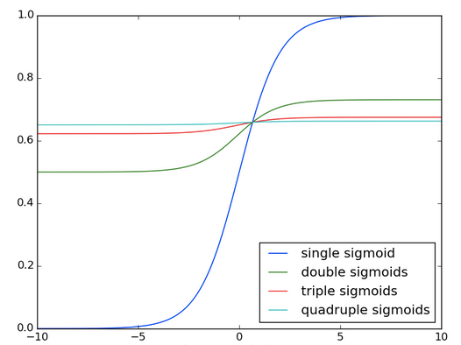
Vanishing/exploding gradients
Notes:
You see the effects of applying a sigmoid function over and over again
The data is flattened until, for large stretches, it has no detectable slope.
This is analogous to a gradient vanishing as it passes through many layers.

Slide 15
Some previous work
Gradient-descent variants: suffer from the same problems as BPTT and RTRL
Time-delays: practical for short time lags only, which update unit activations based on a weighted sum of old activations
Time constants: to deal with long time lags, uses time constants influencing changes of unit activations. But for long time lags, the time constants need external fin tuning updates the activation of a RNN by adding the old activation and the current net input. The net input tends to perturb the stored information, which makes long-term storage impractical
Ring’s approach: to deal with long time lags. Whenever a unit in his network receives conflicting error signals, he adds a higher order unit influencing appropriate connections. To bridge a time lag involving 100 steps, require the addition of 100 units. Also it does not generalize to unseen lag durations

Slide 16
Some previous work
5. Kalman filters: improve RNN performance. No reason to believe that it will be useful for very long minimal time lags
Second order nets: use multiplicative units to protect error flow from unwanted perturbations
Simple weight guessing: avoid long time lag problems of gradient-based approaches. Random initialize all net weights until the resulting net happens to classify all training sequences correctly. Only for simple problems
Adaptive sequence chunkers: bridge arbitrary time lags only if there is local predictability across the subsequences causing the time lags. But when the noise level increases the input sequences become less compressible.

Slide 17
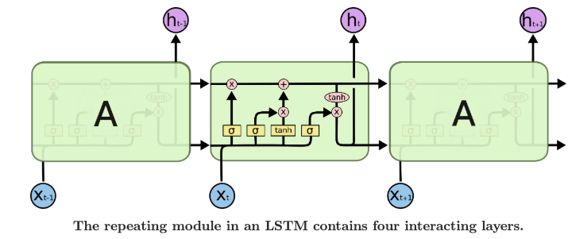
LSTM(long short term memory)
Overcome the error back-flow problems:
It can learn to bridge time intervals in excess of 1000 steps, even in case of noisy, incompressible input sequences

Slide 18
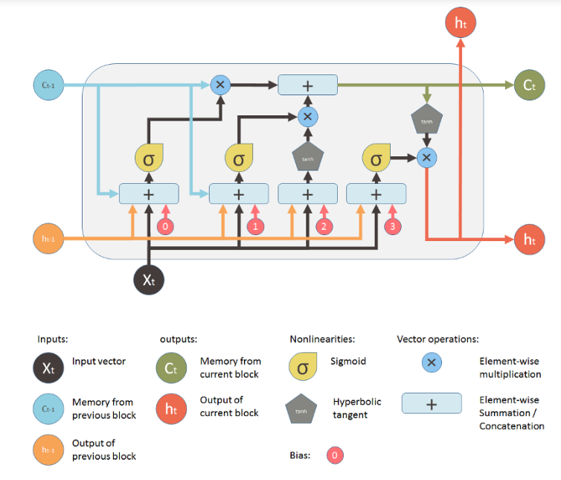
Notes:
Talk about the multiply vector and summation vector
Xt is the input of the current time step
Ht-1 is the output from the previous lstm unit
Ct-1 is the memory of the previous init
Ht is the ouputs for current network
Ct is the memory of the current unit

Slide 19
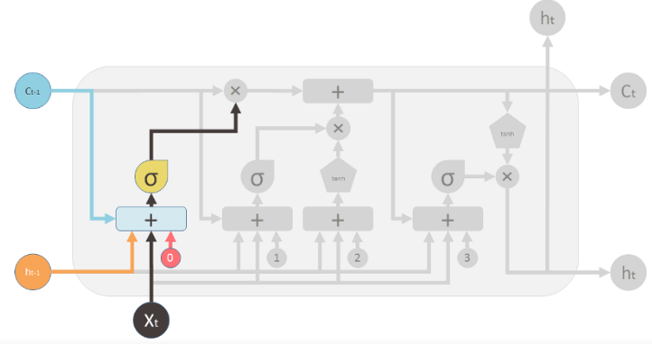
LSTM-forget value
Notes:
It is controlled by a simple one layer neural network. The inputs of the neural network is h_t-1 the output of the previous LSTM block, X_t, the input for the current LSTM block, C_t-1 the memory of the previous block and finally a bias vector b_0. This nerual network has a sigmoid function as activation, and it’s output vector is the forget value , which will applied to the old memory C_t-1 by element-wise multipliaction\
Sigmoid layer outputs numbers between 0 and 1. describing how much of each component should be let through.
A value of 0 means let nothing trough while a value of 1 means let every thing through

Slide 20
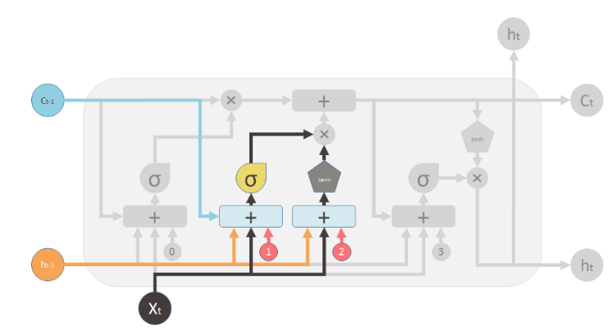
LSTM-input gate layer
Notes:
Ignoring: let us actually ignore possible predictions possibilities as they come in
This is an intention mechanism it lets things that are not immediately relevant be set aside
So they do not cloud the predictions in memory going forward
It has its own neural network and activation

Slide 21
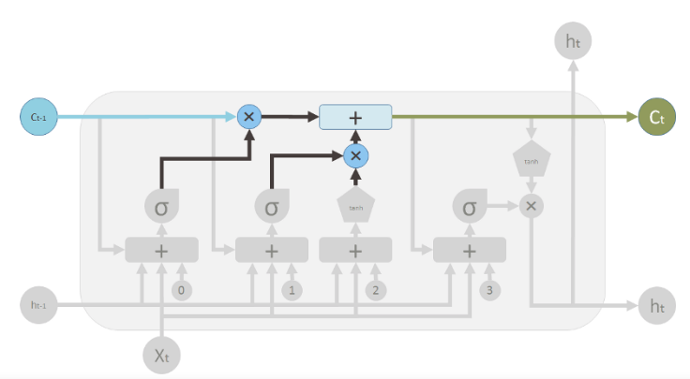
LSTM-update memory

Slide 22
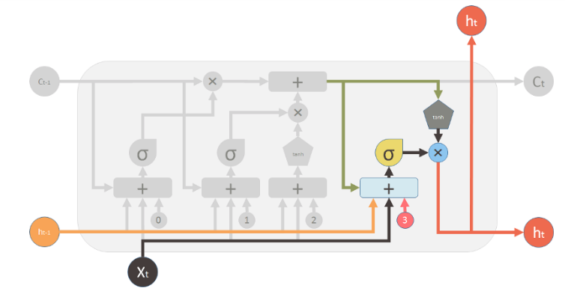
LSTM-output
Notes:
Selection: when we are combining out predictions with our memories, we may not necessarily want to release all of those memories out as new predictions each time so we want a little filter to keep out memories inside and let our predictions get out and that is we add another gate for that to do selection
New information and previous predictions can be used to vote on what all the gates should be what should be kept internal and what should be released as a prediction
Tanh:since we do an addition here it is possible that things could become greater than 1 or smaller than minus 1
So we use tanh to make sure it never gets out of control

Slide 23
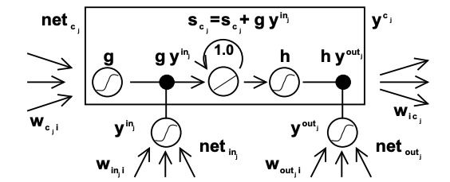

Slide 24
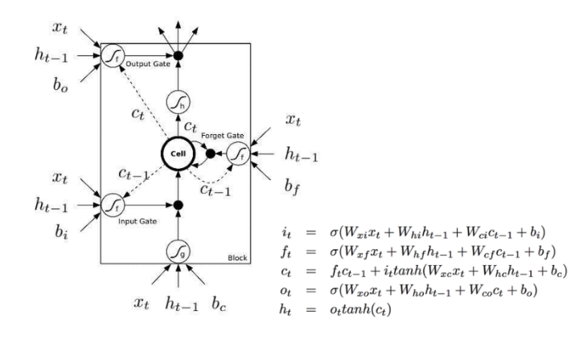

Slide 25
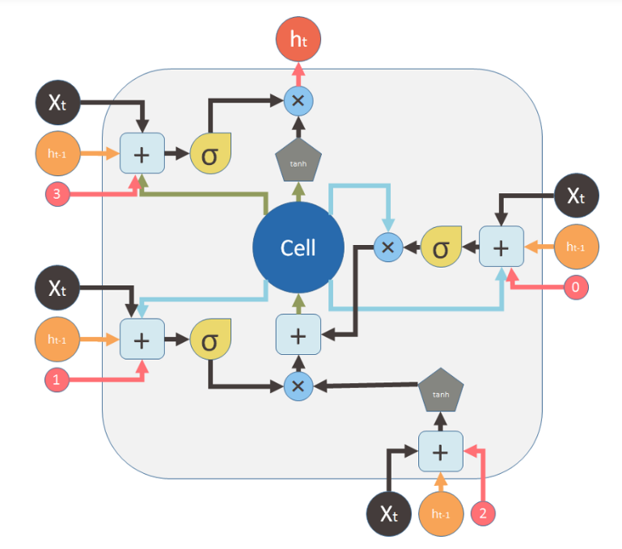

Slide 26
LSTM-limitations
20
Truncated backprop version of the LSTM algorithm will not easily solve problems similar to “strongly delayed XOR problem”. The reason is that storing only one of the inputs will not help to reduce the expected error, the task is non-decomposable in the sense that it is impossible to incrementally reduce the error by first solving an easier subgoal.
Each memory cell block needs two additional units (input and out gate). In the LSTM architecture, each conventional hidden unit is replaced at most 3 units, increasing the number of weights by a factor of 3 in to 2 in the fully connected case
Due to constant error flow through CECs with in memory cells, LSTM runs into problems similar to those of feedforward networks seeing the entire input string at once.
20

