Slide 1

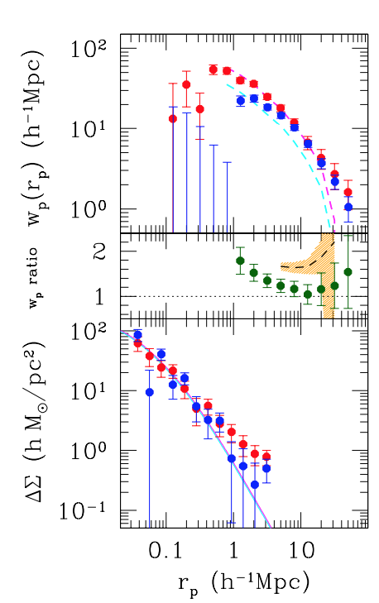
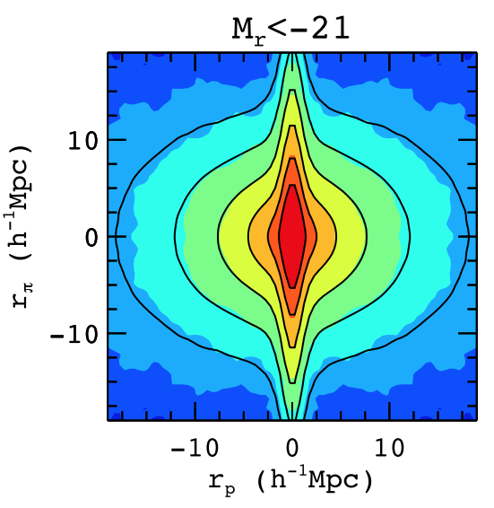


On the Constraints of Galaxy Assembly Bias in Velocity Space
Kevin Spencer McCarthy
Search for AB in projected space so far inconclusive.
What about redshift space?
Extend Lin et al. 2016 ‘central-only’ galaxy analysis into redshift space.
Early-type vs Late-type
$\left[w_{p},ξ_{0},ξ_{2}\right]→$ HOD+(velocity bias)
Guo + 2015
Lin + 2016
Early/Late samples: Same halo mass but different central velocity bias?
KITP: Galaxy-Halo Connection Conference Aug. 7th 2020 1/2
Notes:
Hello, my name is Kevin McCarthy and I am a PhD candidate at the University of Utah working with Prof. Zheng Zheng. This morning I am going to speak with you briefly about our search for galaxy assembly bias in velocity space.
Searches for galaxy assembly bias in real-world data is complicated by the need to observe galaxies that are split by some assembly-dependent variable while remaining to reside within the same host halo mass.
Recently, Lin et al. 2016 observed central-only galaxies within a fixed halo mass bin verified through measurements of the excess surface mass density from galaxy-galaxy weak lensing shown in the bottom panel of the middle plot. They split these galaxies into Early and Late-type samples according to specific star formation rate, with Early-type in red and late-type in blue dots. In the top panel of the middle plot we see the projected correlation function along with predictions from age-matching galaxy catalogs shown in the cyan and magenta curves. The ratio of these measurements and predication (green dots and orange contours in middle panel) do not agree, suggesting no assembly bias signal.
Informed by this selection criteria, we extend the search into redshift-space (the 2PCF of which is shown on the right plot, adding in the line-of-sight direction sourced from the redshift of the galaxies) where we are able to extract cosmological information from the dark matter velocity field.
Specifically, by adding in modeling of the clustering multipoles (monopole, quadrupole) from this observation with the halo occupation distribution (or HOD) framework(+ galaxy velocity bias) we can learn about the relative velocity between the central galaxy and host halo.
We are interested to see if our Early/Late samples will have similar host halo masses but show significantly different values of central galaxy velocity bias, a parameter that details how offset the central galaxy is from its host halo in velocity-space. Perhaps systems that have undergone more violent mergers will be more perturbed and have a higher central galaxy velocity bias…

Slide 2
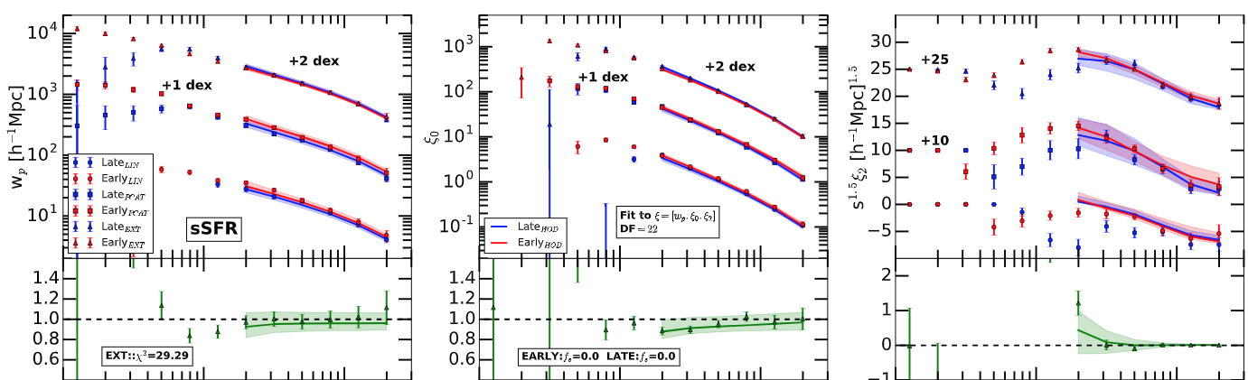
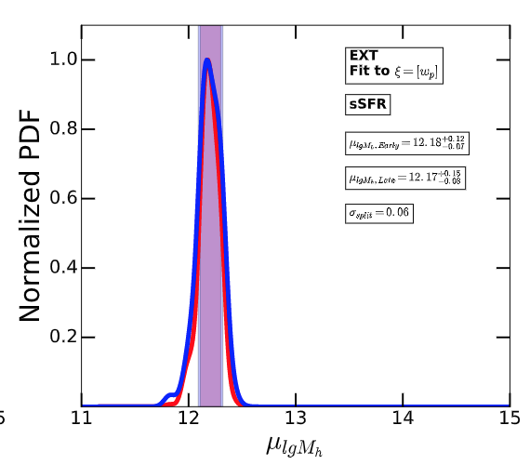
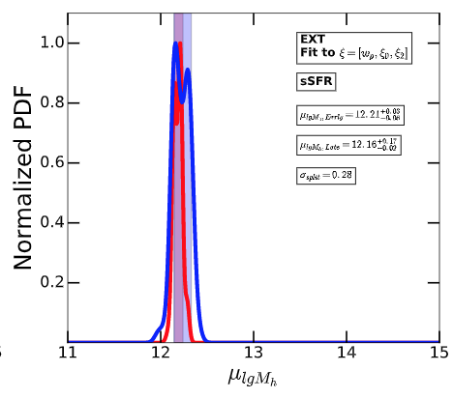
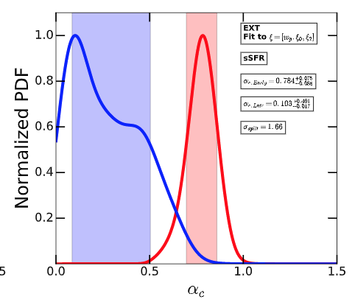




On the Constraints of Galaxy Assembly Bias in Velocity Space
Kevin Spencer McCarthy
Consistent halo mass
Hint of difference in velocity bias.
Reflect merger activity?
projected
monopole
quadrupole
McCarthy + 2020 (in prep)
ratio
ratio
diff.
← Projected space only
Projected + Redshift space →
Mean halo mass
Mean halo mass
Central velocity bias
KITP: Galaxy-Halo Connection Conference Aug. 7th 2020 2/2
Notes:
Here I show you the measurements AND HOD modeling fits for projected, monopole, and quadrupole 2PCF (top row from left to right) for one of our Early/Late sample pairs (we have other selection pairs that will be presented in the publication). For both fits to projected and projected+redshift space we find consistent mean host halo masses (bottom left and middle plots). With the fit to monopole and quadrupole we can constrain the central galaxy velocity bias (bottom right plot)
We find that there appears to be a split between Early and Late values at 1.66 sigma significance. If this detection is robust, this would imply that the Early systems (with low sSFR) have their central galaxies more perturbed within their host halos than the Late systems (with high sSFR). If these quenched low sSFR Early systems are more likely to be ellipticals and the active star forming high sSFR Late systems are spirals, this could indicate a central velocity bias dependence on the morphology of the galaxies, or rather the magnitude of the merger event, i.e. whether or not the system has had a major merger.
Please look for our publication on the arXiv in the near future.

