Slide 1

Note: The data and information in this document is reflective of a hypothetical situation and client. This document is to be used for KPMG Virtual Internship purposes only.
Sprocket Central Pty Ltd
Data analytics approach

Slide 2
Note: The data and information in this document is reflective of a hypothetical situation and client. This document is to be used for KPMG Virtual Internship purposes only.
Agenda
Introduction
Data Exploration
Model Development
Interpretation

Slide 3
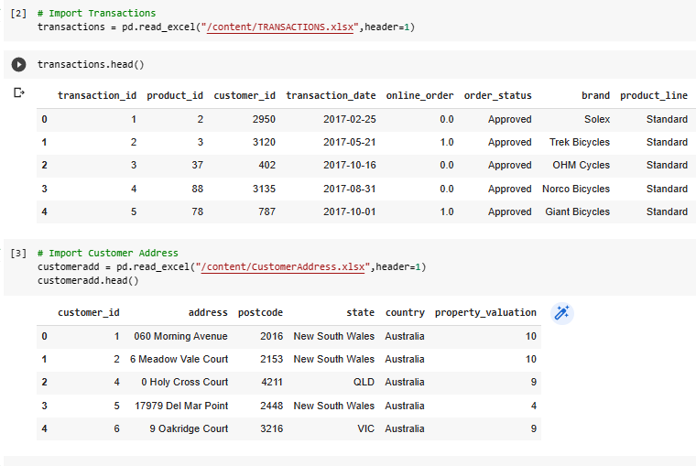
Note: The data and information in this document is reflective of a hypothetical situation and client. This document is to be used for KPMG Virtual Internship purposes only.
Introduction
IMPORT THE DATA
For context, Sprocket Central Pty Ltd is a long-standing KPMG client whom specialises in high-quality bikes and accessible cycling accessories to riders. Their marketing team is looking to boost business by analysing their existing customer dataset to determine customer trends and behavior.
Using the existing 3 datasets (Customer demographic, customer address and transactions) as a labelled dataset, please recommend which of these 1000 new customers should be targeted to drive the most value for the organization.
In building this recommendation, we need to start with a PowerPoint presentation which outlines the approach which we will be taking. The client has agreed on a 3 week scope with the following 3 phases as follows - Data Exploration; Model Development and Interpretation.
Prepare a detailed approach for completing the analysis including activities – i.e. understanding the data distributions, feature engineering, data transformations, modelling, results interpretation and reporting. This detailed plan needs to be presented to the client to get a sign-off. Please advise what steps you would take.

Slide 4
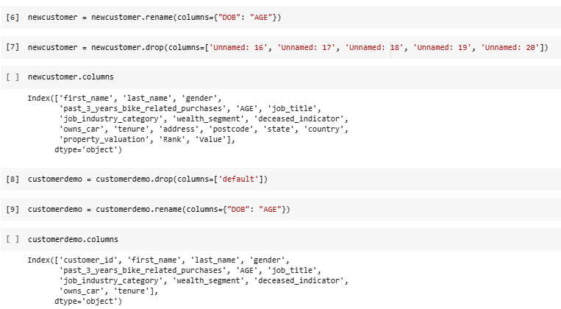
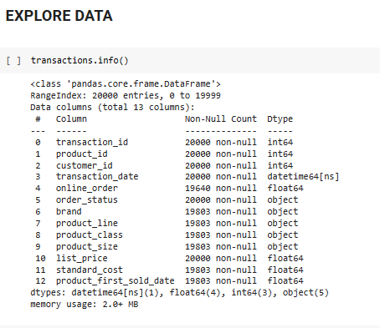
Note: The data and information in this document is reflective of a hypothetical situation and client. This document is to be used for KPMG Virtual Internship purposes only.
Data Transform and Exploration

Slide 5
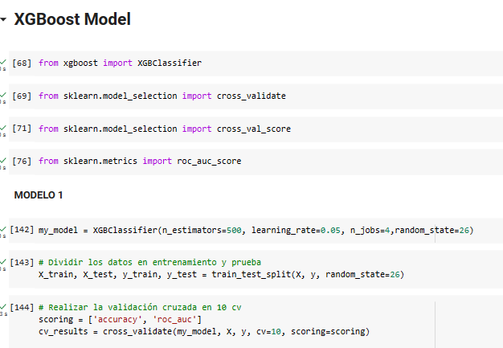
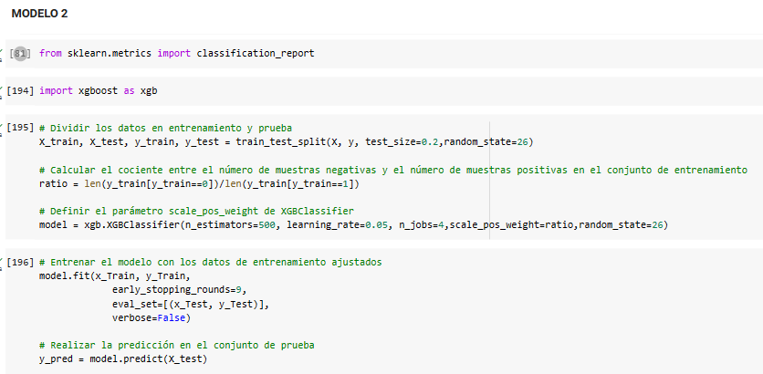
Note: The data and information in this document is reflective of a hypothetical situation and client. This document is to be used for KPMG Virtual Internship purposes only.
Model Development
XGBOOST MODEL OF CLASSIFIER

Slide 6
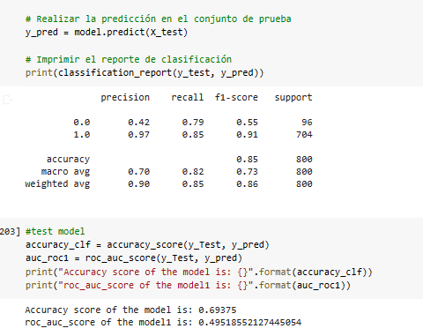
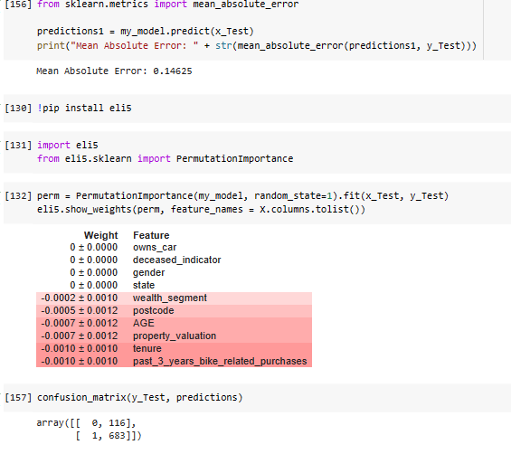
Note: The data and information in this document is reflective of a hypothetical situation and client. This document is to be used for KPMG Virtual Internship purposes only.
Interpretation
EVALUATION OF THE MODEL

