Slide 1
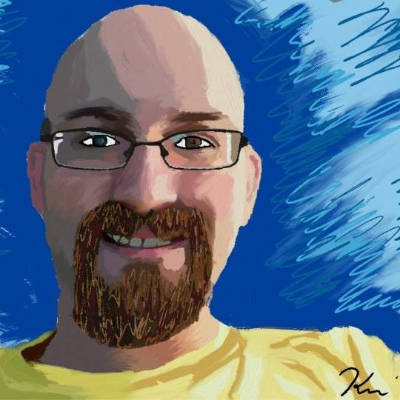
<#
Kevin Marquette
KevMar@gmail.com
@KevinMarquette
http://KevinMarquette.blogspot.com
www.linkedin.com/in/kevinmarquette
BIO:
I am a Network and Systems Automation Architect for Everi Games located in Austin, TX. I am an active member of and speaker for the @ATXPowershell user group and /r/Powershell online community. I started working with Powershell in 2009 and I always look forward to sharing my Powershell experiences and passion with others.
#>

Slide 2
<#
Session Title:
Powershell: General admin problems and how to solve them
Topic Details:
There are some common problems that can offer unique challenges for those new to Powershell. It could be installing MSIs, remoting, working with scheduled tasks or even the infamous double hop problem. Learn about these roadblocks before you hit them yourself.
#>

Slide 3
<#
Kevin Marquette
KevMar@gmail.com
@KevinMarquette
http://KevinMarquette.blogspot.com
www.linkedin.com/in/kevinmarquette
BIO:
I am a Network and Systems Automation Architect for Everi Games located in Austin, TX. I am an active member of and speaker for the @ATXPowershell user group and /r/Powershell online community. I started working with Powershell in 2009 and I always look forward to sharing my Powershell experiences and passion with others.
#>

