Slide 1
Writing a DSL for PowerShell (Domain Specific Languages)
Kevin Marquette

Slide 2

About Kevin Marquette
Sr. DevOps Engineer at loanDepot
SoCal PowerShell User Group
Community Modules:
PSGraph
PSGraphPlus
Chronometer
PSHonolulu
Select-AST
PowerShell Blog: kevinmarquette.github.io/blog
Twitter: @KevinMarquette
/u/KevMar

Slide 3
Introduction to Domain Specific Languages
PowerShell DSL examples from the community
Syntax breakdown of a common DSL
Create a basic DSL command
Common DSL command patterns
Lessons learned

Slide 4
Introduction to Domain Specific Languages
PowerShell DSL examples from the community
Syntax breakdown of a common DSL
Create a basic DSL command
Common DSL command patterns
Lessons learned

Slide 5
Introduction to Domain Specific Languages
PowerShell DSL examples from the community
Syntax breakdown of a common DSL
Create a basic DSL command
Common DSL command patterns
Lessons learned

Slide 6
What we will learn today:
How to shape PowerShell functions into a DSL syntax
What is not covered in this talk:
Regex parsing and interpreting text as commands
DynamicKeyword

Slide 7
What is a DSL?
“A domain-specific language (DSL) is a computer language specialized to a particular application domain. This is in contrast to a general-purpose language (GPL), which is broadly applicable across domains, and lacks specialized features for a particular domain.” -Wikipedia
“An application domain may be specialized enough that it has it’s own language to describe things. Sometimes that does not translate well to the tools we are using. We have many ways to approach these problems and using a DSL is one of them.” -Kevin Marquette

Slide 8
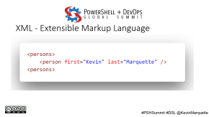
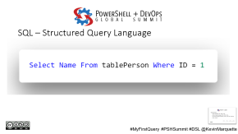
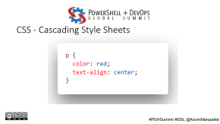
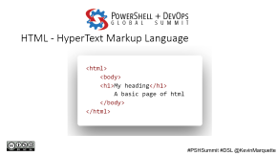
DSL Examples:
Query languages: SQL, XPath, LINQ
Data exchange languages: XML, JSON, YAML,
Document languages: Markdown, HTML, CSS, PDF, PostScript
Other: Gherkin

Slide 9
PowerShell DSL Examples
DSC – Desired State Configuration
Pester - Test and Mock Framework

Slide 10
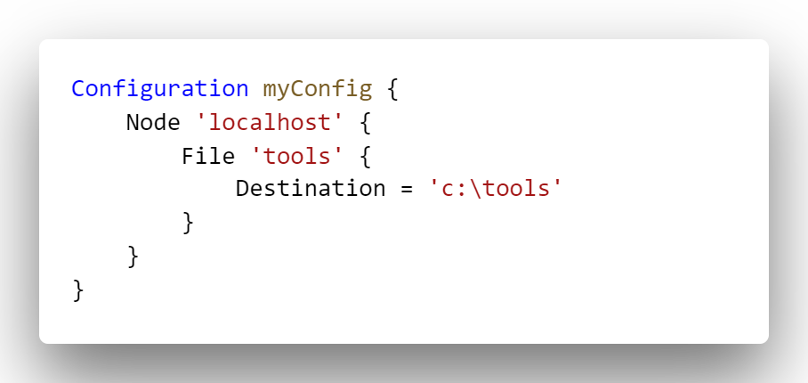
DSC – Desired State Configuration
#DSC

Slide 11
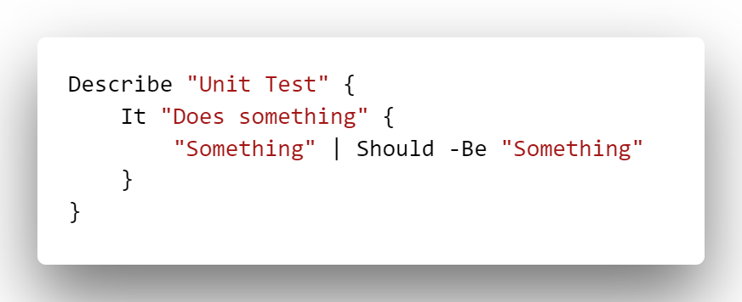
Pester – Test and Mock Framework
https://github.com/pester/Pester
@Pester

Slide 12
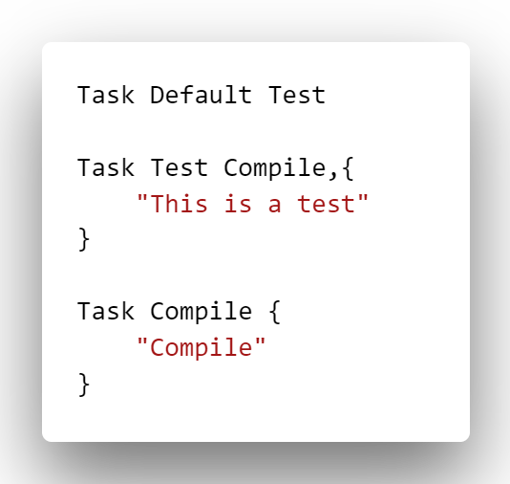
InvokeBuild – Build Automation
https://github.com/nightroman/Invoke-Build
@romkuzmin

Slide 13
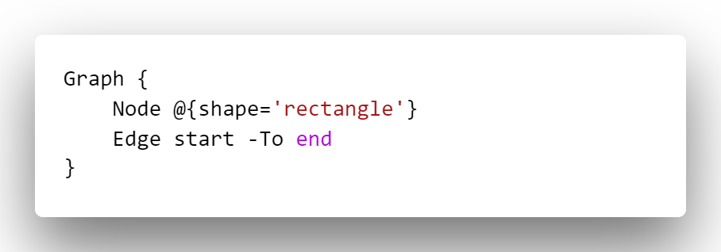
PSGraph – Node/Edge Graph DSL
https://github.com/KevinMarquette/PSGraph

Slide 14
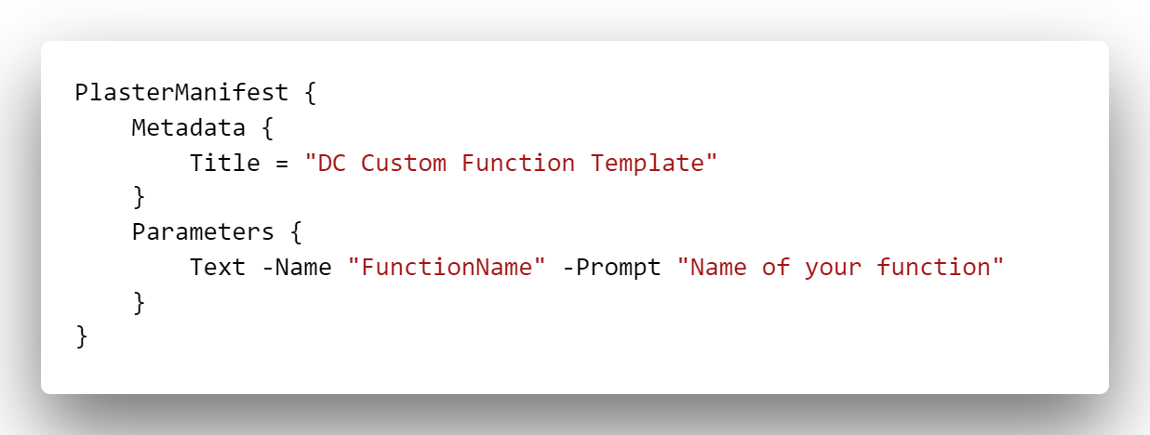
PlasterDSL - Plaster Manifest DSL
https://github.com/dchristian3188/PlasterManifestDSL
@dchristian3188

Slide 15
Others
psake - https://github.com/psake/psake
PSHTML - https://github.com/Stephanevg/PSHTML
New-XmlDocument - Bruce Payette PowerShell In Action
XML - https://github.com/Jaykul/Xml
ShowUI - https://github.com/ShowUI/ShowUI

Slide 16
Syntax breakdown of Pester as a DSL
Function
Parameter
ScriptBlock
https://github.com/pester/Pester
@Pester

Slide 17
I would love to see your feedback. The good and the bad.
@KevinMarquette

Slide 19
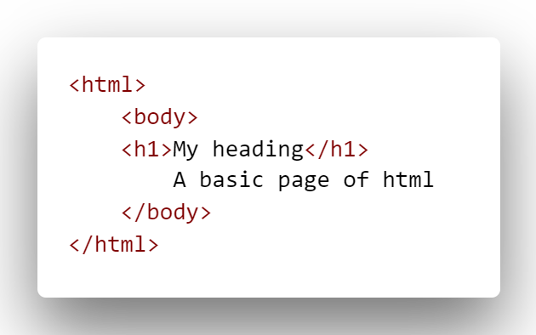
HTML - HyperText Markup Language

Slide 20
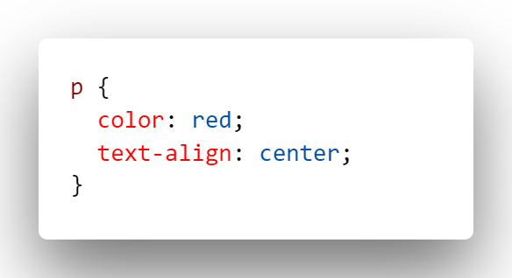
CSS - Cascading Style Sheets

Slide 21
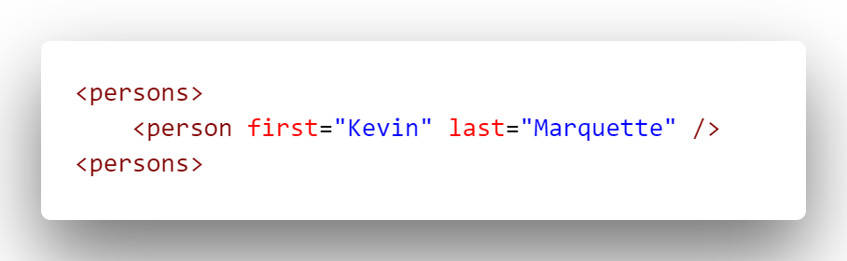
XML - Extensible Markup Language

Slide 22
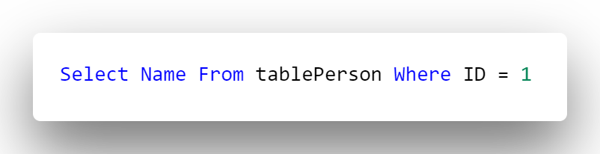
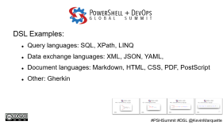
SQL – Structured Query Language
#MyFirstQuery

