Slide 1
Design Notes
These slides are hidden, and will not display when presenting.
You’re welcome to delete these slides if you plan to share your deck.

Slide 2
Sharing
You are responsible for sharing your deck, your code, or anything else you like.
You can use Sched.com, or you can use another location. It’s entirely up to you.
We suggest including a shortened URL at the end of the presentation.

Slide 3
Demos
Please modify console, ISE, or VS Code colors to use a high-contrast color scheme.
“Light” themes often work better, especially when combined with bold fonts and dark text colors.
Jack up the font size so your code is legible at the back of the room.

Slide 4
Demos
We strongly recommend the use of VS Code – all attendees can get it, and we’d like them to get used to it
We recommend the Light+ theme
Use the Zoom feature to raise the font size consistently throughout the UI

Slide 5
Copyright
Please do not include graphics or videos you found on the Internet unless you have explicit permission from their owner to use them.
We have had take-down notices in the past and would like to avoid this.
When in doubt, skip the silly picture.

Slide 6
Copyright
We default slides to a Creative Commons attribution, sharealike, noncommercial license
You’re welcome to state a different copyright policy. If you do, please remove the CC logos.

Slide 7
Lastly
Please leave the boilerplate slide at the end of the presentation, and leave it on-screen as you end.
During your “Final Q&A” is a good time to bring that slide up.

Slide 8
Writing a DSL for PowerShell (Domain Specific Languages)
Kevin Marquette

Slide 9
About Kevin Marquette
Sr. DevOps Engineer at loanDepot
SoCal PowerShell User Group Organizer @SoCalPowerShell
Community Modules: https://github.com/kevinmarquette
PSGraph
PSGraphPlus
Chronometer
PSHonolulu
Select-AST
PowerShell Blog: kevinmarquette.github.io/blog
Twitter: @KevinMarquette
/u/KevMar @ reddit.com/r/PowerShell

Slide 10
Introduction to Domain Specific Languages
PowerShell DSL examples from the community
Syntax breakdown of a common DSL
Create a basic DSL command
Common DSL command patterns
Lessons learned

Slide 11
What we will learn today:
How to shape PowerShell functions into a DSL syntax
What is not covered in this talk:
Regex parsing and interpreting text as commands
DynamicKeyword

Slide 12
What is a DSL?
“A domain-specific language (DSL) is a computer language specialized to a particular application domain. This is in contrast to a general-purpose language (GPL), which is broadly applicable across domains, and lacks specialized features for a particular domain.” -Wikipedia
“An application domain may be specialized enough that it has it’s own language to describe things. Sometimes that does not translate well to the tools we are using. We have many ways to approach these problems and using a DSL is one of them.” -Kevin Marquette

Slide 13
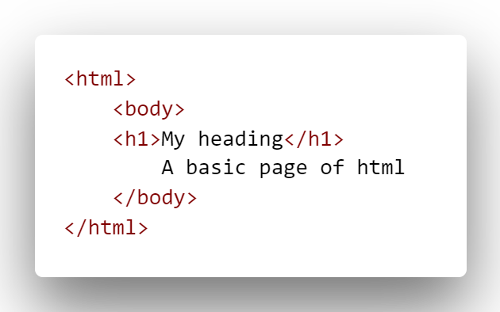
HTML - HyperText Markup Language

Slide 14
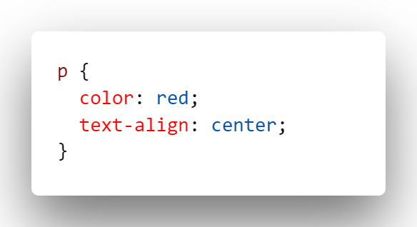
CSS - Cascading Style Sheets

Slide 15
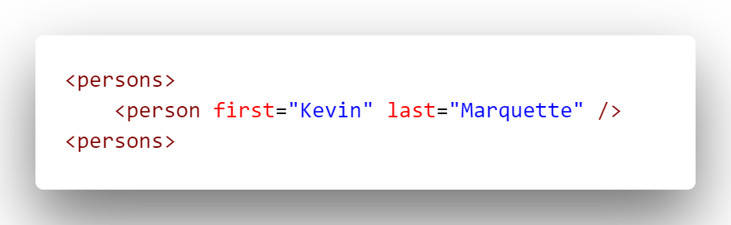
XML - Extensible Markup Language

Slide 16
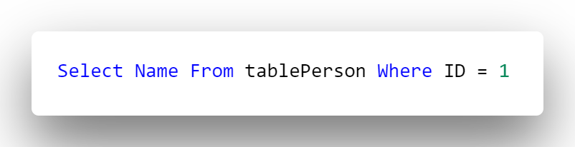
SQL – Structured Query Language
#MyFirstQuery

Slide 17
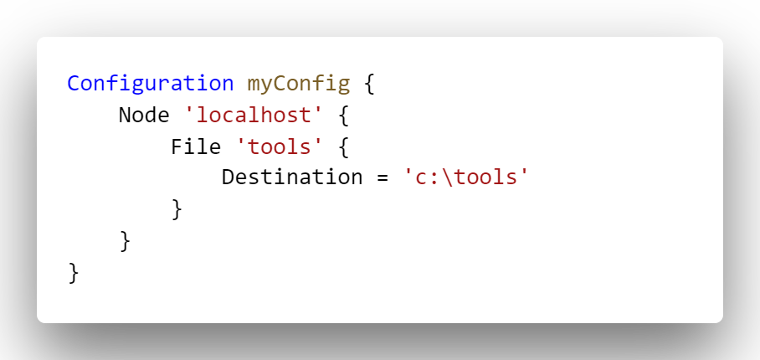
DSC – Desired State Configuration
#DSC

Slide 18
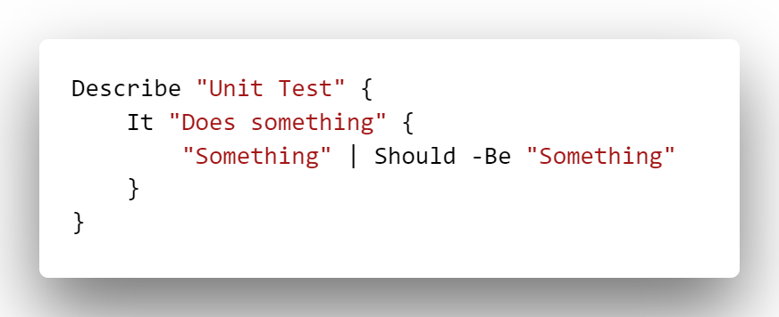
Pester – Test and Mock Framework
https://github.com/pester/Pester
@Pester

Slide 19
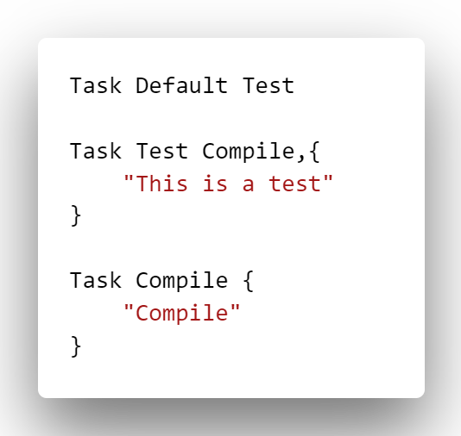
InvokeBuild – Build Automation
https://github.com/nightroman/Invoke-Build
@romkuzmin

Slide 20
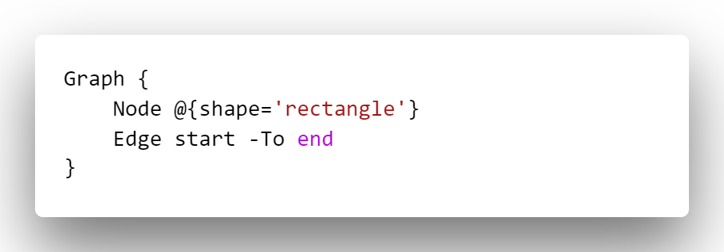
PSGraph – Node/Edge Graph DSL
https://github.com/KevinMarquette/PSGraph

Slide 21
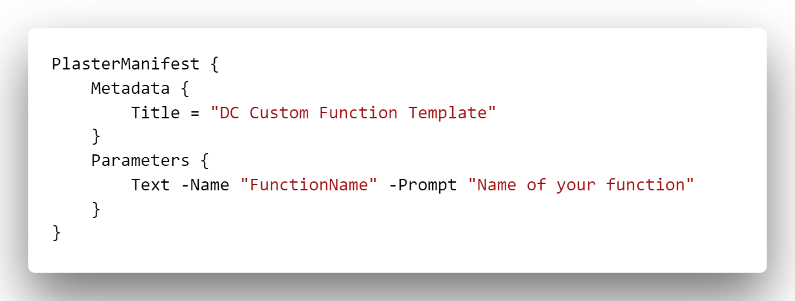
PlasterDSL - Plaster Manifest DSL
https://github.com/dchristian3188/PlasterManifestDSL
@dchristian3188

Slide 22
Others
psake - https://github.com/psake/psake
PSHTML - https://github.com/Stephanevg/PSHTML
New-XmlDocument - Bruce Payette PowerShell In Action
XML - https://github.com/Jaykul/Xml
ShowUI - https://github.com/ShowUI/ShowUI

Slide 23
Syntax breakdown of Pester as a DSL
Function
Parameter
ScriptBlock
https://github.com/pester/Pester
@Pester

Slide 24
I would love to see your feedback. The good and the bad.
@KevinMarquette

