Slide 1
Writing a DSL for PowerShell (Domain Specific Languages)
Kevin Marquette
https://github.com/KevinMarquette/DSLPresentation

Slide 2

About Kevin Marquette
Sr. DevOps Engineer at loanDepot
SoCal PowerShell user group
Modules
PSGraph
PSGraphPlus
Chronometer
PSHonolulu
kmarquette.github.io
@KevinMarquette
https://github.com/KevinMarquette/DSLPresentation

Slide 3
What is a DSL?
A general-purpose language (GPL) is broadly applicable across domains, and lacks specialized features for a particular domain.
A domain-specific language (DSL) is a computer language specialized to a particular application domain.
-Wikipedia

Slide 4
PowerShell DSL Examples
DSC
Pester
InvokeBuild
psake
PSGraph
PlasterDSL
Gherkin
PSHTML

Slide 5
PowerShell DSL code samples

Slide 6
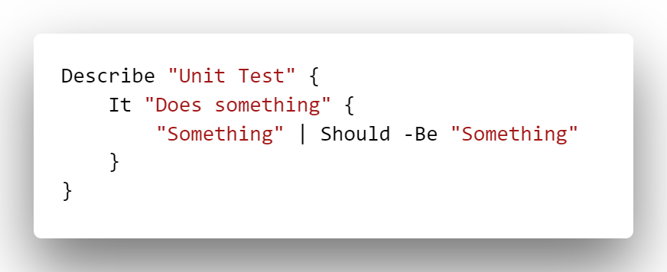
Syntax breakdown of Pester as a DSL
Function
Parameter
ScriptBlock

Slide 7
Deeper Pester deconstruction

Slide 8
DSL Commands
DSL commands are functions
Don’t follow community cmdlet best practices
Named according to the problem domain
Use positional and unnamed parameters
String parameters are not placed in quotes
Abuse ScriptBlocks for nesting or child elements
Can also use arrays or multiline strings
Use hashtable for arbitrary properties
Usually parried with an “Invoke” command
Invoke-Pester
Invoke-Build
Show-PSGraph

Slide 9
Planning a DSL
Make sure a DSL is what you need
1
Prototype syntax before you code it
2
Try to create different style samples
Build to the target domain
3
Look for structure
Focus on user experience
4
Just because you can…
Easy to use vs easy to make

Slide 10
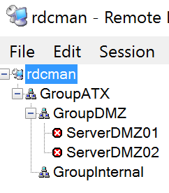
Building a RDCMan DSL

Slide 11
DLS Tricks (Design Patterns?)
Value passthrough
Simple template
Nested template
Hashtable passthrough
Hashtable builder
Object collector

Slide 12
Restricted DSL
Data statement
Data -SupportedCommand $command {…}
$ScriptBlock.CheckRestrictedLanguage
# $null for unrestricted
# [string[]]@() for full restrictions
[string[]]$commands = @('State','ServerDetails','RDCServer')
[string[]]$variables = $null
[bool]$allowEnvVariables = $true
$scriptBlock.CheckRestrictedLanguage($commands, $variables, $allowEnvVariables)

Slide 13
Internal Only Commands
Defined inside parent function
Get-PSCallStack

Slide 14
DynamicKeyword
The method used by DSC
Supports scriptblock or hashtable
Name is optional
Limitations:
Must be loaded before script is parsed
Can’t use any other function parameters

Slide 15
Debugging
function RdcGroup
{
[CmdletBinding()]
[System.Diagnostics.DebuggerStepThrough()]
param(
….

Slide 16
Kevin Marquette
SoCal PowerShell user group
Modules
PSGraph
PSGraphPlus
Chronometer
PSHonolulu
kmarquette.github.io
@KevinMarquette
https://github.com/KevinMarquette/DSLPresentation

