Slide 1
Working with PSGraph 2.1
Kevin Marquette

Slide 2

Why am I talking about PSGraph?
Author and Maintainer
PSGraph
PSGraphPlus
Community Speaker on PSGraph
Using PSGraph in Production

Slide 3
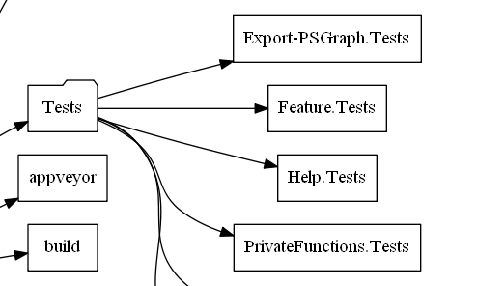
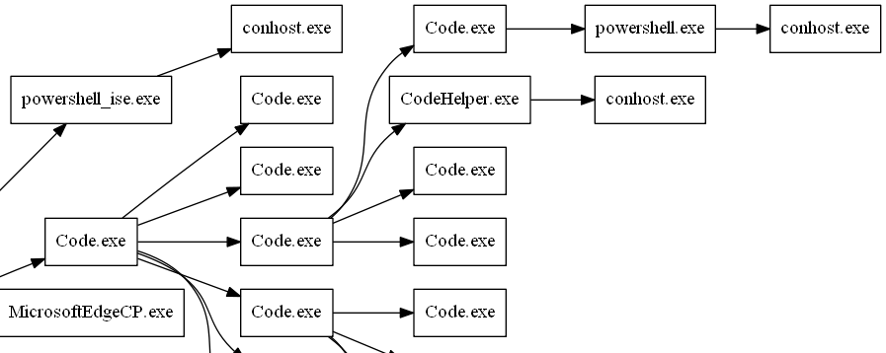
What kind of graphs?
Node to Node based graphs
Relationships, Dependencies, Structure
Tools like Visio are easy to use, hard to script

Slide 4
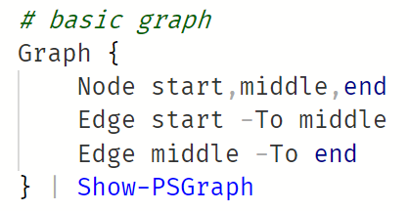
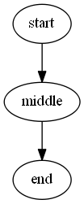
PSGraph
A DSL implemented as a PowerShell Module
Uses graphviz layout and rendering engine
PowerShell
PNG
GRAPHVIZ

Slide 5
Demo: PSGraph features
Node
Edge
Rank
Record
Entity
Subgraph
Show-PSGraph

Slide 6
Demo: Server Diagram
Demo: Org Chart
Graph {…}

Slide 7
Lightning Demos
Import-Module PSGraphPlus

Slide 8
PowerShellExplained.com
Related Articles:
PSGraph, A graph module built on GraphViz
PSGraph the Get-Help related links
PSGraph 1.2, The SubGraph Release
PSGraph 2.1 the record release

Slide 9

Kevin Marquette
PowerShellExplained.com
KevMar@gmail.com
@KevinMarquette

Slide 10

About Kevin Marquette
Principal DevOps Engineer at loanDepot
Microsoft MVP
2018 PowerShell Community Hero
SoCal PowerShell User Group Organizer
PowerShellExplained.com
Module Author: PSGraph, VsoLoggingCommands, TFVC, Chronometer, Jira, DependsOn, Watch-Command, Select-Ast
KevMar@gmail.com
@KevinMarquette

Slide 11
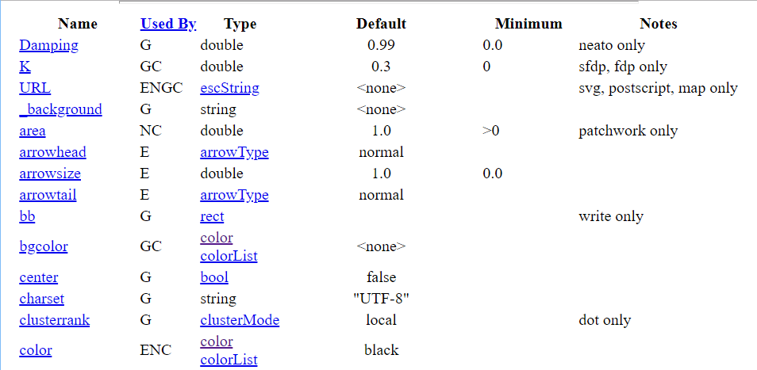
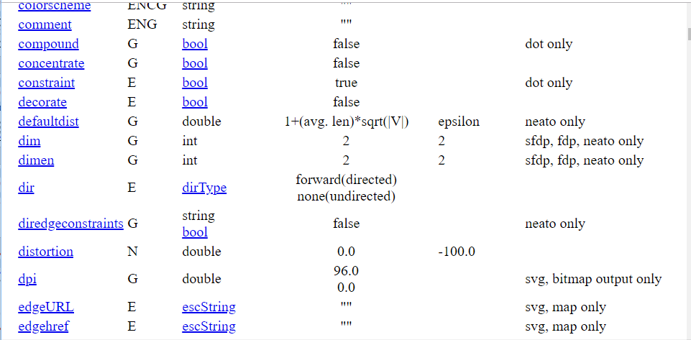
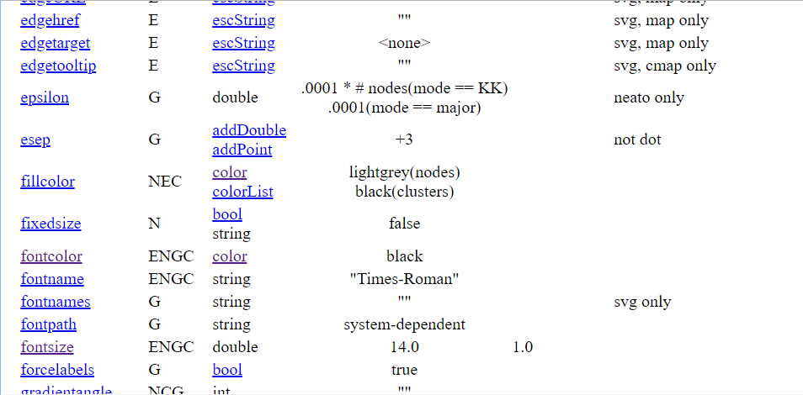
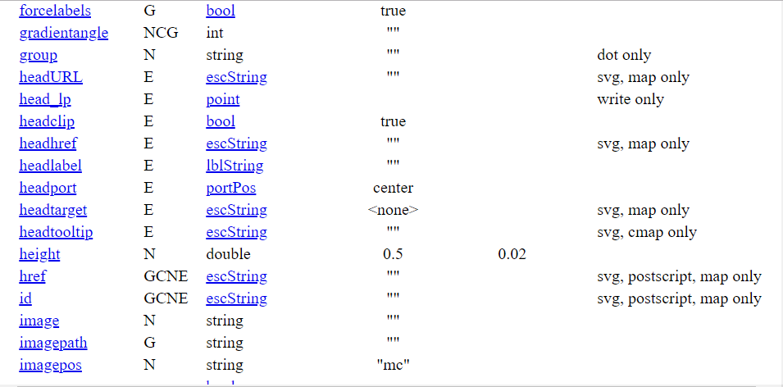
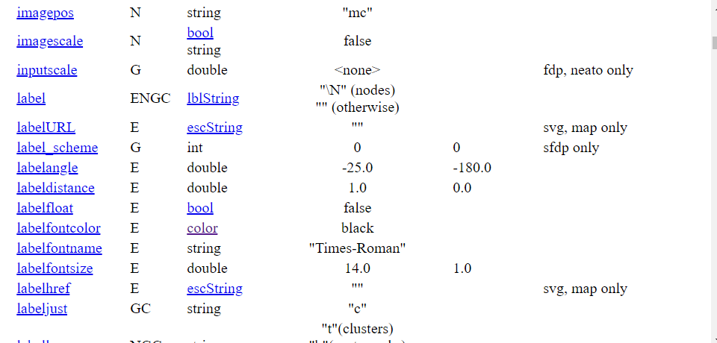
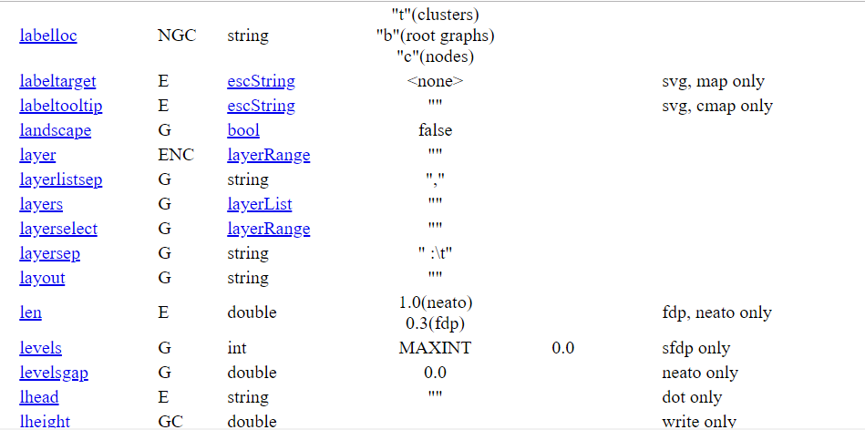
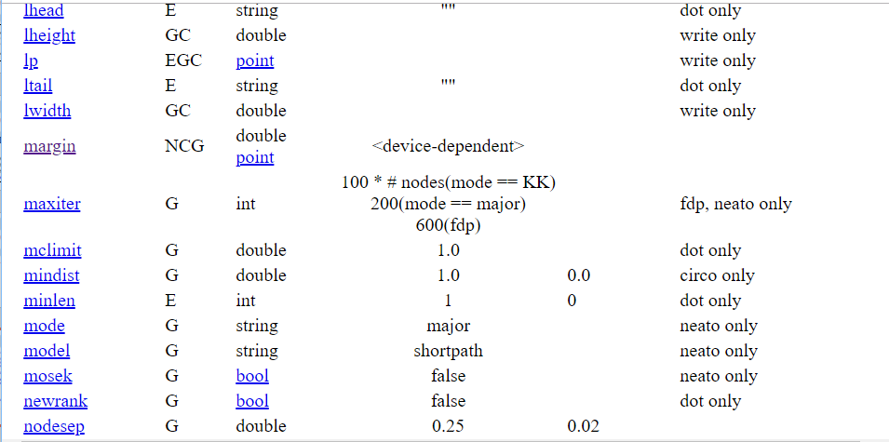
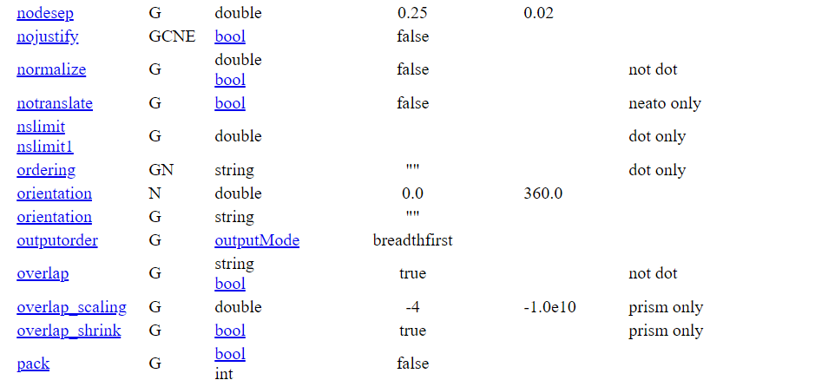
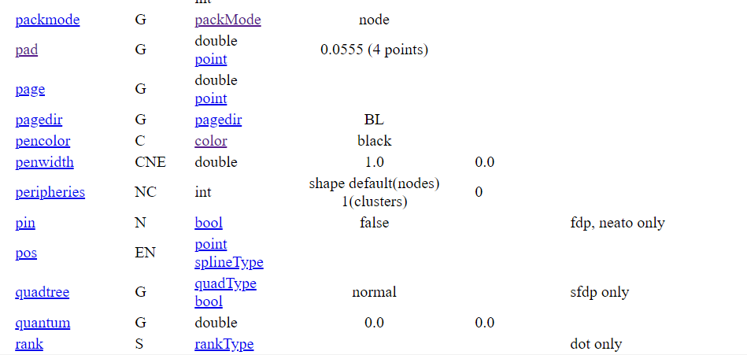
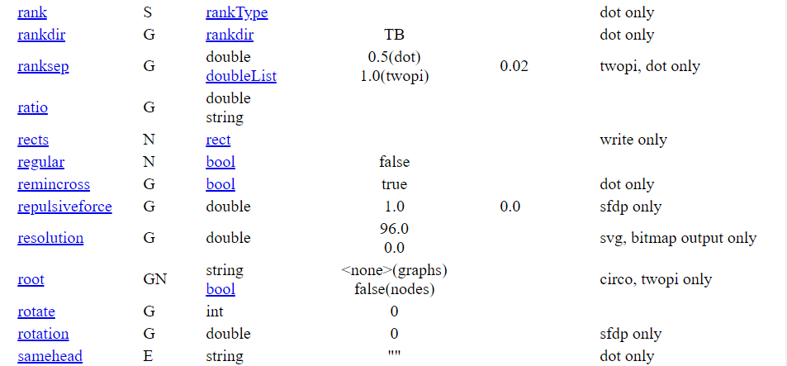
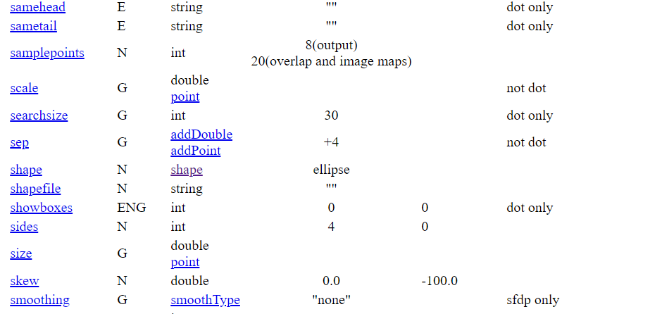
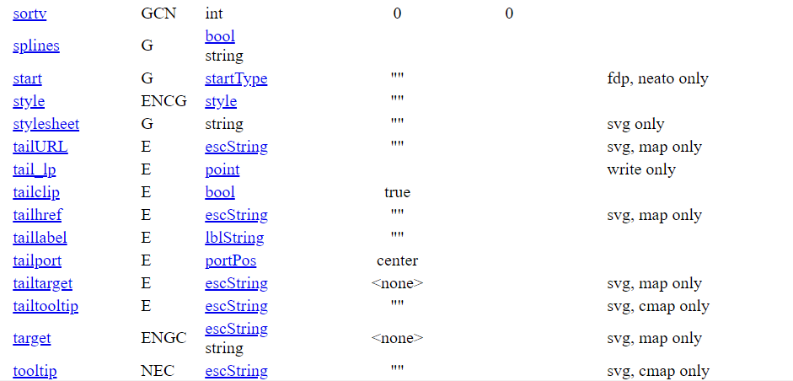
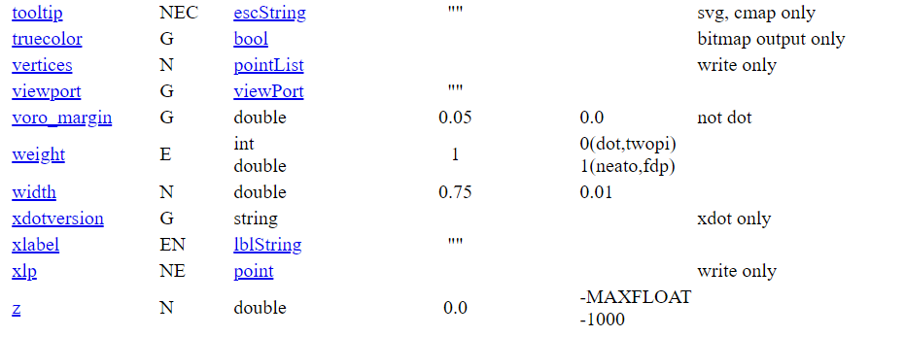
Graphviz Attributes

Slide 12
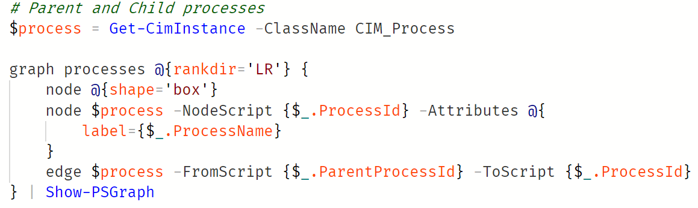
Parent and child processes

Slide 13
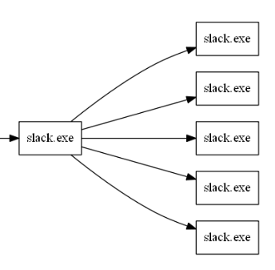
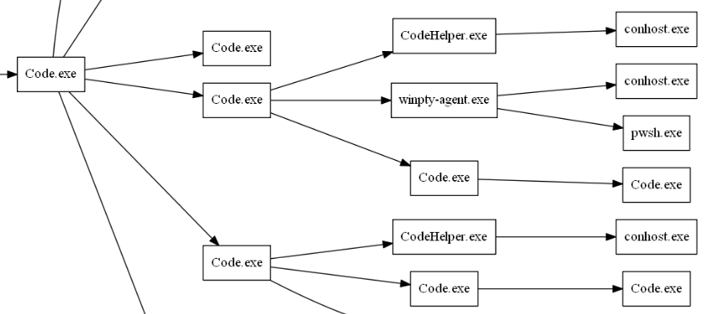

Slide 14
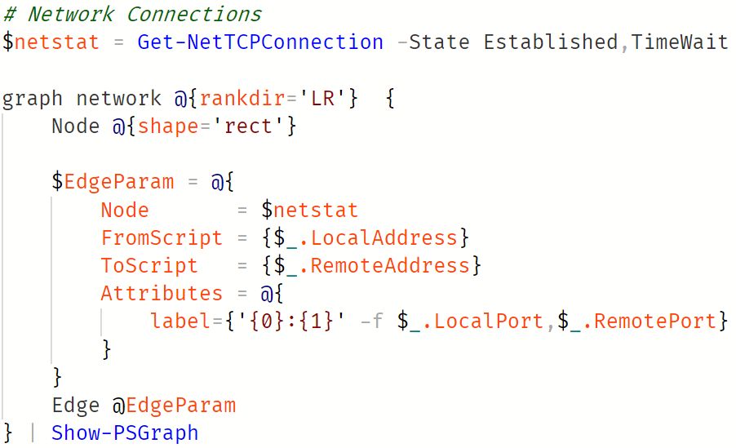

Slide 15
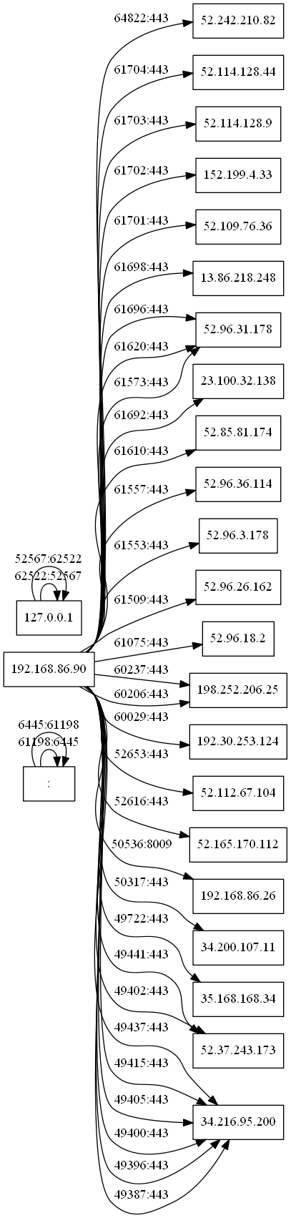
Show-NetworkConnectionGraph

Slide 16
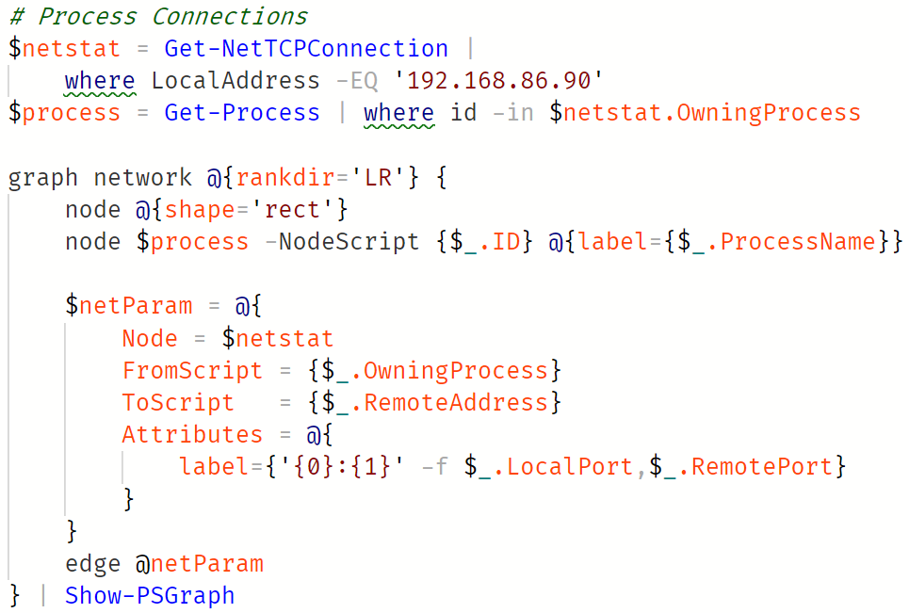

Slide 17
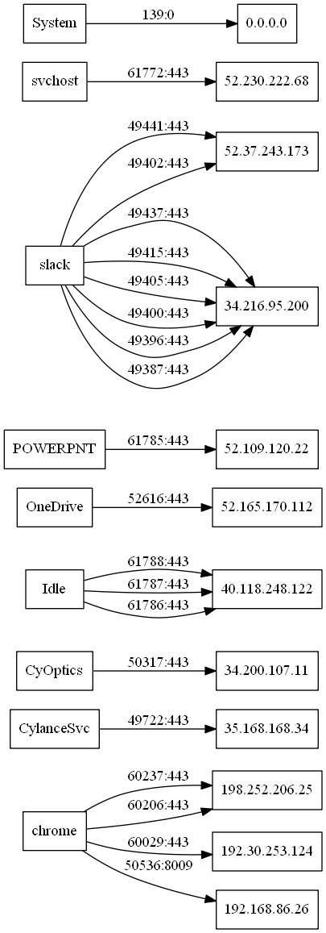
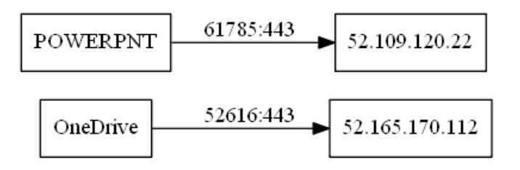
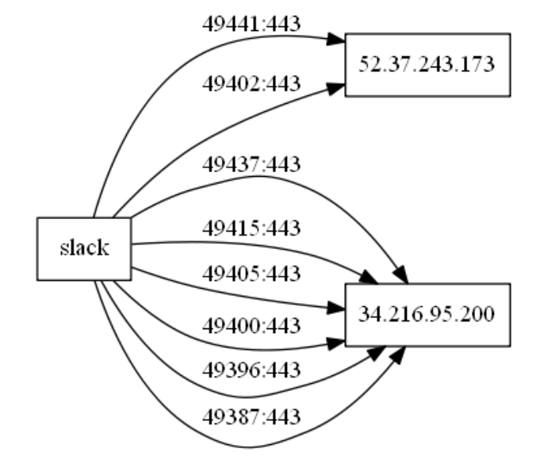
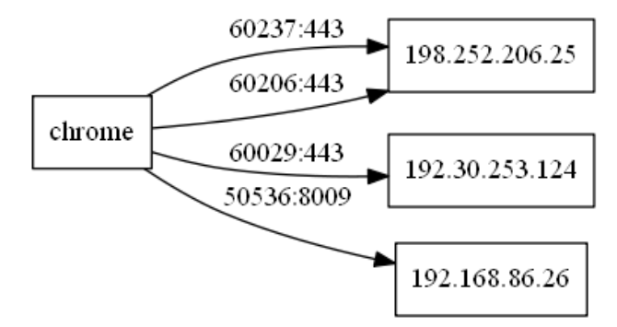
Show-ProcessConnectionGraph

Slide 18
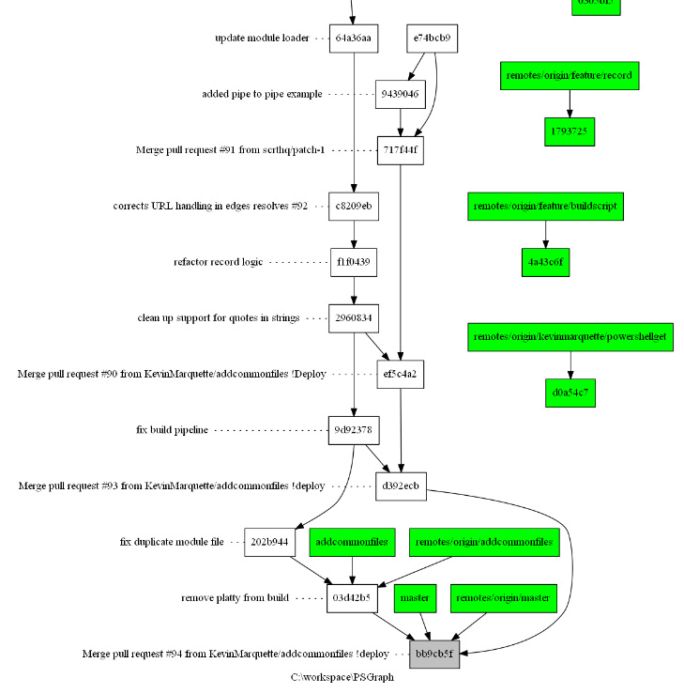
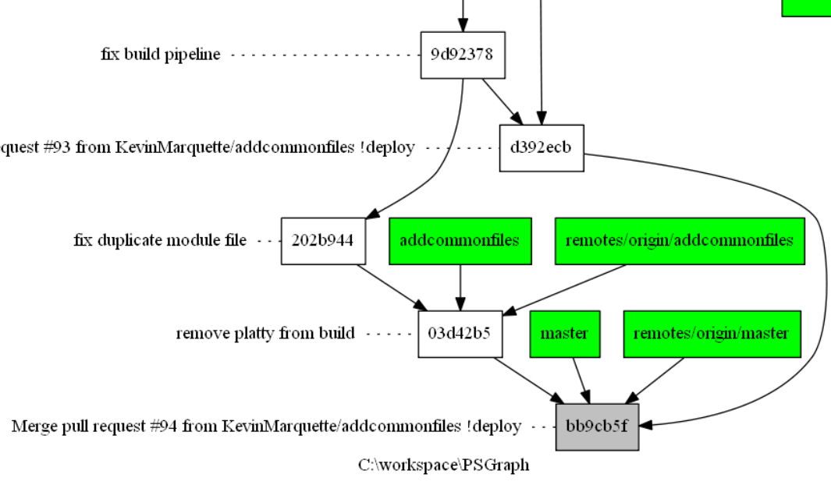
Show-GitGraph -ShowCommitMessage -Direction TopToBottom -Path .\PSGraph

Slide 19
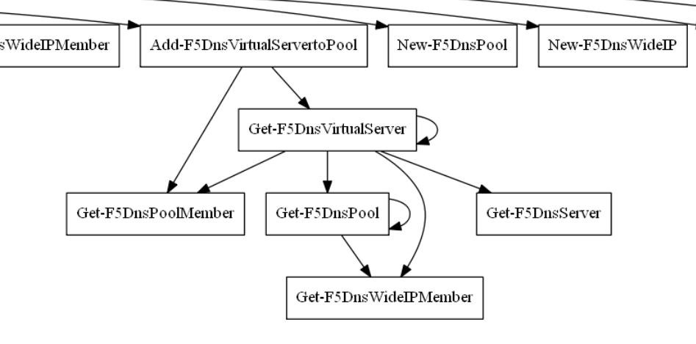
Show-AstCommandGraph -Path C:\ldx\LDF5\Output\LDF5\LDF5.psm1

Slide 20
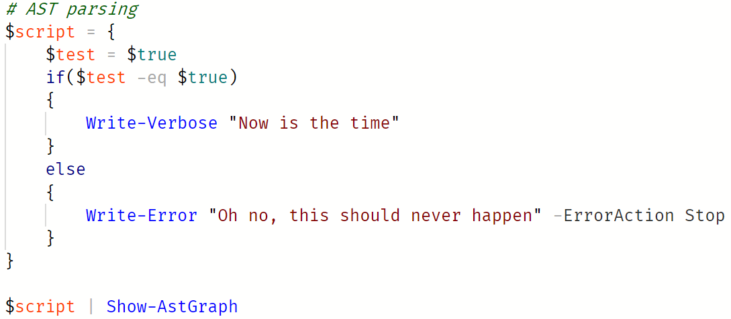

Slide 21
