Slide 1
Ad Targeting – Bank Division
L. Realty Inc.
Focused on Real Estate
And
Banks Industries

Slide 2
Statistics
Homeowners 10% more like to be male
Renters Total Household Income $50,330
Owners Total Household Income $92462

Slide 3
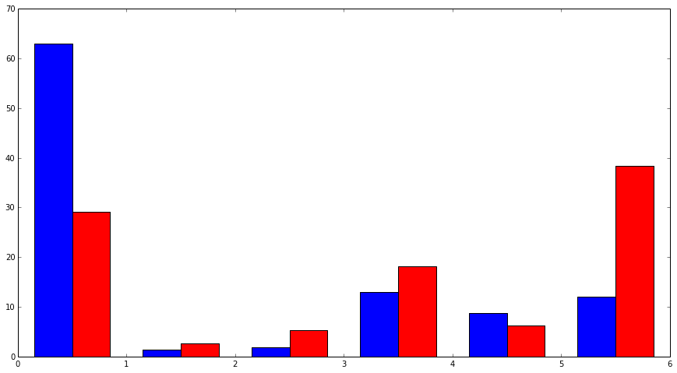
Marital Status
Percent
Married
Single
Red is Renters, Blue is Owners

Slide 4
*Black Line Depicts Renters
Most common age of a renter is 26, while a homeowner is 50

Slide 5
*black line depicts renter
Homeowners are 7% more likely to have a bachelor’s degree than renters

