Slide 1
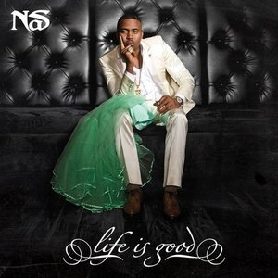
Themely
By Kevin Mardakhayev

Slide 2
About Me
Brooklyn Tech High School
Worked in Real Estate
Ran a staffing company
Graduated from Baruch College
Notes:
I didn’t like it but it gave me the intiative I needed to ran a company a year later and then end up at metis
The indepenedent nature of runnnig my own company and the skills I learned parallel what I used Metis as Data Scientist

Slide 3
How does an artist’s growth as a person reflect in their music lyrics?
Understand other artists
Future success of new artists
People’s taste in music
Notes:
I love music

Slide 4
Notes:
Users have the ability to annotate any line of the song

Slide 5
Nas
From Queens, NY
Released Illmatic in 1994
Prolific on RapGenius
Notes:
He is very prolific on rapgenius, where he annotates a lot of his own lyrics and that give us more text to analyze

Slide 6
Themely
Scraped RapGenius
Lyrics + Annotations
Found keywords of each album
TFIDF Vectorizer
Topic Analysis with custom topics
Notes:
What is Themely?
I scraped genius for all nas’ albums over a 18 year career span
For each song in the album I took the unique set of words, so that a song with a lot of repetitive words wouldn’t end up representing the whole album
Now I am going to briefly show you some of my findings

Slide 7
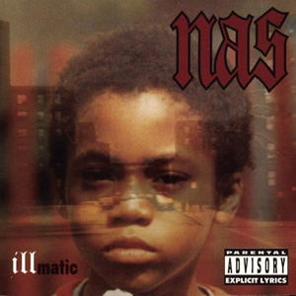
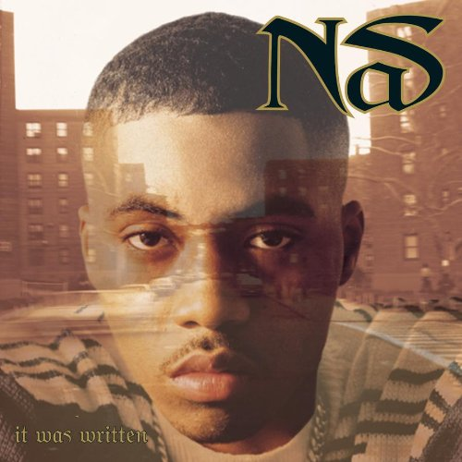
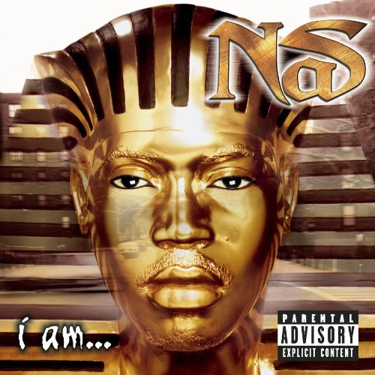
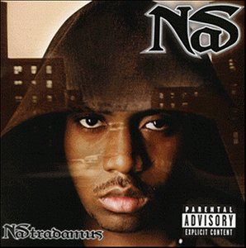
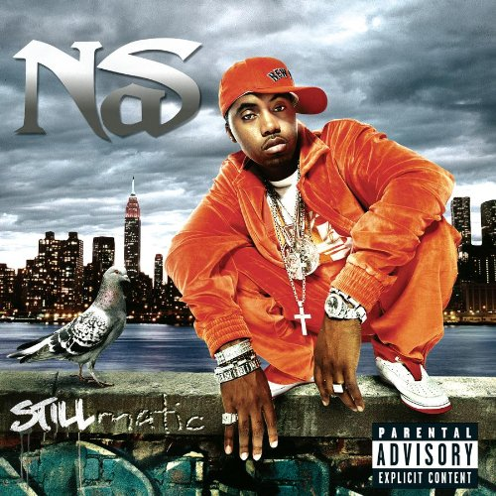
1994 1996 1999 1999 2001
Keywords
Herb, ganja, cannabis, buddha, heroin, coke, cigars, inhale
Escobar, dealers, ounce, snitches, connections, law, cognac
Jewelry, Allah, problems, Religion, ladies
Notes:
Starts off with love of marijuana
day to day problems in his neighborhood
philosophical outlook

Slide 8
1994 1996 1999 1999 2001
Keywords
Herb, ganja, cannabis, buddha, heroin, coke, cigars, inhale
Escobar, dealers, ounce, snitches, connections, law, cognac
Jewelry, Allah, problems, Religion, ladies
Notes:
Then selling drugs and criminal activities
self proclaimed “pablo escobar” (after the Columbian drug lord)

Slide 9
1994 1996 1999 1999 2001
Keywords
Herb, ganja, cannabis, buddha, heroin, coke, cigars, inhale
Escobar, dealers, ounce, snitches, connections, law, cognac
Jewelry, Allah, problems, Religion, ladies
Notes:
5 years after that we see the shift has turned
More focused on religion
Jewelry now that he has more wealth
Stops calling women derogatory names

Slide 10
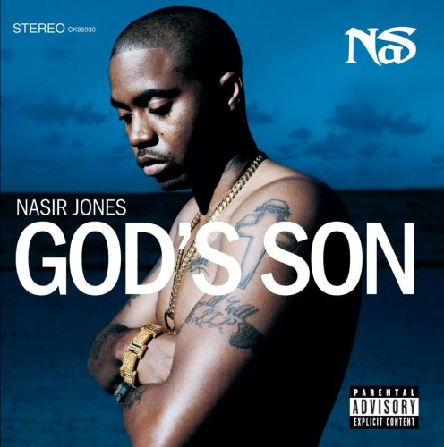
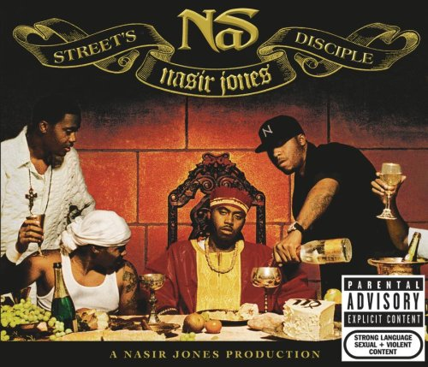
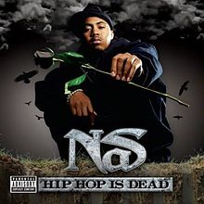
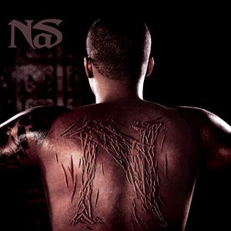
2002 2004 2006 2008 2012
Keywords
Mommy, master, trust, daughter, royalty, curse
African, racism, KKK, government, rights, slave, Jackson
Divorce, 80s, Kelis, legend, graffiti , age
Notes:
Mother passed away, sentimental album
And throughout his albums subtle references distrust of government
This blows up

Slide 11
2002 2004 2006 2008 2012
Keywords
Mommy, master, trust, daughter, royalty, curse
African, racism, KKK, government, rights, slave, Jackson
Divorce, 80s, Kelis, legend, graffiti , age
Notes:
In his 2008 album called untitled
Focus on problems that affect the poor, black communities
His lyricism has improved
A lot of Historical references and How it came about to this point
We get this from the annotations

Slide 12
2002 2004 2006 2008 2012
Keywords
Mommy, master, trust, daughter, royalty, curse
African, racism, KKK, government, rights, slave, Jackson
Divorce, 80s, Kelis, legend, graffiti , age
Notes:
Reminiscent of Life in the 80’s, Divorce
I was able to understand a story from his keywords. SO the next thing I did was put similar keywords together into topics and gain a picture understanding of his growth

Slide 13
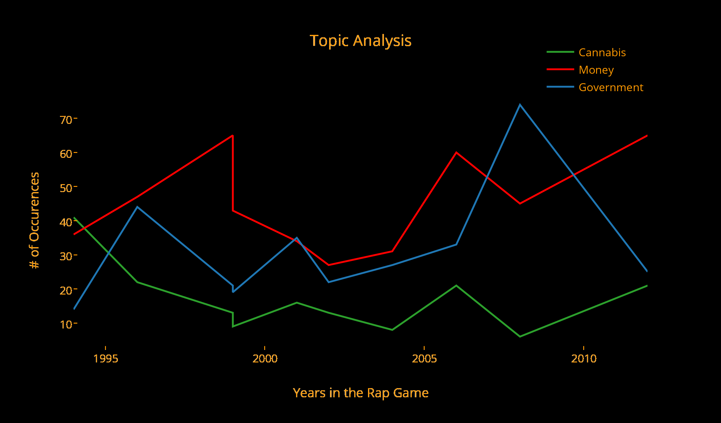
Notes:
In thie graph I made a couple of topics based on his use of similar words/synonyms refering to cannabis, money and government
We can see slight upward and downward trend in his use of topics over time
And I think this is very important in understanding How does talking about certain topics affect sales and reviews?

Slide 14
What Next?
Expand the corpus of topics
Recommend artists based on topics, lyrics, and annotations
Notes:
And moving forward from there
Expand corpus so I can add other artists and compare them

Slide 15
Future Implications
Build a Music Recommender System
Literature, History
Predicting popularity of new artists based on vocabulary/slang
Lops, Gemmis, and Semeraro (2011) Content-based Recommender Systems: State of the Art and Trends
Notes:
can take into account what people want to listen to and build better music recommender systems
that would would also help us in other areas of literature
For example if someone listen to nas’ untitled album they might be interested in his historical references and we can recommend them historical reading on that
Also we can use our insights of correlation between topics and album sales to predict future popularity
I think user generated content and websites are becoming more popular and giving us new tools to use in the future

Slide 16
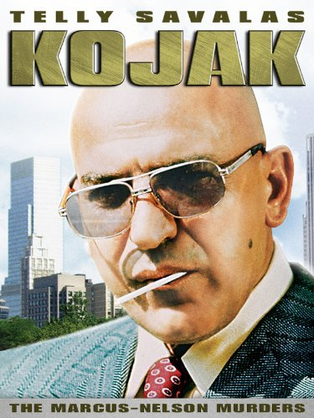
Project Kojak at Metis
Saving Crime
One Cluster at a Time

