Slide 1
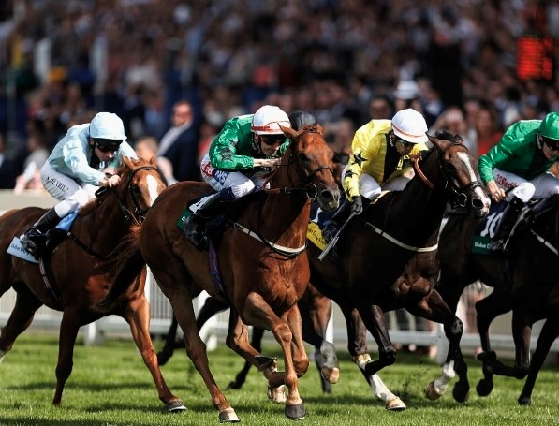
Quant Sports Trading Limited
`
Notes:
1

Slide 2

QST Concept: Algorithmic Trading of Sports Events
The application of hedge fund expertise to the sports trading market
A state-of-the-art tool set focused on proprietary machine learning models
An exceptional ROI anticipated for exclusive investment partners
Significant financial reward to be realised through the relative immaturity of the sports trading market
The opportunity to serve as both liquidity provider and / or liquidity taker dependent upon employed strategy
A proof of concept currently active in the financial markets
Notes:
2

Slide 3
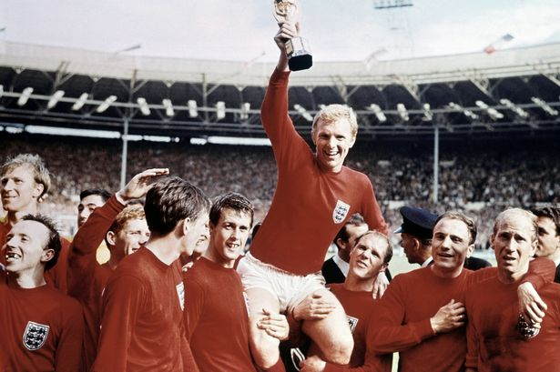
Quant Sports Trading Limited
`
Notes:
3

Slide 4
QST: Disciplined Process
Highly disciplined process based purely upon statistical analysis
Automated process requiring zero human input
Automated execution of thousands of trades in any given sports event
Data driven processes providing greater certainty for deployed strategies:
Raw data: Millions of millisecond updates received via the data pipeline
Feature engineering: Predictive signal identification and noise elimination
Model Building: Signal combination utilising state-of-the-art machine learning.
Model Validation: Outputs are tested on unseen data for predictive quality
Paper Trading: Pipeline convergence tested prior to real money trading
Live Trading: Strategy deployed
Multiple models & strategies employed over multiple events
Notes:
4

Slide 5
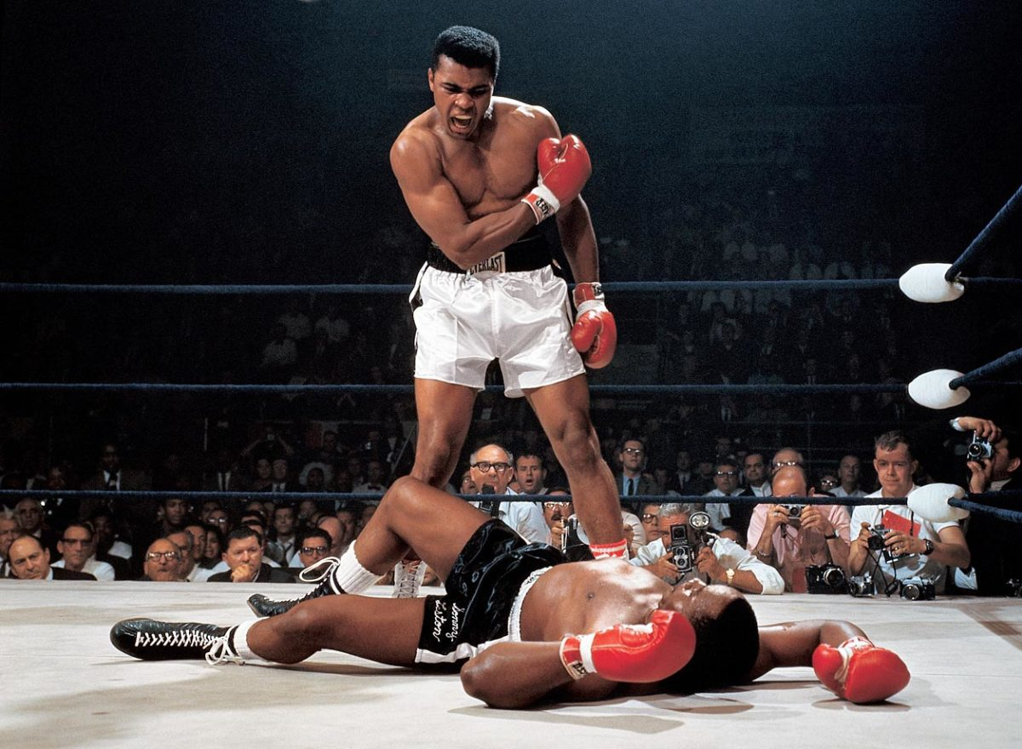
Quant Sports Trading Limited
`
Notes:
5

Slide 6
QST: Potential Business Strategies & Products
Algorithmic Sports Trading Company:
A pre-game trading environment
An in-play trading environment
A suite of multi-sport strategies; market-making, trading & hedging
A suite of predictive trading models based on ML (Machine Learning)
Subscriber web-based front-end (GUI) for more sophisticated betters:
Provision of analytics and subscription data (Can also be used for our own strategies or as a resell).
Provision of predictive models and strategy development
Provision of extensive data sourcing and intelligent analysis of historic sports events
Provision of a back-testing engine for client strategies
Notes:
6

Slide 7
QST: Potential Business Strategies & Products (Cont’d)
Provision of a forum for latest news and views
Provision of crowd-sourced predictions
Best strategies for profit; owners receive a percentage of gain
Gamification and exploration of Blockchain advantages
Proprietary exchange: Sufficient scale would enable bookies to hedge with QST
Sports betting consultancy services and published tipster content
Notes:
7

Slide 8
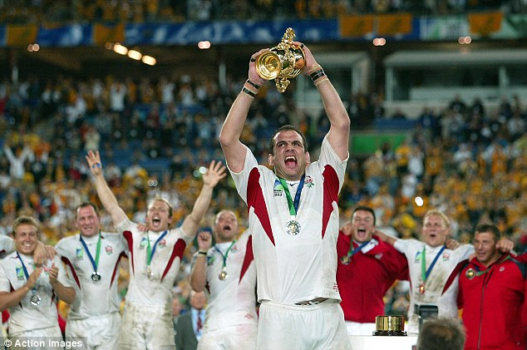
Quant Sports Trading Limited
`
Notes:
8

Slide 9
QST Advantages: Current & Sought
Knowledge
Algorithmic trading strategies sourced from hedge fund expertise
Machine Learning: Robust research element allied to University College London
An aspiration and expection to be state-of-the-art in this field
Data (Sought)
An acceleration of development, strategy quality and research with paid data
A requirement for quality, volume & timeliness (high quality, high speed) of data
An opportunity, over time, to resell the data
Process
Algorithmic processes back-testing to establish a robust statistical advantage
The application of the dominant and successful methodology utilized in financial markets
Risk management as an integral & critical element of the platform.
Notes:
9

Slide 10
QST Advantages: Current & Sought (Cont’d)
Network Effect – The genesis of a trading platform from an algorithmic trading dawn:
To enable users to exchange views, trade and test strategies
To access funds to unlock the best timely data and expand our suite of strategies
To offer lower commissions on competitor exchanges or our own - cost advantage through scale.
To be the ‘early-movers’ as the sports trading market transitions towards a closer rendition of the financial trading market
Notes:
10

Slide 11

Quant Sports Trading Limited
`
Notes:
11

Slide 12
QST: Why The Sports Market?
In contrast to the highly regulated equities market the sports exchange
market exhibits:
A large proportion of retail customers
A small proportion of computerised traders
A typical trading strategy of one-per-event rather than multiple adjustments
A lack of hedge fund involvement
An average ‘punter’ who is price insensitive
An immature, low-regulation market
A market where sports exchanges have increased the market liquidity
A growth market from increased legalisation, particularly in the US
An early-mover advantage therefore exists in what preliminary investigations have identified as a softer and therefore very fertile market
SportsNewCo0922
Notes:
12

Slide 13
Quant Sports Trading Limited
`
Notes:
13

