Slide 1
AIS – Asset Influence Score a Metric for assessing the Impact of an Influencer‘s Twitter Activity on the Price of a Cryptocurrency
Kevin Miller, BSc
Supervisors: Dr. Kristof Böhmer, Univ.-Prof. Dr.Uwe Zdun

Slide 2
Agenda
Background & Introduction
Problem Description
Goals and Research Questions
Systematic Literature Review & Discussion
Our Approach – the AIS
Evaluation and Analysis
Conclusion and Discussion

Slide 3
Background & Introduction
Twitter acts as a real-time primary news source
Cryptocurrencies are highly volatile
Some feature revolutionary technology
Some are just speculation and hype

Slide 4
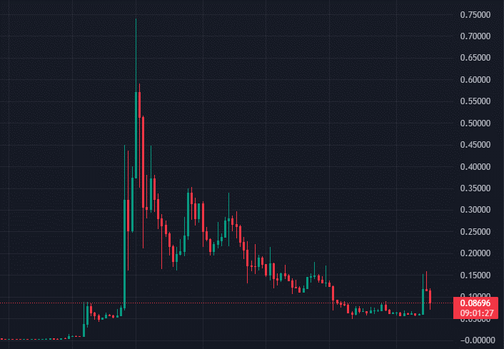
Dogecoin & Elon Musk
Dogecoin is a fork of a fork of Bitcoin
Based on the then-popular Shiba Inu Doge Meme
Developed as a Joke
Went up 15.000% thanks to Elon Musks Twitter Activity
from 0,0048$ to 0,74$, back to 0,08$
1000$ -> 152.000$
Dogecoin price action with weekly price candles
“Live stock, index, futures, Forex and Bitcoin charts on TradingView,” TradingView. https://www.tradingview.com/symbols/SPX/ (accessed Nov 13, 2022).
Notes:
Problem is not price activity, but its tie to Elon Musk

Slide 5
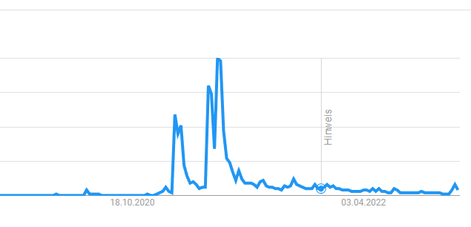
Problem Description
Crypto-Tastemakers influence price action
CEO’s, celebrities, politicians, sports players, …
Heavily dependent on the tweet issuer
Can become completely detached from macro-environment
Can therefore become easily manipulated
Google Search Trends for “Dogecoin”
https://trends.google.com/trends/explore?date=today%205-y&q=dogecoin

Slide 6
Goals
AIS – Asset Influence Score
Quantify the influence of a user over an asset
Arm investors with knowledge about who influences their investments
Tackled by applying design science research*
A. R. Hevner, S. T. March, J. Park, and S. Ram, “Design Science in Information Systems Research,” p. 32.

Slide 7
Research Questions
What are current approaches and algorithms for price prediction that utilize data from microblogs and are there any areas that lack research?
How and to what extent do price predictions utilize sentiment analysis?
How is the data fetched, prepared and processed and how can it be presented?
Are the results meaningful, explainable and replicable?
Is it possible to create a meaningful metric for the classifying the potential influence of a given user over a given asset?

Slide 8
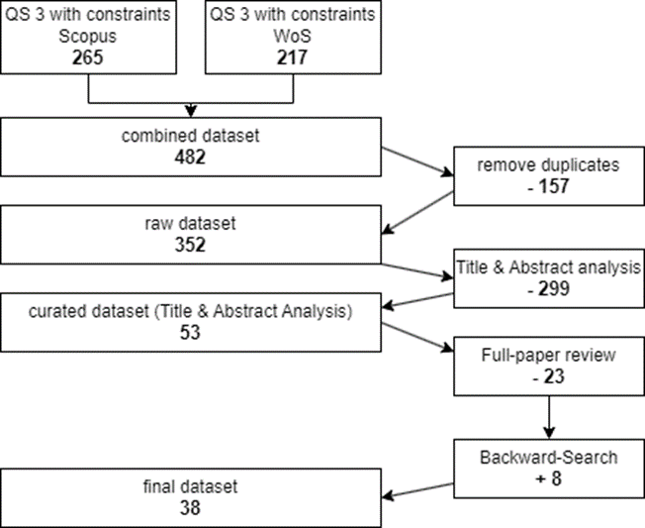
Systematic Literature Review
twitter ∧ (cryptocurrency ∨ stock ∨ asset ∨ price ∨ market cap* ∨ Bitcoin ∨ Ethereum ∨ BNB ∨ XRP ∨ Solana ∨ Cardano ∨ Terra ∨ Dogecoin ∨ Polkadot ∨ Avalanche)
Based on Barbara Kitchenham*
Databases:
  Scopus
  Web of Science (WoS)
Constraints:
  English
  Article/Conference Paper
“B. Kitchenham, “Procedures for Performing Systematic Reviews,” Keele UK Keele Univ, vol. 33, Aug. 2004.

Slide 9
Research Questions - Answered
What are current approaches and algorithms for price prediction that utilize data from microblogs and are there any areas that lack research?
How and to what extent do price predictions utilize sentiment analysis?
How is the data fetched, prepared and processed and how can it be presented?
Are the results meaningful, explainable and replicable?

Slide 10
Findings
  Price prediction through
    Sentiment Analysis
    Google Trends
    Tweet Volume
  Broad userbase sentiment
  Neural Networks perform best
Gaps
  Lack of explainability
  No replicability
  Data only used as tool for prediction
  Data source is often neglected
Unanswered:
5. Is it possible to create a meaningful metric for the classifying the potential influence of a given user over a given asset?

Slide 11
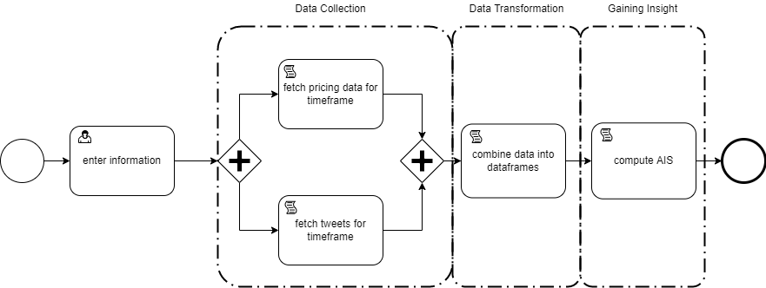
The AIS – General Approach

Slide 12
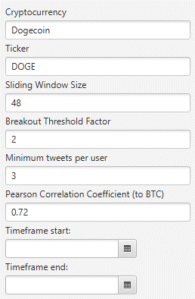
Enter Information
Cryptocurrency
Sliding Window Size
Breakout Threshold Factor
Minimum Tweets per User
Pearson Correlation Coefficient to Bitcoin
Timeframe

Slide 13
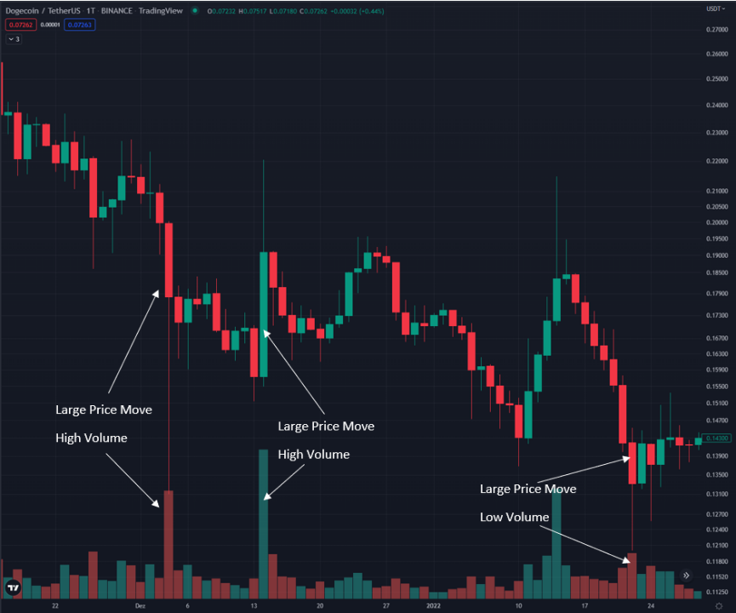
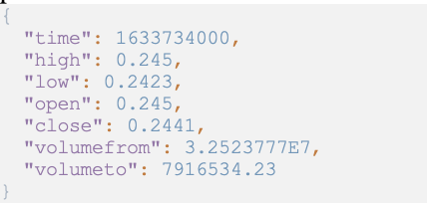
Data Collection – Price data
Cryptocompare API
OHLCV (Open, High, Low, Close, Volume)
Hourly

Slide 14
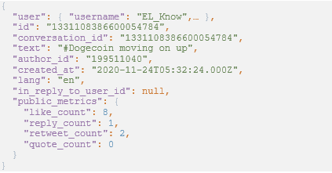
Data Collection - Tweets
Twitter API v2 – Academic Access
Search-term: Crypto & Ticker
Grouped into hourly segments
Public metrics also fetched

Slide 15
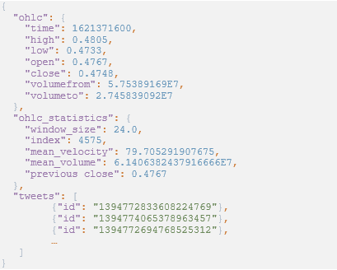
Data Transformation - Dataframes
Comprised of
  Tweets
  Price Data
  Statistics
    The averages over the sliding window
Represents 1 hour of market activity

Slide 16



Prerequisites
Velocity
  Represents trading activity
Magnitude
  Compares current velocity to average
Magnitude Attributable to external factors (MEF)
  Magnitude accounted for Bitcoins movement
Engagement Share of a Tweet (ES)
  The percentage of likes/retweets from 1 tweet in relation to all tweets from that hour

Slide 17
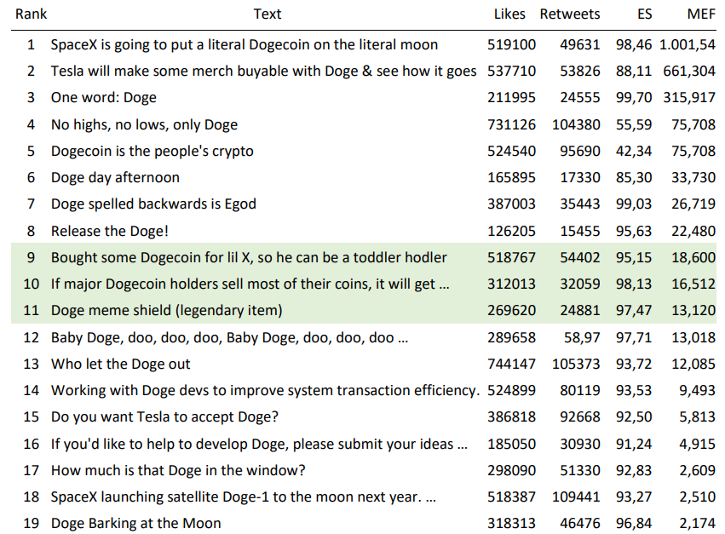
Example Dataset

Slide 18





Calculating the AIS
Median Magnitude
Median Engagement Share
Median Attributable Magnitude
AIS

Slide 19
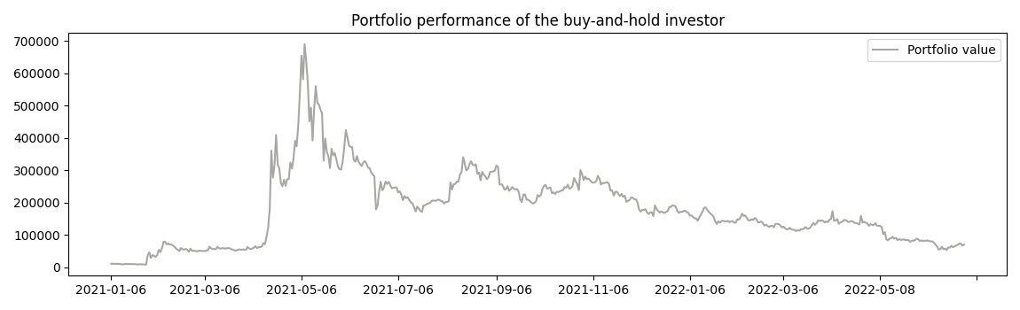
Evaluation
Compare buy-and-hold investor to AIS-based trader
Same starting capital, same timeframe (Jan 5, 2021 – Dec 31, 2021)

Slide 20
Trading Algorithm
Buys, whenever one of top 8 users (by AIS) tweets
Holds for different durations and sells at the end of that day
  Same day
  1 day
  2 days
  3 days
  1 week
  2 weeks

Slide 21
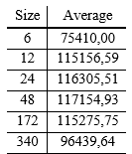
Optimizing Parameters – Sliding Window Size
Optimal Size: 48
Strikes balance in terms of sensitivity

Slide 22
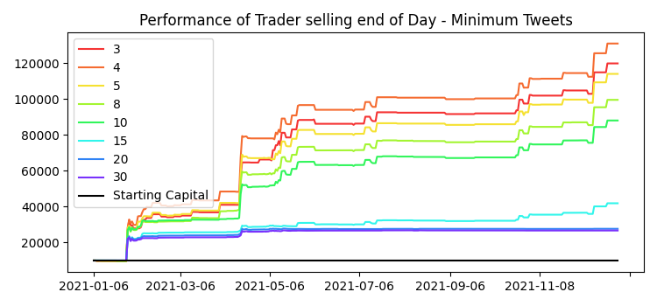
Optimizing Parameters – Minimum Number of Tweets
Lower is better
Optimal Value: 3
Engagement Share handles this better than artificially limiting userbase

Slide 23
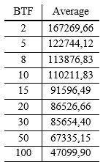
Optimizing Parameters – Breakout Threshold Factor
Lower is better
Could indicate general statement
Might only be true for generally bullish markets
→ extend timeframe

Slide 24
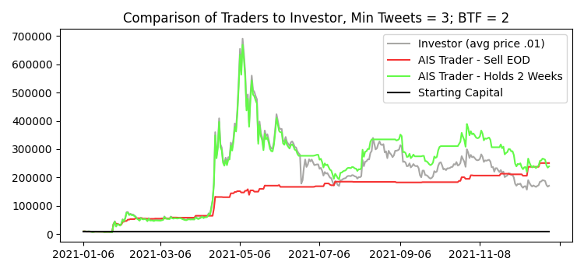
Results for timeframe: Jan 5 – Dec 31, 2021

Slide 25
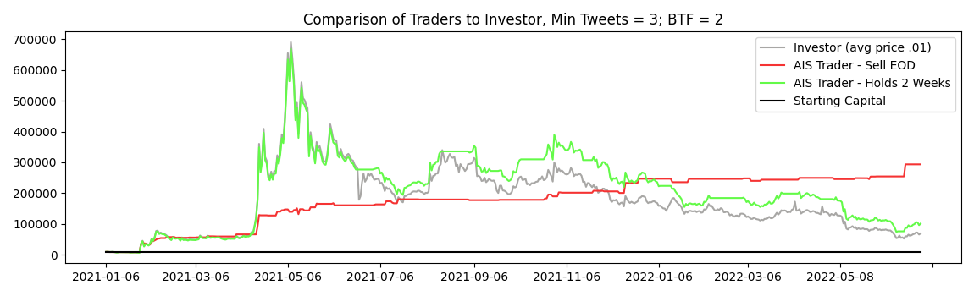
Evaluation of the AIS on a longer timeframe - Dogecoin

Slide 26
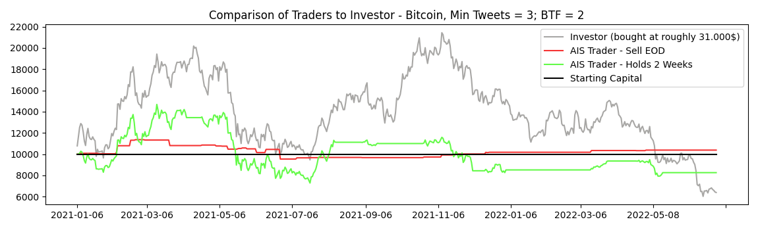
Evaluation of the AIS on a longer timeframe - Bitcoin

Slide 27
The Client Application - Showcase

Slide 28
Conclusion
Gap in Research about opinion leaders
It is possible to create an effective, understandable and replicable metric
Only applicable to assets which display strong Twitter correlation

Slide 29
Future Work
Experiment with Sentiment Analysis
Incorporate multiple assets
Study network effects

Slide 30
Questions?
Thank you for listening!

