Slide 1
Are we approaching the reverse of the David Tepper trade?
May 2017

Slide 2

September 24th, 2010

Slide 3
QE2
On August 10th, 2010 in Jackson Hole, Ben Bernanke set the table.
On November 10th, 2010, Ben Bernanke serviced the food.

Slide 4
Where did we stand then vs today?
1)P/E ratio on trailing 12 month earnings was 15 vs 21 today on non GAAP. It was 16 on GAAP vs 24 today.
2)Price/sales ratio on trailing 12 month sales was 1.25 vs 2.0 today and vs 2.25 in 2000.
3)Median price/sales ratio on trailing 12 month sales was 1.5 vs 2.5 today and vs 1.7 In 2000.
4)Non financial market cap/non financial GVA was about 1.25 vs 2.0 today and vs 2.25 in 2000.
5)The Shiller P/E was 22 vs 30 today, where it stood in 1929.

Slide 5
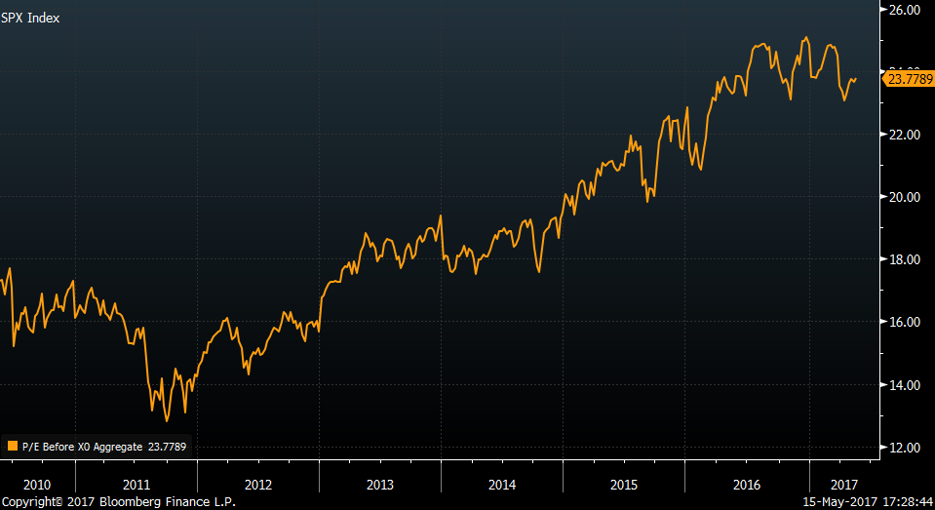
P/E ratio on trailing 12 month earnings was 15 vs 21 today on non GAAP. It was 16 on GAAP vs 24 today.

Slide 6
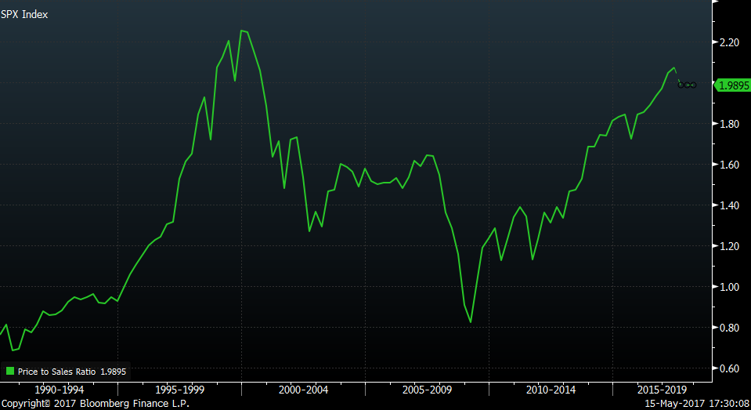
Price/sales ratio on trailing 12 month sales was 1.25 vs 2.0 today and vs 2.25 in 2000.

Slide 7
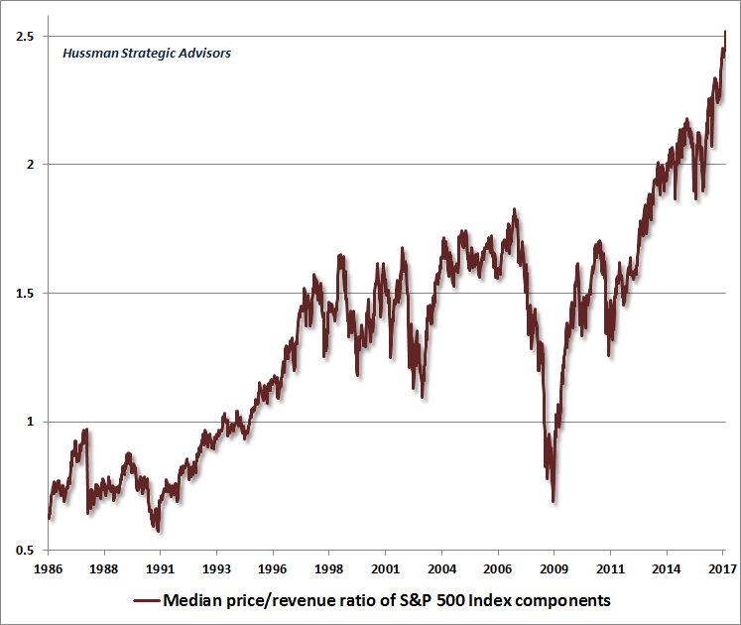
Median price/sales ratio on trailing 12 month sales was 1.5 vs 2.5 today and vs 1.7 In 2000.

Slide 8
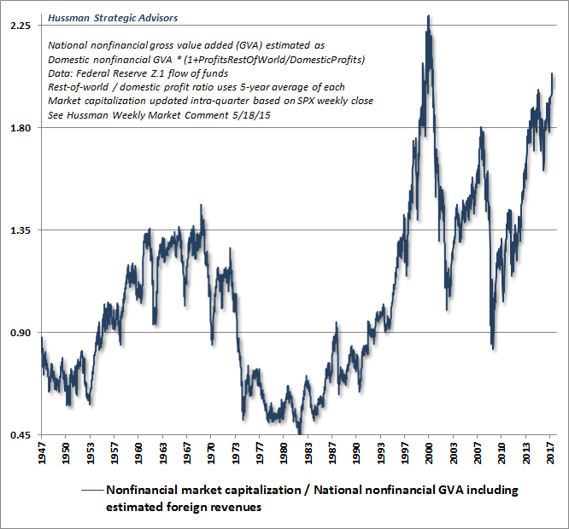
Non financial market cap/non financial GVA was about 1.25 vs 2.0 today and vs 2.25 in 2000.

Slide 9
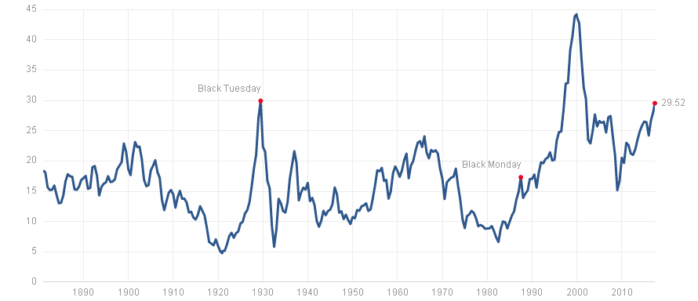
The Shiller P/E was 22 vs 30 today, where it stood in 1929.

Slide 10
The metrics I just showed you don’t matter!!!

Slide 11
Until they do

Slide 12
And now it does because we are on the cusp of the Tepper trade in reverse
1)If the economy rolls over from here we will head into a recession and that’s a major sell signal for stocks.
2)If the economy remains steady state with 2% type growth or even accelerates from here on the heels of tax and regulatory reform, the Fed will continue to hike rates and will embark on QT, quantitative tightening. Then sell almost everything because something will break.
3)The more aggressive the fiscal policy, the more the Fed will hike. Sell.

Slide 13
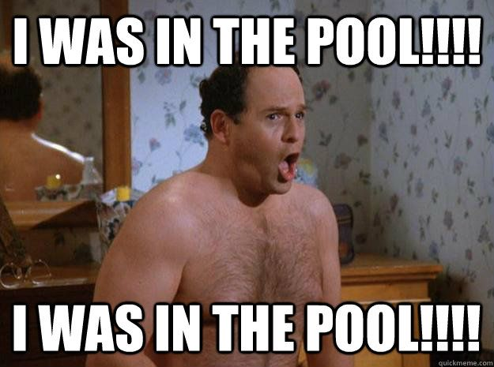
I stopped calling it the shrinkage of the balance sheet

Slide 14
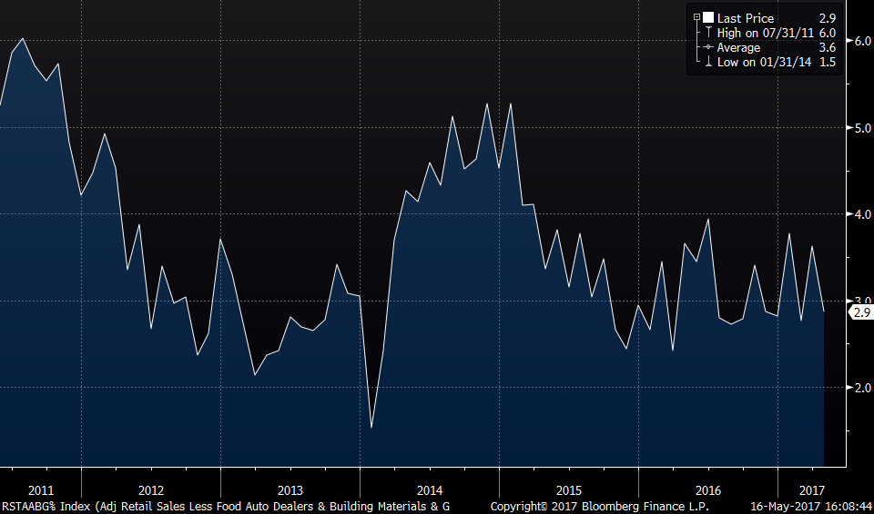
The precarious state of things as we enter this monetary headwind Core retail sales y/o/y:

Slide 15
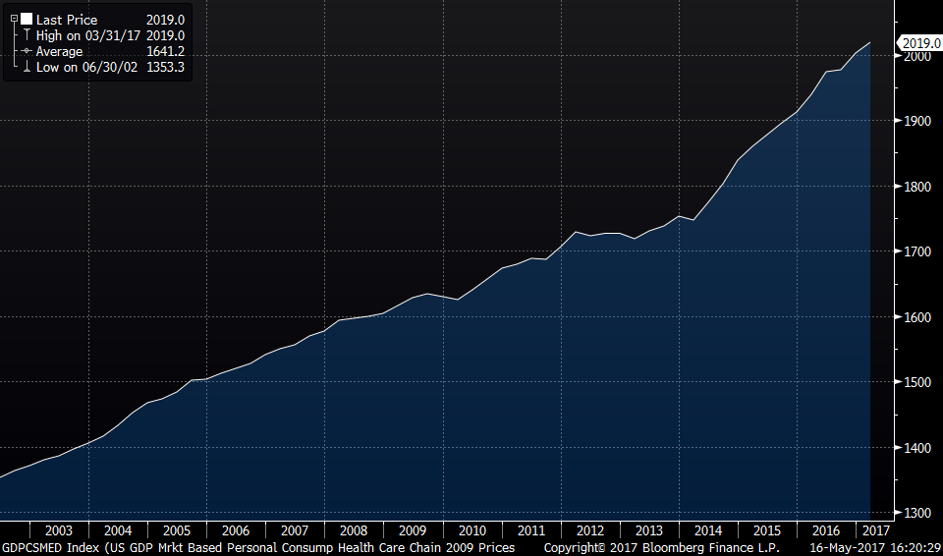
With more of one’s pocketbook going to healthcare spending. Most of ACA started January 2014.

Slide 16
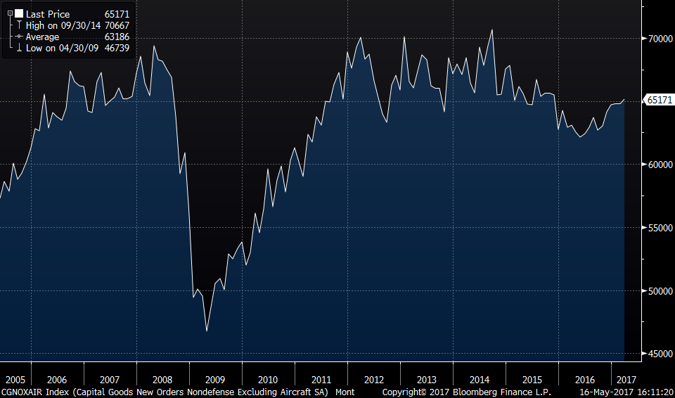
Core durable goods orders are where they were in 2006

Slide 17
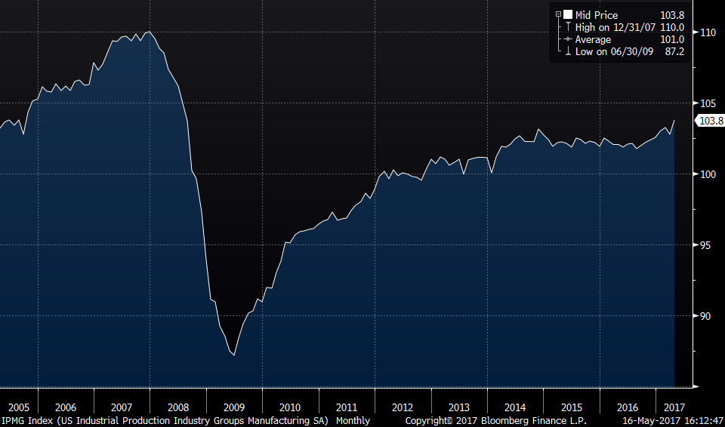
Manufacturing production is where it was in 2005

Slide 18
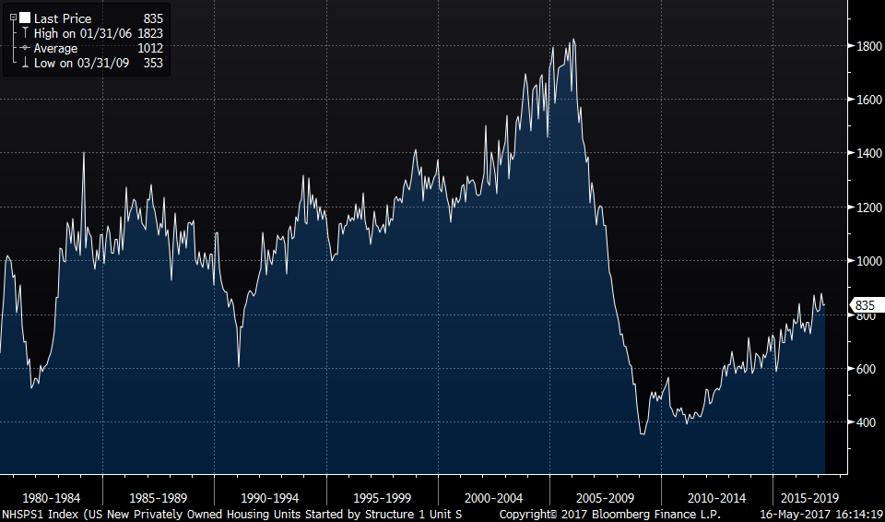
In 1980 there were more single family housing starts than there were in April

Slide 19
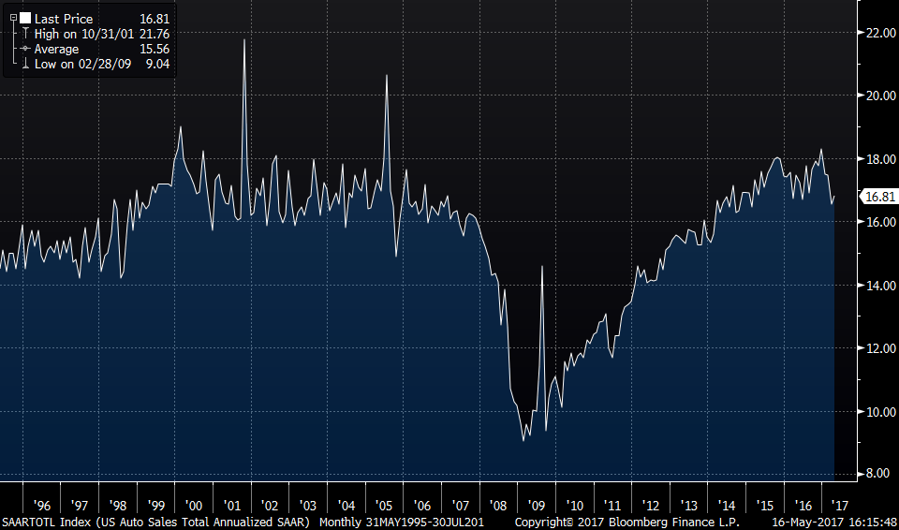
Go back to 1998 to see the same level of auto sales

Slide 20
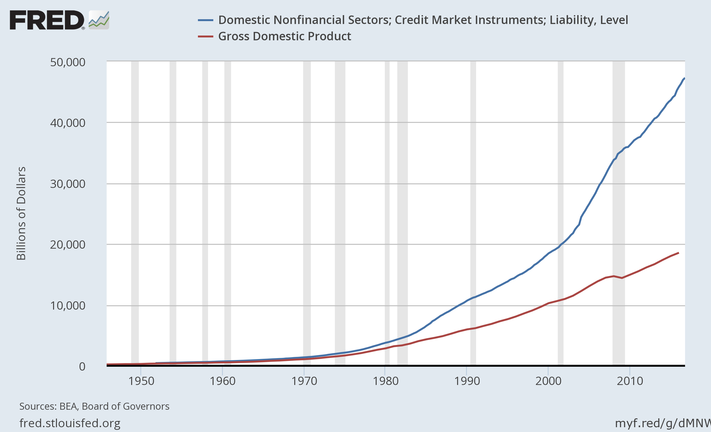
And this is the debt we are left with relative to the size of the US economy that the Fed will be tightening into.

Slide 21
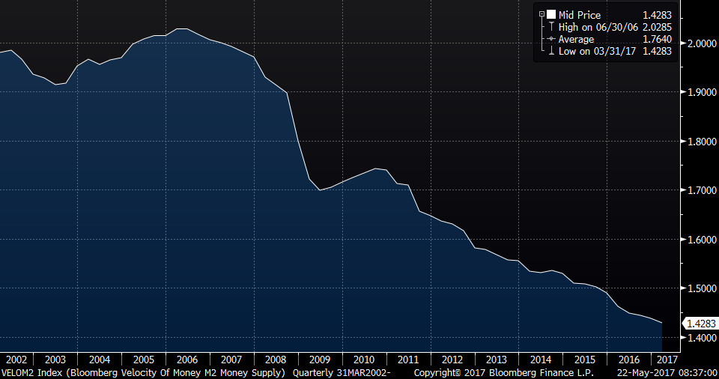
Velocity of Money (M2)

Slide 22
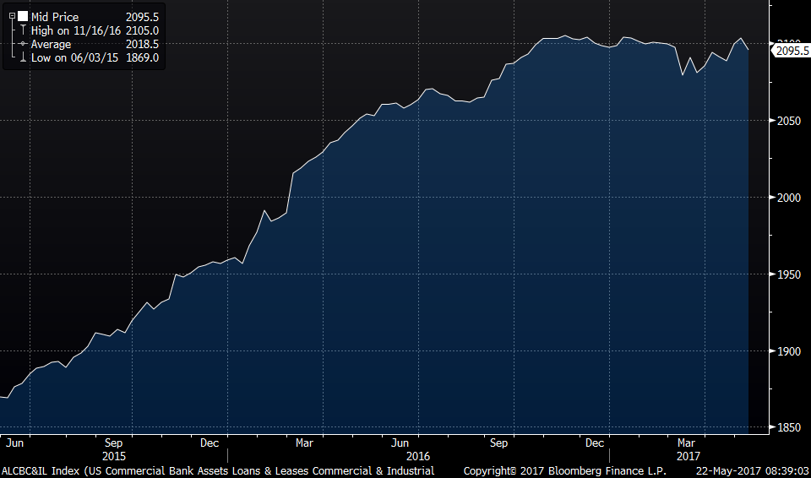
And C&I loans no higher than 7 months ago

Slide 23
And expect more tightening from the ECB, BoE, BoJ and PBOC
1)Expect full taper strategy by year end from the ECB and plan to rid themselves of the poison that is negative interest rates.
2)The BoJ is in the midst of a VERY subtle taper that has taken its 40 yr JGB yield from .07% in July 2016 to 1.07%.
3)Mark Carney is now only reinvesting and will likely hike at least once.
4)The PBOC shuttles between a covert and overt crackdown on excessive credit growth via higher rates.

Slide 24
The European sovereign and corporate bond markets are a MASSIVE BUBBLE and a train wreck waiting to happen
1)German 2 yr yield: -.66%
2)German 10 yr yield: .44%
3)Italian 2 yr yield: -.20%
4)Italian 10 yr yield: 2.24%
5)Deutsche Telekom 5 yr yield: 1.88%
6)Barclays Pan European high yield: 3.32%

Slide 25
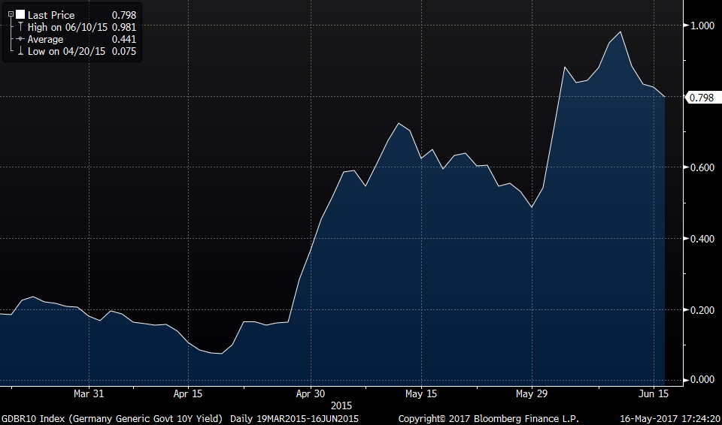
Look what the German 10 yr yield did in two months in 2015

Slide 26
Trumponomics and stocks love it!
1)Regulatory relief – I saw study last year that said annual cost to comply with Federal reg’s is $1.9 Trillion.
2)Overhaul Obamacare but I can’t quantify impact yet.
3)Tax reform, aka, lower corporate tax rate. Great but…

Slide 27
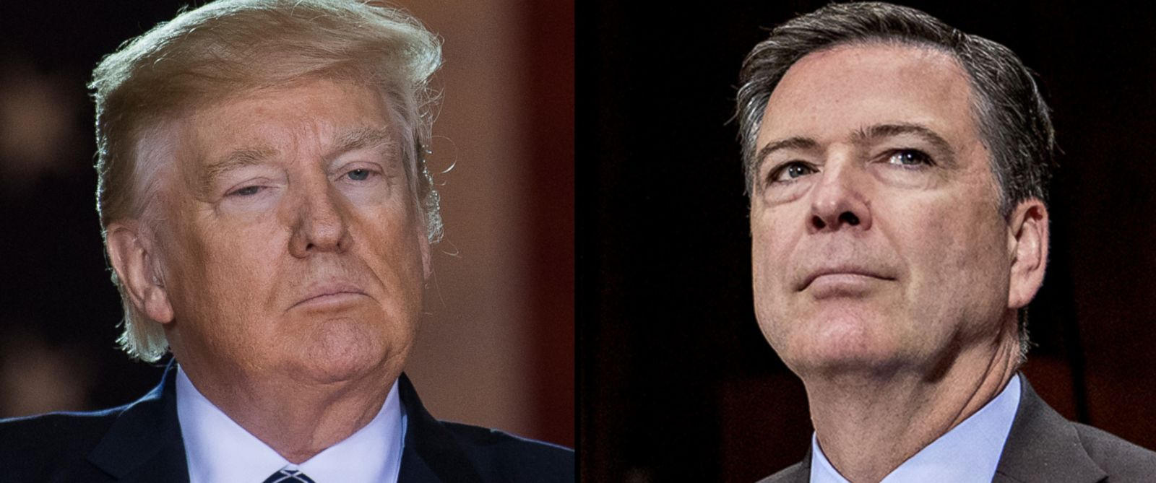
But we have a new problem on our hands

Slide 28
Let’s dig in to the numbers
1)The CBO estimates $320b of US corporate income taxes paid in fiscal year 2017.
2)If corporate rate goes from an effective level of 26% to 20%, companies would save about $75b.
3)If the cost of funding goes up by 100 bps, non financial corporate interest expense would go up by $135b on $13.5T of total business debt.
4)If the growth rate of private sector wages and salaries goes up 100 bps, it would add $70b to labor costs on $7T of pay.

Slide 29
And what about all that cash sitting overseas?
FACTS, with help from FT article on April 28th:
1)Tech companies own about half of the $1.3T sitting overseas.
2)Apple, Alphabet, Microsoft, Oracle and Cisco have about $500b of this, adding $315b over the past 5 years.
3)Over these same 5 years, these 5 have added $218b of debt.
4)Thus, about 70% of the added cash has already been spoken for via more debt.

Slide 30
What about all those stock buybacks?
1)Goldman Sachs estimates that companies in the S&P 500 have authorized 15% less in stock buybacks y/o/y.
2)Actual buybacks executed is down 20% y/o/y.

Slide 31
The Tepper trade in reverse scenario 1
Eric Rosengren, Boston Federal Reserve President said this on May 10th:
“If we were to get a lot more stimulus, that would cause us probably to raise rates a little more quickly.”
Sell

Slide 32
The Tepper trade in reverse scenario 2
The economy remains in a 2% growth rate, the Fed will hike 3 times per year and start QT.
Sell

Slide 33
The Tepper trade in reverse scenario 3
The US economy falters from here and maybe enters into a recession and the Fed has blanks left in their arsenal.
Sell

Slide 34
I see the global monetary wall ahead with valuations near record highs as markets whistle and cheer their way towards this wall.
On where we end up, it reminds of the scene from Vacation when the Griswolds finally got to Walley World.
https://www.youtube.com/watch?v=jtyrDZG-eDo

