Slide 3
1. What we do?

Slide 4
1. What we do?
Score is an open source project that aims to make it easier to choose a high school
Notes:
Score is an open source project that aims to make it easier to choose a high school for parents and students

Slide 5
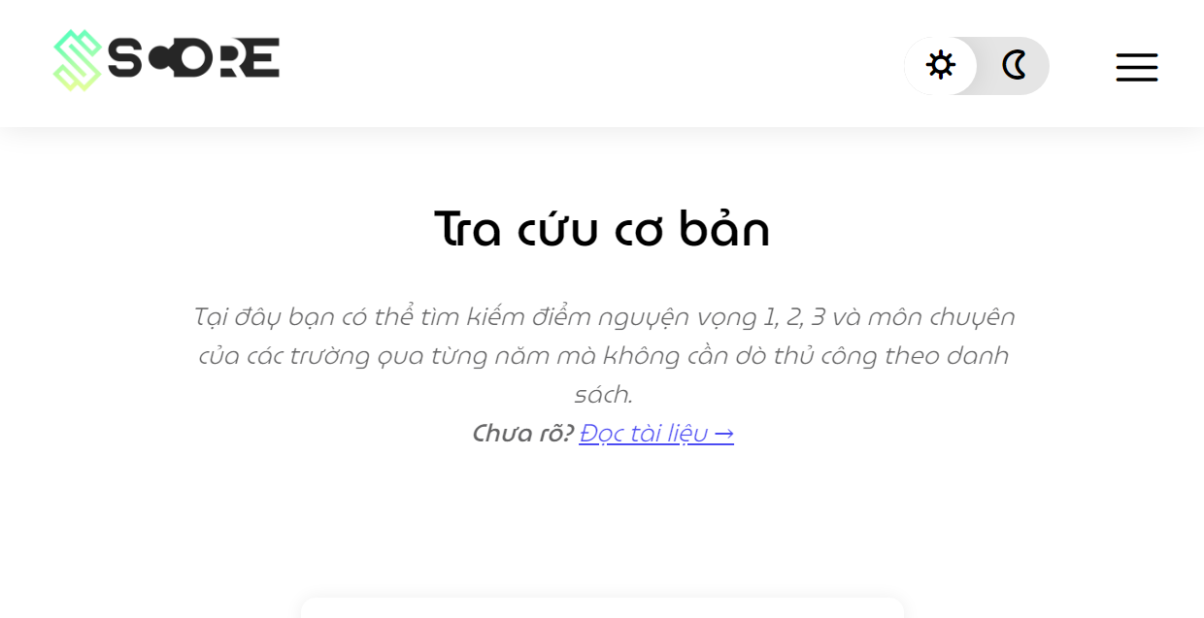
1. What we do?
Users will have access to many different data analysis functions with a web interface that is both simple and easy to understand
Notes:
In particular, users will have access to many different data analysis functions with a web interface that is both simple and easy to understand

Slide 6
2. Why we do?

Slide 7

2. Why we do?
- The 10th grade entrance exam is an important milestone
Notes:
Why we do? The 10th grade entrance exam is an important milestone because it is both decisive for all three years of high school and serves as the foundation for the National High School Exam

Slide 8

2. Why we do?
- 10th grade entrance exam scores are publicly posted on information pages, but only stop at images or discrete data
Notes:
Currently, 10th grade entrance exam scores are publicly posted on information pages, but only stop at images or discrete data

Slide 9

2. Why we do?
- The lookup as well as the comparison of points between schools takes a long time, making it difficult for parents to make the right decisions
Notes:
Consequently, the lookup as well as the comparison of points between schools takes a long time, making it difficult for parents to make the right decisions

Slide 10
2. Why we do?
Therefore, Score was born and developed to support users:
Notes:
Therefore, Score was born and developed to support users:
Compile admission scores data for the years from 2015 to the present and perform in the most visual way.
Combine data analysis functions (sorting, statistics, filtering) so that users quickly grasp the meaning and correlation of data.
Give suggestions for selecting schools based on score estimates.

Slide 11
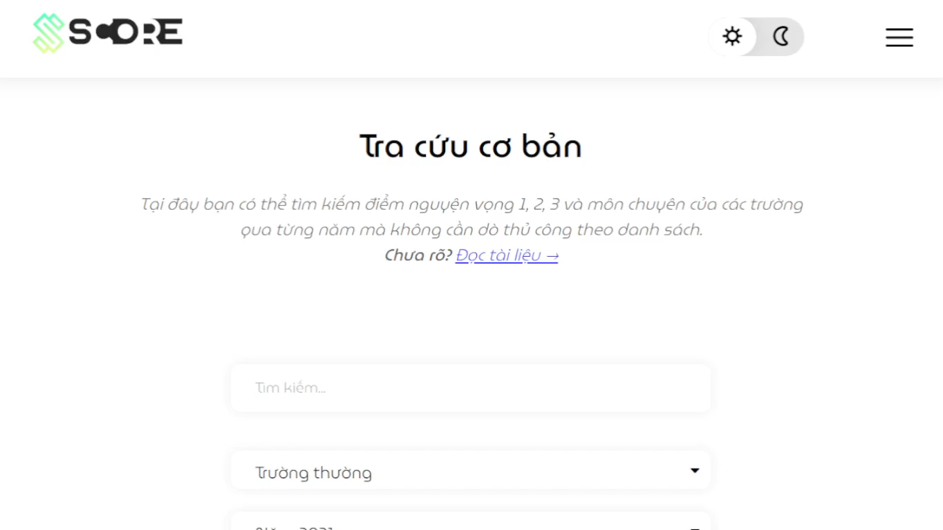
2. Why we do?
Therefore, Score was born and developed to support users:
- Scores data from 2015 to the present and perform in the most visual way
- Analysis functions (sorting, statistics, filtering)
- Give suggestions for selecting schools
Notes:
Therefore, Score was born and developed to support users:
Compile admission scores data for the years from 2015 to the present and perform in the most visual way.
Combine data analysis functions (sorting, statistics, filtering) so that users quickly grasp the meaning and correlation of data.
Give suggestions for selecting schools based on score estimates.

Slide 13

https://score-official.rf.gd/

