Slide 4
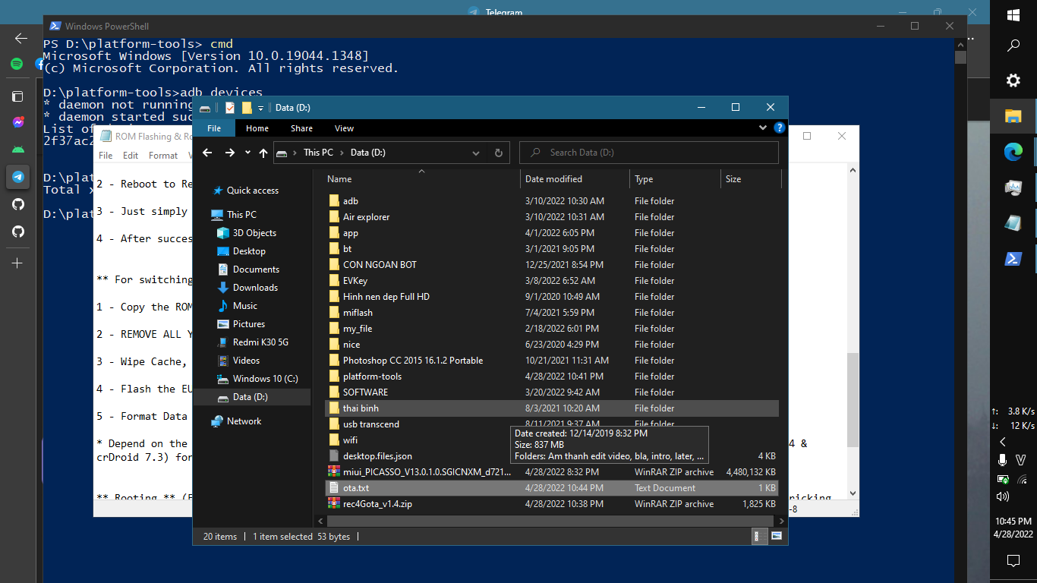
MEMBERS
Nguyễn Thị Bích Hảo
Leading teacher
Tô Thành Long
Nguyễn Mậu Dân
Leader & Developer
Translator & Presenter
Trần Nguyễn Thái Bình
Trần Nguyễn Duy Minh
Designer
Reporter
1. What we do?

Slide 5
1. What we do?

Slide 6
1. What we do?
Score is an open source project that aims to make it easier to choose a high school
Notes:
Score is an open source project that aims to make it easier to choose a high school for parents and students

Slide 7
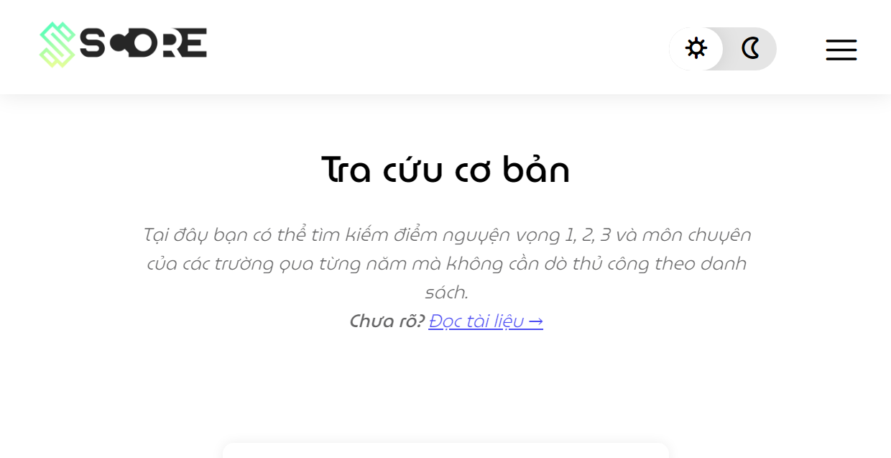
1. What we do?
Users will have access to many different data analysis functions with a web interface that is both simple and easy to understand
2. Why we do?
Notes:
In particular, users will have access to many different data analysis functions with a web interface that is both simple and easy to understand

Slide 8
2. Why we do?

Slide 9

2. Why we do?
- The 10th grade entrance exam is an important milestone
Notes:
Why we do? The 10th grade entrance exam is an important milestone because it is both decisive for all three years of high school and serves as the foundation for the National High School Exam

Slide 10


2. Why we do?
- 10th grade entrance exam scores are publicly posted on information pages, but only stop at images or discrete data
Notes:
Currently, 10th grade entrance exam scores are publicly posted on information pages, but only stop at images or discrete data

Slide 11

2. Why we do?
- The lookup as well as the comparison of points between schools takes a long time, making it difficult to make the right decisions
Therefore, Score was born and developed to support users:
Notes:
Consequently, the lookup as well as the comparison of points between schools takes a long time, making it difficult for parents to make the right decisions

Slide 12
2. Why we do?
Therefore, Score was born and developed to support users:
Notes:
Therefore, Score was born and developed to support users:
Compile admission scores data for the years from 2015 to the present and perform in the most visual way.
Combine data analysis functions (sorting, statistics, filtering) so that users quickly grasp the meaning and correlation of data.
Give suggestions for selecting schools based on score estimates.

Slide 13
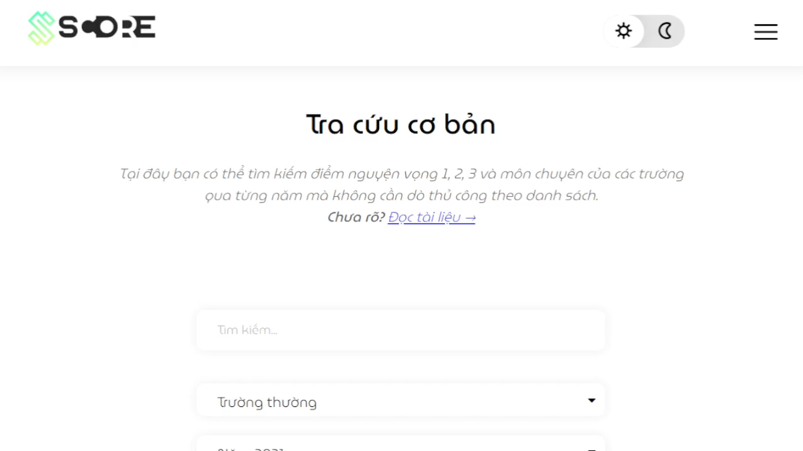
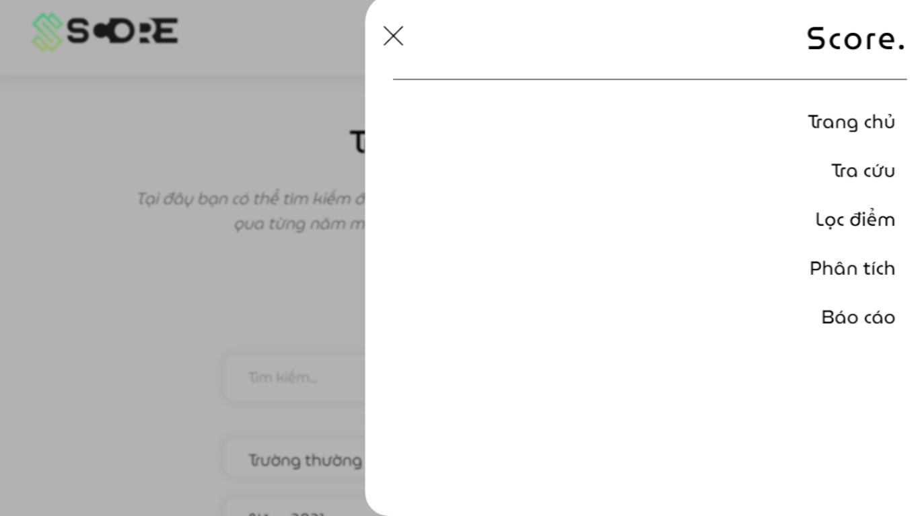
2. Why we do?
Therefore, Score was born and developed to support users:
- Scores data from 2015 to present and perform in the most visual way
- Analysis functions (sorting, statistics, filtering)
- Give suggestions for selecting schools
3. How we do?
Notes:
Therefore, Score was born and developed to support users:
Compile admission scores data for the years from 2015 to the present and perform in the most visual way.
Combine data analysis functions (sorting, statistics, filtering) so that users quickly grasp the meaning and correlation of data.
Give suggestions for selecting schools based on score estimates.

Slide 14
3. How we do?

Slide 15
3. How we do?
How SCORE constructed
Score
Functions
Search
Suggestion
Analysis & Visualization
Report
Details
School name
School type
Year
Score base
Location base
Combo charts
Correlational comparison
Filtering
Flexible ranking
General statistics

Slide 16
3. How we do?
SCORE administrator
Score
Import
Update
Functions
Publish

Slide 17

3. How we do?
What languages SCORE used

Slide 18
3. How we do?
How SCORE works
Interface
 | Input | Function
Send
Receive
Data processing
Process (Javascript) | Database interactions (PHP)
Database server
Search
Analyse
Report
School name
Served data
Arrange & Pack data
Post requirements
Scores
Suggest
- Run MySQL queries
Website appearance
Colorize, stylize tables, graphs
Arrange layout and UI
Insert figures into tables, graphs.
Receive packed data
Unpack and handle
HTML, CSS

Slide 19
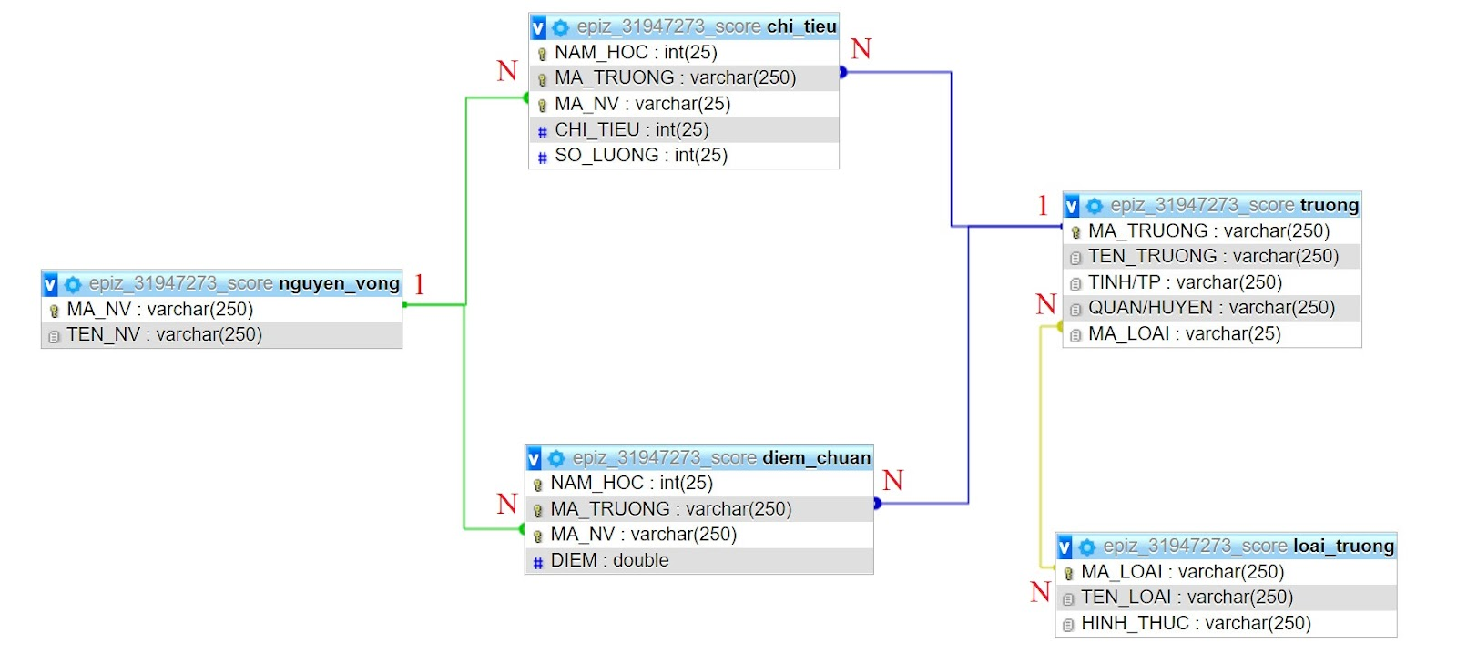

3. How we do?
Database structure

Slide 20
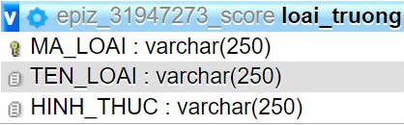
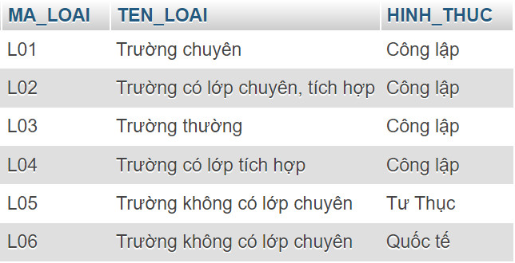
3. How we do?
Table structure and data
Structure
Data
Notes:
We use the relational database model. The collected data is planned into tables with careful calculation to avoid excess data; at the same time the designation of primary, and foreign key constraints and links helps to create connectivity across the entire database, which allows making queries across the globe to be done quickly and accurately; in addition, the new additional data is collated with the main table to ensure accuracy even though entered in different tables.
The database is also calculated so that it can be adapted in situations where there is a change in the number of aspirations, the number of exam subjects, etc.

Slide 21
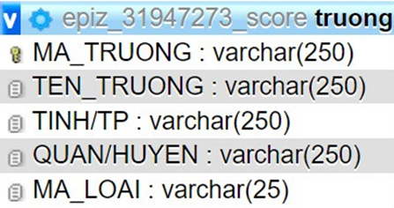
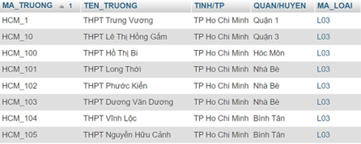
3. How we do?
Table structure and data
Structure
Data
Notes:
We use the relational database model. The collected data is planned into tables with careful calculation to avoid excess data; at the same time the designation of primary, and foreign key constraints and links helps to create connectivity across the entire database, which allows making queries across the globe to be done quickly and accurately; in addition, the new additional data is collated with the main table to ensure accuracy even though entered in different tables.
The database is also calculated so that it can be adapted in situations where there is a change in the number of aspirations, the number of exam subjects, etc.

Slide 22
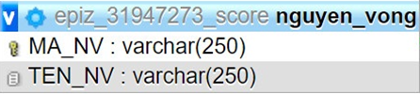
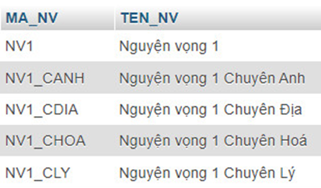
3. How we do?
Table structure and data
Structure
Data
Notes:
We use the relational database model. The collected data is planned into tables with careful calculation to avoid excess data; at the same time the designation of primary, and foreign key constraints and links helps to create connectivity across the entire database, which allows making queries across the globe to be done quickly and accurately; in addition, the new additional data is collated with the main table to ensure accuracy even though entered in different tables.
The database is also calculated so that it can be adapted in situations where there is a change in the number of aspirations, the number of exam subjects, etc.

Slide 23
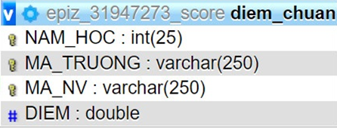
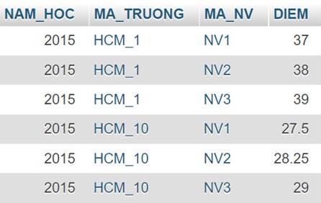
3. How we do?
Table structure and data
Structure
Data
Notes:
We use the relational database model. The collected data is planned into tables with careful calculation to avoid excess data; at the same time the designation of primary, and foreign key constraints and links helps to create connectivity across the entire database, which allows making queries across the globe to be done quickly and accurately; in addition, the new additional data is collated with the main table to ensure accuracy even though entered in different tables.
The database is also calculated so that it can be adapted in situations where there is a change in the number of aspirations, the number of exam subjects, etc.

Slide 24
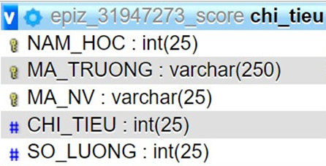
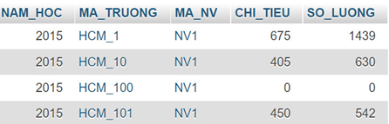
3. How we do?
Table structure and data
Structure
Data
Notes:
We use the relational database model. The collected data is planned into tables with careful calculation to avoid excess data; at the same time the designation of primary, and foreign key constraints and links helps to create connectivity across the entire database, which allows making queries across the globe to be done quickly and accurately; in addition, the new additional data is collated with the main table to ensure accuracy even though entered in different tables.
The database is also calculated so that it can be adapted in situations where there is a change in the number of aspirations, the number of exam subjects, etc.

Slide 25

3. How we do?
REAL DATA
Notes:
We don't use demo data, which doesn't give accurate analysis results. We download 10th-grade entrance exam scores data in Ho Chi Minh City from 2015 to the present and plan on the tables.

Slide 26
3. How we do?
Ảnh Long…

Slide 27
3. How we do?
Xử lý vấn đề 2021

Slide 28
Score circulation
Stage 1: User interface
Stage 2: System execution
Stage 3: Database association
Stage 4: Data receipt

Slide 30
https://score-official.rf.gd/

