Slide 1
Hello and Welcome
Test Findings
Test Team ECHO

Slide 2
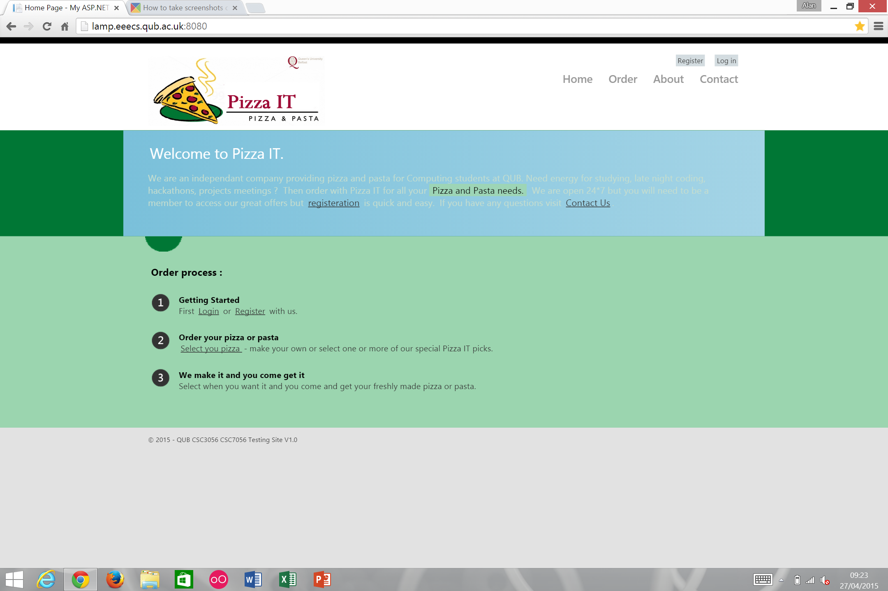
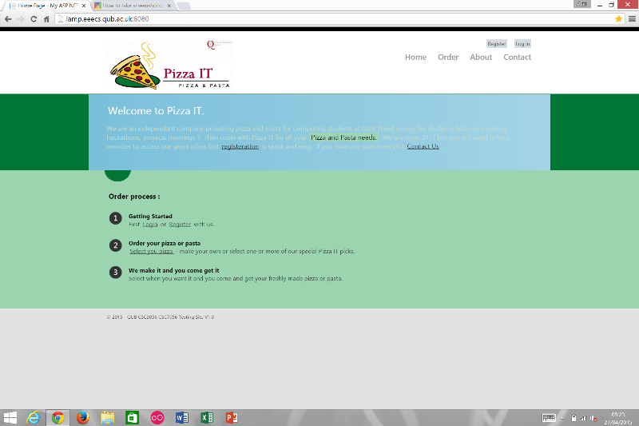
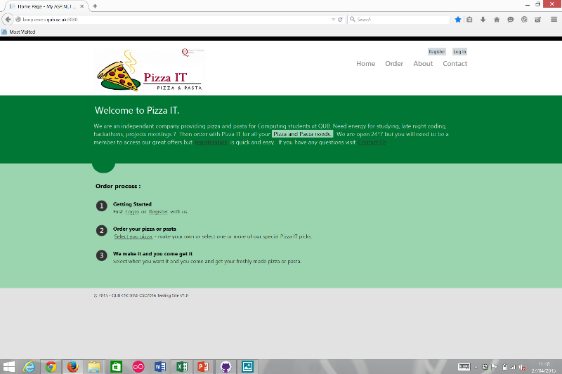
Home Page
2 Cosmetic and 2 Minor defects found.
Some spelling mistakes and a formatting error.
Problem with the Select your Pizza link.

Slide 3
Registration Page
Overall page created to high standard
However, small number of manageable defects are present
Despite this no critical defects exist
3 noteworthy defects are categorised as follows:
Major = 1
Moderate = 1
Minor = 1
Most notable defect is the ability of an unregistered user to successfully resister using an invalid email address format
customer@email.com
Conflicts with 4.1.13

Slide 4
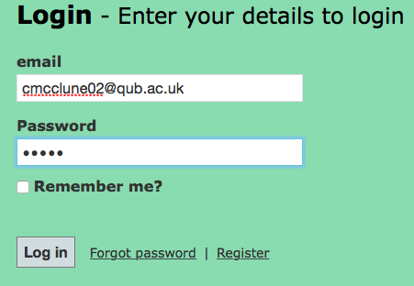

Login
Login page is mostly well structured
Few problems
User able to login with password less than specified 6 characters
Validation is server side rather than client side.

Slide 5

About Page
No user input sections
Mostly textual information
Only 2 cosmetic defects encountered

Slide 6
Contact

Slide 7
Order Pizza

Slide 8
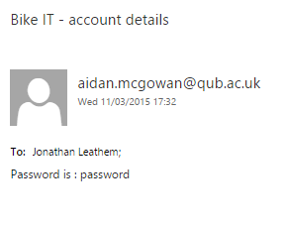
Forgot Password Page
One minor defect
Email subject reads “Bike IT – account details”
Appears unprofessional
Three cosmetic defects
Notes:
Forgot password functions fine
User should know themselves that they entered a forgot password request on the Pizza IT site and that they’ll soon receive an email containing their password
Won’t affect the running of the site
Recommend changing the email subject to “Pizza IT – account details” to make company as a whole appear more professional and for complete clarity with customers
Three cosmetic defects:
Web page spacing on Samsung Galaxy S4, iPhone 6, and Amazon Kindle Fire 7”.
Positioning of the Pizza IT logo on the logo in comparison to other pages.
Watermark “99” on the Pizza IT logo.

Slide 9
Schedule Order Page
1 Moderate, 7 Major, 4 Critical defects
Critical defects were caused by the order validation button still working after trying to order beyond the limit of one week in the ‘Later Service’
Automated Selenium Tests caused Major defects in testing as
the pop up boxes would cause ‘time
outs’ before moving onto the next page
Moderate and Exploratory issues such as
the ‘Now Service’ showing collection time
is 10 mins over what is expected

Slide 10
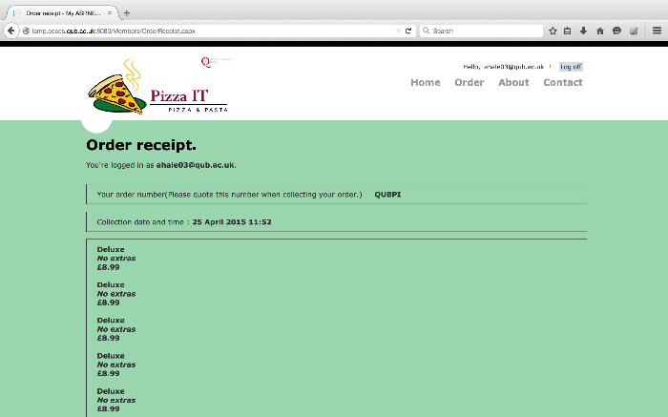
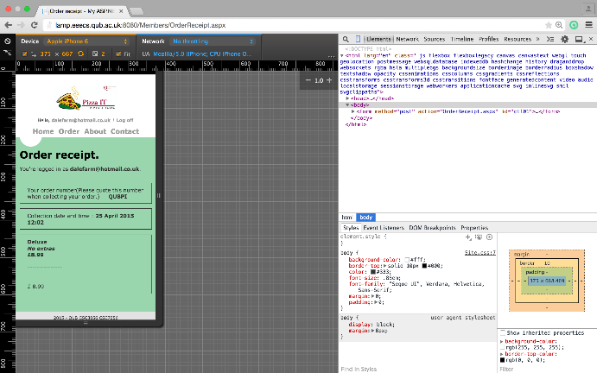
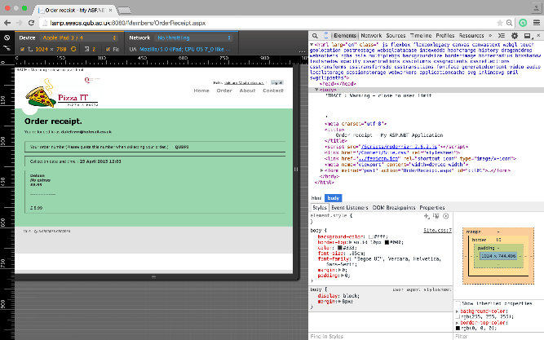
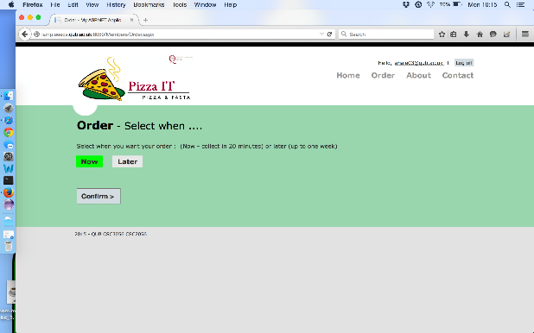
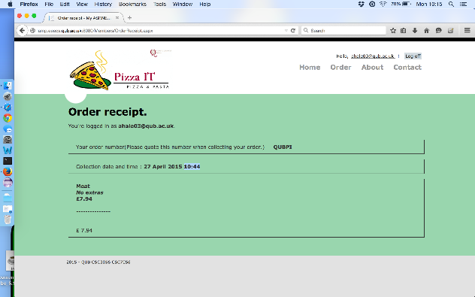
Order Receipt Page
Mostly Moderate defects found
Unique Order Reference
Time
Prices

Slide 11

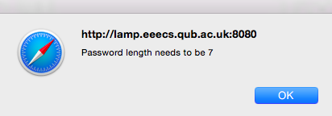
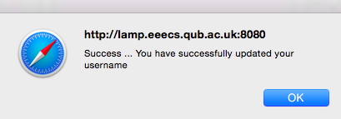
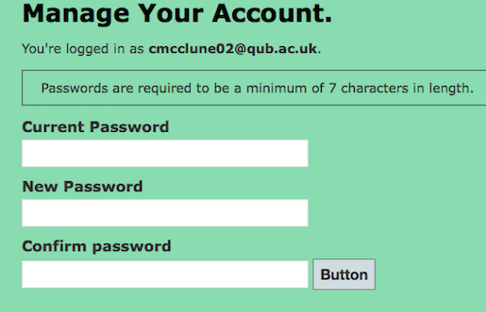
Manage Account – Reset Password
The version and © information omitted
Validation fix
Miscommunication
Inconsistency
Majority of defects cosmetic → moderate

