Slide 1
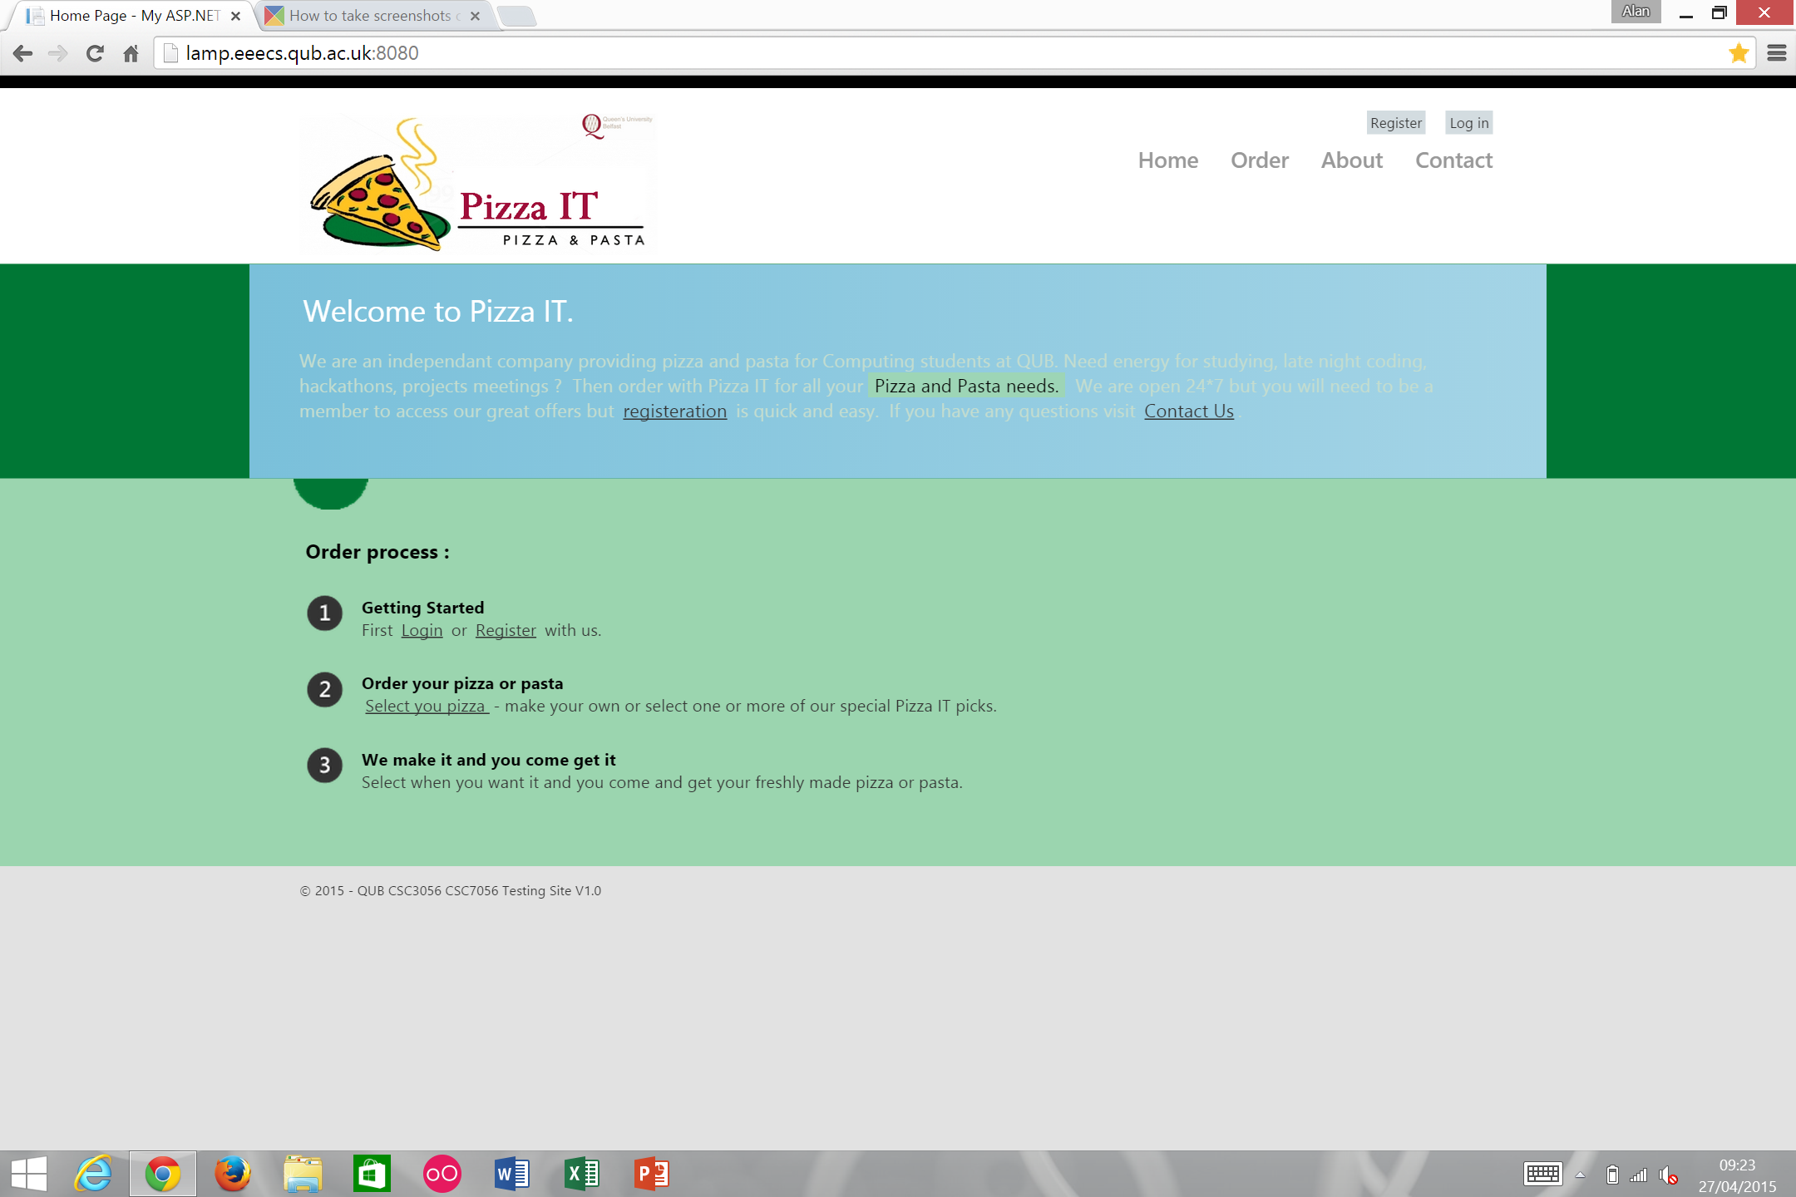
Registration
Overall - page created to high standard
Small number of manageable defects are present
No critical defects exist
3 defects:
Major = 1
Moderate = 1
Minor = 1
Ability of an unregistered user to successfully resister using an invalid email address format
customer@email.com
Conflicts with 4.1.13

