Slide 1
Hello and Welcome
Test Findings
Test Team ECHO

Slide 2
Order Pizza
Inability to remove a pizza in Internet Explorer 11 produces a set of critical defects. Fixing the “remove” button code likely will have a domino-effect, resolving all listed critical defects. Fixing the remove button will render the page functional on the most recent version of that browser.
If item is in the shopping basket and user navigates to the Home page, Ordering Page, About Page or Contact page and then tries to navigate back to the Ordering Pizza page, the Schedule page eventuates. No means of being able to navigate back via navigation to the Ordering Pizza.
Major defects flow from minor inaccuracies in the coded prices for the Meat Extravaganza pizza and the Peppers topping. Correcting these errors at the source likely will redress related major defects listed downstream.
This holds true for the onions not adding to the Cheese Pizza.
Price freeze after £100 in the basket.

Slide 3
Myriad cosmetic and minor that could be corrected if the page is being revisited anyway. E.g. Pizza descriptions.
Many classified moderates are negated once source problems (chiefly, the pizza prices) are corrected.

Slide 4
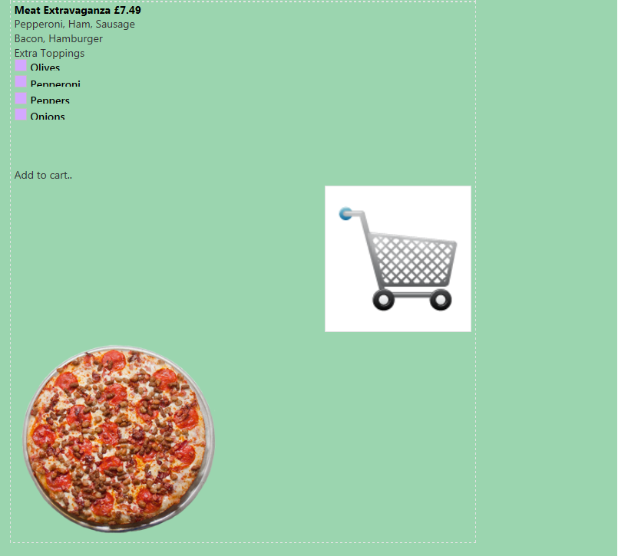
Meat Extravaganza – price £7.49.

Slide 5
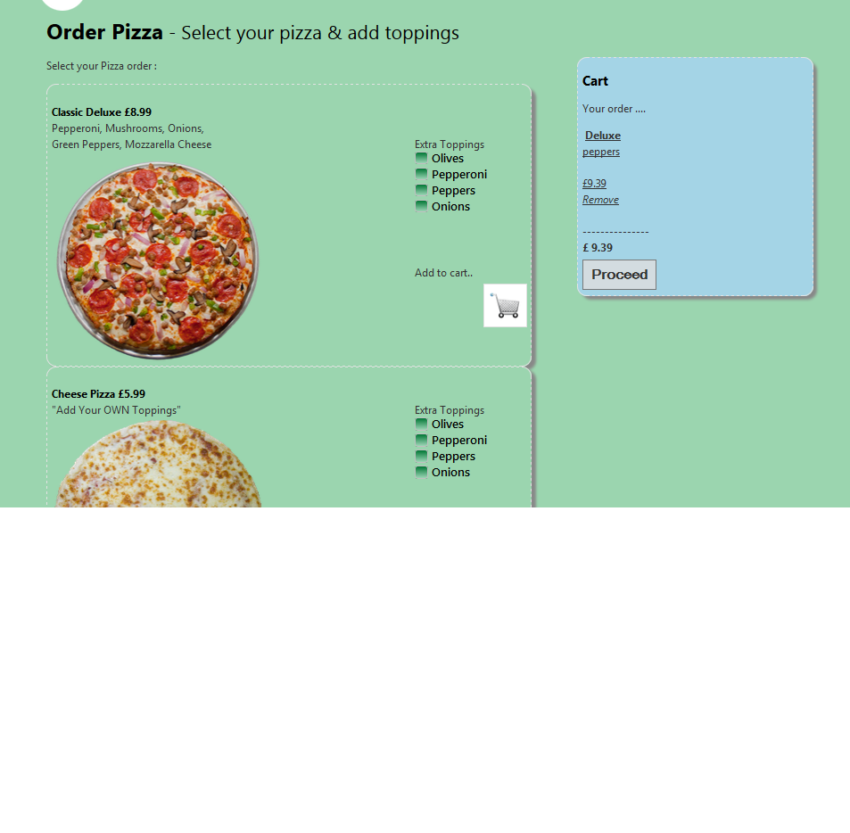
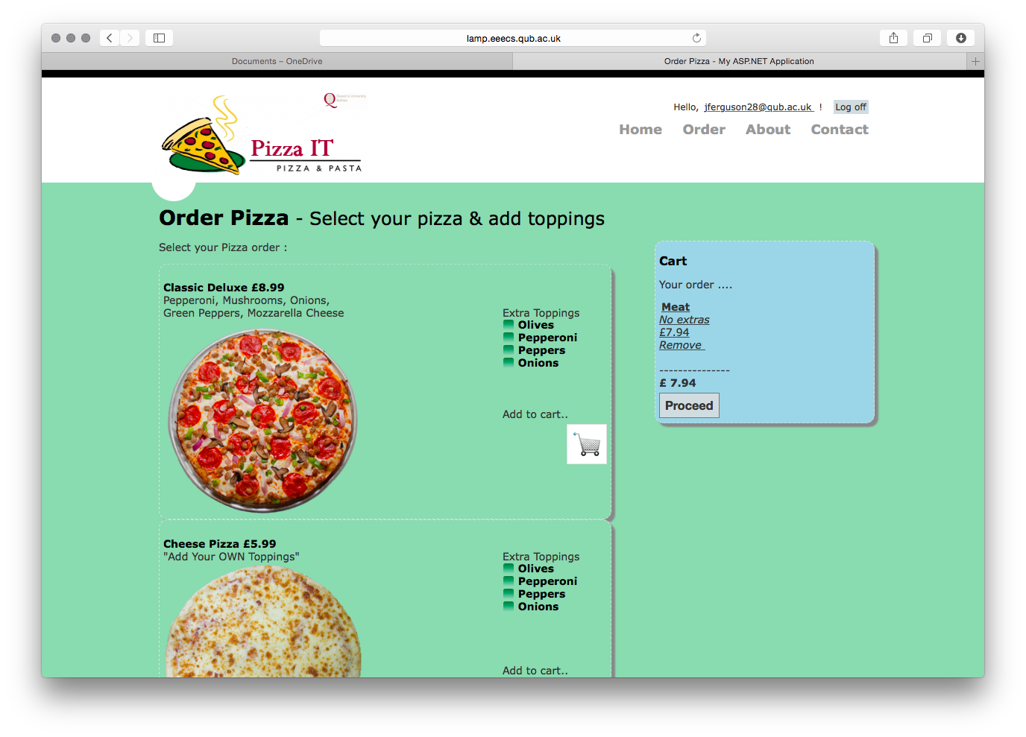
Peppers bring the price up to 9.39; peppers at 40p. Price should be 9.49.
Onions don’t add to basket with Cheese Pizza.

Slide 6
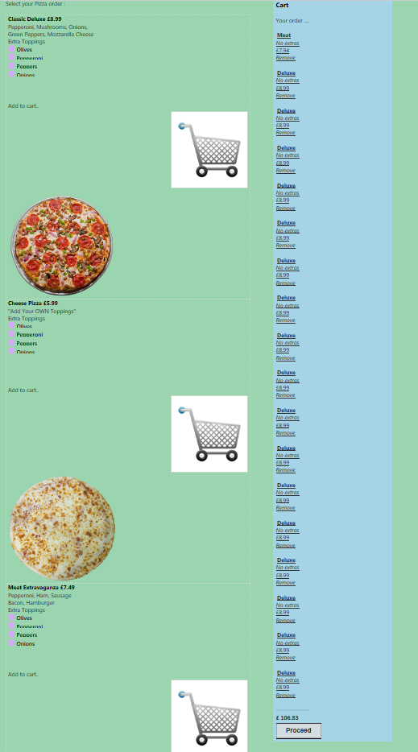
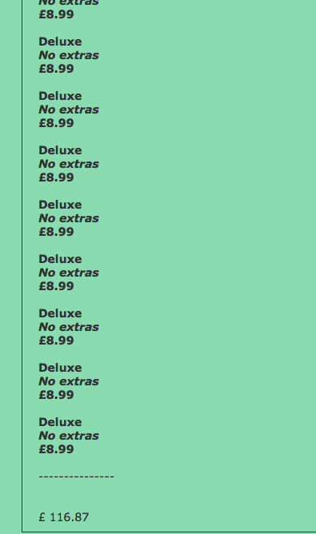

Slide 7
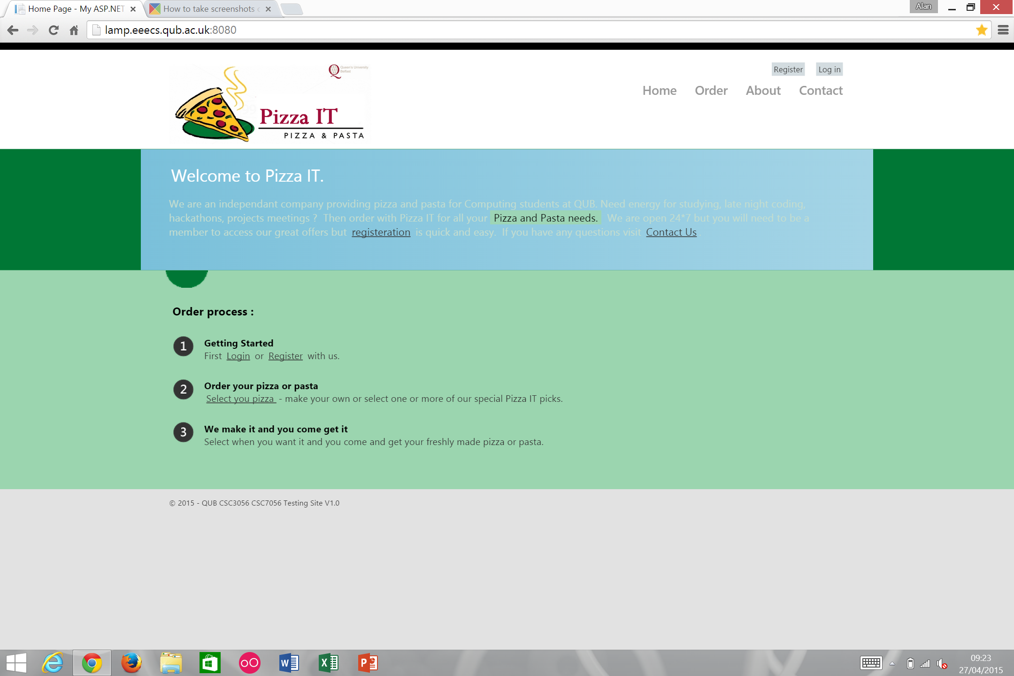
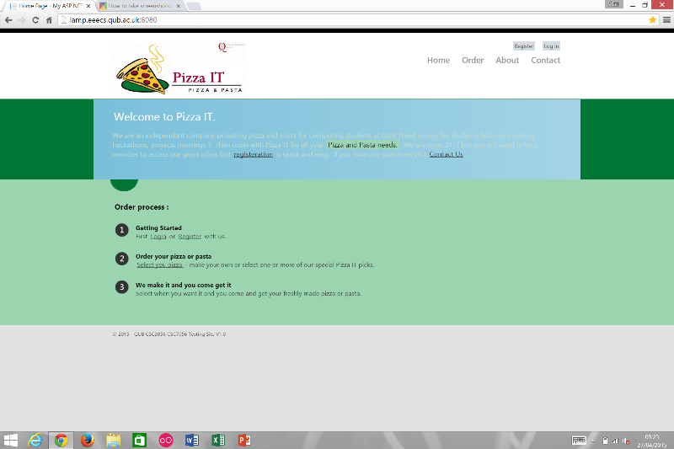
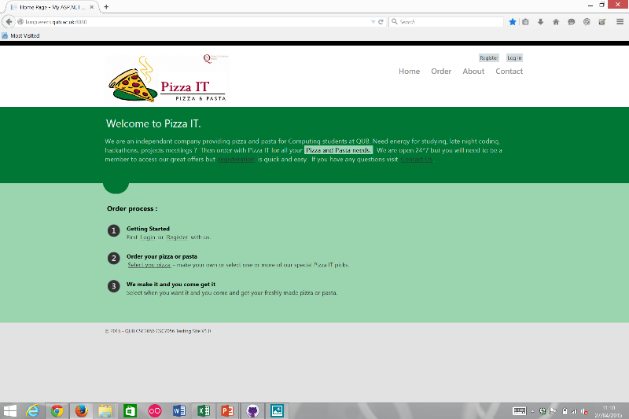
Home Page
2 Cosmetic and 2 Minor defects found.
Some spelling mistakes and a formatting error.
Problem with the Select your Pizza link.

Slide 8
Registration Page
Overall page created to high standard
However, small number of manageable defects are present
Despite this no critical defects exist
3 noteworthy defects are categorised as follows:
Major = 1
Moderate = 1
Minor = 1
Most notable defect is the ability of an unregistered user to successfully resister using an invalid email address format
customer@email.com
Conflicts with 4.1.13

Slide 9
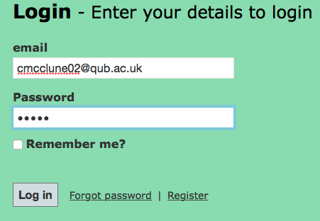

Login
Login page is mostly well structured
Few problems
User able to login with password less than specified 6 characters
Validation is server side rather than client side.

Slide 10

About Page
No user input sections
Mostly textual information
Only 2 cosmetic defects encountered

Slide 11
Contact

Slide 12
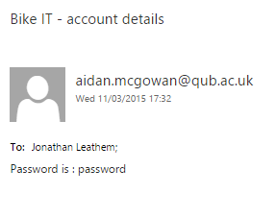
Forgot Password Page
One minor defect
Email subject reads “Bike IT – account details”
Appears unprofessional
Three cosmetic defects
Notes:
Forgot password functions fine
User should know themselves that they entered a forgot password request on the Pizza IT site and that they’ll soon receive an email containing their password
Won’t affect the running of the site
Recommend changing the email subject to “Pizza IT – account details” to make company as a whole appear more professional and for complete clarity with customers
Three cosmetic defects:
Web page spacing on Samsung Galaxy S4, iPhone 6, and Amazon Kindle Fire 7”.
Positioning of the Pizza IT logo on the logo in comparison to other pages.
Watermark “99” on the Pizza IT logo.

Slide 13
Schedule Order Page
1 Moderate, 7 Major, 4 Critical defects
Critical defects were caused by the order validation button still working after trying to order beyond the limit of one week in the ‘Later Service’
Automated Selenium Tests caused Major defects in testing as
the pop up boxes would cause ‘time
outs’ before moving onto the next page
Moderate and Exploratory issues such as
the ‘Now Service’ showing collection time
is 10 mins over what is expected

Slide 14
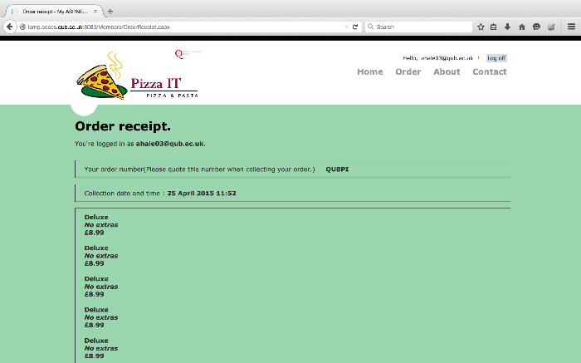
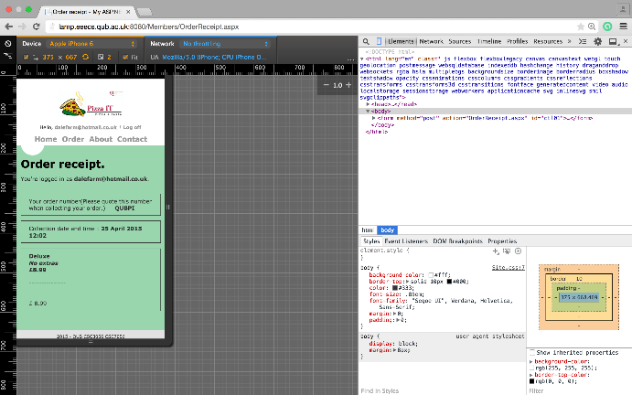
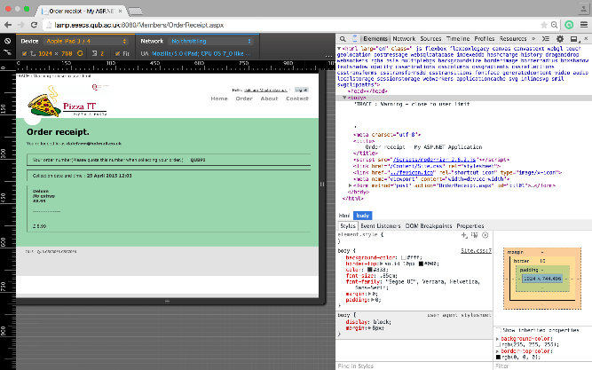
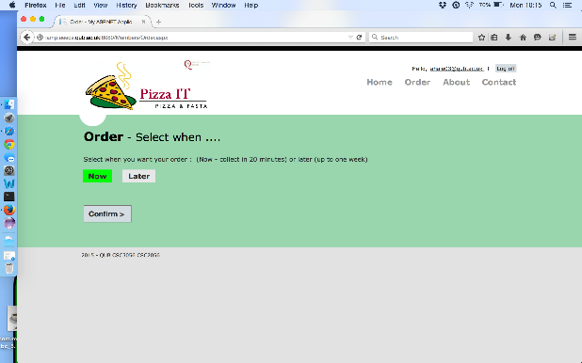
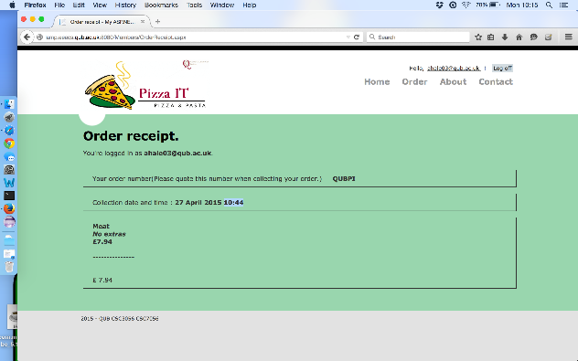
Order Receipt Page
Mostly Moderate defects found
Unique Order Reference
Time
Prices

Slide 15

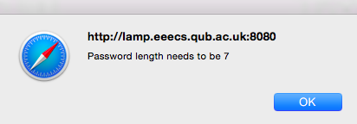
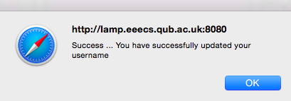
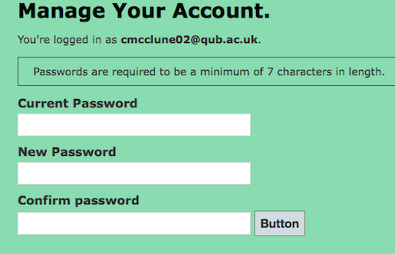
Manage Account – Reset Password
The version and © information omitted
Validation fix
Miscommunication
Inconsistency
Majority of defects cosmetic → moderate

