Slide 1
Starwatch – An Annual Report Information Extractor
Group 9
XUE Kaiwen
YANG Wenbo
ZHANG Deheng
QING Yuhao
LI Chaohui

Slide 2
Outline
Starwatch Beta1.0 -- NLP Extractor
1. Convert PDF to XML file
2. Add marking tags to XML
3. Extract intended information from XML
Starwatch Beta2.0 – LSTM RNN Network (Under construction)
1. Get a words’ frequency matrix from an annual report
2. Derive a relation between frequency matrix and page
importance matrix
3. Extract information by binary classification logistic regression

Slide 3
Starwatch Beta1.0 -- NLP Extractor
Convert PDF to XML file
PDF file
(Annual Report)
PDF Miner
XML file
2. Add marking tags to XML
Self-written script
Tags

Slide 4
Starwatch Beta1.0 -- NLP Extractor
3. Extract intended information from XML
Take the advantages of the pattern of the document, eg.
Font size,
Special title.

Slide 5
Starwatch Beta 1.1 -- Simple ML techniques
Learn the frequency of words in all annual reports.
Unexpected high word frequency -> the word is special for that company.

Slide 6
Starwatch Beta1.0 -- NLP Extractor
Demo
import starwatch
import starwatch.toxml
starwatch.toxml.toxml("tester.xml", "../CityU-Hackathon-2019/Testing/67/*.pdf")
res = starwatch.extract_entity("tester.xml")
print(res)
res = starwatch.extract_auditor("tester.xml")
print(res)
res = starwatch.extract_num("tester.xml")
print(res)
API Usage
Result

Slide 7
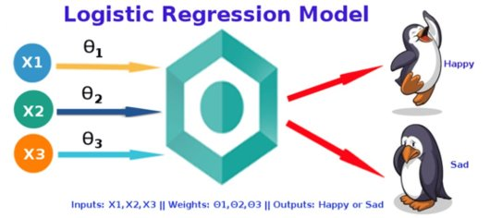
Starwatch Beta2.0 – LSTM RNN Network
Each row represent a page
Attribute vector: A vector of frequencies
Output : Page importance

Slide 8
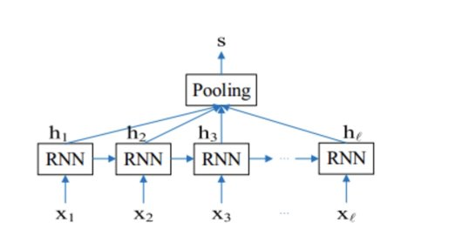
Starwatch Beta2.0 – LSTM RNN Network
Input : sentences in the selected important pages
Output : contents's information label

Slide 9
Contribution
XUE Kaiwen – Financial Statement extraction, API making
YANG Wenbo – Entity extraction, PDF converter design
ZHANG Deheng – Audit information extraction, Beta 2.0 design
QING Yuhao – Beta 2.0 design and implementation
LI Chaohui – Planning, PPT

Slide 10
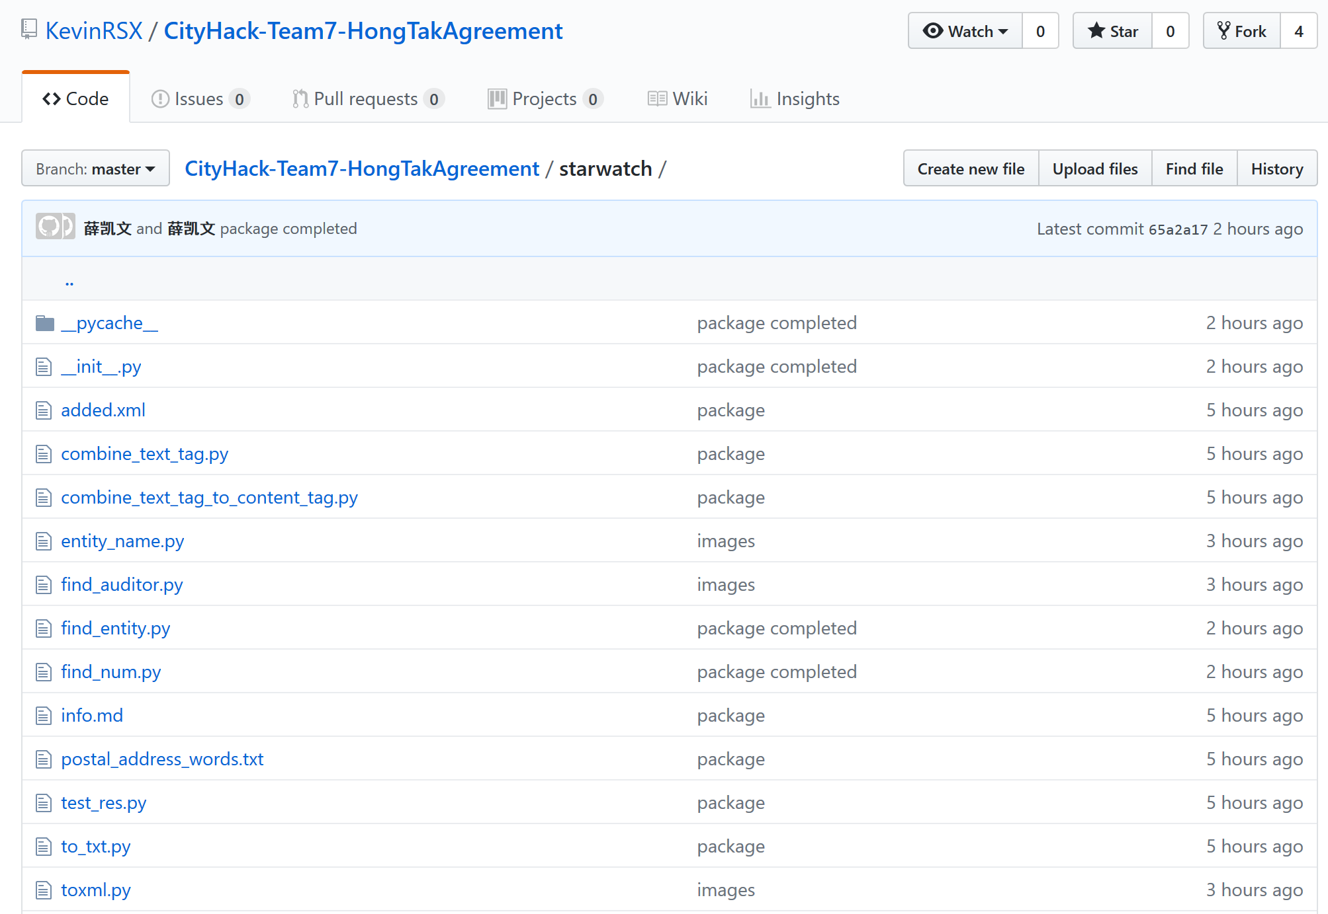
Our GitHub page
https://github.com/KevinRSX/CityHack-Team7-HongTakAgreement

