Slide 1
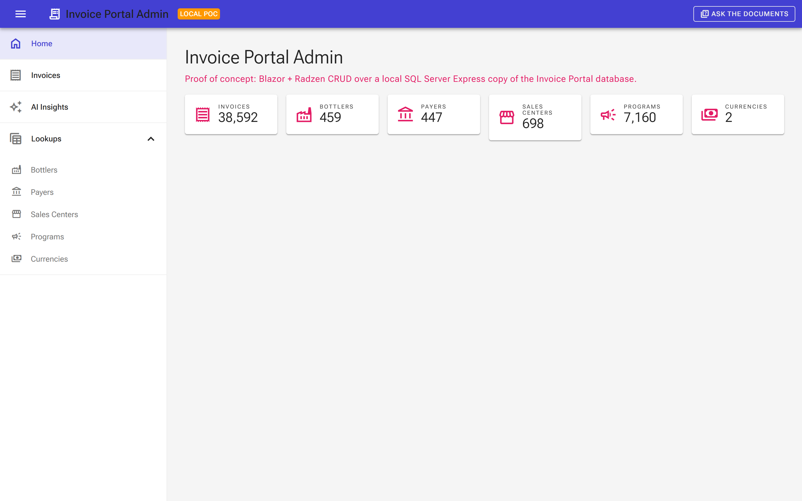
INVOICE PORTAL ADMIN
A friendlier front door
to our invoice data
A proof of concept: modern UI, safe data access, and a first look at AI over our own numbers.
Kevin Raffay architecture, UI and AI
IT leadership briefing · September 2026
Notes:
Welcome. Keep this to 30 minutes. Set the tone: this is a proof of concept we built to answer two questions. Can we give ops a modern, safe way to look at and fix Invoice Portal data? And can we try AI on our own data without any risk to production? Spoiler: yes to both, and we'll show it live-ish with screenshots and short clips. Introduce your database colleague and say they'll take the last third.

Slide 2



The next 30 minutes
Three short chapters, then your questions.
The big picture
UI and AI in action
The data side
What we built, why, and what it runs on.
A tour of the screens and the two AI features.
Where the data comes from and how we keep it safe.
Kevin · 8 min
Kevin · 12 min
[Colleague] · 8 min
Then: questions and what's next · 2 min
Invoice Portal Admin · 2
Notes:
One breath on the agenda. Tell them they can interrupt any time; the deck is a guide, not a script.

Slide 3



Why we built it
Three itches, one small app.
Ops needs to see and fix records
Invoices, bottlers, payers, programs. Today that means SQL scripts or waiting on a developer.
Without touching production
A full copy of the real data, running on one laptop or one container host. Break it, reset it, no harm done.
And a cheap way to try AI
Same real data, same screens. Ask questions in plain English and see what happens, with guardrails on.
38,592 invoices, 459 bottlers, 447 payers: the real shape of the data, locally.
Invoice Portal Admin · 3
Notes:
The origin story in plain terms. Ops has to look things up and occasionally fix a record; that currently means someone writing SQL against production. We wanted a screen for that, and we wanted to practice on a copy so nobody has to be brave. The AI part was the bonus: if we already have a safe sandbox with real data, it is the perfect place to test what AI can and cannot do for us.

Slide 4
The big picture
Everything runs in a handful of containers on one machine. No cloud required.
Docker Compose (one host)
Web app
SQL Server Express
AI model
Browser
Blazor Server + Radzen
Grids, dialogs, AI screens
Full copy of the Invoice Portal database
Durable Docker volume
Optional. Built-in mock today.
Local or Azure OpenAI later.
Ops user, any modern browser
Production backup file (.bacpac)
One-shot importer
Copied once to the laptop. Never written back anywhere.
Restores the production backup on first run, then exits
Start it with one command. Reset it with one command. The AI box is a plug, not a dependency.
Invoice Portal Admin · 4
Notes:
Walk left to right. A browser talks to a web app. The web app talks to a SQL Server that is a full copy of the real database. A tiny helper restores the production backup the first time and then gets out of the way. The AI box is dashed on purpose: today it is a built-in stand-in that needs no network. When we want a real model, local or Azure, we flip a setting. Everything here starts with 'docker compose up' and resets with 'docker compose down'.

Slide 5





What it's made of
Boring, well-supported Microsoft pieces. That is a feature.
.NET 10 and Blazor
Radzen components
EF Core + SQL Server
Our standard stack. C# end to end, one team can own it.
Grids, dialogs and forms that look finished on day one.
The data model is generated from the real schema, not hand-typed.
Docker Compose
Microsoft.Extensions.AI
OpenTelemetry
Same containers on a laptop, a build agent or Azure.
One AI interface; swap the model without touching the app.
Traces and metrics built in, so we can see what it is doing.
Invoice Portal Admin · 5
Notes:
Nothing exotic. That is deliberate: the interesting part of this project is the AI experiment, so the rest should be as ordinary as possible. Two things worth a sentence each. The data model is generated from the real database, so when the schema changes we regenerate instead of hand-editing. And the AI layer sits behind Microsoft's standard interface, so a model swap is a config change, not a rewrite.

Slide 6
Runs on a laptop today. Azure tomorrow.
Same container image, same code. Only the surroundings change.
Today: local
Ready: Azure
One command to start, one to reset
Real data, zero cloud spend
AI uses the built-in stand-in or a model on the developer's GPU
Nothing leaves the machine
Azure Container Apps, deployed with the Azure Developer CLI
Points at the existing Azure SQL database. It never creates or restores one
Managed identity everywhere: no passwords or keys in config
Entra ID sign-in switched on in front of the app
Infrastructure is code in the repo, and a GitHub Actions workflow deploys on merge.
Invoice Portal Admin · 6
Notes:
Left side is where we are; right side is ready to go when there is appetite. Emphasise the middle bullet on the right: in Azure the app would point at the existing database. This project never copies production data into a new cloud database. Also worth saying: no secrets in config anywhere in the Azure path, it is all managed identity.

Slide 7
CHAPTER 2
A quick tour
The screens people will actually use.
Invoice Portal Admin · 7
Notes:
Transition. Two screens for the everyday work, then the two AI features.

Slide 8
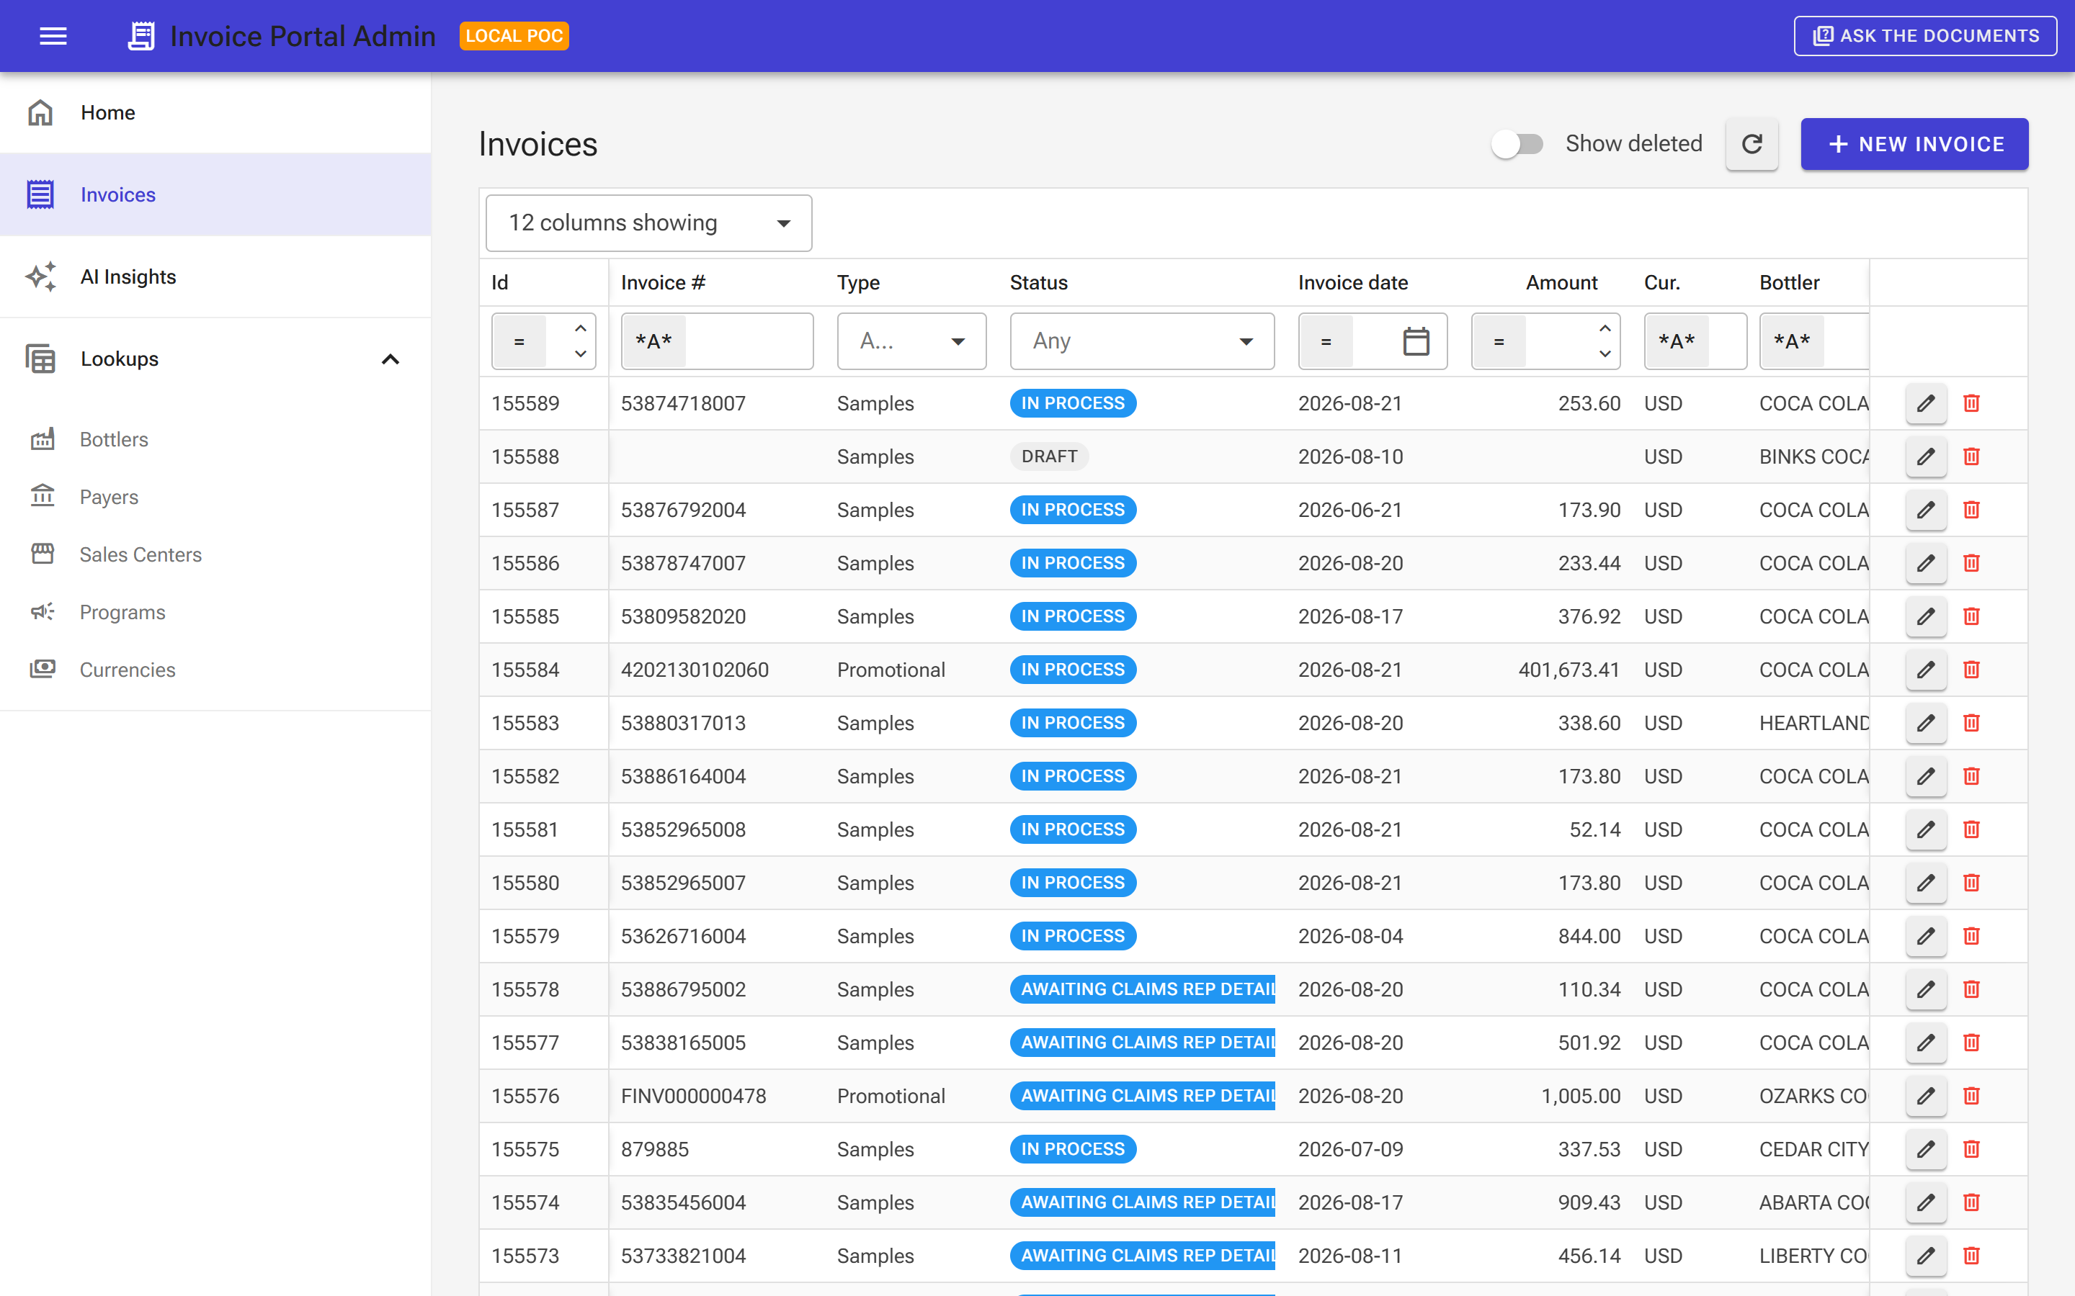



Grids that do the heavy lifting
Filter, sort and page through 38,000 invoices without a query in sight.
Server does the work
Only the rows on screen are fetched. Filters and sorts run in SQL, so it stays quick.
Delete is reversible
Deleting an invoice hides it. Flip "Show deleted" and restore it in one click.
Pick your columns
Each user shows the columns they care about. Nothing is lost, just tucked away.
Invoice Portal Admin · 8
Notes:
This is the Invoices screen. The point to land: it feels like a spreadsheet but the database does the heavy lifting, so it is fast even on the full data set. Deleting is a soft delete: rows are marked, never removed, and can be restored. Same pattern for bottlers, payers, sales centers, programs and currencies.

Slide 9
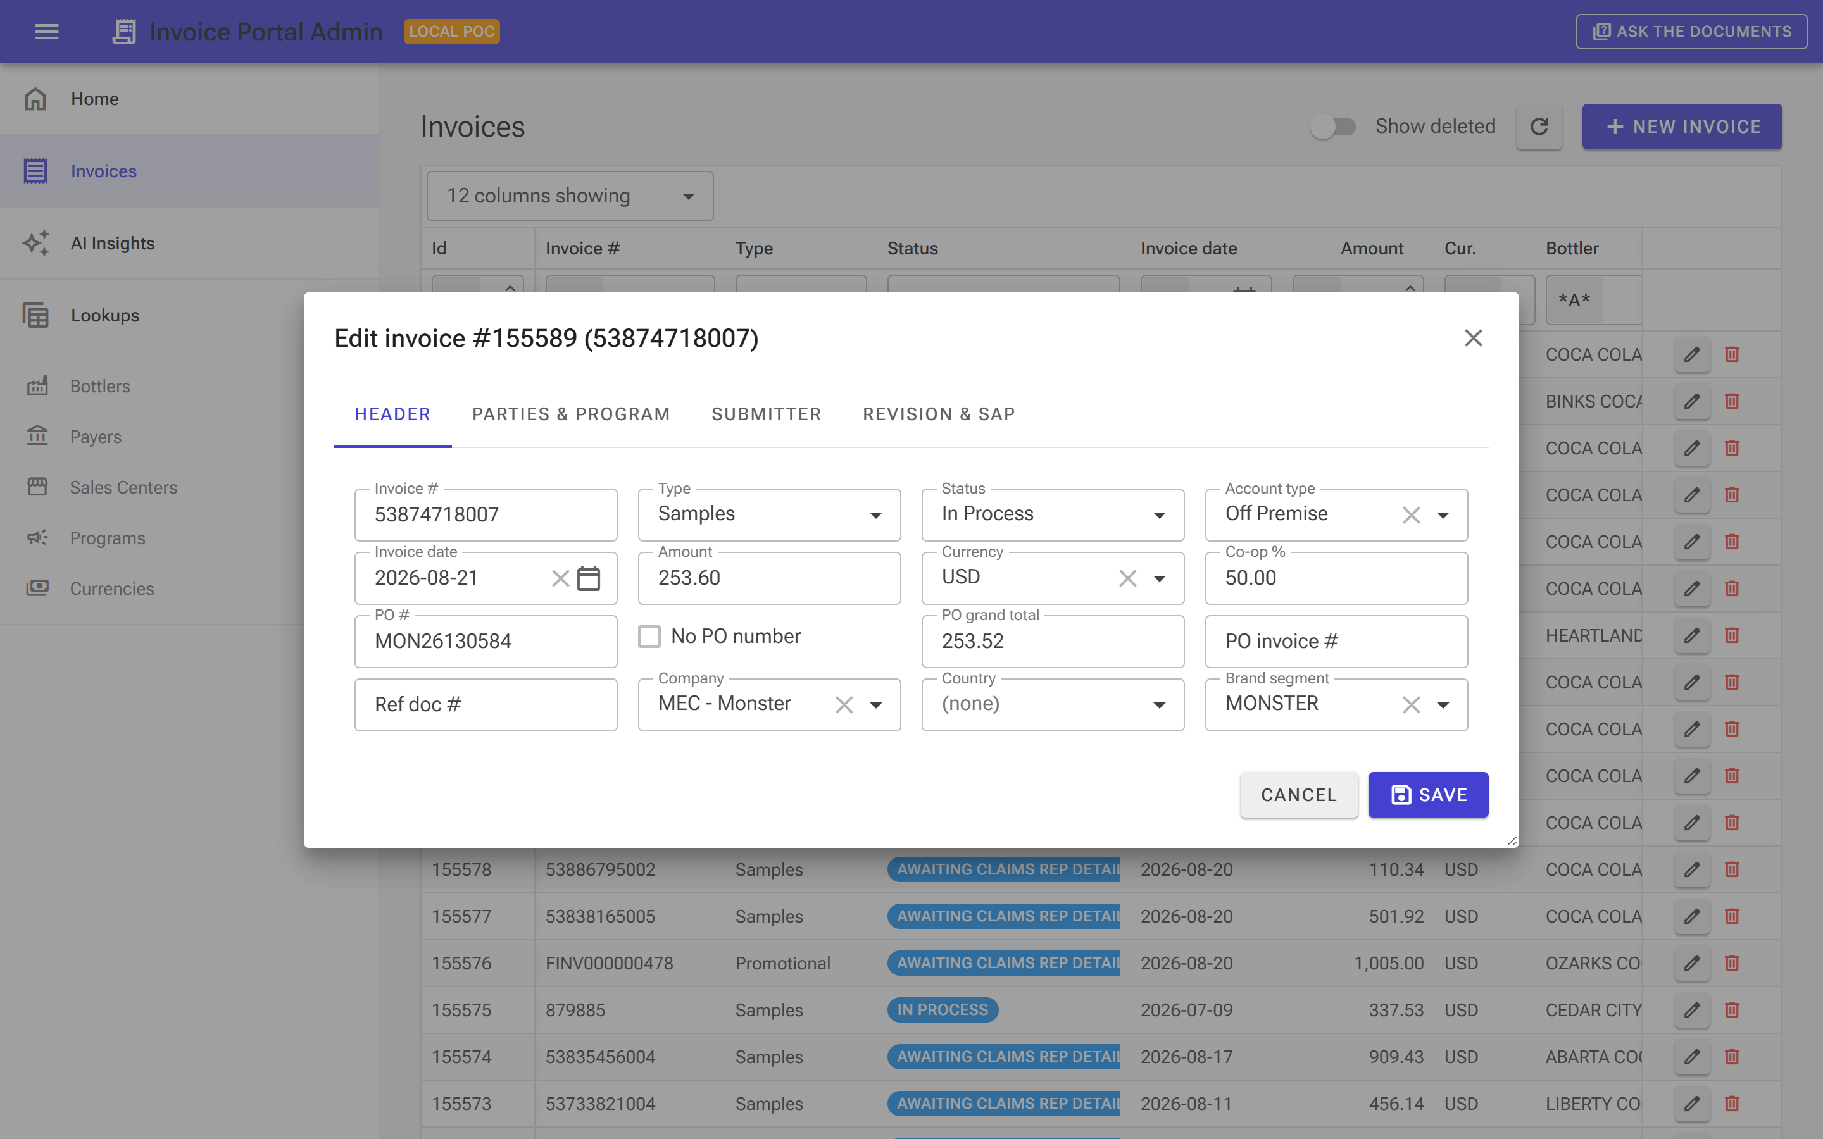



Editing without surprises
A tabbed form with the fields grouped the way the business thinks about them.
Dropdowns that follow the data
Pick a bottler and the payer list narrows. Pick a payer and the sales centers follow.
Guardrails from the database
Required fields, unique ids and references are enforced. Errors come back in plain English.
Audit stamps, automatically
Created and updated timestamps are set for you. Nothing to remember.
Invoice Portal Admin · 9
Notes:
The edit dialog. Four tabs: header, parties and program, submitter, revision and SAP. The dropdowns cascade so you cannot pick a payer that does not belong to the bottler. When the database says no, the user sees a sentence, not a SQL error code.

Slide 10
CHAPTER 3
AI, with guardrails
Two features. Both useful. Neither can hurt the data.
Kevin
Invoice Portal Admin · 10
Notes:
Transition. Set expectations: this is a first look, running against a stand-in model today, but every safety check is the real thing.

Slide 11
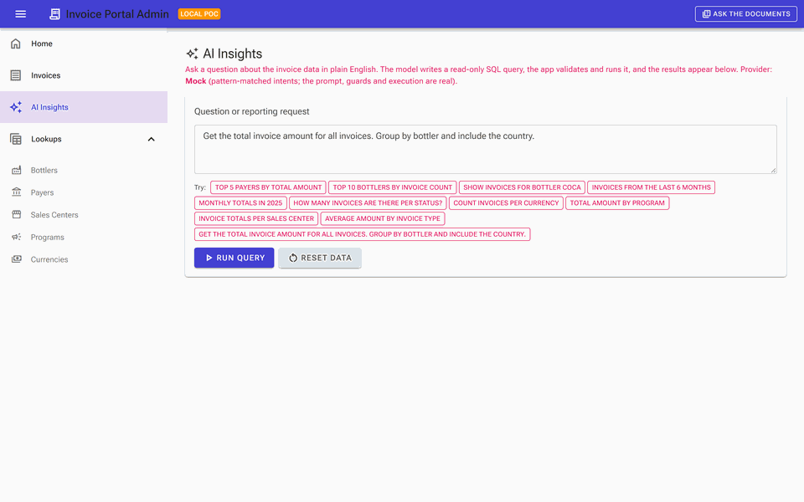

Ask in plain English
Type a question. Get a table. The SQL is there if you want to peek.
You ask
"Top 5 payers by total amount"
The model drafts SQL
Read-only, using a description of our tables
The app checks it
Anything but a single SELECT is rejected
You get a grid
Sortable, filterable, capped at 200 rows
Clip plays in slideshow mode.
Invoice Portal Admin · 11
Notes:
Let the clip play once (it is about ten seconds). Narrate the four steps on the right. The honest caveat: today the model is a stand-in that understands a dozen kinds of question, which is why the suggestion chips exist. The plumbing around it, the prompt, the checks, the execution, is exactly what a real model would go through.

Slide 12


What keeps it safe
We assume the model will get it wrong sometimes. The app is built so that does not matter.
Read only, full stop
One SELECT statement. No updates, deletes or admin commands, ever.
200
5 s
10
Checked before it runs
The app inspects the SQL the model wrote and refuses anything outside the rules.
rows max
per query
asks per minute
Always rolled back
Every AI query runs in a transaction that is undone at the end, even when it succeeds.
Recommended next step: run AI queries under a read-only database login too. Belt and braces.
Hard limits
Five-second timeout, 200-row cap, ten questions a minute per user.
Switchable
Feature flags hide the AI entirely, or just the document chat, with one setting.
Invoice Portal Admin · 12
Notes:
This is the slide for the risk-minded. The model writes SQL; the app does not trust it. Single read-only statement, inspected, time-boxed, row-capped, and the transaction is rolled back regardless. Plus feature flags to turn it off. Mention the follow-up: a read-only database account for the AI path so the database itself is the last line of defence.

Slide 13
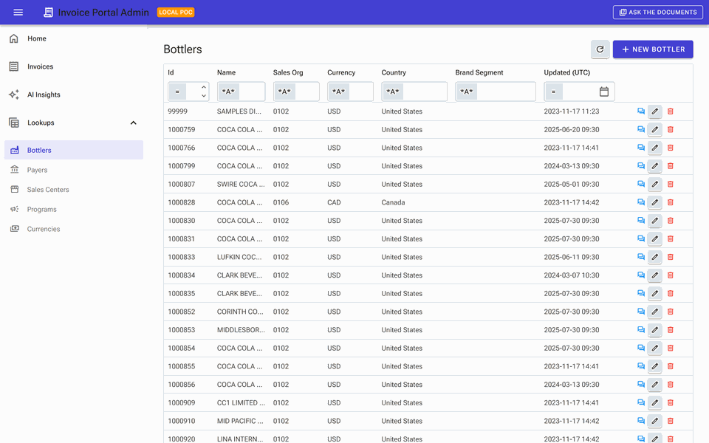



Ask the documents
Questions about a bottler, answered from our own documents, with receipts.
Grounded, not guessed
The model only sees the documents we hand it and must answer from those.
Every claim is cited
Each sentence carries a source label. Uncited answers are rejected.
One click from a bottler
The chat button on a bottler row opens with that customer's name already filled in.
Invoice Portal Admin · 13
Clip plays in slideshow mode. Documents shown are sample content.
Notes:
Second AI feature. Think of it as search that talks back. The important design choice: the model can only use what we give it and has to cite it, so the answer is checkable. Be upfront that the documents in the demo are samples we wrote; the real version would index the actual customer documents.

Slide 14


Swap the brain, keep the app
The model is a setting. Three options are wired in today.
Today
Ready
Ready
Built-in stand-in
Local model (Ollama)
Azure OpenAI
Default. Works offline, deterministic, needs no keys. Great for demos and tests.
A real open model on a developer's GPU. Free-form questions, nothing leaves the machine.
Managed model, Entra ID auth, no keys. What the Azure deployment uses.
Whichever we pick, the prompts, the safety checks and the screens do not change.
Invoice Portal Admin · 14
Notes:
This is the strategic point. We are not betting on a vendor. Today's demos run on a stand-in; a developer can point it at a local open model; the Azure path uses Azure OpenAI with our identity, no API keys. In every case the app code is identical. Note that anything other than the stand-in sends the question, our table names and document text to that model, so the choice is a data-handling decision as much as a technical one.

Slide 15
CHAPTER 4
The data side
Where it comes from, how the app uses it, how we keep it safe.
Invoice Portal Admin · 15
Notes:
Hand over to your database colleague here. Roughly eight minutes for the next three slides.

Slide 16



Where the data comes from
A faithful copy of production, made safe for a laptop.
Production backup
Cleaned up
Restored locally
Reset any time
A standard Azure SQL export file, copied once.
Cloud-only pieces (identity users, encryption flags) are stripped from a copy. The original is untouched.
Into SQL Server Express in Docker. About a minute for 744,000 rows.
Throw the container away and it rebuilds itself from the backup.
It runs once. If the database already exists, it does nothing. If a restore fails halfway, it cleans up so the next run can try again.
Invoice Portal Admin · 16
Notes:
[Colleague] Suggested talking points: the backup is the same export Azure produces; the cleanup only removes things an on-premises SQL Server cannot have, so the schema and data are exactly production's. The restore is automatic and idempotent. Reset is a one-liner. Add colour on how long it takes and how often you have refreshed it.

Slide 17

How the app talks to the database
Generated model, short conversations, nothing destructive.
Model generated from the schema
Short-lived connections
Nine tables the UI needs, generated straight from the database. Schema changes mean regenerate, not retype.
Every screen action opens a connection, does its work and closes it. No long-lived sessions hogging the server.
Soft delete and audit
AI reads, never writes
Deletes flip a flag. Created and updated timestamps are set automatically. History is preserved.
AI queries run through the same connection, inside a transaction that is always rolled back.
Invoice Portal Admin · 17
Notes:
[Colleague] High level only. Four ideas: the model is generated so it cannot drift from the real schema; connections are short so the app is polite to the server; deletes are soft so nothing is truly lost; and the AI path is read-only and rolled back. If asked about scale: filtering, sorting and paging all happen in SQL, so the app only ever pulls one page of rows.

Slide 18
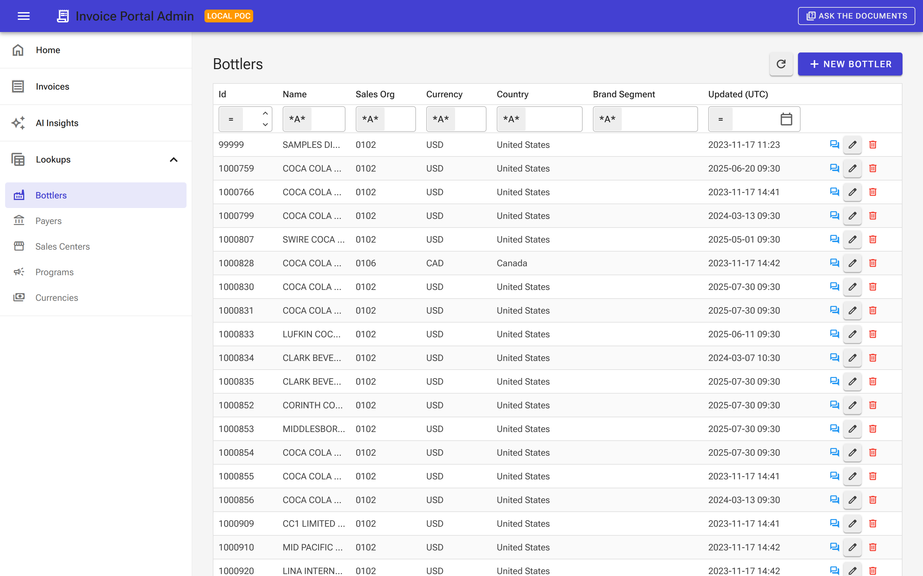



Keeping production data safe
It is real data, so we treat it like real data.
Lives in one place
The copy exists only on the local Docker volume and the backup file. Both are excluded from source control.
Never pushed back to the cloud
Nothing in this project restores the backup to Azure. The Azure deployment points at the existing database.
No secrets in code
Local passwords live in an ignored env file. In Azure it is managed identity end to end.
Real bottlers, real ids. Handle with care.
Next: least privilege
Give the AI path its own read-only login, and put sign-in in front of the app before anyone but us uses it.
Invoice Portal Admin · 18
Notes:
[Colleague] The reassurance slide. Where the copy lives, what never happens (no restore to the cloud), how secrets are handled, and the two follow-ups we would want before this goes beyond the team: a read-only login for the AI path and sign-in on the app.

Slide 19
What's next, if you want more
Small steps, each one useful on its own.
1
2
3
4
Real model, real documents
Sign-in and least privilege
Pilot in Azure
Grow the screens
Switch the AI to Azure OpenAI or a local model and index the actual customer documents.
Entra ID in front of the app, a read-only database login for the AI path.
Deploy to Container Apps against the existing database for a small ops group.
More tables as ops asks for them. Each new screen is a grid, a dialog and an afternoon.
None of these require rework. The plumbing for all four is already in the repo.
Invoice Portal Admin · 19
Notes:
Kevin takes it back. Four options, in the order we would suggest. The ask is not for budget today; it is for a steer on which of these is worth a pilot. The numbered order is a real sequence: a real model and sign-in come before anyone outside the team touches it.

Slide 20
Questions?
A modern, safe screen over the real Invoice Portal data.
AI that helps you ask, and cannot change a thing.
Runs on a laptop today, ready for Azure when you are.
Kevin Raffay ·
Invoice Portal Admin · 20
Notes:
Three takeaways, then open the floor. If time is short, the one sentence is: we can look at our data safely and ask it questions, and none of it touches production.

