Slide 1

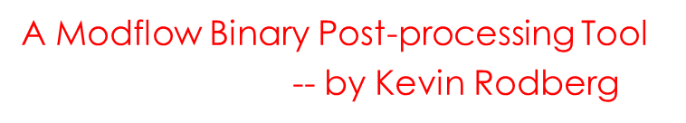
RMB3.py ReadModflowBinaryV3.py

Slide 2
Program Description:
ReadModflowBinaryV2.py is designed to process Modflow binary output producing either:
ArcGIS Rasters and Point Features in an ESRI Geodatabase
(ArcGIS arcpy module required)
or
GeoTIFF Rasters [georeferenced .tif files] and ESRI style point shapefiles in a user designated folder (resulting in 20-70 x faster processing)
(Python 3.6 gdal module required)
The previous version: ReadModflowBinary.py required you to post process the model results with Citrix or wherever you would normally use ArcGIS, sending results to geodatabases.

Slide 3
Python requirements:
ReadModflowBinaryV2.py is written in Python.
The code is compatible to run with:
ArcGIS/w Python 2.7 (pythonwin)
configured to support pandas, numpy, and arcpy
or:
Python 3.6+ (Anaconda3 or Miniconda3) with Spyder
configured to support pandas, numpy and gdal

Slide 4
Multiple user interfaces:
GUI for argument and keyword selection
(if -gui command line arguments or no –nam parameter supplied)
Spyder console execution with/or without some keywords and arguments
(defaults to -gui operation)
Command line argument parser c:\>
(Argument usage and help available with –h or --help)
Batch execution using python.exe
(if arguments are understood and known in advance)

Slide 5
Command Line Arguments and Batch Processing
All options defined using the gui feature can also be assigned on the command line with keyword options and arguments
A usable command line string is output to the console after successful execution, making it a great resource to copy and paste directly into a batch file, for future post processing.
Batch files are an ideal approach for post processing model runs.
Adding a few commands to an existing batch file will perform post processing steps as soon as the model finishes running.

Slide 6
Command Line Arguments and Batch Processing
Map network drives to letters to shorten filenames:
net use G: \\ad.sfwmd.gov\DFSRoot\data\wsd\GIS\GISP_2012\WorkingDirectory\KAR\ModflowProcessing
net use M: \\whqhpc01p\hpcc_shared\krodberg\WCFM\TRANS_COUPLE
net use T: \\ad.sfwmd.gov\dfsroot\data\wsd\SUP\devel\source\Python\ReadModflowBinary
C:\python27\arcGIS10.3\python T:\ReadModflowBinaryV2.py -mod WCFM -hds -lay 1 -strPer 31 -nam m:\wcfm.nam
Note: UNC paths can be used, if mapped drives are not preferred.
C:\python27\arcGIS10.3\python.exe
\\ad.sfwmd.gov\dfsroot\data\wsd\SUP\devel\source\Python\ReadModflowBinary\ReadModflowBinaryV2.py
-mod WCFM -hds -lay 1 -strPer 31 -nam \\whqhpc01p\hpcc_shared\krodberg\WCFM\TRANS_COUPLE\wcfm.nam

Slide 7
Usage statement: [shown from Spyder console execution or command line]
runfile('ReadModflowBinaryV2.py', args='--help', wdir='T:/ReadModflowBinary’)
Or:
C:\python27\arcGIS10.3\python.exe T:\ReadModflowBinary\ReadModflowBinaryV2.py --help
usage: ReadModflowBinaryV2 [-h]
[-agg {min, max, mean}][-bud]
[-clpbox CLIPBOX][-clpgdb CLPGDB][-gdb GEODB]
[-gui] [-hds][-lay LAYERSTR]
[-mod {C4CDC,ECFM,ECFT,ECFTX,LECSR,LKBGWM,LWCFAS,LWCSAS,
LWCSIM,NPALM,WCFM}]
[-nam NAMEFILE] [-noArcGIS] [-quiet]
[-ras RASFOLDER] [-res RESAMPLE]
[-strPer STRSTR] [-swi] [-tds]
[-terms TERMS][units {cfd,mgd,inPerSP}][-uzf] [-vec]

Slide 8
Usage statement (continued): [shown from Spyder console execution or command line]
-h, --help show this help message and exit
-agg {min, max, mean}
aggregate rasters
-bud process CellxCell budgets
-clpbox CLIPBOX Clip rasters to extent.
-clpgdb CLPGDB Separate geodb for Clipped Rasters
-gdb GEODB Save rasters in GeoDatabase.
-gui GUI for options & arguments
-hds Process Heads file.
-lay LAYERSTR Define Layers to process:
-- Single layer: '-lay 1'
-- Multiple layers: '-lay 1,3-4,7'
-- No Layers: '-lay 0'
-- All Layers: '-lay None'
-- Command line Default: all layers
-mod {C4CDC,ECFM,ECFT,ECFTX,LECSR,NPALM,LKBGWM,LWCFAS,
LWCSAS,LWCSIM,WCFM}
Model defines Spatial Reference
and Raster Lower Left Origin
-nam NAMEFILE Assign Modflow .NAM FILE
-noArcGIS Process binary files w/o ArcGIS
-quiet Reduce output to console
-ras RASFOLDER Save rasters in folder
-res RESAMPLE Resampling appropriately aggregates
values from model results
-Flow Magnitude is summed
-Flow Direction is averaged
--------------------------
-res 5 Aggregates 5x5 grid
-res 1 Default: no resampling 1x1
-strPer STRSTR Define Stress Periods to process:
One stress period: -strPer 218
Multiple periods: -strPer 1-12,218,288
- Omit option [-strPer] for all periods
- Use -strPer 0 for none
-swi Process SWI Zetas file.
-tds Process TDS from MT3D file.
-terms TERMS Process 'Terms' for CellxCell budget
'FLOW’
Right, Front & Lower face flow
'RIGHT|FRONT’
FLOW_RIGHT_FACE & FLOW_FRONT_FACE
No parameters for all budget terms
-units {cfd,mgd,inPerSP}
Units multiplies rasters by a conversion
factor using one of the predefine mulitpliers
['cfd', 'mgd', 'inPerSP']
-uzf Process UZF cellbycell budgets
-vec Process Flow budgets for flow vectors

Slide 9
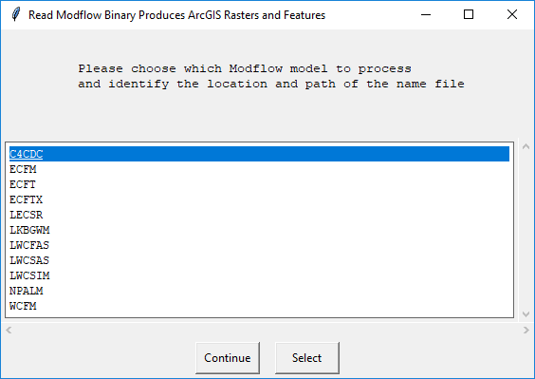
Supports most SFWMD Models: [required keyword -nam MODELNAME]
ReadModflowBinaryV2.py is configured to support the Modflow models used by Water Supply Modeling
I can easily add others
I may have missed

Slide 10
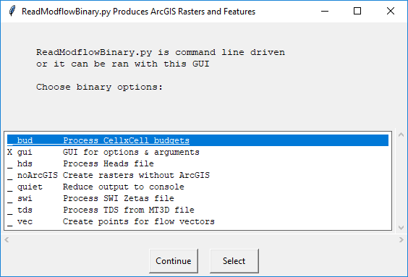
ReadModflowBinaryV2 Features: [via graphic user interface]
ReadModflowBinaryV2.py processes several types of Modflow Binary output via a GUI interface:
CellXCell Budgets
Binary Heads
SWI Zetas
TDS Concentrations
Flow Vectors
Additional Keywords
noArcGIS
quiet

Slide 11
Keywords by Type of Binary Data [By Layer and Stress Periods]
-bud Budget Term Rasters
-hds Water Level Head Rasters
-swi SWI Zetas Rasters
-tds TDS Rasters
-uzf UZF Budget Term Rasters.
-vec Horizontal Flow for flow vectors
(point features and rasters)

Slide 12
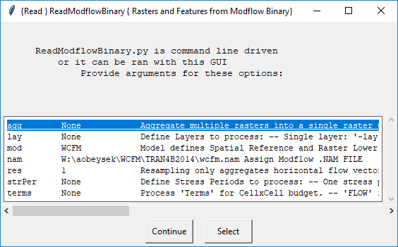
Additional Options:
ReadModflowBinaryV2.py adds some options to
define or select just what output you want to create.
Raster Aggregation:
-agg
Options for all data types:
-lay
-strPer
-clpbox
Option for Flow Vectors:
-res
Option for Budgets:
-terms
If you are working with budgets and
do not specify terms a gui interface
provides an easy method of selection.

Slide 13
Keywords to Identify Post-processing Layers and Stress Periods
-lay LAYERSTR Define Layers to process:
Single Layer: -lay 1
Multiple Layers: -lay 1,3-5,7 ← 1, 3, 4, 5, 7
No Layers: -lay 0 ←Useful for testing other keyword options
All Layers: -lay None or Omit keyword - lay
Default: All Layers
-strPer STRSTR Define Stress Periods to process:
One stress period: -strPer 218
Multiple stress periods: -strPer 1-5,218,288 ← 1, 2, 3, 4, 5, 218, 288
No stress periods: -strPer 0 ←Useful for testing other options
All stress periods: -strPer None or Omit keyword -strPer
Default: All stress periods

Slide 14
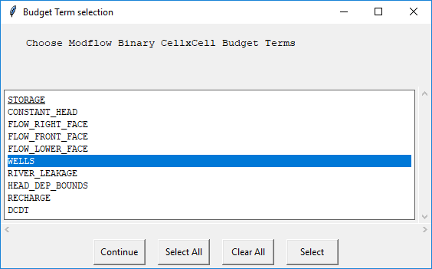
Simplify definition of Budget Terms
ReadModflowBinaryV2.py also provides a means to choose which budget terms to process.
It samples the
cell by cell budget
file and lists the
terms available.

Slide 15
Budget Terms may be specified directly [However, TERMS need to exactly match the Modflow TEXT stored in the binary file unless a shorthand has been specifically added to the code]
-terms TERMS Process TERMS' for CellxCell budget rasters
One Budget Term:
-term WELLS
Multiple Budget Terms:
-term ['CONSTANT_HEAD', 'WELLS', 'RIVER_LEAKAGE', 'RECHARGE']
All FLOW faces
-term [‘FLOW_RIGHT_FACE’,‘FLOW_FRONT_FACE’,’FLOW_LOWER_FACE’]
-term FLOW ← shorthand method
Just Horizontal Flow :
-term [‘FLOW_RIGHT_FACE’, ‘FLOW_FRONT_FACE’]
-term RIGHT|FRONT ← shorthand method
No parameters indicates all budget terms

Slide 16
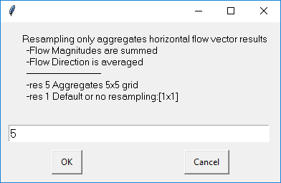
Resample or Aggregate Flow Vectors Either by Command Line or GUI
-res RESAMPLE SUM or Average values for flow rasters and vectors
as appropriate for the type of data:
Flow Magnitude is Summed
Flow Direction is averaged
RESAMPLE indicates number of cells to aggregate:
-res 10 10x10 or 100 cells
-res 5 5x5 or 25 cells
-res 1 No Resampling

