Slide 1

RMFB colorized
Readmodflowbinary
Presented by: Kevin A. Rodberg

Slide 2
“ReadModflowBinary” Enhancements with RMB3.py and RasDif.py -- a GW Tech Unit project
Quick review of model results currently requires:
Postprocessing to visualize the model results
Using RMB2.py as well as RD3.py
The actual “visualizing” requires an additional couple steps to see what the model generated even after postprocessing:
importing .tif files to ArcMap,
setting symbology,
tinkering with color ramps

Slide 3
Integrate the Demonstration code: ColorRasters.py into RMB2.py and RD3.py
Objective
Full implementation may require a couple weeks, depending upon how detailed the training ends up, and how much is improvised, or is just demonstrated.
Note: Some steps could be split into individual work assignments
to be done outside the group GW tech meetings,
Allowing each person time to fully understand, at their own pace,
what the code does, and exploring their personal coding strengths,
with follow-up presentations sharing their work.

Slide 4
ReadModflowBinary - colorized Migration of RMB and RD to RMFB
5 Steps
Understand what the demonstration code, ColorRasters.py, does.
Implement color as a default feature and review steps already taken.
Make colorized output an option, rather than a default.
Review removal of Python 2.7 and future ArcGISPro arcpy module
Rigorous testing of RMB3.py and RasDif.py with the new options

Slide 5
from osgeo import gdal
Background
RMB uses GDAL and creates single-band floating point geoTiffs from numpy arrays of data read from Modflow binary data.
GDAL functions are based upon a C++ class library callable via Python hooks in osgeo
https://gdal.org/doxygen/index.html
GDAL typically provides raster colors with multiband rasters and assume raster values are integer not floats (except via another program) but there are some attempts to get it done with one.

Slide 6
Google seach for ‘GDAL color ramps’
Background
The following link advises start and end color ramp indexes should be integer,
as noted on GDAL docs (see link on previous slide):
https://gis.stackexchange.com/questions/354650/gdal-colorramp-for-float-based-values
This link references a Python function raster2png, but I consider it a cheat,
normalizing floats to a range of integer values 0-255 in a new raster:
http://geoexamples.blogspot.com/2012/02/colorize-raster-with-gdal-python.html?_sm_au_=iVVTt6Q21HsSJNTg08GkNK3vjB1QF
This one is closer, and ends up being like what I did although I found it after the fact:
(also uses gdaldem via subprocess)
https://gis.stackexchange.com/questions/130199/changing-color-of-raster-images-based-on-their-data-values-gdal

Slide 7
Floating point rasters with GDAL
Background
“gdaldem” was the web advice I followed,
Although… requires a new module: subprocess
that involves installing a new Anaconda package
And requires “colorfiles” to define color ramp ranges & RGB values
But…setting up RGB color themes is challenging
and seems to be somewhat of an art-form,
and not readily available to download from any search I found.

Slide 8
What does the ColorRasters.py do?
Step 1
The ColorRasters.py defines 35 color ramp themes with colrRampDef() using data
generated with an Rscript using RColorBrewer, copying the output into a Python Pandas dataframe.
colorRamps=colrRampDef()
Script has a hard-coded theme and raster filename from data processed via RD3.py or RMB2.py
color = 'YlGnBu’
raster_file =path +'HEAD_00100_1.tif’
colorFile = 'colorfilr.clr'
A colorfile is generated with a single band of the defined raster and calculates ramp intervals from data
createColorfile(raster_file,colorFile,color)
Using (precision,minVal, maxVal) = setColrRampPrec(band)
Creates the colorized png files:
gdalcmd = "gdaldem color-relief " +raster_file+ " " +colorFile+ " " +png_file
subprocess.call(gdalcmd)

Slide 9
gdaldem: Requires “colorfiles” defining color ramp ranges and RGB values to setup RGB color themes
Step 1a
library(RColorBrewer)
vHex2RGB<-Vectorize(col2rgb)
dfList = list();x = 0
for (ramp in row.names(brewer.pal.info)){
x = x + 1
n=brewer.pal.info[ramp,1] # max colors
df <-cbind(seq(1,n),as.data.frame(t(vHex2RGB(brewer.pal(n,ramp)))))
names(df)<- c('seq','R','G','B’)
dfList[[x]]=cbind(ramp,df)
}
colorRampRGB <- do.call(rbind,dfList)
write.table(colorRampRGB,file ='',row.names = FALSE)

Slide 10
gdaldem: requires a new module: subprocess that means installing a new Anaconda package
Step 1b
Install subprocess module on your own systems
Work with each of the modelers to make sure they have the necessary module installed
Upgrade to the new Anaconda Professional, which facilitates the Python stack administration.
Note Mike Carney has retired,
Quick admin permissions, may not be an option, initially.
We may need to train Mike’s replacement, for setup of Anaconda Professional.

Slide 11
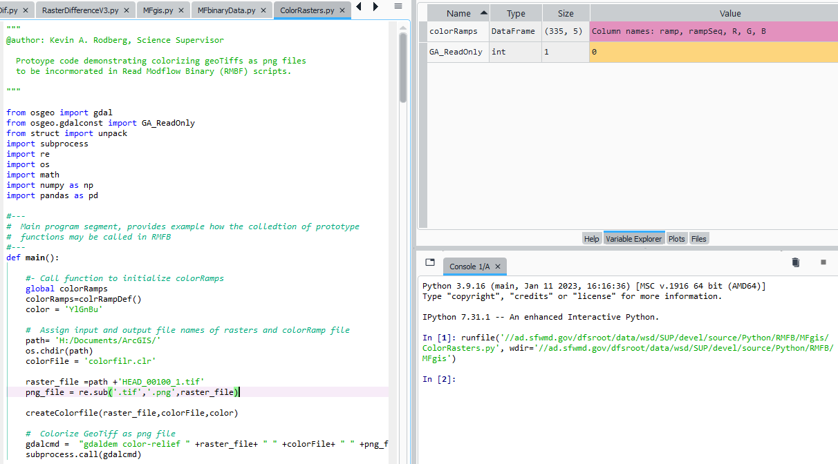
"\\ad.sfwmd.gov\dfsroot\data\wsd\SUP\devel\source\Python\RMFB\MFgis\ColorRasters.py"

Slide 12
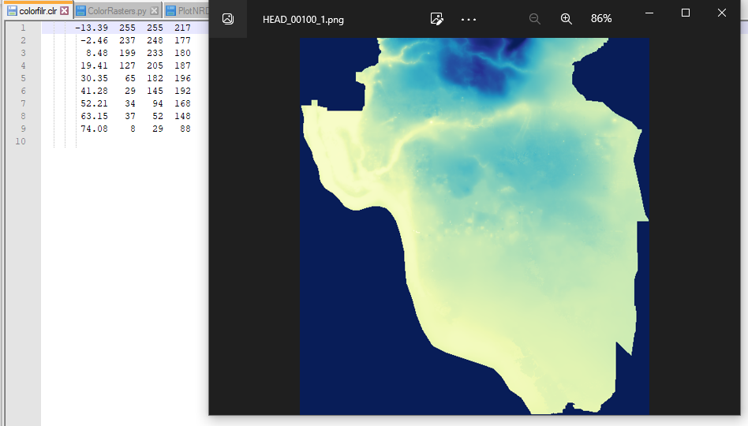
subprocess.call( "gdaldem color-relief 'HEAD_00100_1.tif' 'colorfilr.clr' 'HEAD_00100_1.png' ")

Slide 13
Implement colorized output as a default feature and steps already taken.
Step 2
Steps I’ve already taken:
merge modules: RD and RMB into: RMFB
Implement initially as a default feature:
making png generation automatic with raster tif creation.
Brainstorm ideas for and later steps:
via command line arguments in MFargDefaults.py
via MFgui.py .

Slide 14
Steps I’ve already taken:
Step 2a
Merge modules: RD and RMB into: RMFB
Involved setting up new draft versions:
RMB2.py as RMB3.py
RD3.py as RasDif.py
Create a single copy of RMB module as RMFB
[RD was a nearly identical copy of RMB used by RD3.py]

Slide 15
Implement initially as a default feature:
Step 2b
Add the new ColorRasters.py functions to the shared MFgis module
And add purple code after call to MFgis.CreateGeoTiff() function:
CreateGeoTiff(rasFilename,adjustednpArray,resx,resy,ulx,uly,getModel_SR(optArgs['model’]))
png_file = re.sub('.tif','.png', rasFilename)
colorFile = 'colorfilr.clr'
color = 'YlGnBu'
createColorfile(rasFilename,colorFile,color)
gdalcmd = "gdaldem color-relief " +rasFilename+ " " +colorFile+ " " +png_file
subprocess.call(gdalcmd)
Note:
MFgis.raster_X_coeff also creates rasters, however, is not currently implemented

Slide 16
Make colorized output an option, rather than a default. – in 2 steps?
Step 3
Why make it an option?:
PNG creation impacts post processing time and may not be desired.
3a [MFargDefaults.py edits]
Simple set of functions and the first step is adding the new option
Named : -color?
3b [MFgui.py edits] .
Updating the MFgui.py module is cumbersome, but depending upon how argDefaults is done may not require any code changes

Slide 17
Colorized output --additional options
Step 3b
Additional option considerations:
Named colorfiles, -color [colorfile.clr]
Creation of single colorfile for group of rasters
[Fairly simple in rasDif.py as code structure is in place]
Color ramp intervals with alternate sequences, such as:
Equal interval
Geometric numpy.geomspace(.001, 36, num=9, endpoint=True, dtype=None)
Natural Breaks bin_edges = binned_statistic(values, values, bins=9, range=(minVal, maxVal))[1]

Slide 18
Removal of any Python 2.7 and the future ArcGIS Pro arcpy module
Step 4a
A great deal of code exists in applications: RMB2.py and RD3.py,
providing functionality with Python 2.7 or Python 3.6
And use of arcpy for local or Citrix ArcGIS installations.
Removal of Python 2.7 code dependence is minor:
if sys.version_info[0] == 3:
from tkinter import *
else: from Tkinter import Tk ## notice capitalized T in Tkinter

Slide 19
Removal of any Python 2.7 and future ArcGIS Pro arcpy module
Step 4b
Migration to ArcGIS Pro started in IT 2 years ago.
Water Supply Bureau staff migration is coming soon.
New Info: ArcPy for ArcGIS Pro docs show it provides an equivalent ArcPy module for Python 3.6.
Python 2.7 geoprocessing tools have been ported to Python 3.6 and work without modification
A few older features are no longer supported, such as coverage related tools
On the other hand:
The RMB code for arcpy currently has little value as it is very slow by comparison to GDAL.
The benefit of keeping arcpy calls in RMFB is to support Python in a Citrix environment.
Code complexity needs to be considered to weigh keeping the arcpy hooks.

Slide 20
Rigorous testing with new options RMB3.py and RasDif.py
Step 5
This might be an area where we explore some ideas about unit testing, or define testing scenarios up front.
Other topics to explore, involve source code control, GitHub, and/or Python modules added to python_path
https://packaging.python.org/en/latest/tutorials/packaging-projects/
Create color ramps in a Python Class [vs dataframe and code]with attributes defining the RGB values and functions to create and or modify the colorfiles.

