Slide 1


RasterDifferenceV3.py

Slide 2
Program Description:
RasterDifferenceV3.py is designed to process rasters from ArcGIS geodatabases or directories with .tif files:
ArcGIS Rasters in an ESRI Geodatabase
(ArcGIS arcpy module required)
or
GeoTIFF Rasters [georeferenced .tif filesin a user designated folder (resulting faster processing than ArcGIS rasters)
(Python 3.6 gdal module required)
The previous version: RasterDifference.py required you to post process rasters with Citrix or wherever you would normally use ArcGIS, sending results to geodatabases.

Slide 3
Python requirements:
RasterDifferenceV3.py is written in Python.
The code is compatible to run with:
ArcGIS/w Python 2.7 (pythonwin)
configured to support pandas, numpy, and arcpy
or:
Python 3.6 (Anaconda3 and Spyder)
configured to support pandas, numpy and gdal

Slide 4
Multiple user interfaces:
GUI for argument and keyword selection
(if -gui command line arguments)
Spyder console execution with some arguments
Command line argument parser c:\>
(Argument usage and help available with –h or --help)
Batch execution using python.exe
(if arguments are understood and known in advance)

Slide 5
Usage statement: [shown from Spyder console execution or command line]
runfile(RasterDifferenceV3.py', args='--help', wdir='T:/ReadModflowBinary’)
Or:
C:\python27\arcGIS10.3\python.exe T:\ReadModflowBinary\RasterDifferenceV3.py --help
ESRI arcpy library not imported
C:\ProgramData\Anaconda3\pythonw.exe
Running in Python IDLE
Args for RasterDifferenceV3.py
optional arguments:
-h, --help show this help message and exit
-bgdb BGDB Subtract from Rasters in B-workspace
-fgeo FGDB Subtract F-workspace Rasters from B-workspace rasters (B-F)
-gui GUI for options & arguments
-noArcGIS Create Rasters without using ArcGIS
-ogeo OGDB Saves rasters in O-workspace
-one RASTERNAME Subtract One raster from rasters in B-workspace
-quiet Reduce output to console
-rasras LISTOF2 LISTOF2 Use 2 rasters:
SecondRaster is subtracted from FirstRaster
-ratio Calculate Percent change instead of difference

Slide 6
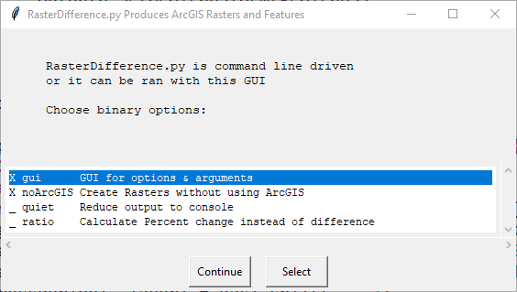
Program Description:
RasterDifferenceV3.py Displays the following launch menu when ran from Windows or with the –gui command line keyword

Slide 7
Raster Difference Processing Schemes
Subrtract:
Rasters in f-workspace that have the same names as rasters in b-workspace
One named raster: from each raster in b-workspace with the same layer and data type
Named raster from named raster
-ratio: This option changes difference calculations to % change (bRas- fRas)/fRas

Slide 8
Raster Difference Processing Schemes –bgdb –fgeo –ogeo
Subrtract:
Rasters in f-workspace that have the same names as rasters in b-workspace:
C:\ProgramData\Anaconda3\pythonw.exe
T:\ReadModflowBinary\RasterDifferenceV2.py -noArcGIS
-bgdb H:\\Documents\\ArcGIS\\Rasters\\Heads2040
-fgeo H:\\Documents\\ArcGIS\\Rasters\\Heads2014
-ogeo H:\\Documents\\ArcGIS\\Rasters\\HeadsDiff
runfile ('T:/ReadModflowBinary/RasterDifferenceV2.py,
wdir= 'T:/ReadModflowBinary’,
args=" -noArcGIS -bgdb H:/Documents/ArcGIS/Rasters/Heads2040
-fgeo H:/Documents/ArcGIS/Rasters/Heads2014
-ogeo H:/Documents/ArcGIS/Rasters/HeadsDiff")

Slide 9
Raster Difference Processing Schemes -bgdb –one –ogeo
Subrtract:
One named raster from each raster
in b-workspace with the same
layer and data type
Subrtract one raster: HEAD_00012_1 from each raster in WCFMbase.gdb
C:\python27\arcGIS10.2\python
T:\ReadModflowBinary\RasterDifference.py
-bggdb L:\WCFM\WCFMbase.gdb
-one L:\WCFM\WCFMbase.gdb\HEAD_00012_1
-ogeo L:\WCFM\WCFMdiffsV1.gdb

Slide 10
Raster Difference Processing Schemes -bgdb –rasras –ogeo
Subrtract:
Named raster from named raster
Subrtract raster named: CONC_00365_1 from raster named CONC_08766_1 workspace identified in -bgdb is required for app consistency by not used for input data although it should be consistent with other workspace types (folder w/folder or .gdb w/.gdb)
C:\python27\arcGIS10.2\python
T:\ReadModflowBinary\RasterDifference.py
-bgdb L:\MB\GIS\Spatial\TDS\gdb\KARecfmtds2016b.gdb
-rasras L:\MB\GIS\Spatial\TDS\gdb\KARecfmtds2016b.gdb\CONC_08766_1
L:\MB\GIS\Spatial\TDS\gdb\KARecfmtds2016b.gdb\CONC_00365_1
-ogeo L:\MB\GIS\Spatial\TDS\gdb\KARtdsDiffs.gdb

